Slide 1
NASA Astrophysics Program Update
Paul Hertz
Director, Astrophysics Division
Science Mission Directorate
@PHertzNASA
Astrophysics Subcommittee
November 14, 2014

Slide 2
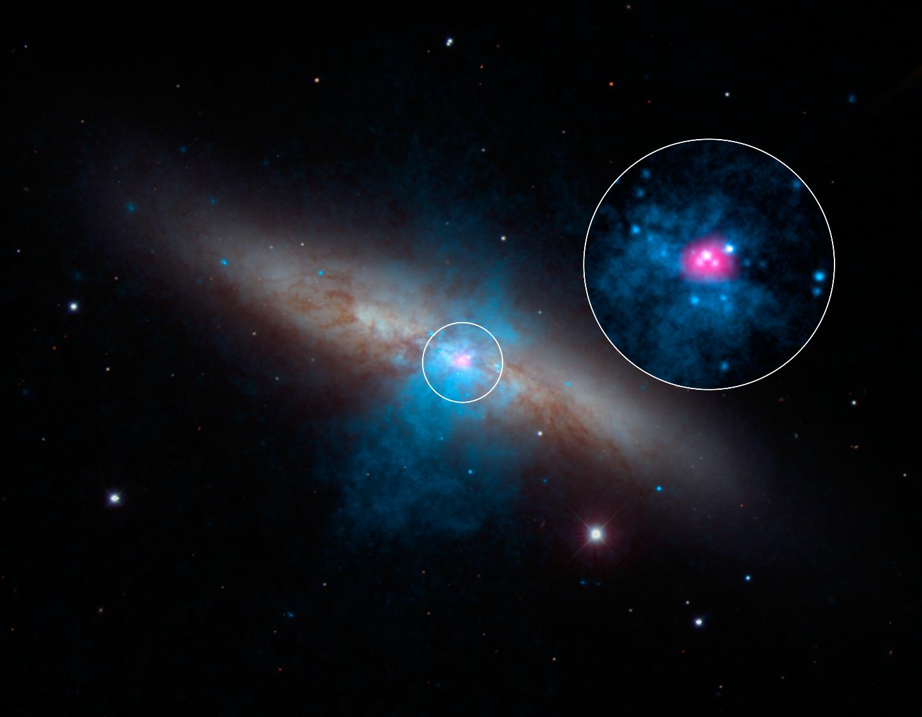
M82X-2: Suspected Black Hole Unmasked as Ultraluminous Pulsar by NuSTAR
Image credit: NASA/JPL-Caltech/SAO/NOAO
2
Notes:
High-energy X-rays streaming from a rare and mighty pulsar (magenta), the brightest found to date, can be seen in this new image combining multi-wavelength data from three telescopes. The bulk of a galaxy called Messier 82 (M82), or the "Cigar galaxy," is seen in visible-light data captured by the National Optical Astronomy Observatory's 2.1-meter telescope at Kitt Peak in Arizona. Starlight is white, and lanes of dust appear brown. Low-energy X-ray data from NASA's Chandra X-ray Observatory are colored blue, and higher-energy X-ray data from NuSTAR are pink.
The magenta object is what's known as an ultraluminous X-ray source, or ULX -- a source of blazing X-rays. Previously, all ULXs were suspected to be massive black holes up to a few hundred times the mass of the sun. But NuSTAR spotted a pulsing of X-rays from this ULX (called M82 X-2) - a telltale sign of a pulsar, not a black hole. A pulsar is a type a neutron star -- a stellar core left over from a supernova explosion -- that sends out rotating beams of high-energy radiation. Scientists were surprised to find the pulsar at the root of the ULX because it shines with a luminosity that is more typical of heftier black holes.
NuSTAR data covers the X-ray energy range of 10 to 40 kiloelectron volts (keV), and Chandra covers the range .1 to 10 keV.
An Ultraluminous X-ray Source (ULX) that astronomers had thought was a black hole is really the brightest pulsar ever recorded. ULXs are objects that produce more X-rays than most "normal" X-ray binary systems, in which a star is orbiting a neutron star or a stellar-mass black hole. Black holes in these X-ray binary systems generally weigh about five to thirty times the mass of the sun.
Astronomers used NASA's NuSTAR (Nuclear Spectroscopic Telescope Array) and Chandra X-ray Observatory to study two ULXs in the center of M82, a galaxy located just over 11 million light years from Earth. This composite image shows X-rays from NuSTAR (purple) and Chandra (blue) that have been combined with optical data from the NOAO 2.1 meter telescope (gold). The extended X-ray emission is unrelated to the two ULXs.
Until now, astronomers have thought that matter falling onto black holes powered the bright X-ray emission in all ULXs. Most of the black holes in ULXs are thought to weigh at least 10 to 50 times the mass of the Sun, but some of the brightest ULXs are thought to weigh 100 times the Sun's mass, or more.
The new X-ray data provide a critical clue to the nature of one of the ULXs in M82. Using NuSTAR, scientists have discovered regular variations, or "pulsations," in the object known as M82X-2. This object pulses once on average every 1.37 seconds, and pulsations change in a regular pattern with a period of 2.5 days.
These types of pulsations are not seen with black holes. Rather, they are the signatures of so-called pulsars, rapidly rotating neutron stars. The apparent shifts in the pulsation period are due to the motion of the star in its orbit. Assuming that the pulsar weighs 1.4 times the mass of the Sun (the common size of a pulsar or neutron star), the data imply that the companion star's mass is at least 5.2 times the mass of the Sun.
This discovery is significant because it may mean that pulsars make up a significant part of the ULX population. Chandra had observed M82X-2 before but these pulsations were not found until observations were made by NuSTAR, a high-energy X-ray mission that was launched in 2012. While NuSTAR detected the pulsations, Chandra, with its excellent spatial resolution, was needed to resolve M82X-2 from the other nearby ULX and rule out the contributions from other possible sources unresolved by NuSTAR. Although Chandra did not detect pulsations from M82X-2, scientists determined which source was responsible for the pulsations seen by NuSTAR by comparing the Chandra and NuSTAR images.
In addition to the pulsations, the overall brightness in X-rays of M82X-2 is variable over timescales lasting weeks and months. At its brightest it is more than ten times brighter than any known pulsar that is powered by accretion of material from a companion star. It is so bright that generally astronomers thought that only 50 to 100 solar mass black holes could explain such a bright ULX.
The latest study of M82X-2 provides new challenges for theorists to develop models explaining how a pulsar can pull matter inward and produce such copious X-rays. When matter is pulled toward a dense, compact object, like a pulsar, neutron star, or black hole, it is heated and produces X-rays. These X-rays create a radiation pressure that pushes out on the matter. For sustained infall of matter, the radiation pressure of the X-rays should be less than the pull of the compact object's gravity.
The X-ray luminosity of M82X-2 reaches about 100 times brighter than the threshold where the outward pressure from radiation balances the inward pull of gravity of the pulsar, the so-called Eddington limit. Possible explanations for violations of the Eddington limit include geometrical effects arising from the funneling of infalling material along magnetic field lines.
NASA's Marshall Space Flight Center in Huntsville, Alabama, manages the Chandra program for NASA's Science Mission Directorate in Washington, DC. The Smithsonian Astrophysical Observatory in Cambridge, Massachusetts, controls Chandra's science and flight operations.
Scale: Image is 10 arcmin (33,000 light years) Category: Normal Galaxies & Starburst Galaxies, Black Holes
Coordinates (J2000): RA 09h 55m 50.70s | Dec +69° 40' 37.00" Constellation: Ursa Major
Observation Date: 22 pointings from 20 Sep 1999 to 03 Feb 2014
Observation Time: 228 hrs 26 min (9 days, 12 hrs, 26 min). Distance Estimate: About 12 million light years
Instrument: ACIS Color Code: X-ray (Magenta, Cyan); Optical (Red, Green, Blue)
NuSTAR Finds a Pulse in Cigar Galaxy
Released: October 8, 2014
Credit: NASA/JPL-Caltech/SAO/NOAO

Slide 3
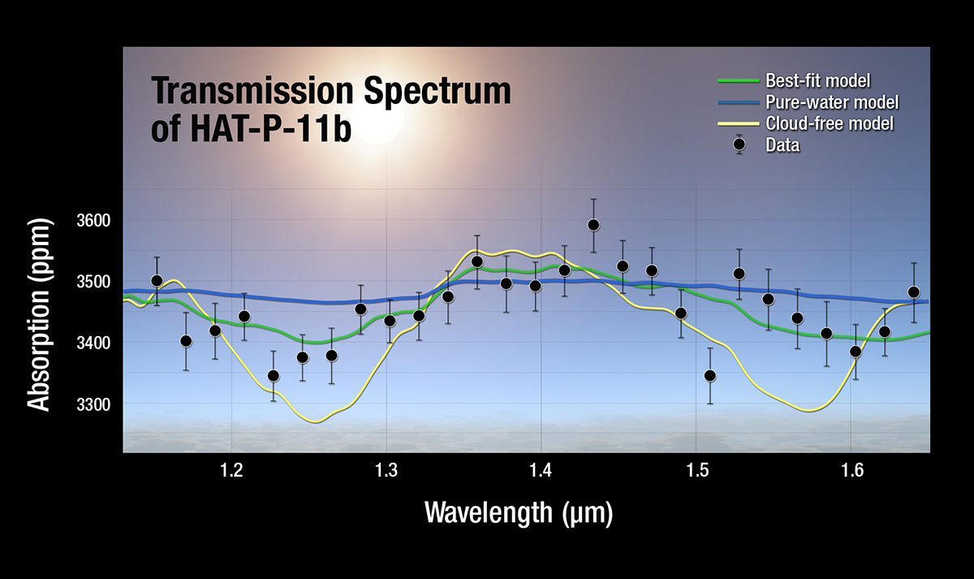
Hubble, Spitzer and Kepler Telescopes Find Clear Skies and Water Vapor on Exo-Neptune
Credit: NASA, ESA, and A. Feild (STScI)
3
Notes:
Astronomers using data from three of NASA's space telescopes — Hubble, Spitzer, and Kepler — have discovered clear skies and steamy water vapor on a gaseous planet outside our solar system. The planet is about the size of Neptune, making it the smallest for which molecules of any kind have been detected.
"This discovery is a significant milepost on the road to eventually analyzing the atmospheric composition of smaller, rocky planets more like Earth," said John Grunsfeld, AA of NASA's SMD in Washington. "Such achievements are only possible today with the combined capabilities of these unique and powerful observatories."
Clouds in the atmospheres of planets can block the view to underlying molecules that reveal information about the planets' comp-ositions & histories. Finding clear skies on a Neptune-size planet is a good sign that smaller planets might have similarly good visibility.
"When astronomers go observing at night with telescopes, they say 'clear skies' to mean good luck," said Jonathan Fraine (Univ of MD, College Park), lead author of a new study appearing in Nature. "In this case, we found clear skies on a distant planet. That's lucky for us because it means clouds didn't block our view of water molecules."
The planet, HAT-P-11b, is a so-called exo-Neptune — a Neptune-size planet that orbits another star. It is located 120 lt-yrs away in the constellation Cygnus. Unlike our Neptune, this planet orbits closer to its star, making one lap roughly every 5 days. It is a warm world thought to have a rocky core and gaseous atmosphere. Not much else was known about the composition of the planet, or other exo-Neptunes like it, until now.
Part of the challenge in analyzing the atmospheres of planets like this is their size. Larger, Jupiter-like planets are easier to see because of their impressive girth & relatively puffy atmospheres. In fact, researchers have already been able to detect water vapor in those planets. Smaller planets are more difficult to probe, and what's more, the ones observed to date all appeared to be cloudy.
In the new study, astronomers set out to look at the atmosphere of HAT-P-11b, not knowing if its weather would call for clouds or not. They used Hubble's WFC3, and a technique called transmission spectroscopy, in which a planet is observed as it crosses in front of its parent star. Starlight filters through the rim of the planet's atmosphere and into a telescope's lens. If molecules like water vapor are present, they absorb some of the starlight, leaving distinct signatures in the light that reaches our telescopes.
Using this strategy, Hubble was able to detect water vapor in HAT-P-11b. This technique indicates the planet did not have clouds blocking the view, a hopeful sign that more cloudless planets can be located and analyzed in the future.
But before the team could celebrate clear skies on the exo-Neptune, they had to show that starspots — cooler "freckles" on the face of stars — were not the real sources of water vapor. Cool starspots on the parent star can contain water vapor that might appear erroneously to be from the planet. That's when the team turned to Kepler and Spitzer. Kepler had been observing one patch of sky for years, and HAT-P-11b happens to lie in the field. Those visible-light data were combined with targeted Spitzer observations taken at infrared wavelengths. By comparing these observations, the astronomers figured out that the starspots were too hot to have any steam.
It was at that point the team could celebrate detecting water vapor on a world unlike any in our solar system. "We think that exo-Neptunes may have diverse compositions, which reflect their formation histories," said Heather Knutson (Caltech, Pasadena), co-author of the study. "Now with data like these, we can begin to piece together a narrative for the origin of these distant worlds."
The results from all 3 telescopes demonstrate that HAT-P-11b is blanketed in water vapor, hydrogen gas, & likely other yet-to-be-identified molecules. Theorists will be drawing up new models to explain the planet's makeup and origins.
"We are working our way down the line, from hot Jupiters to exo-Neptunes," said Drake Deming, a co-author of the study also from University of Maryland, College Park. "We want to expand our knowledge to a diverse range of exoplanets."
The astronomers plan to examine more exo-Neptunes in the future, and hope to apply the same method to smaller super-Earths — the massive, rocky cousins to our home world with up to 10 times the mass. Our solar system doesn't have a super-Earth, but NASA's Kepler mission is finding them around other stars in droves. NASA's James Webb Space Telescope, scheduled to launch in 2018, will search super-Earths for signs of water vapor and other molecules; however, finding signs of oceans and potentially habitable worlds is likely a ways off.
"The work we are doing now is important for future studies of super-Earths and even smaller planets, because we want to be able to pick out in advance the planets with clear atmospheres that will let us detect molecules," said Knutson.
Once again, astronomers will be crossing their fingers for clear skies.
Object Name: HAT-P-11b Object Description: Neptune-size planet outside our solar system (exoplanet)
Position (J2000): R.A. 19h 50m 50s.25 Dec. +48° 04' 51".08 Constellation: Cygnus Distance: 120 light-years (37 parsecs)
Note: Observations from NASA's Kepler Mission and Spitzer Space Telescope contributed to the discovery of HAT-P-11b.
Instrument: WFC3/IR Grating G141 Exposure Date(s): October 18, 2012, and December 15/16, 2012
NASA Telescopes Find Clear Skies and Water Vapor on Exo-Neptune
Released: September 24, 2014
ID: STScI-2014-42
Credit: NASA, ESA, and A. Feild (STScI)
A plot of the transmission spectrum for exoplanet HAT-P-11b, with Kepler, Hubble WFC3, and Spitzer transits combined. The results show a robust detection of water absorption in the WFC3 data. Transmission spectra of selected atmospheric models are plotted for comparison.

Slide 4
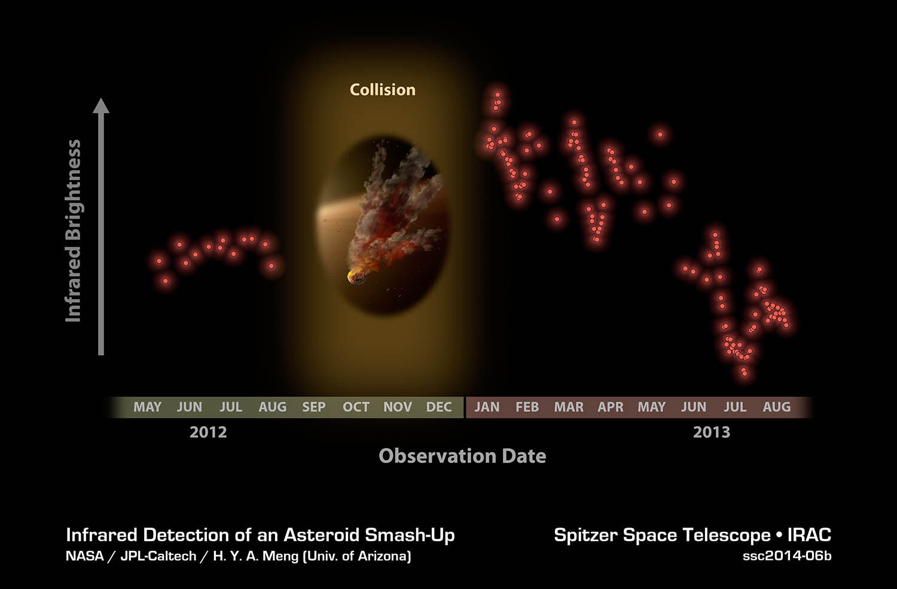
NASA's Spitzer Telescope Witnesses Asteroid Smashup
4
Notes:
NASA's Spitzer Space Telescope has spotted an eruption of dust around a young star, possibly the result of a smashup between large asteroids. This type of collision can eventually lead to the formation of planets.
Scientists had been regularly tracking the star, called NGC 2547-ID8, when it surged with a huge amount of fresh dust between August 2012 and January 2013.
"We think two big asteroids crashed into each other, creating a huge cloud of grains the size of very fine sand, which are now smashing themselves into smithereens and slowly leaking away from the star," said lead author and graduate student Huan Meng of the University of Arizona, Tucson.
While dusty aftermaths of suspected asteroid collisions have been observed by Spitzer before, this is the first time scientists have collected data before and after a planetary system smashup. The viewing offers a glimpse into the violent process of making rocky planets like ours.
Rocky planets begin life as dusty material circling around young stars. The material clumps together to form asteroids that ram into each other. Although the asteroids often are destroyed, some grow over time and transform into proto-planets. After about 100 million years, the objects mature into full-grown, terrestrial planets. Our moon is thought to have formed from a giant impact between proto-Earth and a Mars-size object.
In the new study, Spitzer set its heat-seeking infrared eyes on the dusty star NGC 2547-ID8, which is ~35 million years old and lies 1,200 light-years away in the Vela constellation. Previous observations had already recorded variations in the amount of dust around the star, hinting at possible ongoing asteroid collisions. In hope of witnessing an even larger impact, which is a key step in the birth of a terrestrial planet, the astronomers turned to Spitzer to observe the star regularly. Beginning in May 2012, the telescope began watching the star, sometimes daily.
A dramatic change in the star came during a time when Spitzer had to point away from NGC 2547-ID8 because our sun was in the way. When Spitzer started observing the star again five months later, the team was shocked by the data they received.
"We not only witnessed what appears to be the wreckage of a huge smashup, but have been able to track how it is changing -- the signal is fading as the cloud destroys itself by grinding its grains down so they escape from the star," said Kate Su of the University of Arizona and co-author on the study. "Spitzer is the best telescope for monitoring stars regularly and precisely for small changes in infrared light over months and even years."
A very thick cloud of dusty debris now orbits the star in the zone where rocky planets form. As the scientists observe the star system, the infrared signal from this cloud varies based on what is visible from Earth. For example, when the elongated cloud is facing us, more of its surface area is exposed and the signal is greater. When the head or the tail of the cloud is in view, less infrared light is observed. By studying the infrared oscillations, the team is gathering first-of-its-kind data on the detailed process and outcome of collisions that create rocky planets like Earth.
"We are watching rocky planet formation happen right in front of us," said George Rieke, a University of Arizona co-author of the new study. "This is a unique chance to study this process in near real-time."
The team is continuing to keep an eye on the star with Spitzer. They will see how long the elevated dust levels persist, which will help them calculate how often such events happen around this and other stars. And they might see another smashup while Spitzer looks on.
The results of this study are posted online Thursday in the journal Science.
NASA's JPL in Pasadena, CA, manages the Spitzer Space Telescope mission for NASA's SMD in Washington. Science operations are conducted at the Spitzer Science Center at Caltech in Pasadena. Spacecraft operations are based at Lockheed Martin Space Systems Company in Littleton, Colorado. Data are archived at the Infrared Science Archive housed at the Infrared Processing and Analysis Center at Caltech. Caltech manages JPL for NASA.
Name: NGC 2547-ID8 Type: Star > Circumstellar Material > Disk > Debris
Color Band Wavelength Telescope
Red Infrared 4.5 µm Spitzer IRAC
Notes: Time sequence at 4.5 microns
NASA's Spitzer Telescope Witnesses Asteroid Smashup
Released: August 28, 2014
ID: ssc2014-06b
Credit: NASA/JPL-Caltech/H.Y.A. Meng (Univ. of Arizona)
In this plot, infrared brightness is represented on the vertical axis, and time on the horizontal axis. The data at left show infrared light from the dust around the star back in 2012. Between 2012 and 2013, Spitzer had to stop observing the star because it was located behind the sun, as seen from Spitzer's Earth-trailing orbit.

Slide 5
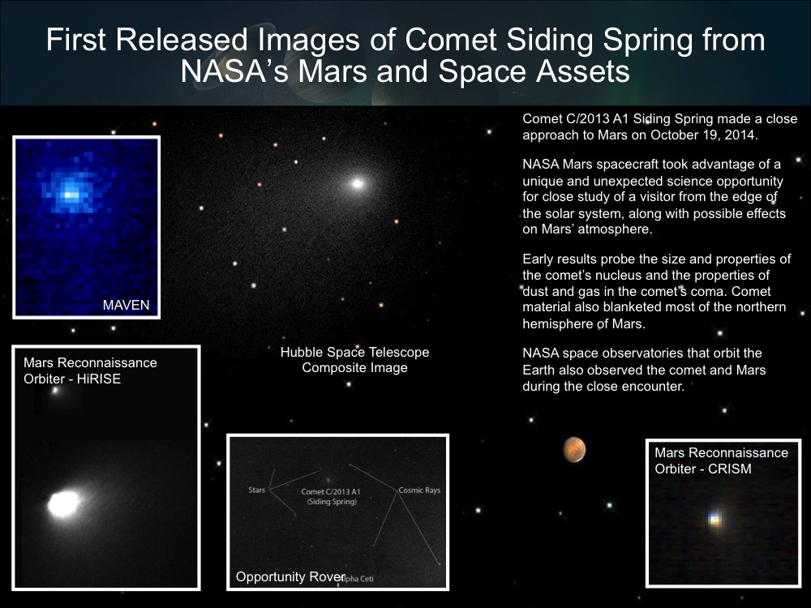

Slide 6
Recent NASA Astrophysics HQ Announcements
NASA Hubble to Begin Search Beyond Pluto for a New Horizons Mission Target (June 16)
Swiftly Moving Gas Streamer Eclipses Supermassive Black Hole (June 19)
Hubble Finds Dwarf Galaxies Formed More Than Their Fair Share of Universe's Stars (June 19)
Testing Completed on NASA's James Webb Space Telescope Backplane (July 8)
Hubble Spots Spiral Bridge of Young Stars Linking Two Ancient Galaxies (July 10)
Leading Space Experts to Discuss the Search for Life Beyond Earth (July 10)
NASA's Chandra X-ray Observatory Celebrates 15th Anniversary (July 22)
Hubble Finds Three Surprisingly Dry Exoplanets (July 24)
NASA's Fermi Space Telescope Reveals New Source of Gamma Rays (July 31)
Hubble Shows Farthest Lensing Galaxy Yields Clues to Early Universe (July 31)
NASA’s Hubble Finds Supernova Star System Linked to Potential “Zombie Star” (August 6)
NASA's NuSTAR Sees Rare Blurring of Black Hole Light (August 12)
NASA's Chandra Observatory Searches for Trigger of Nearby Supernova (August 14)
NASA's RXTE Satellite Decodes the Rhythm of an Unusual Black Hole (August 18)
NASA Telescopes Uncover Early Construction of Giant Galaxy (August 27)
NASA's Spitzer Telescope Witnesses Asteroid Smashup (August 28)
Hubble Finds Supernova Companion Star After Two Decades of Searching (September 9)
NASA's Chandra Finds Planet that Makes Star Act Deceptively Old (September 16)
Hubble Helps Find Smallest Known Galaxy Containing a Supermassive Black Hole (September 17)
NASA Telescopes Find Clear Skies and Water Vapor on Exoplanet (September 24)
NuSTAR Telescope Discovers Shockingly Bright Dead Star (October 8)
Hubble Maps Temperature and Water Vapor on Extreme Exoplanet (October 9)
Hubble Finds Potential Jupiter Belt Targets for New Horizons (October 15)
Hubble Finds Extremely Distant Galaxy Through Cosmic Magnifying Glass (October 16)
Close Encounters: Comet Siding Spring Seen Next to Mars (October 23)
NASA’S Chandra Observatory Identifies Impact of Cosmic Chaos on Star Birth (October 27)

Slide 7
SMD Organization

Slide 8
Astrophysics Staffing Changes
  Martin Still (BAERI) started a 2-year IPA assignment in October 2014.
  Keith Chamberlin (GSFC) started a 1-year detail assignment in October 2014.
  Linda Sparke starting a 1-year detail assignment to MSFC in December 2014.
  Advertised for a HQ civil servant program scientist new hire.

Slide 9
The Big Picture
  We are addressing decadal priorities within budget constraints.
  The budget for NASA astrophysics, which includes JWST, continues at $1.33B in FY14; the President has requested $1.25B in FY15 (the difference is mostly due to deletion of SOFIA from FY15 budget request).
  JWST, the highest priority of the community, is making progress, remains on schedule, and is fully funded for an October 2018 launch.
  NASA is preparing for a strategic Astrophysics mission to follow JWST as soon as funding becomes available. Preformulation of WFIRST/AFTA was funded in FY14 appropriation and is included in FY15 budget request.
  SOFIA has completed development and has entered its operations phase.
  NASA is developing new Explorer missions (NICER, TESS) and contributions to our international partners (LPF, ASTRO-H, Euclid).
  NASA is discussing contributions to ESA’s Athena and L3 GW observatory.
  NASA is planning a robust Astrophysics Explorers Program with a SMEX AO in late CY2014 and an EX AO in ~FY2017.
  Following the 2014 Senior Review, NASA plans to continue operating all currently operating missions, including Spitzer.
  NASA continues to support individual investigators for data analysis, theory, and technology investigations through open, competitive, peer reviews.
  The budgetary future remains uncertain.
  Priorities must be used to guide difficult budget choices.
  The FY2015 budget request represents a ~10% decrease for the Astrophysics Division in FY15; the cost of operating SOFIA can not be accommodated within this reduced budget.
Notes:
Updated August 2014

Slide 10
FY15 President’s Budget Request
Outyears are notional
($M) | 2013 | 2014 | 2015 | 2016 | 2017 | 2018 | 2019
Astrophysics | $617 | $668 | $607 | $634 | $651 | $697 | $993
JWST | $627 | $658 | $645 | $620 | $569 | $535 | $305
Supports pre-formulation of WFIRST/AFTA, including technology development for detectors and coronagraph.
Supports a growing Astrophysics Explorer program with continued development of ASTRO-H, NICER, and TESS, and initiation of the next Small Explorer mission.
Supports operating missions: Hubble, Chandra, and other missions rated highly by the 2014 Senior Review.
Continues a competed astrophysics research program and support of the balloon program.
Seeks to work with current partner Germany and potential partners to identify a path forward for SOFIA with greatly reduced NASA funding. Unless partners are able to support the U.S. portion of SOFIA costs, NASA will place the aircraft into storage by FY 2015.
Supports the commitment to an October 2018 launch date for JWST. Continues manufacturing of the flight sunshield structure and membranes. Completes and delivers the flight cryogenic cooler tower assembly. Delivers the Optical Telescope Element flight structure. Initiates integration of the 18 flight primary mirror segments. Conducts the final Integrated Science Instrument Module level cryo-vacuum test.
Notes:
Contained in Agency material

Slide 11
11

Slide 12
FY15 Budget Appropriation Status
  Administration request is $607M for Astrophysics and $645M for JWST.
  House appropriations bill and report includes:
    Recommendation is $680M for Astrophysics (an increase of $73M) and $645M for JWST
    Restores $5M reduction in Hubble operations
    Rejects SOFIA termination; appropriates $70M (an increase of $58M) for SOFIA operations
    Provides $30M (an increase of $15M) for EPO
  Senate appropriations committee markup and report includes:
    Recommendation is $750M for Astrophysics (an increase of $143M) and $645M for JWST
    Restores $23M reduction in Hubble operations
    Provides $56M for WFIRST (an increase of $42M)
    Rejects SOFIA termination; appropriates $87M (an increase of $75M) for SOFIA operations
    Provides $42M (an increase of $27M) for EPO
  Continuing Resolution through December 11, 2014, funds the first 10 weeks of FY15 at the same levels as FY14.

Slide 13
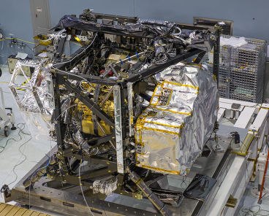
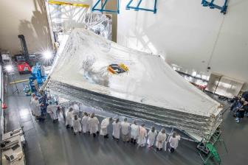
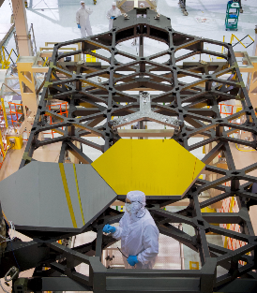
JWST Progress
ISIM completed very successful 116 day cryovacuum test #2.
First of 5 flight sunshields completed, two others being manufactured, 5 engineering sunshields successfully completed deployment testing.
Spacecraft bus under construction.
Pathfinder backplane has optics installed undergoing final assembly before 2015 testing at JSC.
Program remains on track and within budget for October 2018 launch.
http://jwst.nasa.gov/
ISIM with all instruments
5 engineering sunshields
deployed
Flight telescope backplane & with one wing installed
Pathfinder (backplane center section
with secondary mirror structure)
Notes:
Top most image: ISIM with instruments: MIRI (left most, hanging outside the left hand side of the black ISIM cage), NIRCam, (deep gold instrument visible in the lower center of the ISIM), FGS/NIRISS (pale gold visible in the upper center of ISIM) and NIRSpec (silver package outside the right hand part of ISIM)
Second image: 5 ETU sunshields folded up with bottom third mockup of mirror. While spreader bars in the foreground. Spreader bars separate the layers of the sunshield once deployed
Third image with callout. Flight backplane (bottom-most black structure in the picture) and backplane support fixture (black “cage” on top of backplane). In this orientation, the mirror segments are attached on the bottom with the light collecting surface facing down.
Bottom picture: Black structure is the telescope pathfinder structure. It’s a backplane (center section only) with the secondary mirror struts that hold the secondary mirror mount at the top. This image is from tests of the deployment practice for the struts to deploy and unfold.

Slide 14
JWST Flight Sunshield Layer 3
Notes:
IMAGE: James Webb Space Telescope is on track for 2018
Credit: Northrop Grumman Aerospace Systems

Slide 15
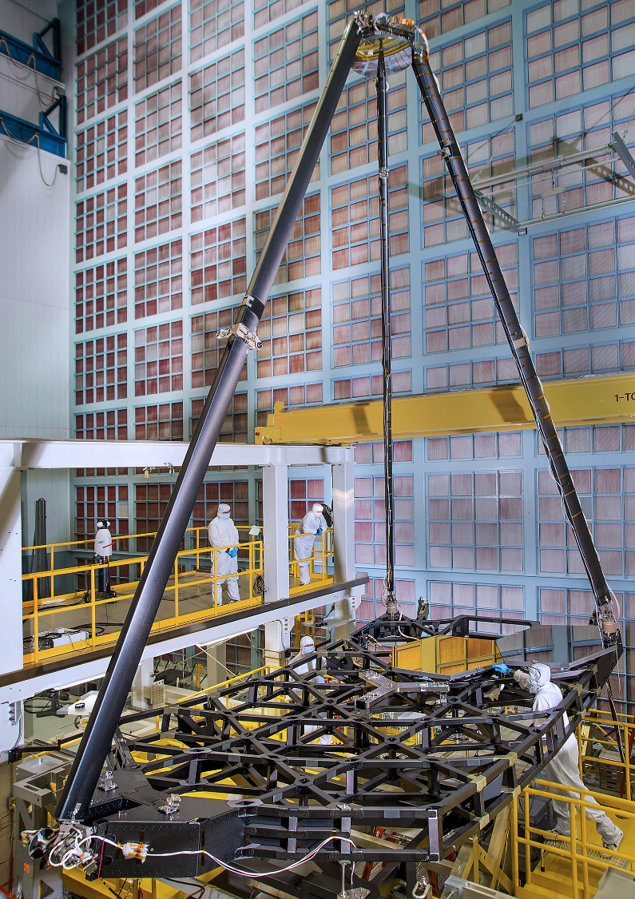
JWST Pathfinder Telescope
Notes:
IMAGE: James Webb Space Telescope is on track for 2018
Credit: Northrop Grumman Aerospace Systems

Slide 16
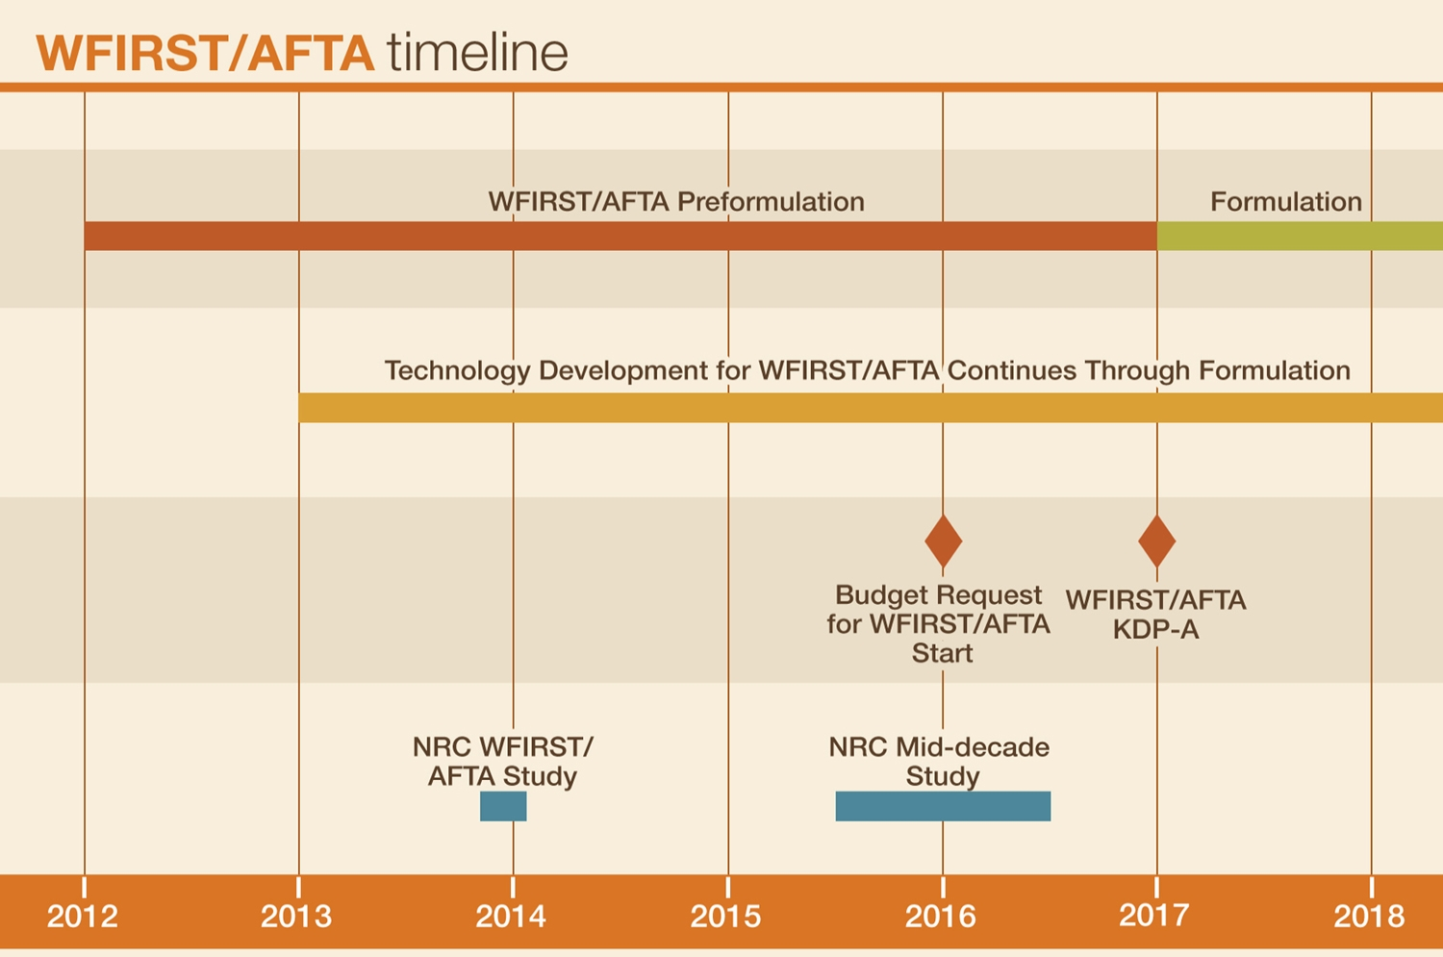
Plan for WFIRST/AFTA Preformulation
Widefield Infrared Survey Telescope using
Astrophysics Focused Telescope Assets

Slide 17
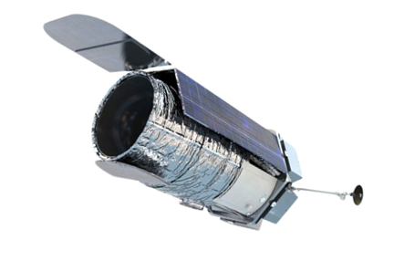
WFIRST / AFTA
Widefield Infrared Survey Telescope with Astrophysics Focused Telescope Assets
  FY14 appropriation ($56M) supports pre-formulation of WFIRST/AFTA, including technology development for detectors and coronagraph (with STMD).
  FY15 request ($14M) supports Agency/Administration decision for formulation to begin NET FY 2017, should funding be available.
CURRENT STATUS:
May 2013, NASA Administrator Bolden directed study of WFIRST/AFTA and preserve option for FY17 new start if budget is available.
  No decision expected before early 2016.
Currently in pre-formulation phase.
  AFTA endorsed by NRC study report released March 2014.
  Interim SDT report posted April 30, 2014
  SDT final report due Jan 2015.
Maturing key technologies to TRL 5 by FY17 and TRL 6 by FY19.
  H4RG infrared detectors for widefield imager.
  Internal coronagraph for exoplanet characterization (two architectures identified December 2013; occulting mask coronagraph and phased induced amplitude apodization complex mask coronagraph).
  FY14 Appropriation and FY15 Request support technology development and assessment of the 2.4m telescopes, mission design trades, payload accommodation studies, and observatory performance simulations.
  Recent NRC study on WFIRST/AFTA offers positive view of AFTA, with concerns about technology and cost risks.
  WFIRST Preparatory Science (WPS) is ROSES element that are relevant to WFIRST’s goals and WFIRST-specific simulations and models.
  Anticipate selecting ~12 proposals, total $1.8M in first year, by end of CY14.
  http://wfirst.gsfc.nasa.gov/

Slide 18
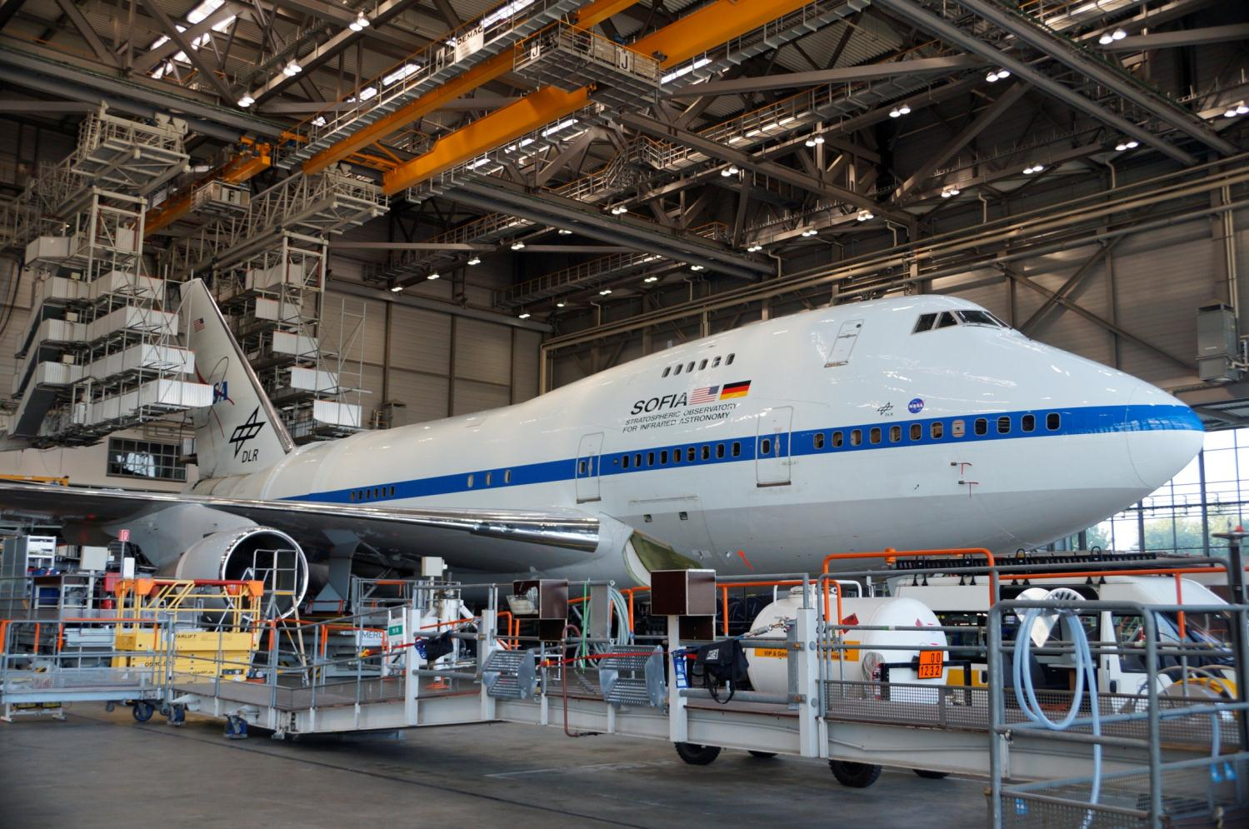
SOFIA Docked at Lufthansa (1 of 3)
18

Slide 19
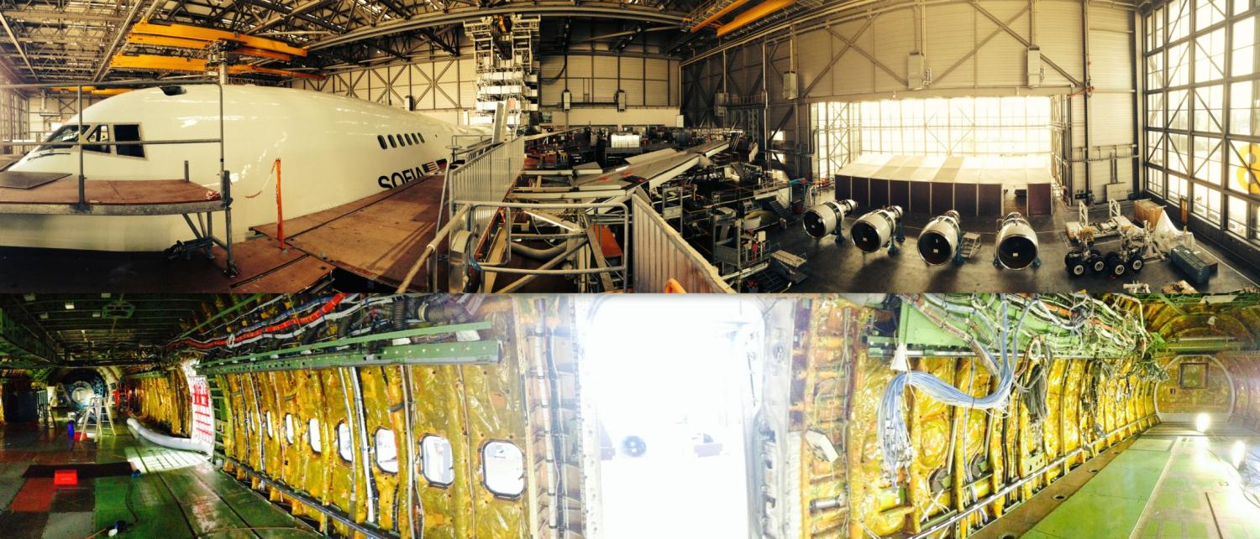
SOFIA Docked at Lufthansa (2 of 3)
SOFIA at maintenance station with engines removed (at right)
Aircraft interior with panels removed

Slide 20
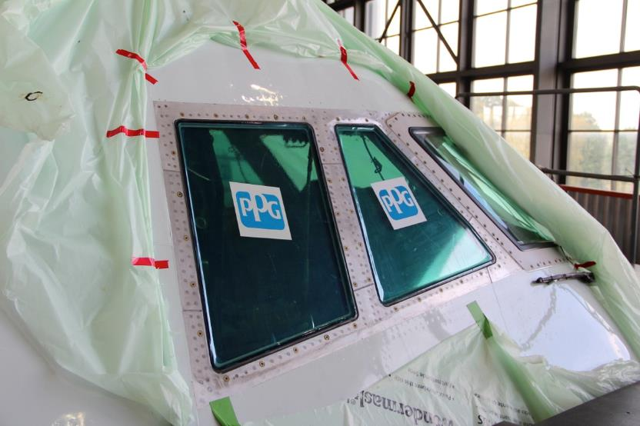
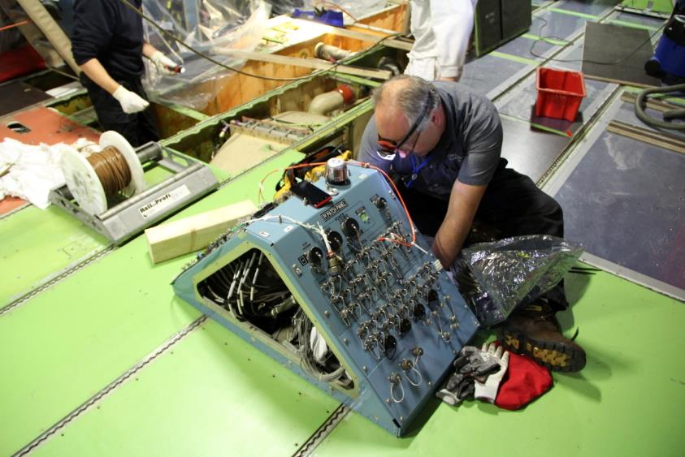
SOFIA Docked at Lufthansa - Reassembly (3 of 3)
New Cockpit windows
Close-out of PI patch panel

Slide 21
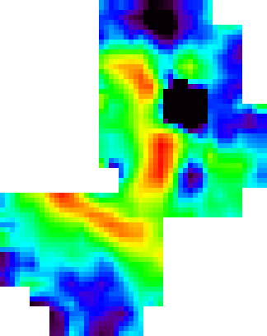
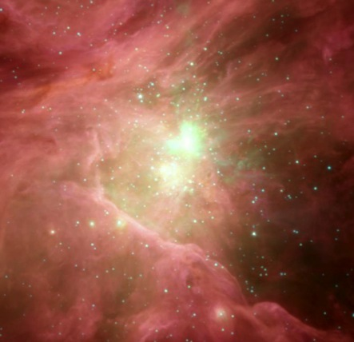
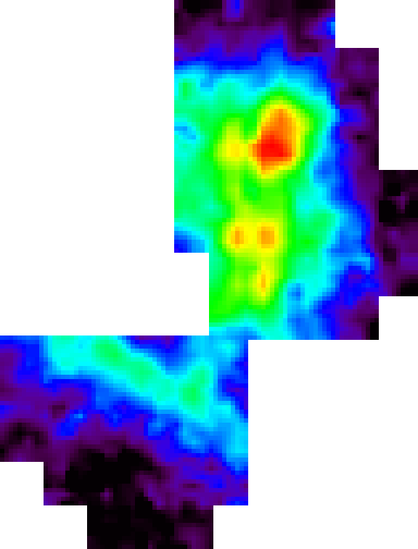
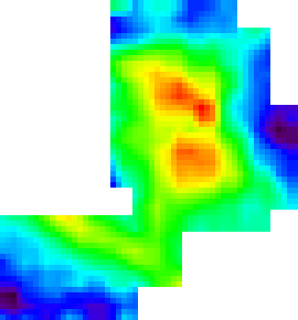
Stratospheric Observatory for Infrared Astronomy
Orion Nebula
SOFIA / FIFI-LS
[OI] 145 µm
© FIFI-LS Team
Becklin-
Neugebauer
Object
[OI] 63 µm
Trapezium Stars
Orion Bar
[CII] 157 µm
© Spitzer Observatory, Thomas Megeath
21

Slide 22
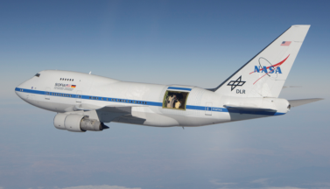
SOFIA
Stratospheric Observatory for Infrared Astronomy
CURRENT STATUS:
Achieved Full Operational Capability Feb 2014.
  Began Cycle 2 science observations Feb 2014.
  Cycle 3 investigations chosen - 2015 execution.
  Commissioning of all six instruments underway
  Demonstrated high cadence ops in April/May 2014.
  Formally entered Operational Phase May 2014.
Second generation instruments under development.
  HAWC+: upgraded far infrared imager & polarimeter. (2016 commissioning)
  upGREAT: multi-pixel heterodyne spectrometer (2015 commissioning)
Astrophysics review June 2014 & IG report July 2014 suggested changes to increase scientific productivity
  Do not concentrate on flight hours as sole metric.
  Development of instruments increases productivity.
  Appropriate funding of analysis should be revisited.
  The pipeline is a bottleneck toward timely science.
  SOFIA’s unique capabilities are the region longer than 27 microns and very high spectral resolution.
Arrived in Germany July 2014 for Heavy Maintenance Visit; continues through Nov 2014.
President’s FY15 budget request proposed to end funding and place SOFIA in storage.
  NASA/DLR Working Group analyzed several scenarios to establish SOFIA’s path forward.
  Currently executing SOFIA’s baseline schedule of operations and scheduled maintenance.
  House and Senate proposed funding for FY15 ops.
World’s Largest Airborne Observatory
2.5-meter telescope
Capable of observing from the visible to the far infrared
80/20 Partnership between NASA and the German Aerospace Center (DLR)
Mission Ops based at NASA-Armstrong
Science Ops based at NASA-Ames
Six First-Generation instruments
  Four U.S., two German
  Imaging, Spectroscopy, and Photometry
Limited Science Ops began in 2010
Transitioned from Development Phase to Operational Phase in May 2014
Notes:
Updated August 11, 2014

Slide 23
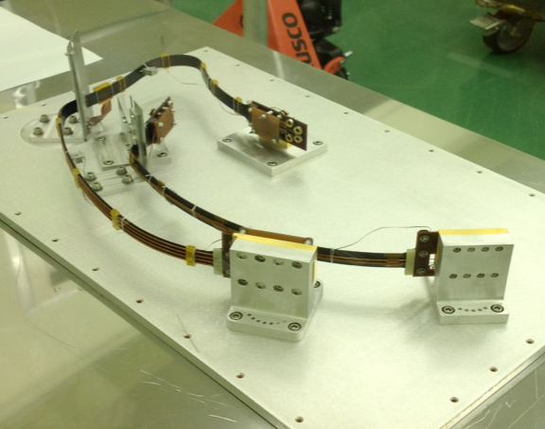
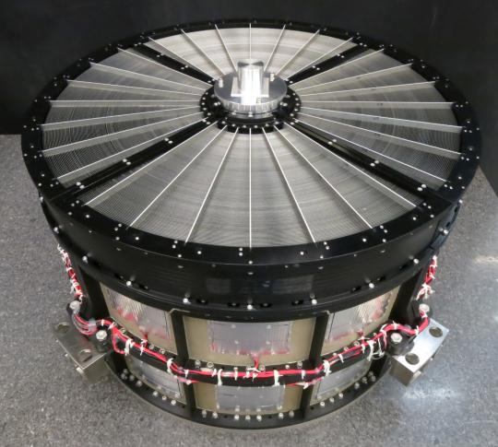
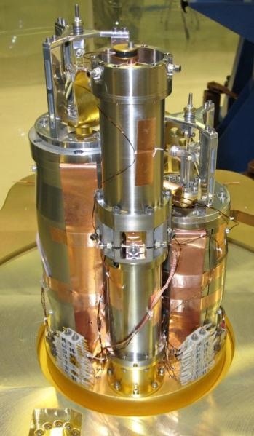
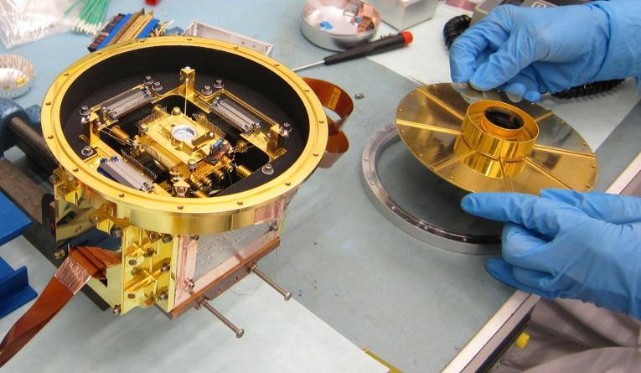
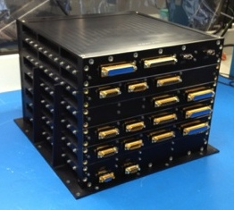
Program Update – ASTRO-H
Soft X-ray Telescope
ADR Assembly
ADR 3
ADR 1 & 2
High Temperature Superconducting Leads
Flight Detector System
ADR Controller

Slide 24
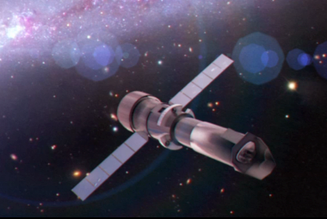
Athena
Advanced Telescope for High Energy Astrophysics
CURRENT STATUS:
Selected as 2nd Large mission in ESA Cosmic Visions Program
Currently in 2 year Assessment Phase
NASA is involved in Study Phase via membership on ESA-chartered Athena Science Study Team
NASA budgeting for a $100M-$150M hardware contribution, plus a US GO program and a U.S. data center
NASA continues to invest in Athena technologies via SAT and directed investigations.
NASA and ESA are discussing possible NASA contributions, such as:
  Portions of the X-ray calorimeter instrument (X-IFU)
  Portions of the Wide Field Imager
  Portions of the X-ray Mirror
  Contribution to science data center (U.S. node)
Second ESA Cosmic Vision Large mission
  L-class with NASA/JAXA participation
  Decadal Survey recommendation
  Large X-ray mirror, X-IFU and WFI instruments
Launch Date: 2028
Breakthrough Technologies:
  High Throughput, Wide FOV, High spectral resolution X-ray Astronomy
  10x Chandra area, 100x improved non-dispersive spectral resolution, 5x FOV.
Science Objectives: The Hot and Energetic Universe:
How does ordinary matter assemble into the large scale structures that we see today?
How do black holes grow and shape the Universe?
Notes:
Updated January 2, 2014

Slide 25

NASA/NSF Partnership for Exoplanet Research
New Worlds, New Horizons:
  “NASA and NSF should support an aggressive program of ground-based high-precision radial velocity surveys of nearby stars to identify potential candidates … for a future space imaging and spectroscopy mission”.
NASA Motivation: To provide US astronomical community with open access to a world-class precision radial velocity facility instrument that will enable:
  follow-up observations in support of current NASA missions (e.g. K2, TESS, JWST)
  pathfinder observations to inform the design and operation of future NASA missions (e.g. WFIRST-AFTA, NWNH “New Worlds Mission”)
Primary objective is to enable a community based exoplanet research program in support of NSF research interests and NASA mission goals (e.g. Kepler, K2, TESS, etc.).
Partnership proposes to capitalize on the NOAO share of the WIYN consortium to implement a joint exoplanet research program that ultimately will focus on high precision radial velocities.
Notes:
Updated based on FY14 appropriation

Slide 26
NASA/NSF Partnership for Exoplanet Research
The program, as currently envisioned, would be carried out in two stages:
  Stage 1. FY2015 – FY2018
    Manage an exoplanet-targeted Guest Observer program with existing instrumentation on WIYN using NOAO share (40%) of WIYN time.
    NASA to release solicitation in early CY 2015 for a facility-class extreme precision radial velocity spectrometer (EPRVS) for the WIYN telescope with the goal of commissioning in 2018.
  Stage 2. FY2018 – TBD
    Manage an exoplanet-targeted GO and guaranteed time program at WIYN with EPRVS instrument and existing instrumentation on WIYN
    Develop and maintain a data management system to serve EPRVS data products.
    Provide open community access to a cutting edge EPRVS instrument for observations that support NASA missions.
Anticipated timeline:
  Early December 2014 – issue community announcement of plan for a NASA solicitation for the construction of an EPRVS.
  Early January 2015 – release of EPRVS solicitation as amendment to ROSES 2014 NRA
  April 2015 – EPRVS proposal submission deadline
  August 2015 – announcement of selection, initiation of project
  FY2018 – commissioning of EPRVS and beginning of operations
Notes:
Updated based on FY14 appropriation

Slide 27
Astrophysics ROSES selection rates
AAAC task force on R&A and demographics being led by Prisca Cushman (U. Minn).

Slide 28
Proposal Selections Since May 2013
Status: November 14, 2014
 | Proposal Due Date | Notify Date | Days since received | Number received | Number selected | % selected
Spitzer GO Cycle 10⁺ | Aug 2 | Oct 22 | 81 | 137 | 38 | 28%
Swift GI Cycle 10 | Sep 26 | Dec 18 | 83 | 175 | 45 | 26%
Fermi Cycle 6 | Jan 31, 2014 | Jun 23 | 143 | 224 | 44 | 20%
Roman Tech Stage 2 | Feb 1 | Apr 21 | 79 | 2 | 1 | 50%
Chandra GO Cycle 16 | Mar 13 | July 17 | 140 | 636 | 192 | 30%
APRA / SAT | Mar 21 | Sep 16 / Aug 18 | 179 / 160 | 177 / 18 | 38 / 10 | 22% / 56%
Hubble GO Cycle 22 | Apr 11 | Jun 23 | 111 | 1135 | 254 | 22%
ADAP (data analysis) | May 16 | Oct 10 | 147 | 300 | 62 | 21%
Exoplanet Research | May 23 | Oct 31 | 161 | 64 | 9 | 14%
ATP (theory) | July 11 |  | 126 | 216
WFIRST (Preparatory Science) | July 11 |  | 126 | 53
SOFIA GO Cycle 3⁺ | July 18 | Oct 29 | 103 | 153 | 73 | 48%
Kepler K2 GO – Cycle 1 | Sep 23 |  | 52 | 93
Roman Tech Stage 1 | Nov 6 |  | 8 | 8
+ Priority 1 proposals only

Slide 29
R&A Theory Program
The Astrophysics Division will not solicit proposals for new Astrophysics Theory Program (ATP) investigations in ROSES-2015. The next proposal opportunity will be offered in ROSES-2016.
Although there is a break in proposal opportunities, there is no break in funding opportunities and the level of ATP funding is not affected.
 | Proposal Due Date | Selections Announced | Funding Initiated | Delay in Funding after Submission of Proposal
ROSES-2013 | July 12, 2013 | January 17, 2014 | October 1, 2014 - July 1, 2015 | 15-25 months
ROSES-2014 | July 11, 2014 | NLT 180 days after proposal receipt (NLT January 7, 2015) | October 1, 2015 - July 1, 2016 | 15-24 months
ROSES-2015 | Not solicited
ROSES-2016 | July 2016 | NLT 180 days after proposal receipt (Early January 2017) | January - July 2017 | 6-12 months

Slide 30
SMD Education
Definitions
Education.* Comprises those activities designed to enhance learning in science, technology, engineering, and mathematics (STEM) content areas using NASA's unique capabilities.
  Communications.* Comprises the comprehensive set of functions necessary to effectively convey - and provide an understanding of - the program, its objectives and benefits to target audiences, the public, and other stakeholders. This includes a diverse, broad, and integrated set of efforts. These efforts are intended to promote interest and foster participation in NASA's endeavors and to develop exposure to - and appreciation for - STEM.
  Media services,
  Multimedia products and services (including Web, social media, and non-technical publications), and
  Public engagement (outreach) activities and events.
* Per NPD’s 1380.1 and 1388.1

Slide 31
SMD Science Education
SMD Science Education Objectives
Enable STEM Education
Improve U.S. Scientific Literacy
Advance National Goals
Leverage through Partnerships

Slide 32
SMD Education
SMD intends to release a Cooperative Agreement Notice (CAN) soliciting team-based proposals for science education.
The goal of the NASA SMD Science Education CAN is to meet the following NASA SMD Science Education Objectives: Enabling STEM education, improving U.S. science literacy; advancing National education goals; and leveraging science education through partnership.
The schedule is as follows:
  Draft CAN Release Date (target) November 6, 2014
  Final CAN Release Date (target) NET December 2014
  Preproposal Conference ~2 weeks after final CAN release
  Notice of Intent to Propose Deadline 30 days after final CAN release
  Electronic Proposal Submittal Deadline 90 days after final CAN release
  Selections Announced (target) Summer 2015
  Projects Begin (target) October 1, 2015

Slide 33
Astrophysics Education Transition Plan for FY15
The Astrophysics Division has consolidated its Education programs into four science areas and assigned providers for each area as follows.
  Cosmic Origins: Space Telescope Science Institute, Baltimore MD
  Physics of the Cosmos: Chandra X-ray Center, Boston MA
  Exoplanet Exploration: Jet Propulsion Laboratory, Pasadena CA
  SOFIA Airborne Astronomy Ambassadors: Armstrong Flight Research Center, CA
During the period of the FY15 continuing resolution (through December 11, 2014), funding levels for Astrophysics E/PO are being maintained at the same annualized level as FY14.

Slide 34
Preparing for the 2020 Decadal Survey
Objective 1: Provide information to the Decadal Survey committee to enable prioritization of large missions
  Science case
  Strawman design reference mission with options/switches
  Technology readiness assessment
  Cost box
Objective 2: Initiate technology development for candidate large missions so that technology will be ready when needed
  Technology needs to be at TRL-5 when it is time to start the highest priority large mission in the 2020 Decadal Survey
  This will be the next large mission after WFIRST/AFTA, and could be started when funding becomes available as WFIRST/AFTA approaches launch

Slide 35
Preparing for the 2020 Decadal Survey
Step 1: Identify (large or strategic) mission concepts to study
Step 2: Initiate studies
Step 3: Conduct studies
Step 4: Identify technology requirements to motivate early technology development
Step 5: Deliver results to 2020 Decadal Survey committee

Slide 36
Preparing for the 2020 Decadal Survey
Step 1: Identify (large or strategic) notional mission concepts to study
There are a limited number of legitimate candidates for the highest priority mission after WFIRST
Use community process to identify the missions before forming STDTs
Proposed Plan: Ask each PAG (Program Analysis Group) to recommend 1-2 missions for study
  The three Astrophysics PAGs (Cosmic Origins PAG/COPAG, Exoplanet Exploration PAG/ExoPAG, Physics of the Cosmos PAG/PhysPAG) provide analysis for the Astrophysics Subcommittee in the science areas of each of the three science-based astrophysics programs
  Must draw candidates from NWNH, SMD Science Plan, and 30-yr Visionary Roadmap
  Astrophysics Subcommittee will collect input and provide list of candidates to Division Director
  Division Director will select studies

Slide 37
Notional Timelines to Identify Studies
Timeline A | Timeline B
January 2015 | Summer 2015 | Announcement of this process including presentation to the Astrophysics Subcommittee, formal charges to the PAGs, and presentation to the NRC Mid-Decade Review Committee.
January 2015 - June 2015 | Summer 2015 - December 2015 | Community discussion and input led by the PAG Executive Committees. Each PAG will determine an appropriate process for community discussion and input.
June 2015 | January 2016 | Meetings of the PAGs in conjunction with the meeting of the American Astronomical Society / Meetings of the PAGs at a NASA-sponsored Astrophysics PAG jamboree in June 2015. Each PAG will finalize its report identifying 1-2 mission concepts to the Astrophysics Subcommittee following these PAG meetings. These public reports will be submitted to the Astrophysics Subcommittee.
Summer 2015 | Spring 2016 | Meeting of the Astrophysics Subcommittee to suggest a consolidated list to the Astrophysics Division Director.
Fall 2015 | Late Spring 2016 | Decision by the Astrophysics Division Director identifying the small number of candidate missions that will be studied by NASA as input for the prioritization process of the 2020 Decadal Survey.

Slide 38
Notional Timelines to Identify Studies
 | Timeline A | Timeline B
ROSES-15: APRA and SAT proposals due in March 2016, selected in Fall 2016, funded in FY2017 | Mission concept studies identified in time for proposals to address perceived technology needs.
ROSES-16: APRA and SAT proposals due in March 2017, selected in Fall 2017, funded in FY2018 | STDT interim reports released in time for proposals to address technology needs identified by the STDTs. | STDT interim reports released in time for proposals to address technology needs identified by the STDTs.
 | Timeline A | Timeline B
Pros | Earlier start to studies Earlier identification of technology development requirements | PAG meetings take place in association with January 2016 AAS meeting
Cons | Requires stand-alone PAG Jamboree in Summer 2015; less community involvement without associated AAS meeting | Later start to studies and identification of technology development. requirements

Slide 39
Preparing for the 2020 Decadal Survey
Step 2: Initiate studies
  Form science and technology definition team (STDT)
  Assign Center-based study office
Step 3: Conduct studies
  Desired outcomes
    Science case
    Strawman DRM with options/switches
    Technology readiness assessment
    Cost box
Step 4: Interim report to identify technology requirements to motivate early technology development
Step 5: Deliver results to 2020 Decadal Survey committee
  Deliver as public STDT report
  Deliver when Decadal Survey committee requires mission input

Slide 40
Preparing for the 2020 Decadal Survey
Announce/socialize process with community Now
Start PAG process to identify STDTs 2015
Identification of STDTs/Call for STDT members 2015/2016
Start of STDTs 2015/2016
Interim reports / influence SAT selections 2017
Submission of reports to Decadal Survey Committee 2019

Slide 41
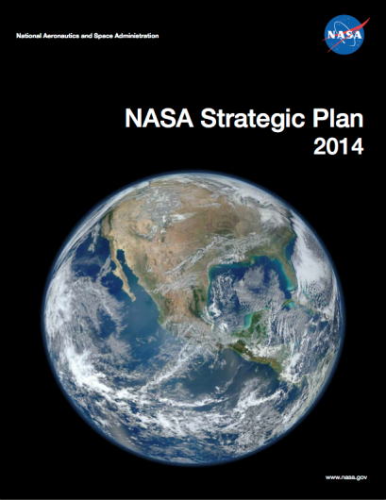
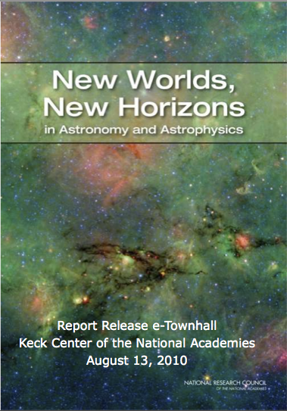
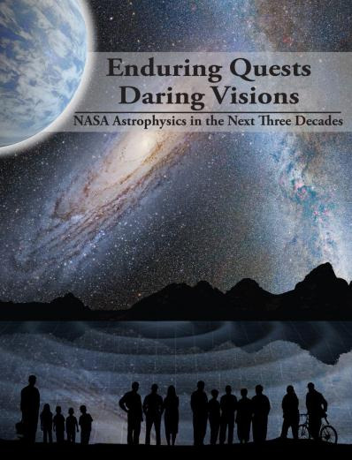
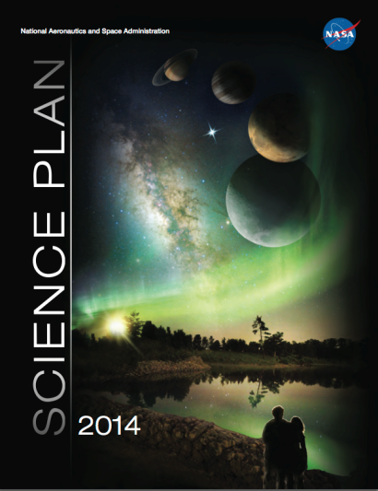
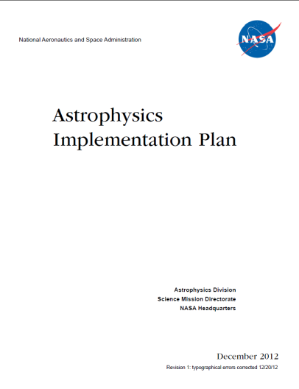
Astrophysics Driving Documents
Update document with progress since Dec 2012 in preparation for Dec 2014 release
http://science.nasa.gov/astrophysics/documents

Slide 42
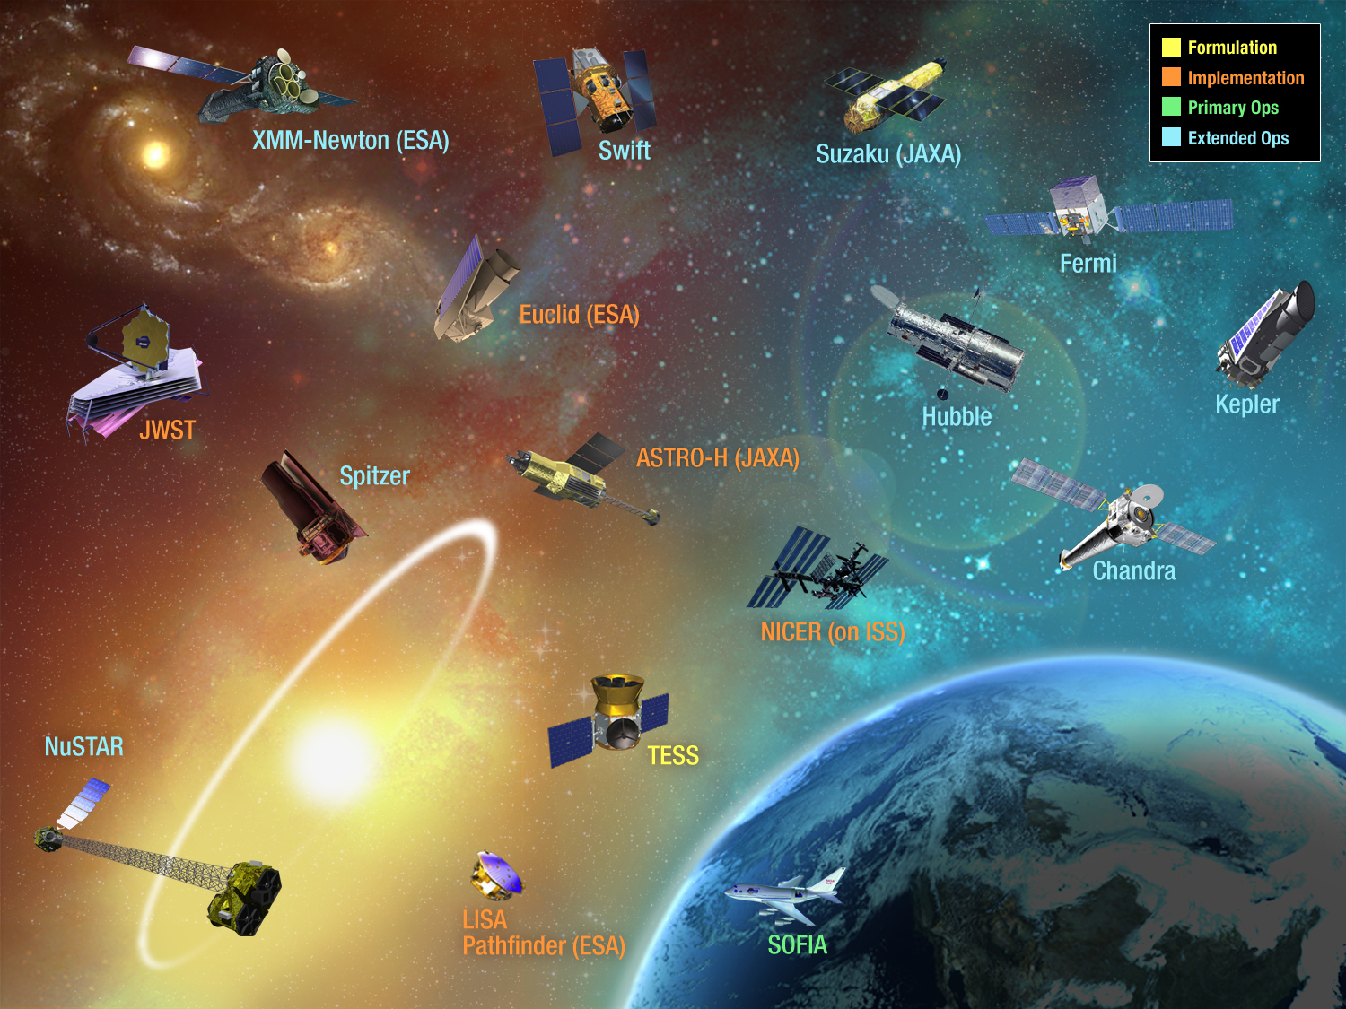
BACK-UP
NASA
Astrophysics
Recently Completed
Planck 2013
Herschel 2013
GALEX 2013
42

Slide 43
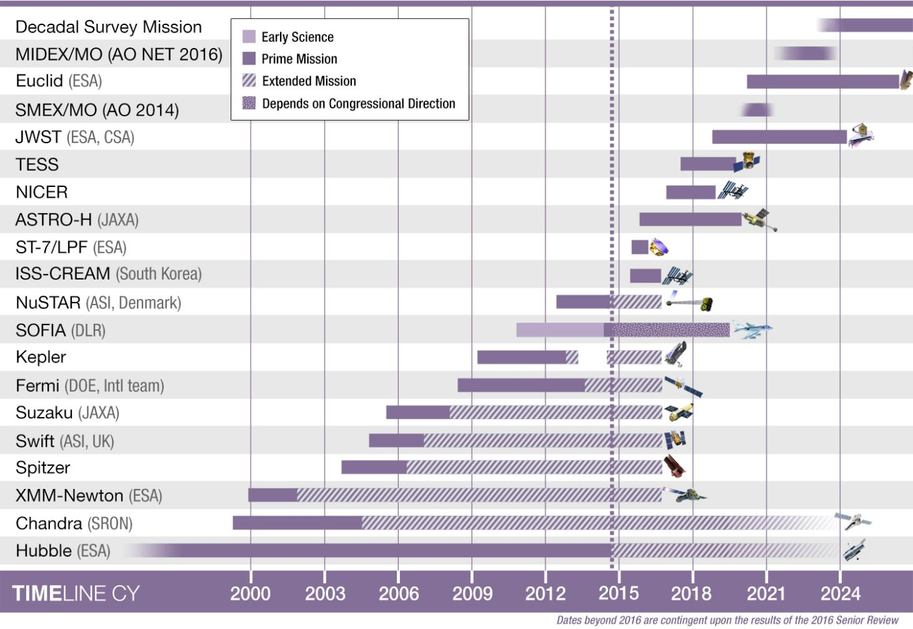
Astrophysics Timeline

Slide 44
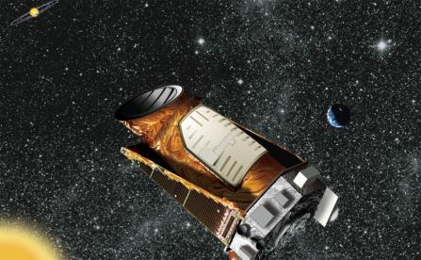
Kepler
Kepler Space Telescope
CURRENT STATUS:
Kepler “K2” mission concept was approved for operations through FY2016 after completion of the 2014 Senior Review.
  Kepler is conducting observations along the ecliptic, changing its orientation four times per year.
  The first 75-day Campaign commenced in June 2014. Campaign 2 began in late August and will conclude in mid-November.
  Targets are selected via proposals from the community. Campaigns 4 and 5 proposal deadline was late September.
From 2009-13, Kepler continuously monitored 100 sq. deg. field in constellations of Cygnus and Lyra for 4+ years.
  These observations ended after failure of 2nd reaction wheel.
Analysis of first 3 years of Kepler data has revealed:
  3845 exoplanet candidates orbiting 2658 unique stars.
  989 candidates confirmed as planets to date
  More than 100 planets discovered in their star’s “habitable zone”.
  two dozen of the habitable zone planet candidates are less than twice the size of the Earth.
Analysis of the full (4+ year) Kepler data set ongoing.
NASA’s first space mission dedicated to the search for extrasolar planets, or exoplanets
PI: W. Borucki, NASA Ames Research Center
Launch Date: March 6, 2009
Payload: 0.95-meter diameter telescope designed to measure the tiny dimming that occurs when an orbiting planet passes in front of ('transits’) a star
Scientific objectives:
  conduct census of exoplanet systems
  explore the structure and diversity of extrasolar planetary systems
  determine the frequency of habitable, Earth-sized planets in our galaxy
Notes:
Updated August 11, 2014

Slide 45
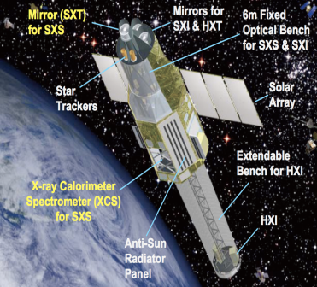
ASTRO-H
Soft X-ray Spectrometer and Soft X-ray Telescope Mirrors
CURRENT STATUS
The U.S. is providing instrument contributions to the JAXA ASTRO-H mission.
Soft X-ray telescope mirrors (SXT-S and SXT-I) – Both delivered.
Calorimeter Spectrometer Insert (CSI) – delivered and integrated on to the FM Dewar and has success-fully been tested at the 2-stage and 3-stage modes.
Completed early FM Dewar cryo performance testing in June with excellent results (>90% response efficiency).
High Temperature Superconductor (HTS) leads were delivered to JAXA on July 16.
Science Data Center Meeting held September 27-28, 2014 (ISAS).
Successfully completed warm Dewar aliveness testing with NASA-provided FM hardware.
UPCOMING EVENTS:
November – JAXA CDR 2
December – FM XBOX and ADRC to JAXA
Jan 2015 – FM Dewar deliver to spacecraft
  Explorer Mission of Opportunity
  PI: R. Kelley, Goddard Space Flight Center
  Launch Date: Nov 2015 on JAXA H-IIA
Science Objectives: Study the physics of cosmic sources via high-resolution X-ray spectroscopy. The SXS will enable a wide range of physical measurements of sources ranging from stellar coronae to clusters of galaxies.
  Operations: Prime Mission is 3 years
Notes:
Updated August 11, 2014

Slide 46
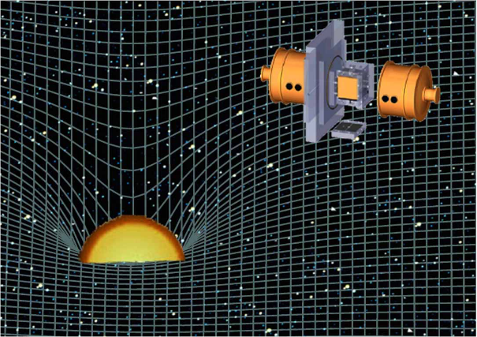
ST-7/LISA Pathfinder
ST-7/Disturbance Reduction System (DRS)
CURRENT STATUS:
JPL executing life tests at Airbus UK
Launch vehicle loads exceed DRS test levels, under review
NASA DRS experiment mission investigators have requested for extra spacecraft data needed for analysis. Current plan is ESA gives only experiment data
Extended mission being discussed
Spacecraft assembly is still ongoing
System level thermal vacuum test in March 2015
System level acoustics and mass properties in May 2015
Shipping in June to launch site
Launch July 31, 2015
ESA Mission with NASA Collaborating
Project Category: 3 Risk Class: C
DRS flies on the ESA LISA Pathfinder spacecraft
Sun-Earth L1 halo orbit
Drag-free satellite to offset solar pressure
Payload delivery: July 2009 – COMPLETE
Launch date: July 31, 2015
Operational life: 2 months
Data Analysis: 12 months
Notes:
Updated August 11, 2014

Slide 47
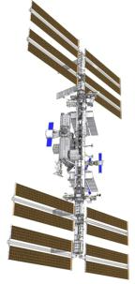
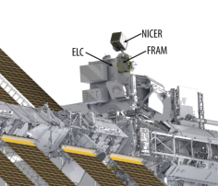
NICER
Neutron Star Interior Composition Explorer
CURRENT STATUS:
Downselected April 2013.
Science team and project management both led by NASA GSFC.
Development progressing on plan.
The Preliminary Design Review successfully completed in December 2013.
NICER passed Confirmation (KDP-C), for approval to enter implementation phase, on February 24, 2014.
All major contracts have been awarded for optics, pointing system and star tracker.
Design is maturing quickly; engineering test units of the optics have been manufactured and tested.
Critical design review (CDR) successfully completed September 15-18, 2014.
Intl
Space
Station
(ISS)
  Explorer Mission of Opportunity
  PI: Keith Gendreau, GSFC
  Launch: October 2016 on Space-X Falcon 9
  Science Objectives: Perform high-time-resolution and spectroscopic observations of neutron stars in the .2-12 keV energy range to study the physics of ultra-dense matter in the core of neutron stars.
  Instrument: X-ray Timing Instrument uses X-ray concentrators and detectors to detect X-ray photons and return energy and time of arrival.
  Platform: Located externally on the ISS, ExPRESS Logistics Carrier 2, Starboard 3 site
  Operations: Operated on a non-interference basis for 18 months
  SEXTANT for Pulsar navigation demo funded by NASA’s Space Technology Mission Directorate
Notes:
Updated August 11, 2014

Slide 48
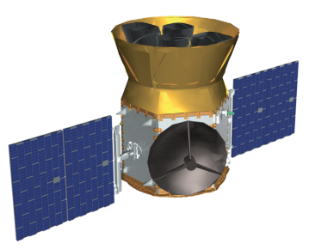
TESS
Transiting Exoplanet Survey Satellite
CURRENT STATUS:
Downselected April 2013.
Major partners:
  PI and science lead: MIT
  Project management: NASA GSFC
  Instrument: Lincoln Laboratory
  Spacecraft: Orbital Science Corp
Tentative launch readiness date August 2017.
High-Earth elliptical orbit (17 x 58.7 Earth radii).
Development progressing on plan.
  Systems Requirement Review (SRR) successfully completed on February 12-13, 2014.
  Preliminary Design Review (PDR) successfully completed Sept 9-12, 2014.
  Confirmation Review, for approval to enter implementation phase, successfully completed October 31, 2014.
Standard Explorer (EX) Mission
PI: G. Ricker (MIT)
Mission: All-Sky photometric exoplanet mapping mission.
Science goal: Search for transiting exoplanets around the closest and brightest stars in the sky.
Instruments: Four wide field of view (24x24 degrees) CCD cameras with overlapping field of view operating in the Visible-IR spectrum (0.6-1 micron).
Operations: 2017 launch with a 2-year prime mission
Notes:
Updated August 11, 2014

Slide 49
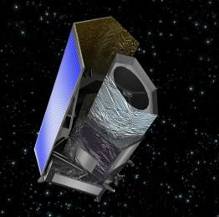
Euclid
A visible and near-infrared telescope to explore cosmic evolution
CURRENT STATUS:
Currently in implementation phase.
~50 U.S. scientists are members of the Euclid Science Team that will analyze the data, and make maps of the sky.
First experimental manufacturing run for the Euclid near-infrared detectors was completed in FY 2014 (ESA) and are currently being evaluated and characterized.
NASA will initiate the buy for the flight infrared detectors in FY15.
NASA will test and characterize the near-IR flight detectors.
NASA is funding the ENSCI (Euclid NASA Science Center at IPAC). ENSCI will
  Support all segments of US community on Euclid to enhance science utilization
  Integrate into Euclid Science Ground System provided by the Euclid consortium to gain/contribute expertise in pipelines
ESA Cosmic Vision 2015-2025 Mission, M-Class with NASA participation.
1.2-m mirror, visible & near-IR images, spectra
Launch Date: Mar 2020
Science Objectives:
Euclid will look back 10 billion years into cosmic history.
Probe the history of cosmic expansion (influenced by dark energy and dark matter) and how gravity pulls galaxies together to form the largest structures.
The shapes of distant galaxies appear distorted because the gravity of dark matter bends their light (gravitational lensing). Measuring this distortion tells us how the largest structures were built up over cosmic time.
Measuring how strongly galaxies are clumped together tells us how gravity influences their motions, and how dark energy has affected the cosmic expansion.
Notes:
Updated August 11, 2014

Slide 50
2014 Astrophysics Explorer AO
Community Announcement released on November 12, 2013, indicating NASA will solicit proposals for SMEX missions and Missions of Opportunity.
Draft AO July 14, 2014, comments received August 4, 2014.
  NASA received ~70 comments.
Final AO released September 17, 2014.
Preproposal Conference held October 7, 2014.
Notice of intent were due October 15, 2014.
  NASA received ~30 NOIs
Proposals due December 18, 2014.
For additional info: http://explorers.larc.nasa.gov/APSMEX/.
Notes:
Updated August 11, 2014

Slide 51
FY15 Planned Accomplishments
The TESS Explorer Mission will be confirmed to begin implementation (KDP-C) in FY15.
The ISS-CREAM experiment will be launched to the International Space Station (KDP-E) in FY15.
The Step 1 selection (KDP-A) will be made for the next Small Astrophysics Explorer and Explorer Mission of Opportunity in FY15.
ESA’s LISA Pathfinder with NASA’s ST-7 experiment will launch (KDP-E) in FY15.
The WFIRST/AFTA science definition team report will be completed in FY15.
Manufacture, assembly, and test of the Euclid flight detectors will continue in FY15.
JAXA’s ASTRO-H mission spacecraft system level test will take place in FY15.
The Astrophysics Archives Senior Review will be held in FY15.
Hubble will achieve 25 years of operation in FY15.
The NRC Mid-Decade Review will begin in FY15.
Four Balloon campaigns will be conducted in FY15.
Five Sounding Rockets with Astrophysics payloads will launch in FY15.

Slide 52

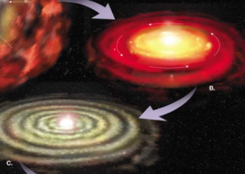




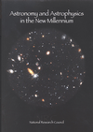
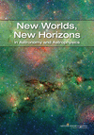
Why Astrophysics?
Astrophysics is humankind’s scientific endeavor to
understand the universe and our place in it.
1. How did our universe
begin and evolve?
2. How did galaxies, stars,
and planets come to be?
3. Are We Alone?
These national
strategic drivers
are enduring
1972
1982
1991
2001
2010

Slide 53
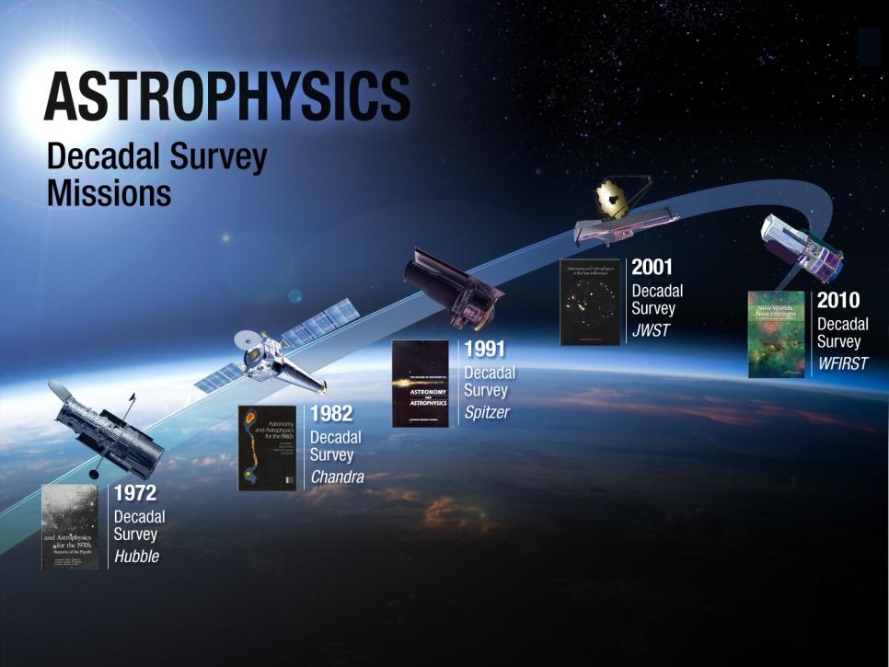
LRD: 2018
LRD: 2020s
2003
1999
1990
53

Slide 54
Progress Toward Decadal Survey Priorities
The NASA FY14 Appropriation, the President’s FY15 Budget Request, and its notional out years support:
Large-scale 1. WFIRST | Preformulation and focused technology development for WFIRST/AFTA (a 2.4m version of WFIRST with a coronagraph) are underway to enable a new start NET FY2017. Planning budget proposed for an Astrophysics Decadal Strategic Mission.
Large-scale 2. Augmentation to Explorer Program | Astrophysics Explorers planned budget increased to ~$150M/yr by FY16; supports decadal cadence of AOs including AO for SMEX AO in Fall 2014 (FY2015) and EX AO in ~FY2017.
Large-scale 3. LISA | Strategic astrophysics technology (SAT) investments including LISA Pathfinder plus discussing partnership on ESA’s L3 gravitational wave observatory – participating in ESA-led assessments in 2014-2015.
Large-scale 4. IXO | Strategic astrophysics technology (SAT) investments plus pursuing partnership on ESA’s L2 Athena X-ray observatory. Athena study phase, with U.S. participation, is underway.
Medium-scale 1. New Worlds Technology Development Program | Focused technology development for a coronagraph on WFIRST, strategic astrophysics technology (SAT) investments, and exoplanet probe mission concept studies.
Notes:
Updated August 2014

Slide 55
Progress Toward Decadal Survey Priorities
The NASA FY14 Appropriation, the President’s FY15 Budget Request, and its notional out years support:
Medium-scale 2. Inflation Probe Technology Development Program | Three balloon-borne investigations plus strategic astrophysics technology (SAT) investments.
Small-scale. Research Program Augmentations | Increased annual R&A budget from $74M (FY10) to $82M (FY12 and beyond). Within R&A: established Theoretical and Computational Astrophysics Networks (TCAN) program with NSF; funding available for astrophysics theory; funding available for lab astrophysics; funding available for suborbital payloads.
Small-scale. Intermediate Technology development Augmentation | Established competed Strategic Astrophysics Technology (SAT) program element; directed technology funding for WFIRST and other large-scale decadal priorities.
Small-scale. Future Ultraviolet-Visible Space Capability | Strategic Astrophysics Technology (SAT) investments.
Small-scale. SPICA (U.S. contribution to JAXA-led) | Not supported as a strategic contribution; candidate for Explorer Mission of Opportunity.
Notes:
Updated August 2014

Slide 56
Astrophysics Science Mission Events
CY
2014
2015
2016
2017
2018
2019
2020
Developing
ISS CREAM
LPF(ESA)/ST-7
ASTRO-H (JAXA)
NICER
TESS
JWST
Euclid (ESA)
May
July
Continued operation depends on results of the 2018 Sr Review
Nov
Feb
TBD
Mgd by JWST PO
Transfer to Astrophysics Div
Oct
KDP-E
Mar
Opportunities
Explorer
SALMON
SMEX AO
MIDEX AO
SMEX AO
MO PEA
MO PEA
MO PEA
Operating
Hubble
Chandra
XMM-Newton (ESA)
Spitzer
Swift
Suzaku (JAXA)
Fermi
Kepler/K2
NuSTAR
SOFIA
Balloons
Rockets
Sept 9
Continued operation depends on results of
the 2016 Sr Review
K2 Start
Jul 31
Notional Sr Review
Return from HMV
Pending Congressional Direction
Launch Date
Event Date
End of Prime Mission
Balloon Campaigns
Notional AO Release Date

Slide 57
Looking toward the 2015 Mid-Decade Review
The usual charge to a mid-decade review (paraphrased)
Assess how NASA is doing implementing the recommendations and priorities of the Decadal Survey, in the context of post-Survey changes and constraints
Directions in New Worlds, New Horizons relevant to NASA (paraphrased)
LISA: If LISA is not L1, or LISA Pathfinder is not successful, or equal partnership is not possible, then conduct review to reconsider LISA’s prioritization. (p.9, p.213)
IXO: If IXO is L1, conduct review then (maybe) invest immediately in technology. By mid-decade, invest aggressively in technology. (p. 214, p. 215)
New Worlds: If precursor science is favorable, conduct review then (maybe) downselect technology and invest to ready a mission for the 2020 decadal survey. (p.20, p.195, p.216)
Inflation Probe: If B-mode detected, conduct review then (maybe) invest in technology for an all-sky mission. (p.198, p.217)
DSIAC: Conduct review to see whether any contingencies have occurred and recommend action. (p.102)

Slide 58
President’s FY15 Budget Request
FY16-FY19 are notional
James Webb Space Telescope
SMD Admin
Exoplanet Exploration
Cosmic Origins
Physics of the Cosmos
Astrophysics Explorers
Senior Review
Astrophysics Research
Notes:
Contained in Agency material

Slide 59
Astrophysics FY 2015 Budget Request
Notional
 | FY 2013 Op Plan | FY 2014 Op Plan | FY 2015 | FY 2016 | FY 2017 | FY 2018 | FY 2019
Astrophysics | 617.0 | 668.0 | 607.3 | 633.7 | 651.2 | 696.8 | 993.0
Astrophysics Research | 155.8 | 134.9 | 191.0 | 216.2 | 221.2 | 234.6 | 261.2
Cosmic Origins | 218.9 | 224.2 | 120.3 | 106.4 | 108.2 | 114.2 | 105.8
Physics of the Cosmos | 124.5 | 112.6 | 108.8 | 100.9 | 86.6 | 89.4 | 142.4
Exoplanet Exploration | 52.8 | 106.7 | 47.5 | 46.4 | 60.4 | 89.8 | 237.3
Astrophysics Explorers | 65.1 | 89.6 | 139.7 | 163.7 | 174.9 | 168.7 | 186.4
James Webb Space Telescope | 627.6 | 658.2 | 645.4 | 620.0 | 569.4 | 534.9 | 305.0
Astrophysics + JWST | 1,244.6 | 1,326.2 | 1,252.7 | 1,253.7 | 1,220.6 | 1,231.7 | 1,298.0
Notes:
Contained in Agency material

