Slide 1
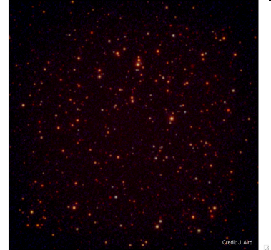

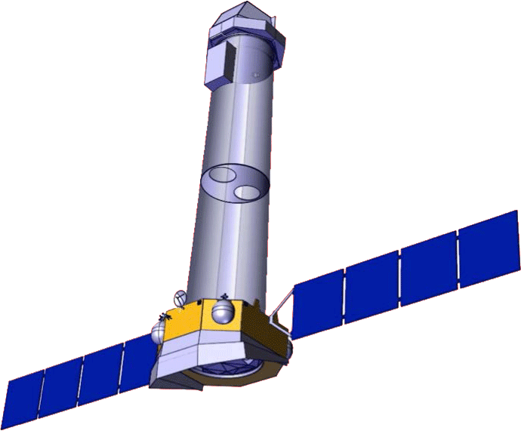
ATHENA: The Advanced Telescope for High Energy Astrophysics
Nicholas E. White, NASA/GSFC
On behalf of the Athena Study Team
Revealing the Extreme Universe from Black Holes to Large Scale Structure

Slide 2
New L-class boundary conditions
Programmatic assumptions:
ESA-led mission with ESA Cost at Completion < 850 MЄ
International cooperation: low-level contributions from JAXA and NASA.
Instruments procured by ESA members states (< 200 M Є) and/or partner agencies (e.g. JAXA and NASA).
TRL ≥ 5 by early 2014 (by end of Phase A).
Targeting launch opportunity by end of 2022.
Implementation phase < 7 yr (including contingency).
Mission schedule milestones:
Following SPC decision (Feb 2012), mission entering directly the Definition Phase (A/B1), with system level studies starting in Q3/2012 (TBC).
Instruments AO released in Q1/2013.
Final missions selection in Q2/2014 (at the end of phase A).
Completion of Phase B1 by end 2014.
Implementation phase (B2/C/D) KO in Q1/2015.

Slide 3
The Reformulation Process
The Problem:
  Fit within ESA cost of <850M€ while retaining key science
Solution:
  Lower Mass (Lower Mirror Effective Area)
  Reduced Complexity (e.g. EOB, Mechanisms)
  Fewer Instruments (6 to 2)
Tradeoff:
  Which Instruments? (XMS, WFI)
  1, 2 or 3 telescopes (1 keV vs 6 keV science)
Process:
  11 Scientific “Task Teams” set up to investigate science potential and impact of tradeoffs
  Broad involvement (100+ scientists), very short timescale
  Presentations and discussion at ESTEC 28th April
  Science Team Meeting at MPE June 14-15

Slide 4
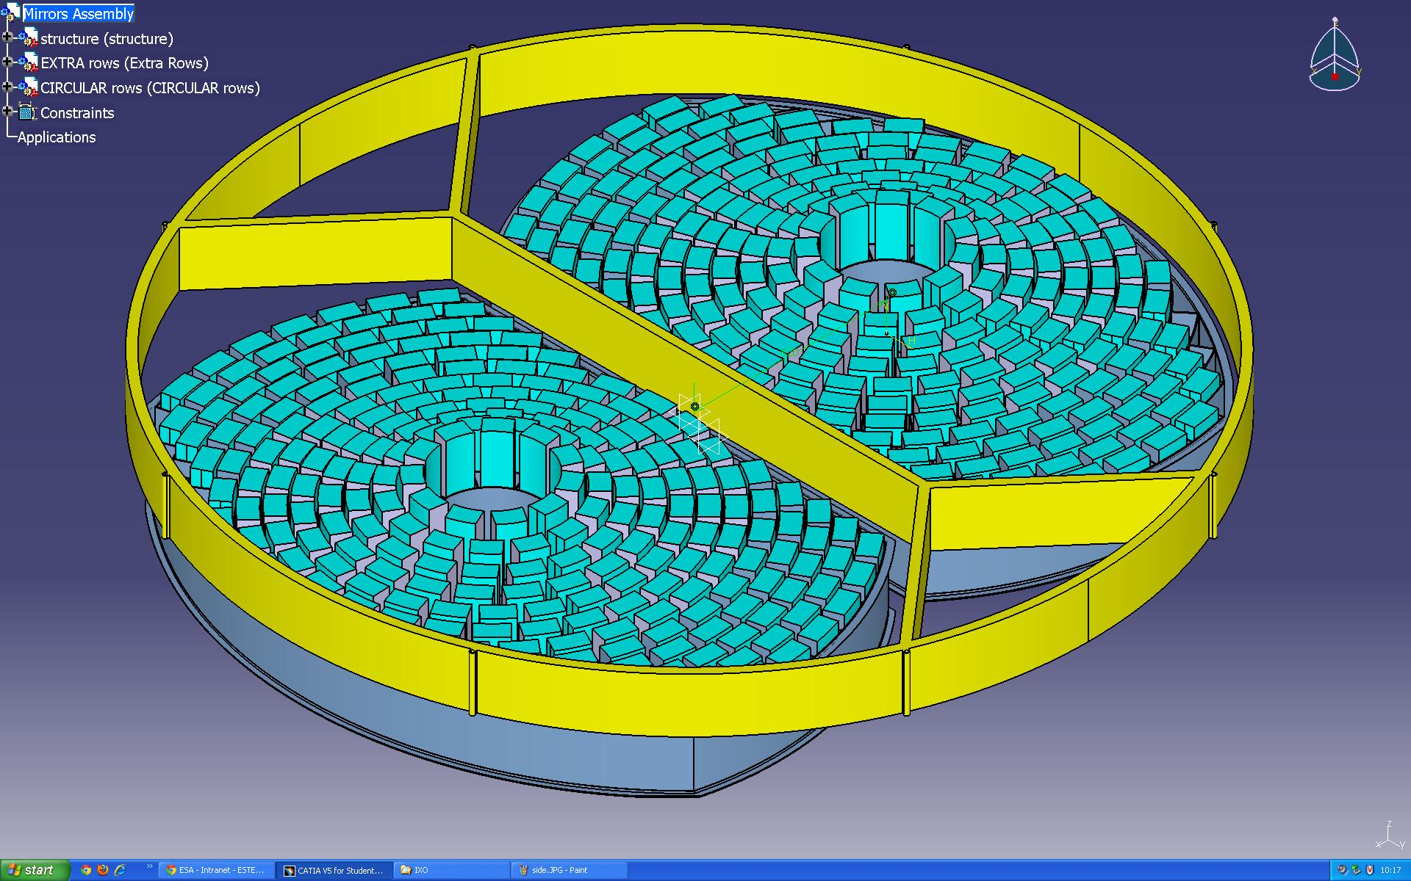
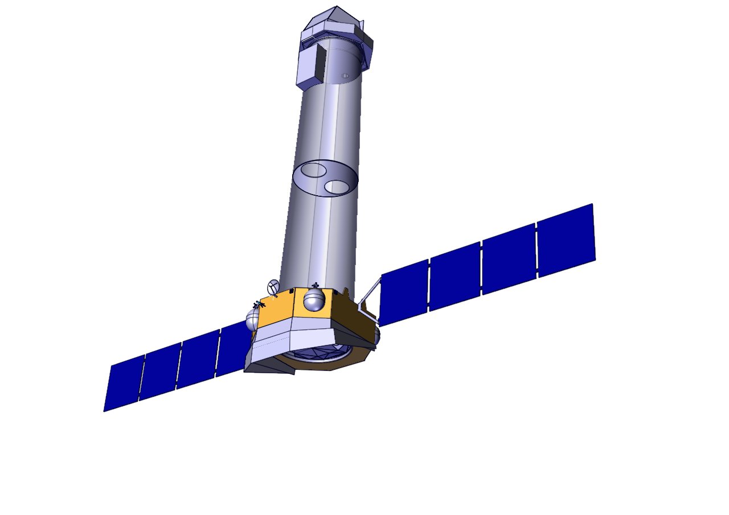
Athena Implementation
Focal plane
Fixed OB
11.5m Focal length
Service Module
Two telescope with 10” resolution (5” goal) with single fixed instrument at each focal plane
MA
ESA Silicon Pore Optics
Ariane V launch to L2
5yr nominal mission
Mirror Assembly

Slide 5
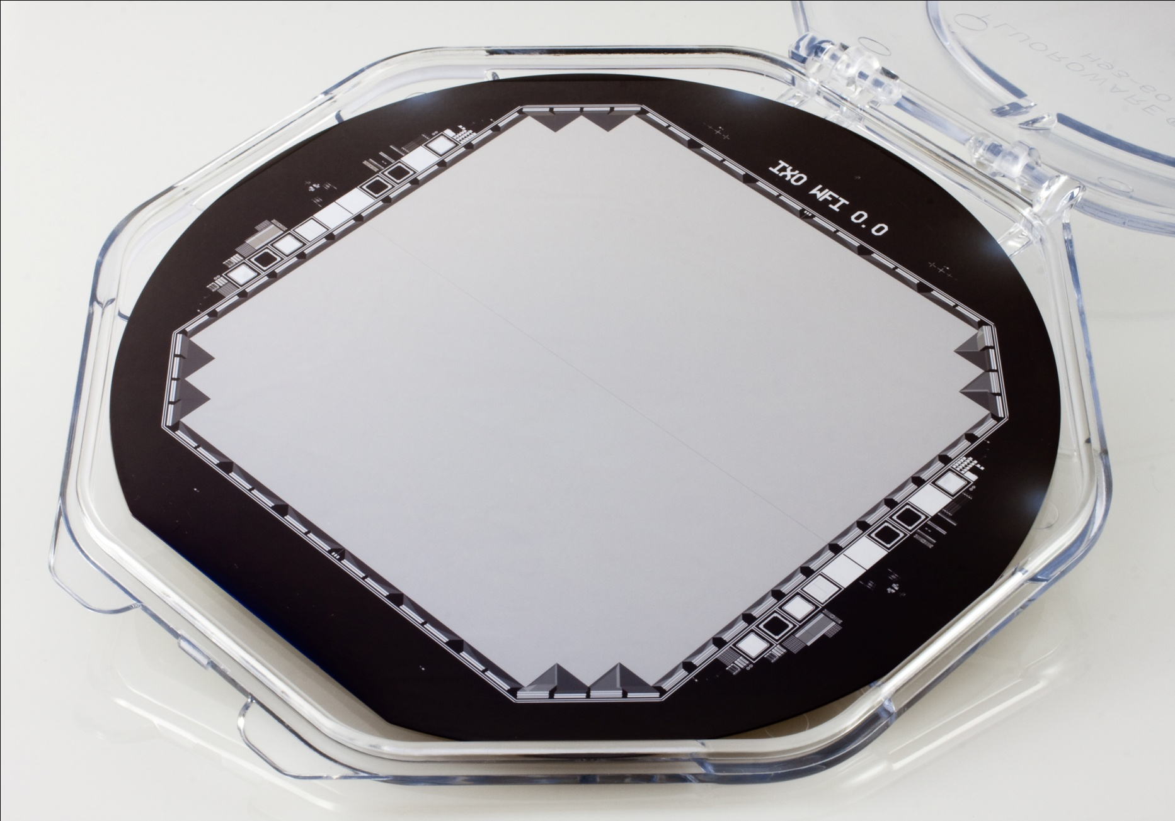
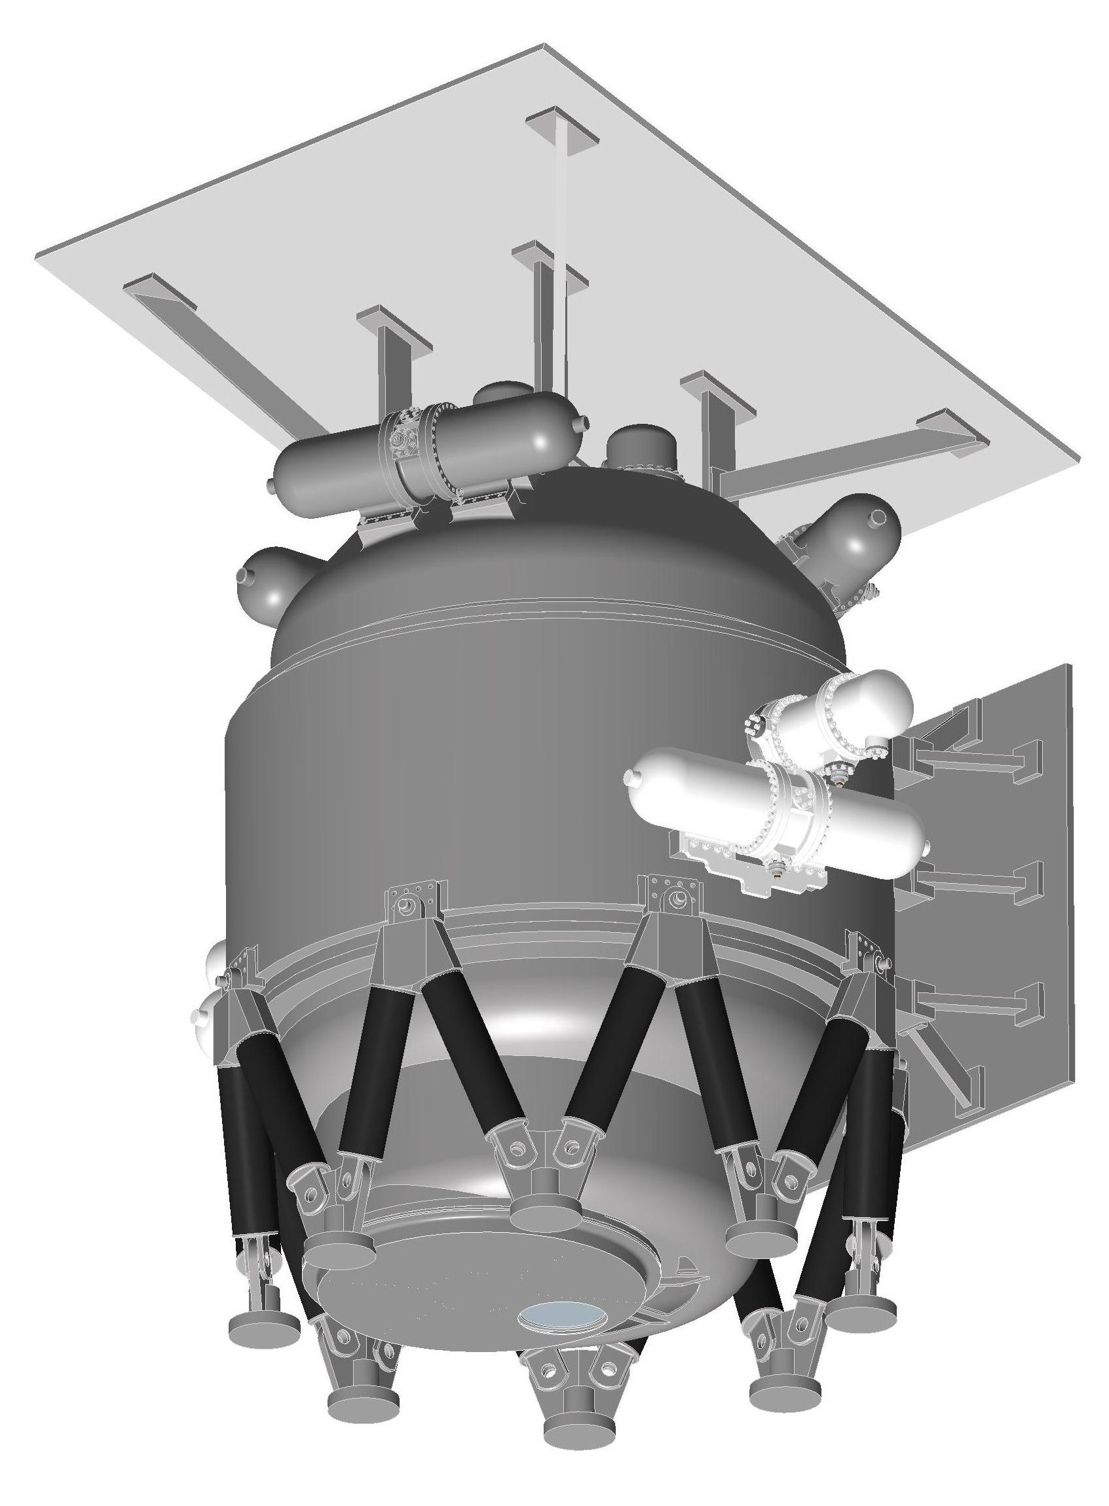
Two Athena Instruments
FPA
FMS
MA
SVM
Wide Field Imager (WFI)
25 x 25 arc min FOV
150 eV @ 6 keV
Microcalorimeter (XMS)
2.4 x 2.4 arc min FOV
3 eV @ 6 KeV
JAXA, NASA contributions

Slide 6
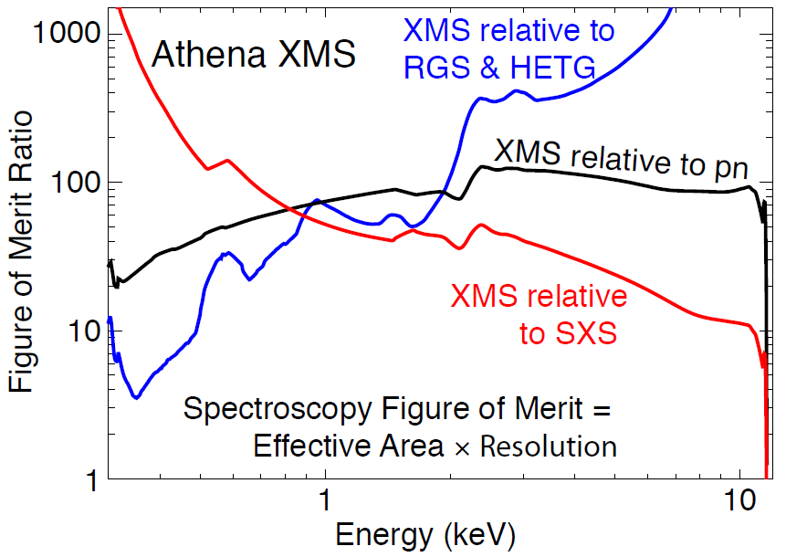
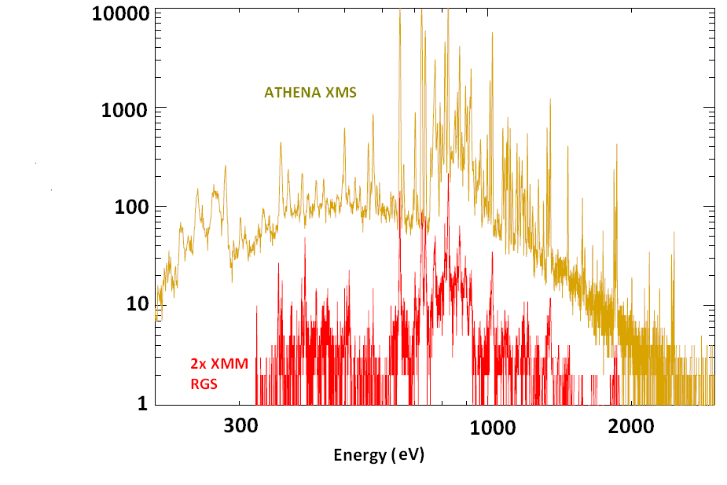
Figure of Merit: Spectroscopy

Slide 7
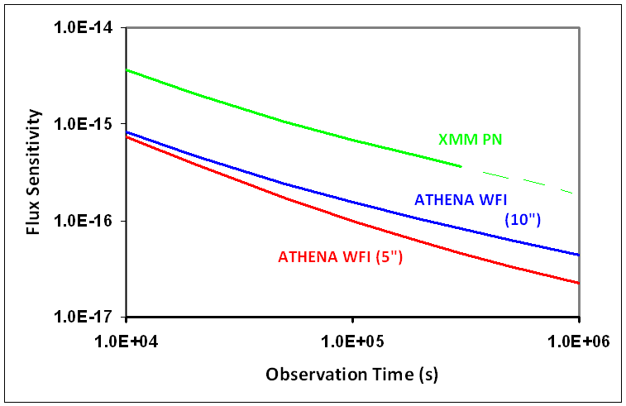
Figure of Merit: Imaging Sensitivity
Power law AGN at high latitude
confusion
L* AGN @ Z~6
At 1Ms with 10” resolution, the sensitivity of ~4 10⁻¹⁷ is comparable with confusion limit

Slide 8
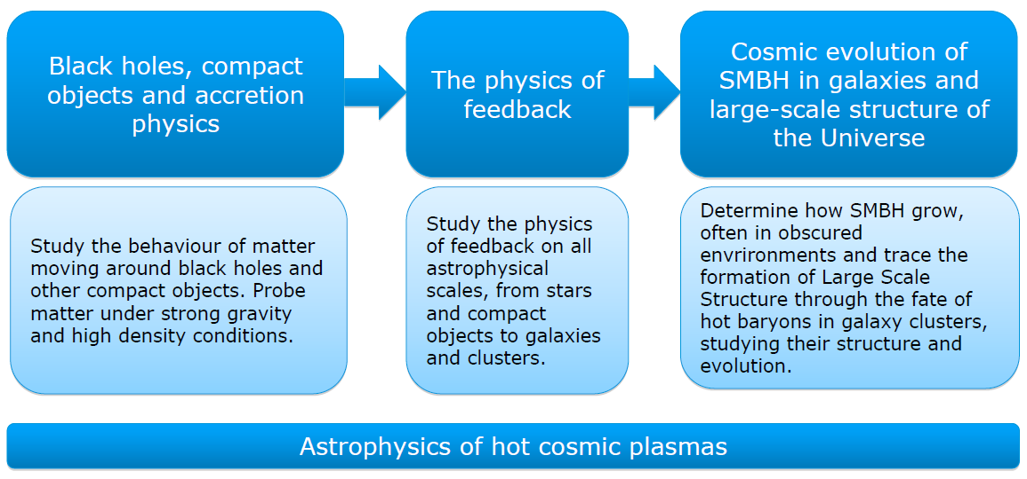
Athena Science Objectives
Diagnose hot cosmic plasmas on all astrophysical environments via spatially resolved high resolution X-ray spectroscopy

Slide 9
Athena Science Requirements
Effective Area | 1 m² @1.25 keV (goal 1.2 m²) 0. 5 m² @ 6 keV (goal 0.7 m²) | Black hole evolution, large scale structure Strong gravity, cosmic feedback
Spectral Resolution (FWHM) | ΔE = 3 eV (@6keV) within 2 x 2 arc min (goal 2.5 eV and 4x3 arc min) ΔE =150 eV at 6 keV within 25 arc min diam (goal of 125 eV and >30 arc min) | Large scale structure, Cosmic Feedback Black Hole evolution, Large scale structure
Angular Resolution | 10 arc sec HPD (0.1 – 7 keV) (goal of 5 arc sec) | Black hole evolution, Cosmic feedback, Large Scale Structure
Count Rate | 1 Crab with >90% throughput. ΔE < 200 eV @ 6keV (0.3 – 15 keV) | Strong gravity
Astrometry | 1.5 arcsec at 3σ confidence | Black hole evolution
Absolute Timing | 100 μsec | Compact Objects

Slide 10
Black Holes and Accretion Physics
M. Cappi, C. Reynolds, L. Brenneman
AGN, BHB, NS binaries, Sgr A*, ULX, CVs etc.

Slide 11
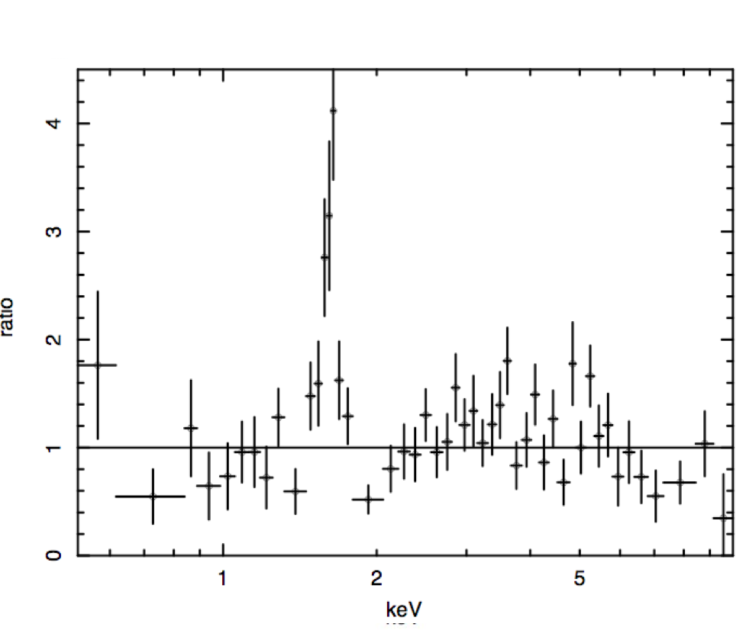
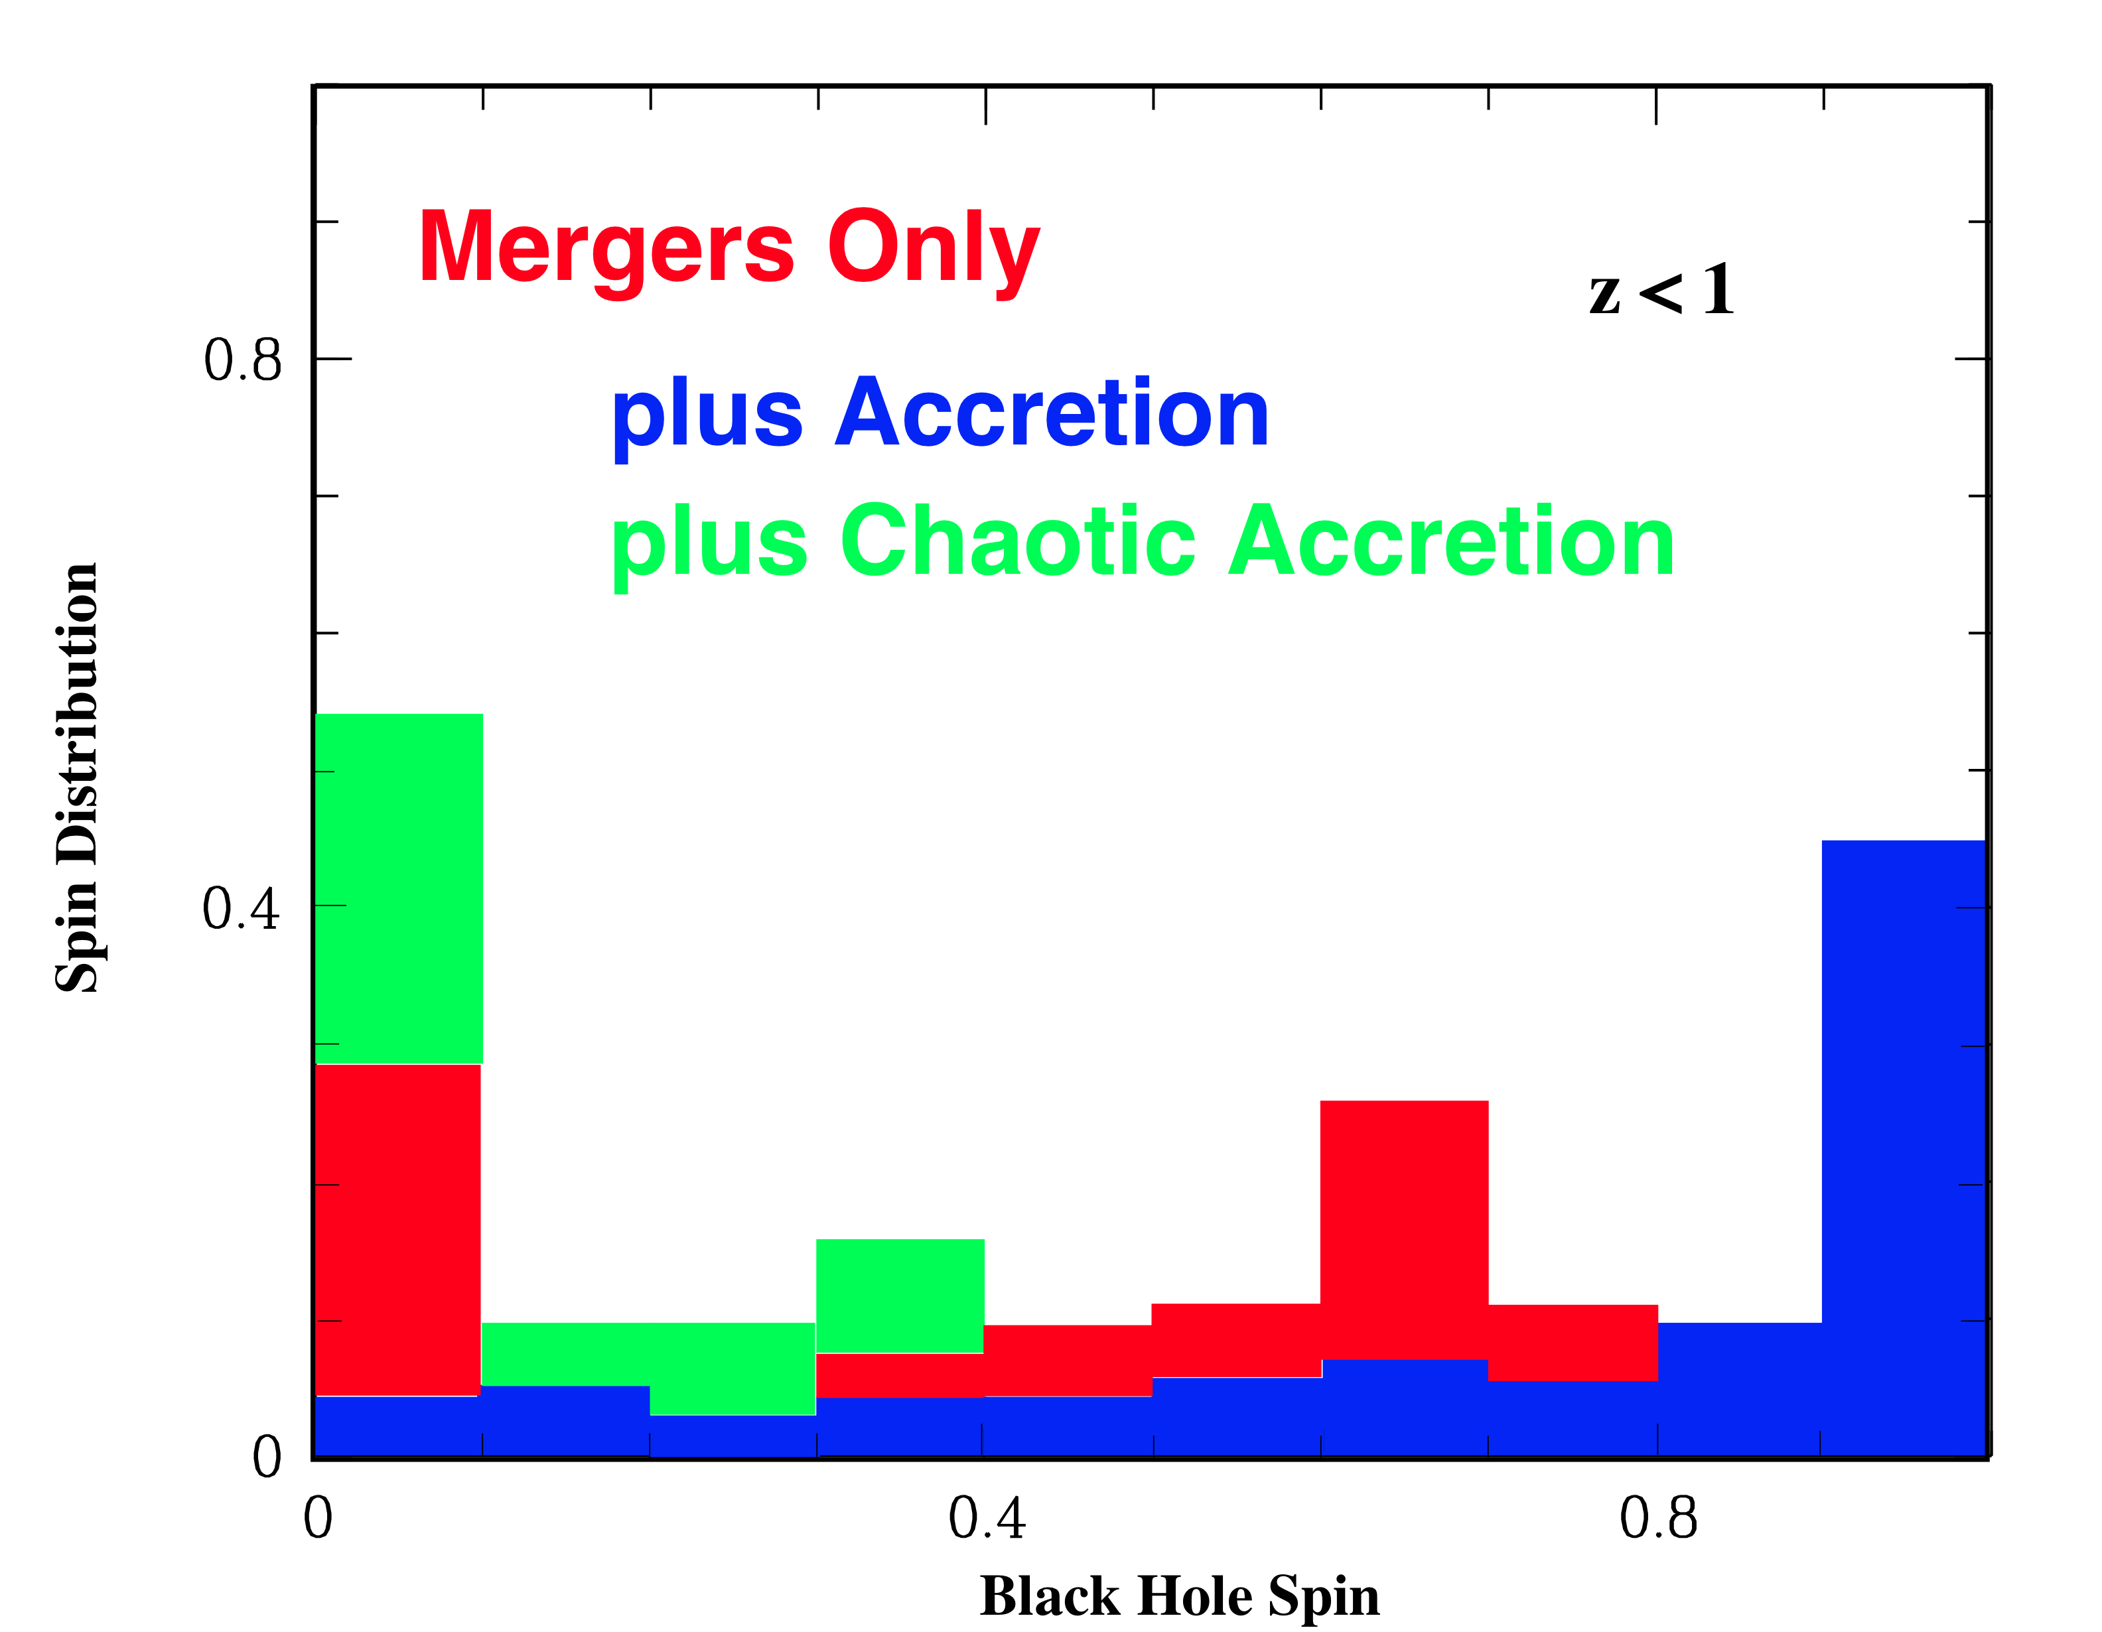
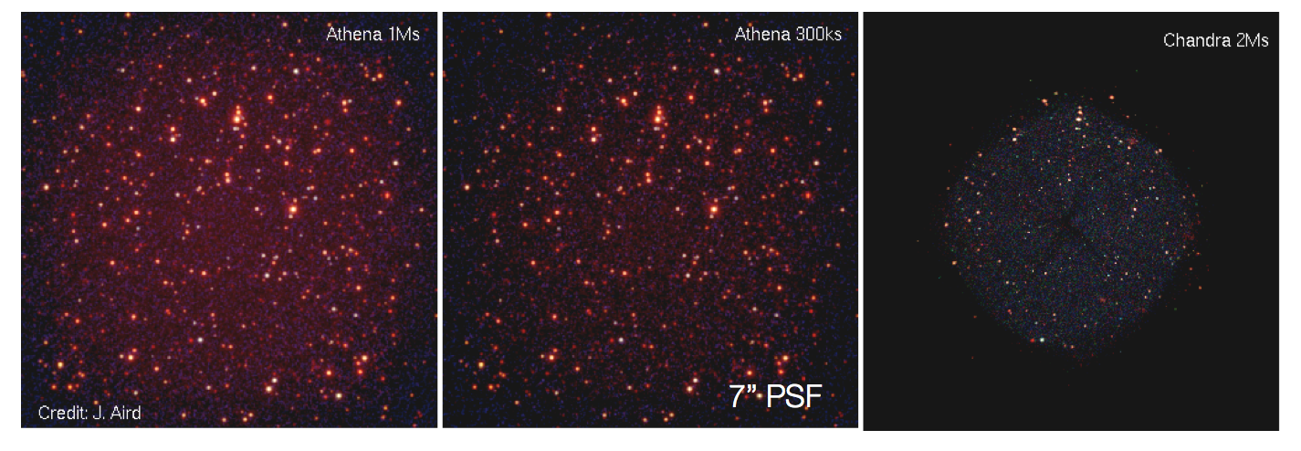
Cosmic Evolution of SMBH
A. Comastri
Fe Kα
Compton thick
AGN@z~2
AGN census at z>6? goal PSF (5”) and WFI FOV (>30’)

Slide 12
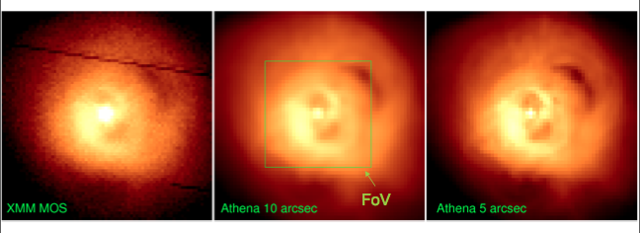
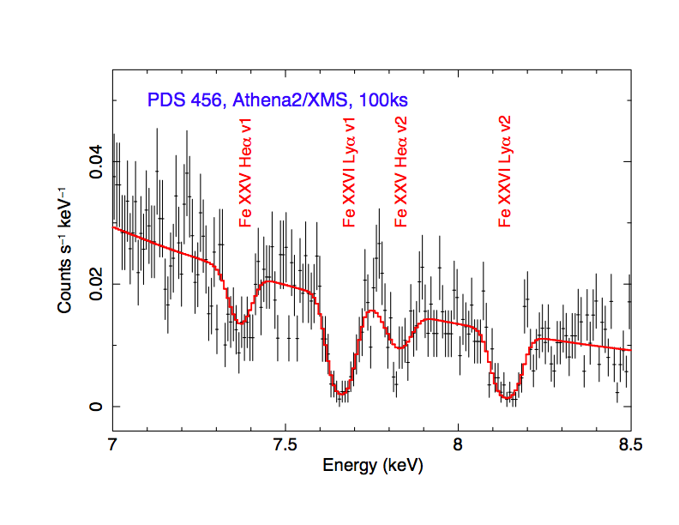
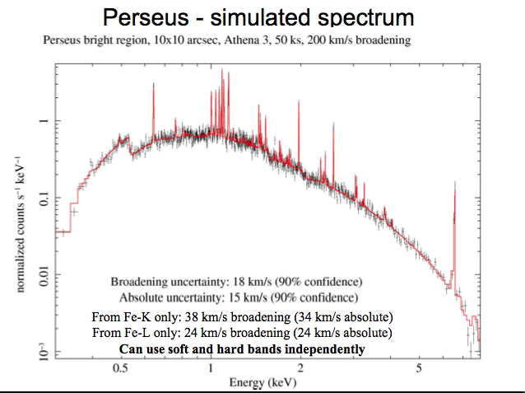
The Physics of Feedback
A. Fabian, J. Sanders
AGN feedback via outflows

Slide 13
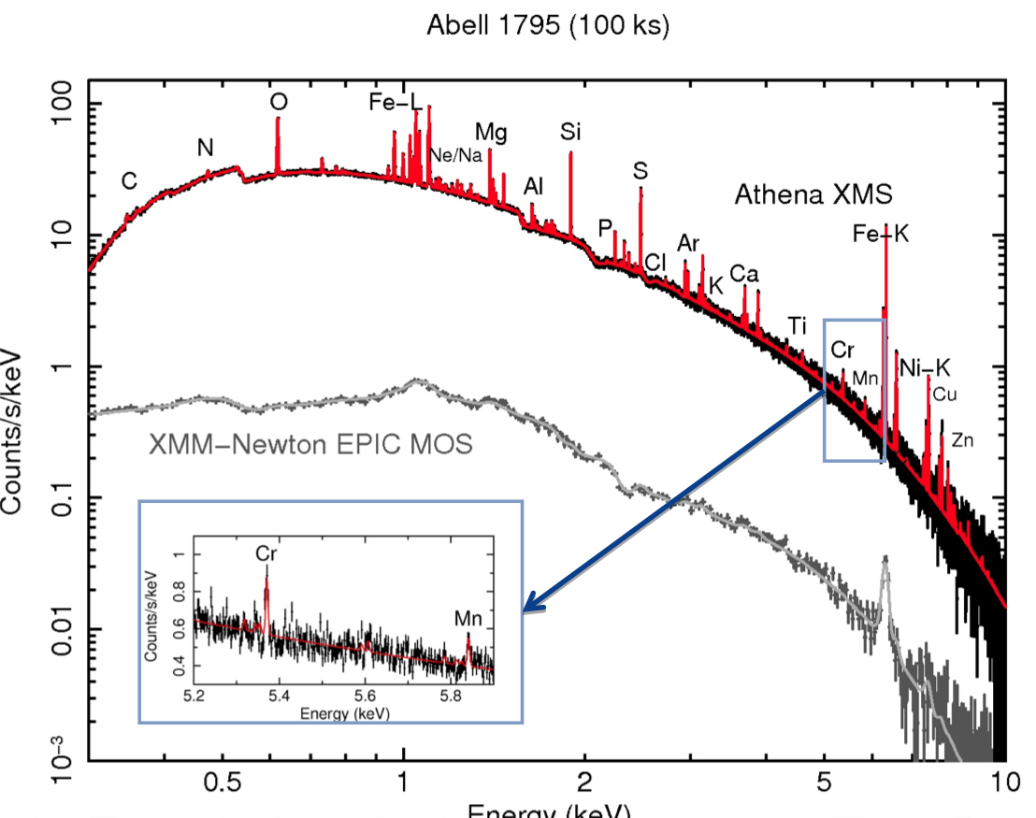
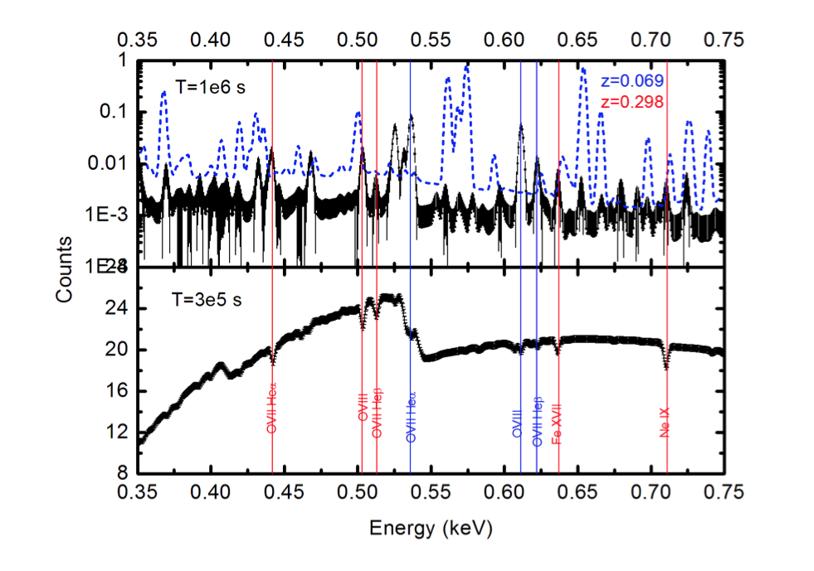
Large-Scale Structure
Clusters
Missing Baryons/WHIM
J. De Plaa
L. Piro
WFI: group, clusters census to z>2
XMS: baryon physics, mass proxies
➔ COSMOLOGY

Slide 14
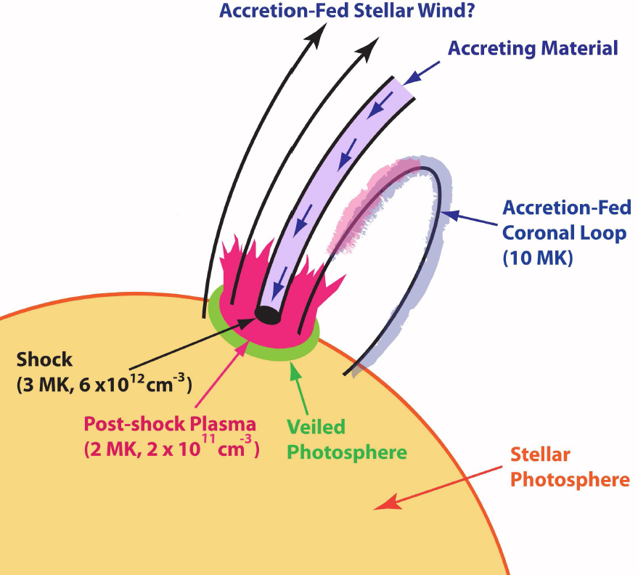
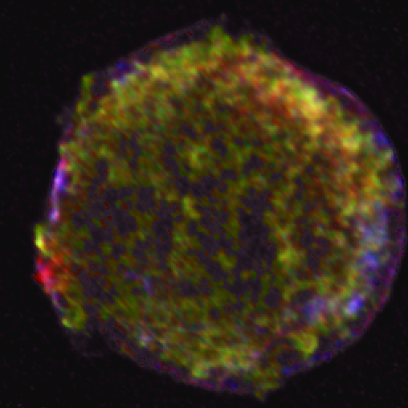
Astrophysics of hot cosmic plasmas
Charge exchange in Solar System bodies: planetary atmospheres, comets, etc.
Stellar evolution:
Young Stellar Objects
Cool stars
Massive stars, mass loss, magnetic fields, etc.
Supernovae and Supernova remnants
Winds and absorption studies in X-ray binaries
Cataclysmic variables
X-ray binary populations in external galaxies
The ISM of our galaxy
And many many more….

Slide 15
ATHENA: The Next Steps
 | Jul | Aug | Sep | Oct | Nov | Dec | Jan | Feb
Industry Study
ESTEC Review
AWG Review
JAXA MDR
Document Pack
Yellow Book
SPC Decision

Slide 16
Possible NASA Contributions
The following are being discussed:
Instrument contributions
  XMS: A TES array and readout electronics, as well as a 3 stage ADR
  WFI: Electronics and software
Infrastructure contributions
  Use of the X-ray Calibration Facility at MSFC
Support for US Guest Observers similar to that for Herschel and XMM-Newton
  Contributions to data analysis software

Slide 17
Process for Selecting NASA Participation
Current thinking is to fund NASA participation through the Explorer program via a Mission of Opportunity call on a TBD timeframe that will ultimately align with the ESA instrument AO process

