Slide 1
Cosmic Origins Program Analysis Group Report
Astrophysics Advisory Committee Meeting – April 2017
Paul Scowen
(COPAG EC Chair)

Slide 2
COPAG EC Membership
Paul Scowen (Chair, APAC Member) Arizona State University
Lee Armus Caltech
Suvi Gezari University of Maryland
Matt Greenhouse NASA/Goddard Space Flight Center
Mary Elizabeth Kaiser Johns Hopkins
Joseph Lazio NASA/JPL
Paul Lightsey ~ Ball Aerospace
Pam Marcum NASA/Ames
Tom Megeath ~ U.Toledo
John O’Meara ~ St. Michael College
Claudia Scarlata ~ U. Minnesota
Sarah Tuttle ~ U. Washington
Mario Perez (Executive Secretary, Ex-Officio) NASA HQ
Eric Tollestrup (Ex-Officio) NASA HQ
Susan Neff (COR Program Office, Ex-Officio) NASA/GSFC
Vacant (COR Program Office, Ex-Officio)
~ New Members as of Nov 2016

Slide 3
COPAG Activities Since October
Members who rotated off:
  Daniela Calzetti – led SAG #9 on Science Enabled by Spitzer Observations Prior to JWST Launch
  Dennis Ebbets – led SAG #6 on Cosmic Origins Science Enabled by the WFIRST-AFTA Coronograph
  James Green – led SAG #7 on Science Enabled by Operations Overlap of HST and JWST
  Sally Heap – led SAG #8 on Science Enabled by the WFIRST - AFTA Data Archive
  Chris Howk*
We thank these people for their excellent hard work and collegial contributions
All SAGs completed their work and were closed by this Committee – their reports are all posted on the COPAG website: https://cor.gsfc.nasa.gov/sigs/sigs.php
* - Chris Howk had only served since November 2015, but had found his commitments at Notre Dame (Sabbatical and study abroad officer) had enlarged to the point that he was having trouble even making the telecons – we mutually agreed that he should step down

Slide 4
COPAG Activities
We advertized for new members in Fall 2016
9 compliant applications were received
Given the people rotating off, we wanted to try to adhere to:
  Gender equality
  Industry representation
  Science diversity compared to remaining members
  Seniority balanced against early career scientists
  Continued representation with the ongoing STDT studies
  In line with instructions – no new members from NASA Centers
The new members selected were:
  Paul Lightsey – Ball Aerospace – known expert in mission design and systems engineering
  Tom Megeath – U. Toledo – FIR observer of star formation
  John O’Meara – St. Michael College – Cosmology and Lyman Limit Systems (LUVOIR)
  Claudia Scarlata – U. Minnesota – Ly-α emitters and galaxy evolution
  Sarah Tuttle – U. Washington – technology and smallsat development

Slide 5
COPAG Activities
SPIE meeting of SIG2 on June 28, 2016, Edinburgh – Meeting discussed the need for some informed assessment of the Technology Gaps list – in response the COPAG is making the request to open a new Interest Group – a Technology Interest Group – the charter has been distributed to the APAC
This motion was made in October 2016, but Paul Hertz requested a deferral to this meeting to allow time for his staff to assess the manner in which the Technology Gaps are handled across the Astrophysics Division
After discussion with COR HQ, we received verbal approval from APD to start populating the new TIG in anticipation of formal approval at this meeting

Slide 6
Technology Interest Group
The intent is to form an open group of community members both from within the Astrophysics community and from within Industry to inform the COPAG as a whole on the Technology Gaps List
Each year the COR Technology Office sends the draft list to the COPAG EC for review before it goes under review by a Technology Management Board
This past year, the EC felt it did not have the expertise to address the list properly
The new TIG will serve both as a more informed review body and provide input on technology developments throughout the year
All input will be treated equally but will be reviewed to ensure that the needs forwarded to the COR Technology Office are complete

Slide 7
COPAG Activities
The COPAG EC has continued to track closely STDT activities:
  OST - Lee Armus
  HabEx - Paul Scowen
  LUVOIR - Daniela Calzetti and now, John O’Meara
  Lynx -Two additional EC members have been covering the activities of this STDT - Joe Lazio and Suvi Gezari
    Overtures were made by the Lynx team for COPAG to help “get the word out” about opportunities to contribute to the STDT SWGs, but after several discussions, no concrete requests for help were made of the COPAG by the Lynx STDT

Slide 8
COPAG Activities
COPAG continues to have no open SAGs
COPAG continues to have 3 open SIGs
All 3 SIGs had community meetings at the January 2017 AAS Meeting in Grapevine, TX
The COPAG co-sponsored a session at the AAS to allow Paul Hertz to address the combined membership of the PAGs, as well as providing a forum to hear summary talks on the state of progress with the STDT efforts

Slide 9
SIG1 - FIR Astronomy
J.D. Smith, U. Toledo - Co-Chair
The Far-Infared Science Interest Group (SIG #1) has been very active in connecting the community with ongoing and planned missions and programs in the FIR & submm.
We hosted a splinter session at the Winter AAS in Texas with the Origins Space Telescope study team. In addition to OST, we heard important updates on SOFIA, SPICA and a variety of smaller missions under study.
The highlight of the session was a chaired panel discussion with several plenary speakers including Henry Norris Russell Lecturer Prof. Chris McKee. All panel members gave tremendous feedback on the scientific and policy directions of the FIR-Space community from an outside perspective.
A newly formed steering committee will build on this success to grow and engage the community at future meetings.
On Mar 23 at Caltech, we helped organize a "Far Infrared Next Generation Instrumentation Community Workshop” with a focus on the next generation of SOFIA instruments.
In addition to meetings, the FIRSIG hosts monthly webinars drawing a variety of speakers from around the community, with the aim of providing a low overhead means of staying updated on developments in the far-infrared scientific and mission landscape.
Follow our activities at http://tinyurl.com/firsig

Slide 10
SIG2 - UV-Visible Astronomy from Space
Paul Scowen, ASU - Chair
The UV-Visible SIG met at the AAS meeting in Grapevine, TX to learn more about the UV-visible instrumentation being designed into both the LUVOIR and HabEx large mission concepts.
Both missions have strong General Astrophysics portfolios and the instrumentation, in both case, consist of wide field cameras and FUV spectrographs, although the specific capabilities differ depending on the science cases that drive their requirements.
An energetic discussion ensued and it was noted that many members of the SIG2 were already actively helping shape these instrument designs and implementations in both science and necessary technologies.
The much awaited workshop paper from the Summer 2015 workshop held by SIG2 at NASA GSFC has been accepted for publication in the PASP and is available online here: https://arxiv.org/abs/1611.09736

Slide 11
SIG3 – Cosmic Dawn
Joe Lazio, JPL - Chair
The Cosmic Dawn SIG held a face-to-face meeting just prior to the 229th AAS meeting. The focus of this meeting was on technology development relevant to future Flagship, and possible Probe-class, missions addressing Cosmic Dawn.
This focus was motivated by a standing responsibility of the COPAG Executive Committee is to provide feedback on the Cosmic Origins Program's Technology Program, and the recent formation of a Technology Interest Group (TIG).
Speakers covered a range of topics, from technology development for the Origins Space Telescope/Far-IR Surveyor and future far-IR and sub-millimeter missions to 21 cm missions to new concepts for Probe-class missions focussing on high-energy transients.
There was also a science overview, both highlighting recent progress in the field, the outlook for the future, and the strong synergy that appears to be developing between studies of the neutral intergalactic medium via the highly redshifted neutral hydrogen hyperfine line and X-ray observations, such as might be undertaken with the Lynx/X-ray Surveyor.
The meeting concluded with a presentation and discussion of the Cosmic Origins Program's Technology Program and its annual technology roadmap, delivered by H. Thronson. The discussion proved both fruitful and illuminating to many participants in understanding the community's role in suggesting technology gaps.
Presentations from the meeting are at: https://cd-sig.jpl.nasa.gov/events.html#sig_meeting2

Slide 12
Actions Requested of the APAC
The COPAG requests permission to establish the new Technology Interest Group in preparation for the annual Technology Gaps exercise in May/June 2017
The COPAG would like to hear more about the ideas SMD (or APD) is (are) considering about Smallsat development for Astrophysics, akin to announcements made by Jim Green at the recent LPSC meeting in Houston, TX for PSD. The COPAG could gather community input and analysis on this topic.

Slide 13
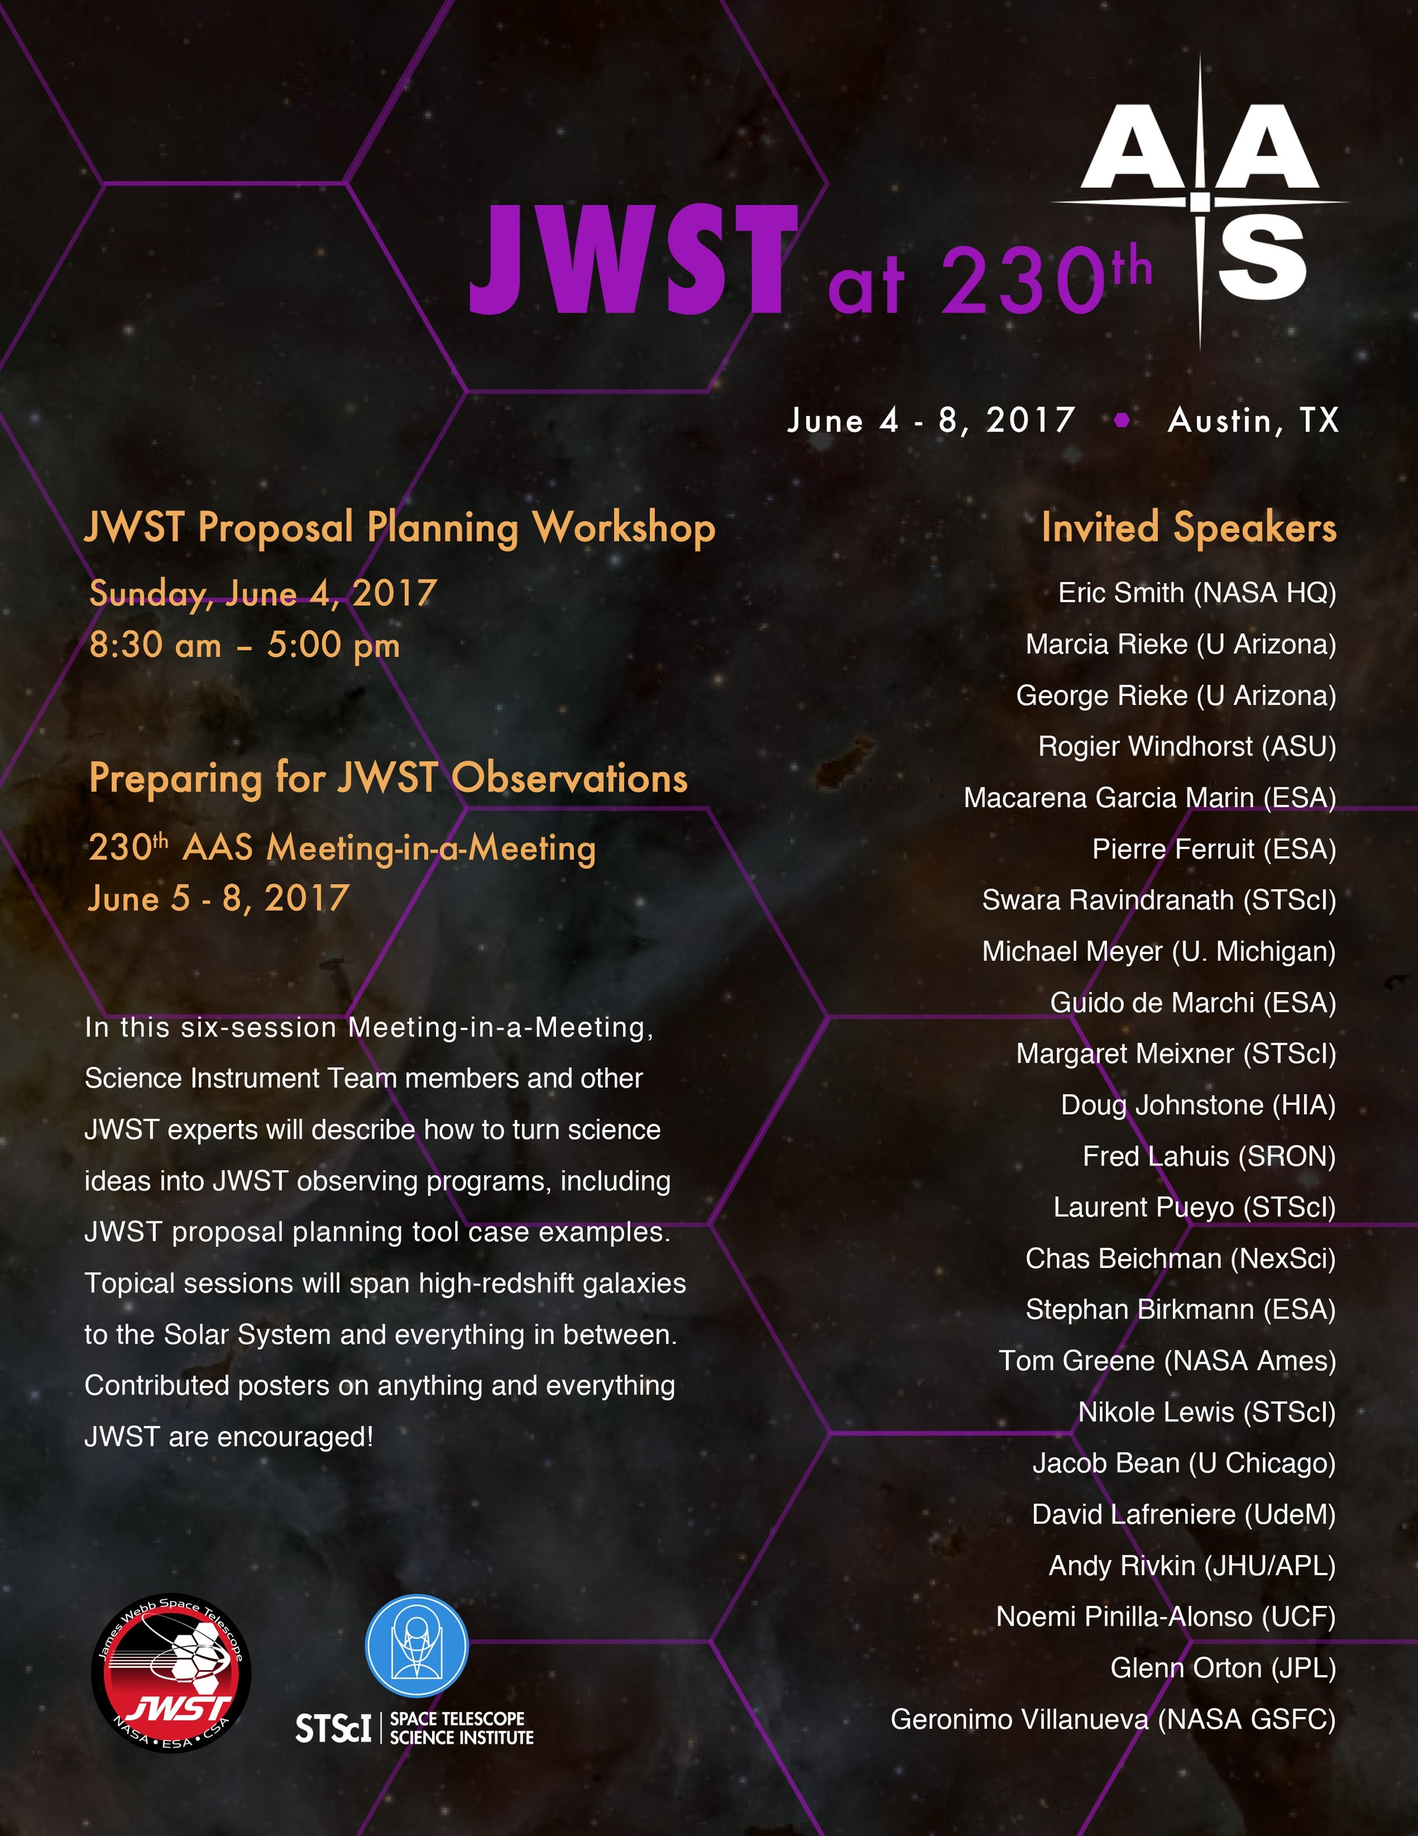
COPAG Future Activities
Bi-weekly EC telecons will continue
The COPAG is eager to promote the upcoming JWST proposal deadlines for Cycle 1 and the JWST meeting-within-a-meeting at the summer 230th AAS in Austin, TX.
Continued dialogue and support of ongoing STDT activities

