Slide 1

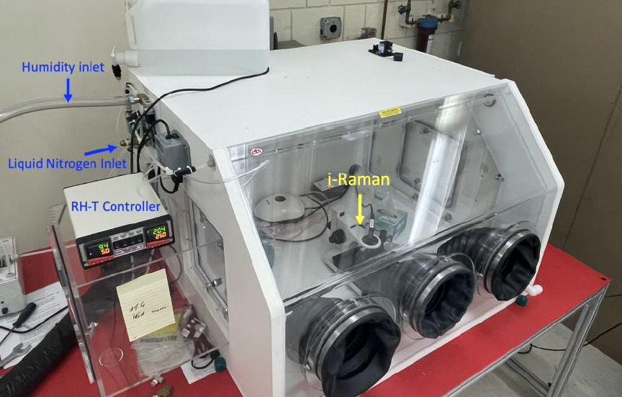
Controlled Environment Chamber (CEC)
PI: Deanne Rogers / SUNY Stony Brook University http://cpex.labs.stonybrook.edu/drogers/
Description of Facility
The CEC is a glove box equipped with a relative humidity and temperature control system that permits experiments, spectral measurements and XRD measurements of RH/T-sensitive samples. Controlled Temperature Range: -25°C to Ambient
Controlled RH Range: 2-85% @ 23°C
Available instruments for use inside the CEC:
  iRaman Plus spectrometer (532 nm excitation laser)
  ASD VNIR reflectance spectrometer
  Olympus BTXII X-ray Diffractometer
100% of instrument time is available to community if not currently in-use by SBU researcher.
Type of access available: in-person
Restrictions on access: none
Environment chamber with Raman spectrometer set up inside.
How to use the facility
Request access by contacting Deanne Rogers or Lars Ehm
Requests are evaluated based on relevance of proposed use to NASA objectives and feasibility of meeting proposed objectives with the facility
SBU researchers receive first priority. External requests are prioritized based on the order received.
Usage costs: free except for liquid nitrogen purchases for active cooling.
Contact information:
Location: Stony Brook University Earth and Space Sciences Bldg. Stony Brook, New York, USA
POC for information and scheduling (email, phone): Deanne Rogers, deanne.rogers@stonybrook.edu, 631-632-1509 or Lars Ehm, lars.ehm@stonybrook.edu
Planetary Science Legacy Facilities

