Slide 1

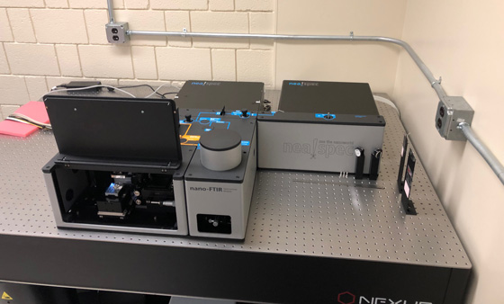
Stony Brook Nano-IR Imaging and Spectroscopy Facility
PI: Tim Glotch/Stony Brook University Website: http://cpex.labs.stonybrook.edu/tglotch/
Description of Facility
Broadband near-field IR imaging, point spectroscopy, and hyperspectral imaging from ~2.4-15.4 µm at 3-30 nm/pixel spatial scales.
Neaspec neaSNOM near-field imaging and spectroscopy system with tunable mid-IR and near-IR laser sources
20% of instrument time available to the community
Analyses can be conducted in person or by sending samples to the PI.
Neaspec neaSNOM near-field infrared imaging and spectroscopy system at Stony Brook University.
How to use the facility
Request access by emailing the PI.
Requests are evaluated based on appropriateness of samples and number of analyses requested.
Requests are prioritized after analyses required by PI and lab members.
Instrument is currently free to use.
Contact information:
063-A Earth and Space Sciences, Stony Brook University, Stony Brook, NY 11794-2100
POC: Prof. Timothy Glotch (timothy.glotch@stonybrook.edu, 631-632-1168)
Planetary Science Legacy Facilities

