Slide 1

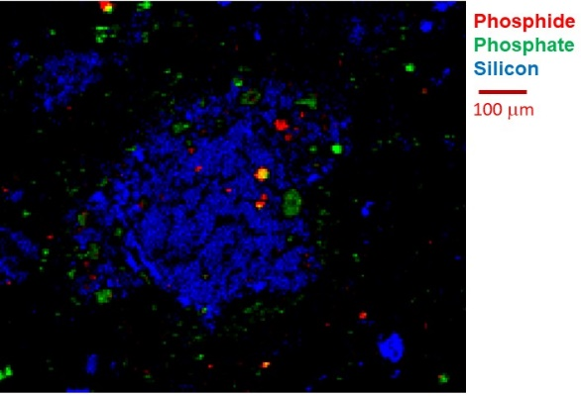
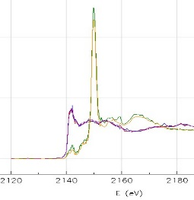
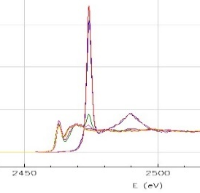
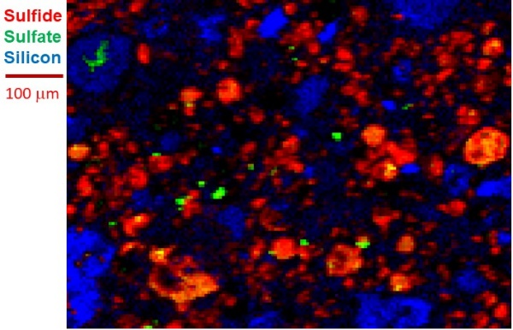
A Tender-Energy X-Ray Microprobe for Analysis of Extraterrestrial Materials
PI: Paul Northrup, Stony Brook University https://www.stonybrook.edu/commcms/geosciences/people/_researchfaculty/northrup.php
Description of “TES” Beamline 8BM Facility
TES is a synchrotron X-ray microprobe optimized for a lower energy range than typical hard X-ray microprobes, to access lighter elements Mg to Ca
Microbeam X-ray fluorescence (XRF) can map distribution and relative concentration of elements
Microbeam X-ray absorption spectroscopy can ID oxidation state, chemical speciation, local structure
Probe beam is user-tunable from 2 to 10 μm
Non-destructive; samples require minimal or no sample prep. Versatile: thin sections, powders, grains, or pieces; helium sample environment.
See Northrup (2019) J. Synch. Rad., 26, 2064-2074
Speciation imaging, at 4 μm resolution, showing distribution of phosphide vs phosphate (above) and sulfide vs sulfate (rt), relative to Si, in NWA12748*. Absorption spectra (top rt) of P and S, used for ID of oxidation state and host phase at ~2 μm resolution and fast (1-2 min) scans.
How to use the facility
TES is available to the community as a User Facility, either in person, remote, or in collaboration with the PI
Access to TES, Beamline 8-BM, can be requested through the NSLS-II User Facility General User program, described at
https://www.bnl.gov/nsls2/userguide/
There is no cost to use TES; access requests are peer-reviewed by an external panel, ranked, and allocated time according to competitive score
Contact information:
The TES Microprobe is Beamline 8BM at the National Synchrotron Light Source II, Brookhaven National Laboratory, on Long Island, NY
NSLSII User Office https://www.bnl.gov/nsls2/user-services.php phone: (631) 344-8737 email: nsls2user@bnl.gov
The TES Project PI ( paul.northrup@stonybrook.edu ) welcomes inquiries and collaborations
*Northrup et al., 2021, LPSC
Planetary Science Legacy Facilities
Notes:
Please complete and email to Kathleen.e.vanderkaaden@nasa.gov

