Slide 1
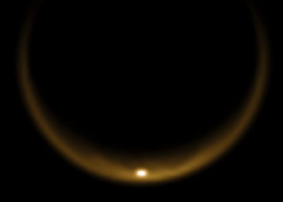
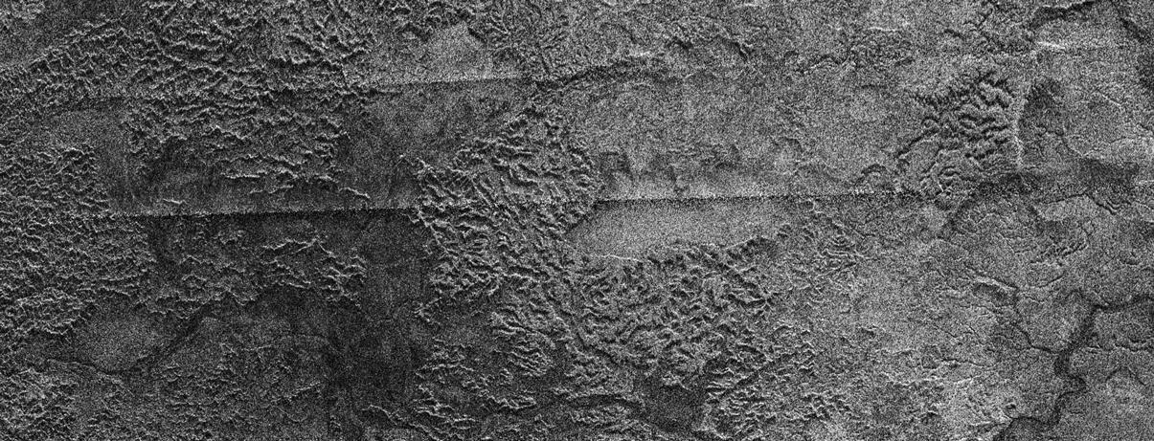
Dissolving Titan:
Dissolution geology on Saturn’s moon
Michael J. Malaska, PhD / NPP Senior Fellow
ORAU / Jet Propulsion Laboratory / California Institute of Technology
Funding from ORAU NPP Program / ASTID / OPR gratefully acknowledged

Slide 2
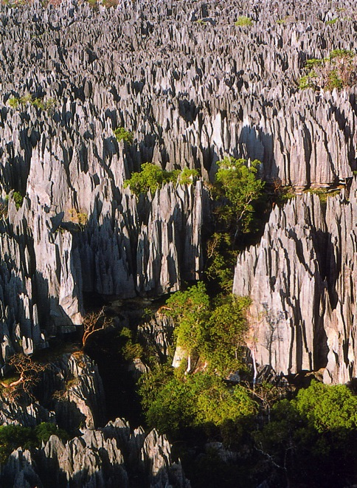
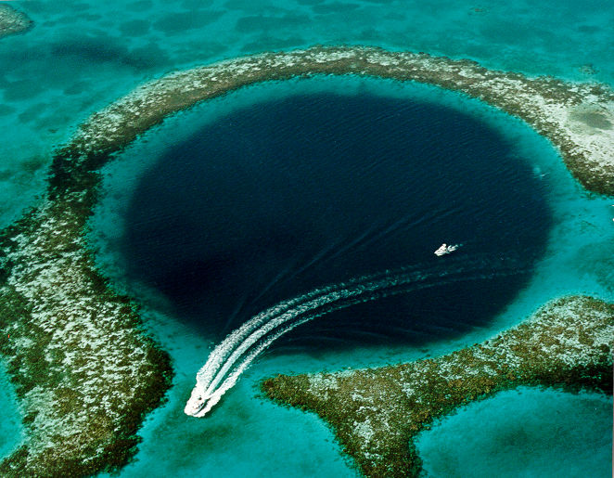
Dissolution geology on Earth
Cycling fluids + soluble materials → dissolution
Tsingy de Bamaraha, Madagascar (UNESCO World Heritage site)
Lighthouse Reef Atoll Blue Hole, Belize.
Image source: Wikpedia
Image credit USGS

Slide 3
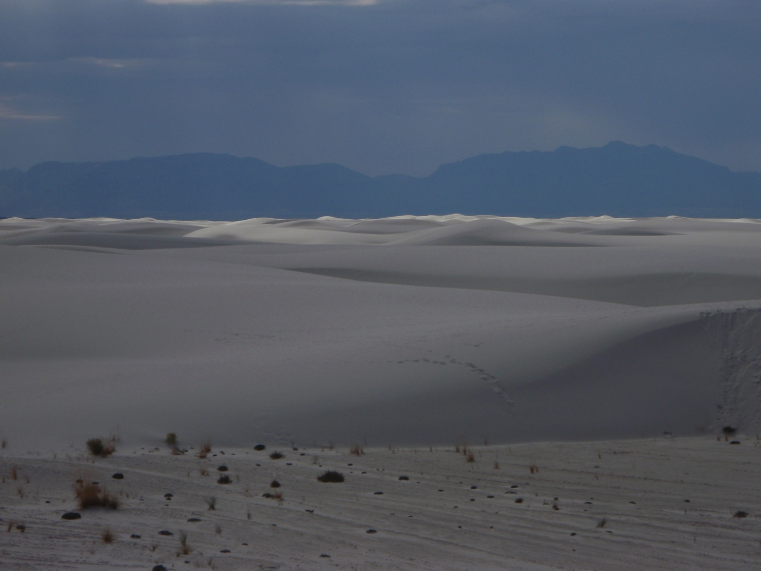
Dissolution on Earth:
White Sands National Monument, NM
Image credit Mike Malaska October, 2011

Slide 4
White Sands National Monument:
Dissolution of gypsum (CaSO₄•2H₂O) in H₂O
3) Evaporation
Evaporite deposition
4) Aeolian deposition
1) Dissolution
Leaching
Erosion
2) Fluvial
transport
subsurface
transport
Ancient evaporite
in uplifted mountains
Evaporite deposit =
Salt deposit
Wind mobile
gypsum dunes

Slide 5
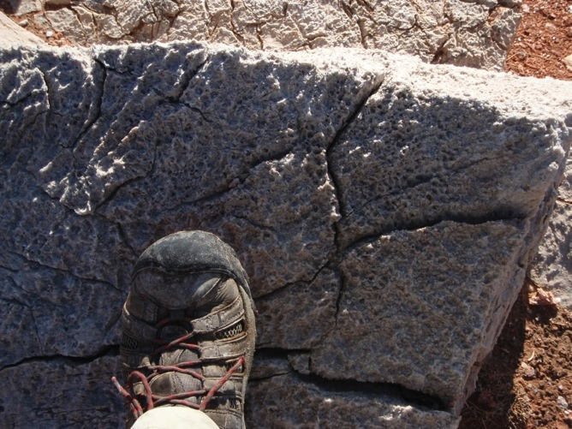
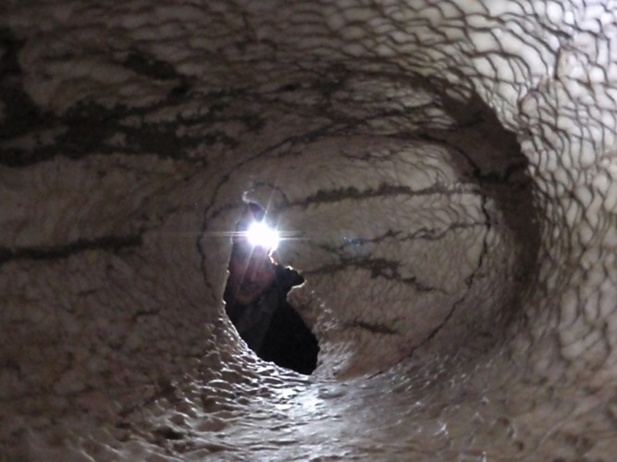
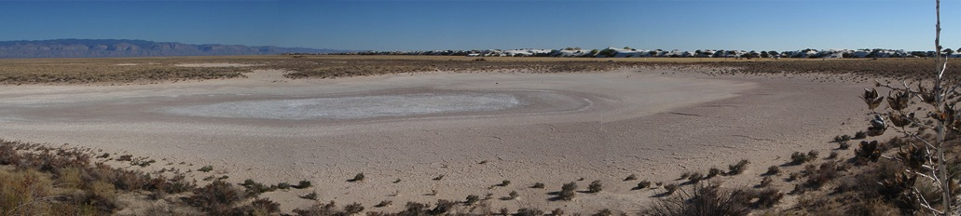
Dissolution and evaporation of gypsum
Karren features in gypsum rock
Bottomless Lake State Park, NM
Conduit in a gypsum cave
Carlsbad Caverns National Monument, NM
Unnamed playa in White Sands National Monument, NM
Image credits Mike Malaska

Slide 6
Dissolution as a molecular process
Solid
Diffusion boundary layer
Bulk solution
Solvent penetration
Dissolution
Weakening
Removal of insoluble materials

Slide 7
Fissure→Conduit
Deeper penetration and widening increases overall throughput
rapid
dissolution
zone
slow
dissolution
zone
1) Initial fissure
2) Fluid penetrates
Laminar flow regime
3) Material dissolves
4) Fissures widens
5) Breakthrough!
Flow increases
Laminar flow regime
6) Turbulent flow
Increased dissolution
Reference: Clemens et al., Hard Rock Hydrosystems, IAHS Pub. No. 241 (1997) pp. 3-10.

Slide 8
Fissure widening and collapse
Dissolution → weakening → erosion
Fissures
Widening
Collapse
Sinkhole
Elapsed time (min)
Figure from: Piccini, L., 1995. International Journal of Speleology 24 (Phys.) 41-54. (Fig 6 in text)

Slide 9
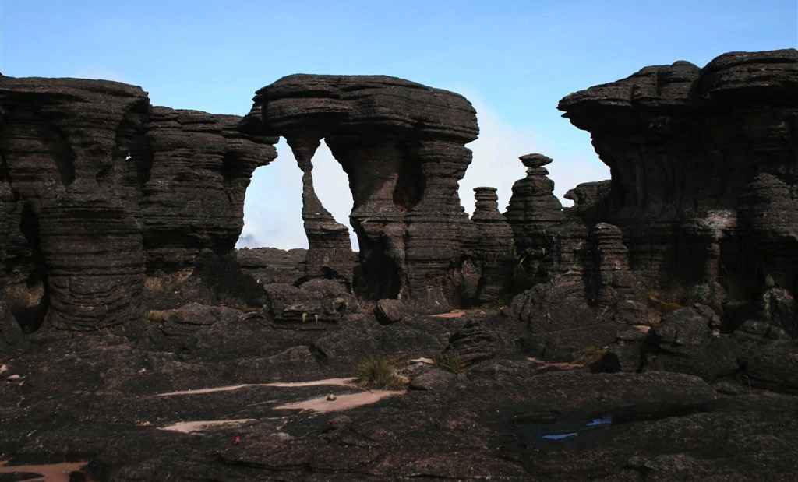
Silica dissolution
Grand Sabana karst, Venezuela
Image Credit: Gerard Vigo

Slide 10
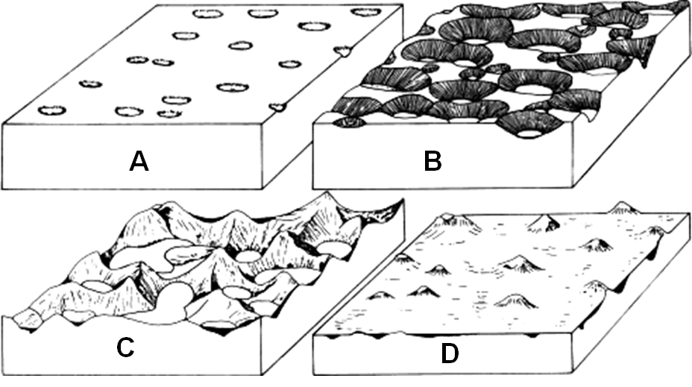
Dissolution landscape development
Pitting → Sinkholes → Polygonal karst →Tower or cone karst
Figure from: Ford and Williams, Karst Hydrogeology and Geomorphology, 2007. Wiley. (Fig 9.63)

Slide 11
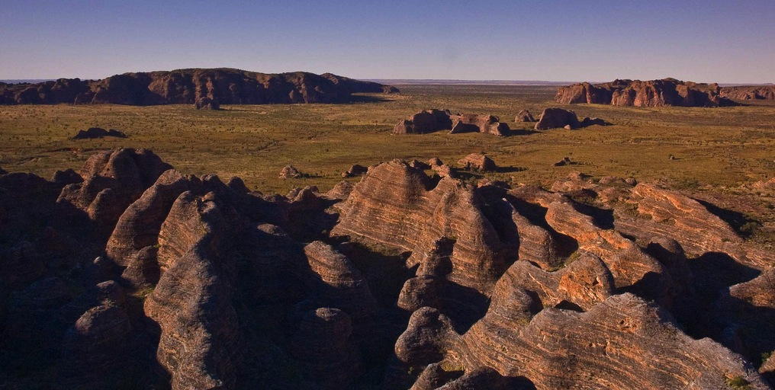
Quartzite Tower karst
Purnululu National Park, Western Australia
Devonian quartz sandstone eroding out to a surrounding sand plain
“the most outstanding example of cone karst in sandstones anywhere in the world’’ - UNESCO
Image credit: Philip Griffin

Slide 12
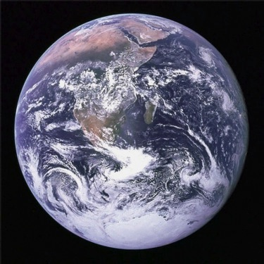
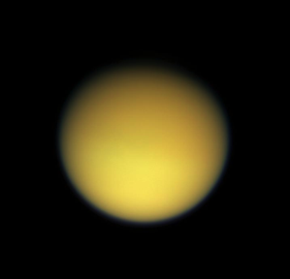
Fluids and materials
Earth (298 K)
Titan (95 K)
H₂O
Halite (NaCl)
Gypsum (CaSO₄•2H₂O)
Limestone (CaCO₃)
Dolomite (CaMg(CO₃)₂)
Silica (SiO₂)_{x}
Methane (CH₄) / N₂
Ethane (C₂H₆)
Propane (C₃H₈)
Acetylene (C₂H₂)
Ethylene (C₂H₄)
Hydrogen cyanide (HCN)
Acetonitrile (CH₃CN)
Acrylonitrile (CH₂CHCN)
Benzene (C₆H₆)
Cyanoacetylene (HCCCN)
Fluids
Materials

Slide 13
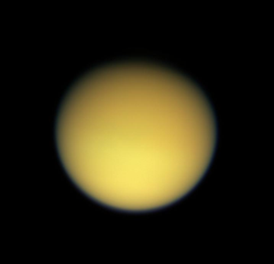
Titan Organic Cycle
Organics and CH₄
Atmospheric photochemistry products
CH₄ condensation
CH₄
evaporation
CH₄ precipitation
Fluvial
transport
Soluble materials
Dissolution?
caves?
subsurface
transport?
Lakes / evaporite playas
Malaska et al., Workshop on the Habitability of Icy Worlds (2014), Abstract 4020.

Slide 14
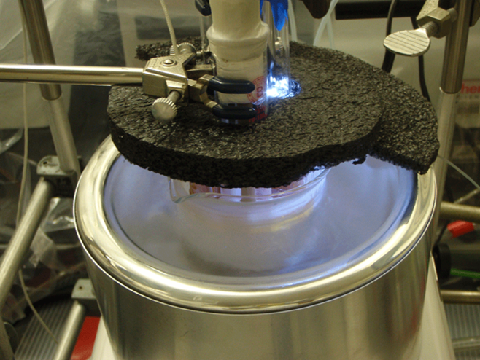
Laboratory experimentation
How soluble are Titan surface materials?
How fast will those materials dissolve at 94 K?
Malaska and Hodyss, LPSC 44 (2013), Abstract 2744.
(Image credit Mike Malaska)

Slide 15
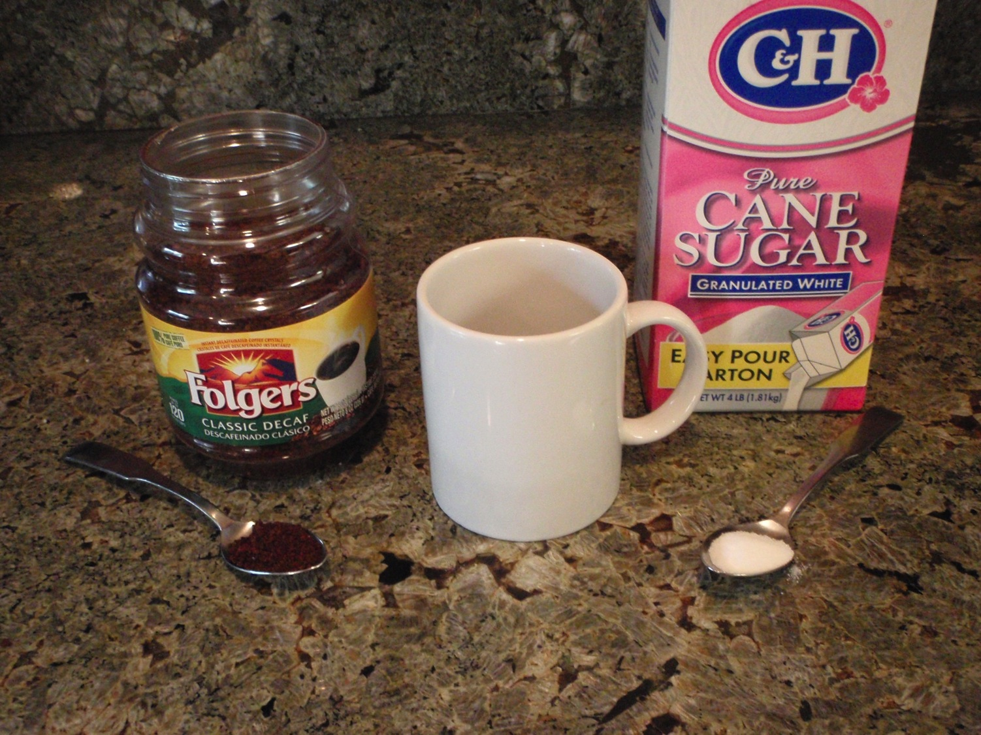
Example: dissolution kinetics of iced coffee at 273 K is slow
How quickly will materials dissolve at 94 K?
Instant coffee
Crystalline sugar
Dissolves fast
Dissolves slow
Image credit Mike Malaska

Slide 16

Example Titan organics
benzene
naphthalene
biphenyl
Benzene detected by INMS: Waite et al., 2007; Vuitton et al, 2008.
Benzene surface detection by VIMS: Clark et al., 2008
Tentative benzene detection by Huygens MS: Niemann et al., 2010.
Naphthalene atmospheric detection by CAPS: Waite et al., 2007.
Polyphenyls (biphenyl is simplest) atmospheric detection by CAPS:
Delitsky and McKay, 2010.
50 cm global layer benzene over 1 Gyr predicted by current Titan atmospheric photochemical models

Slide 17
Laboratory apparatus for cryogenic fluids
Liquid nitrogen
bath cools to
77 K
Interior vessel
“heated” to
94 K
Malaska and Hodyss, LPSC 44 (2013), Abstract 2744.
(Image credit Mike Malaska)

Slide 18
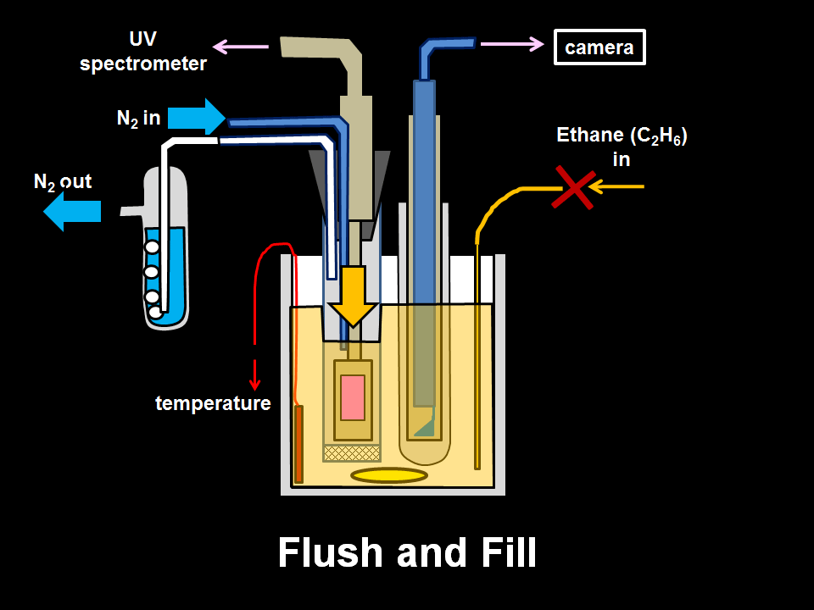
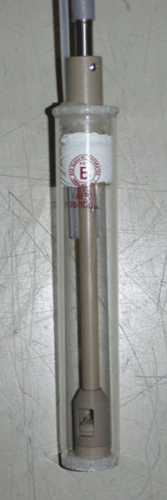
Filter tube
+ UV probe
Malaska and Hodyss, LPSC 44 (2013), Abstract 2744.

Slide 19
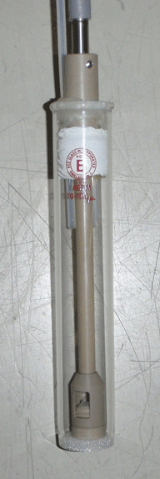
UV probe optical path
Fiber optic cable
UV source
UV
spectrometer
Fiber optic
probe tip
Optical
path length (10 mm)
Mirror

Slide 20
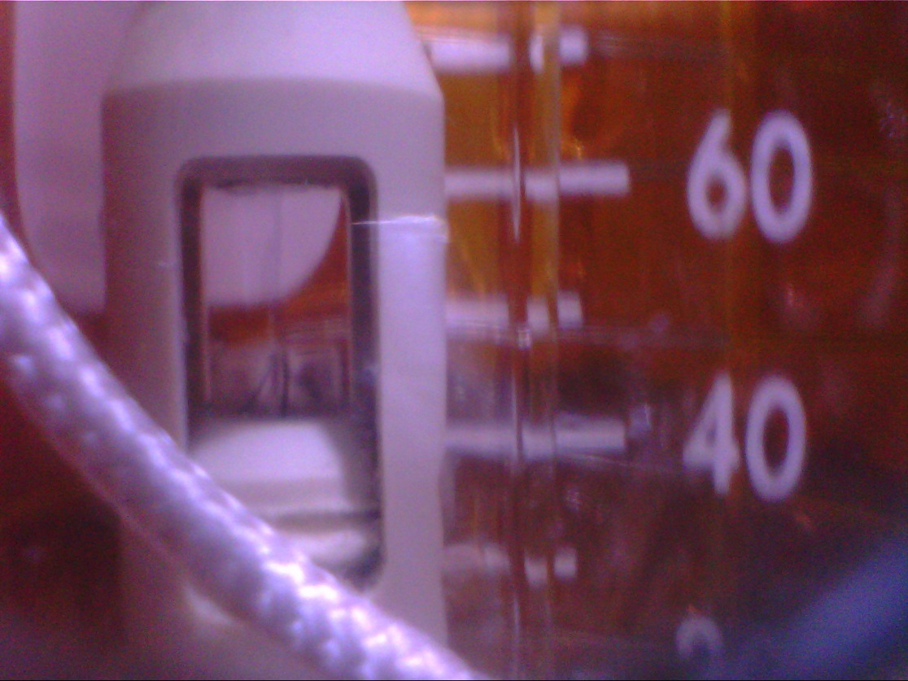
UV probe in liquid ethane at 94 K
Malaska and Hodyss, LPSC 44 (2013), Abstract 2744.

Slide 21
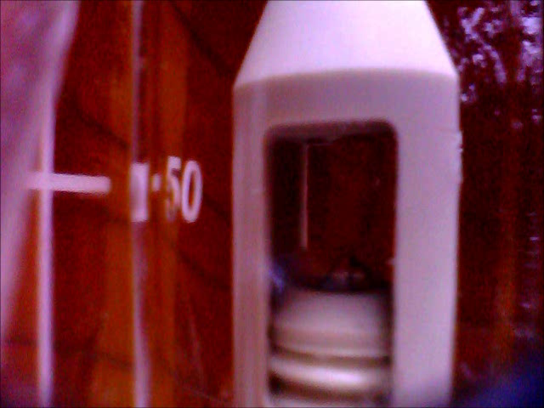
Flush and Fill operation at 94 K
16x actual speed

Slide 22
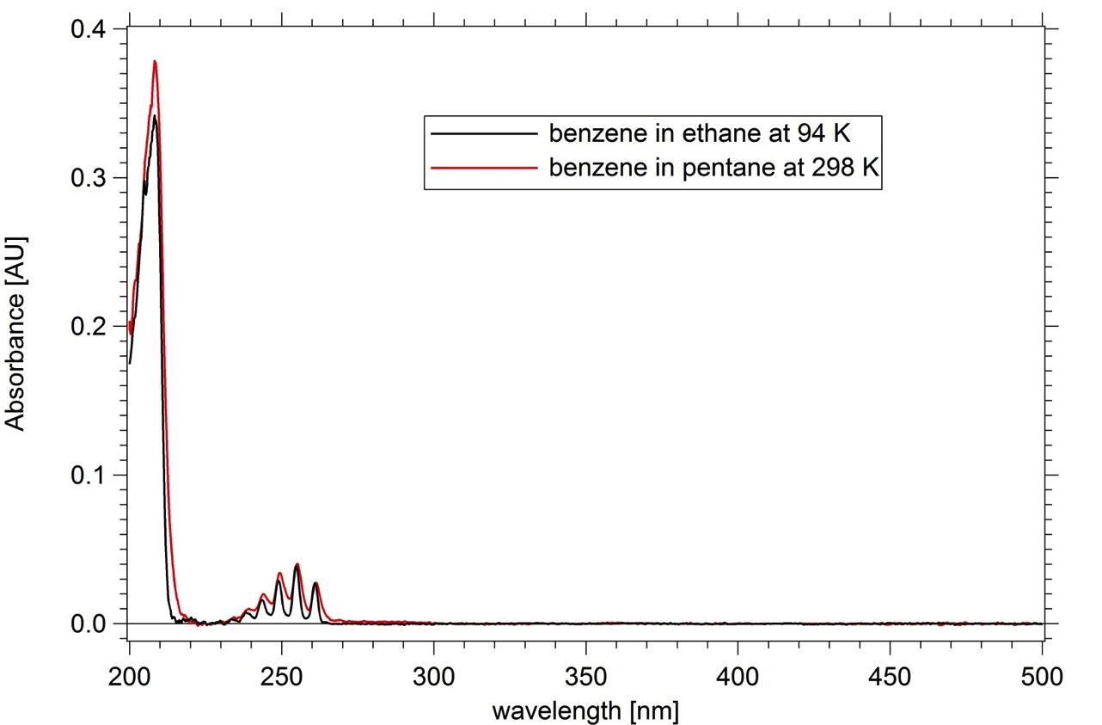
Benzene UV absorbance at 94 K
Comparison between ethane and pentane solutions at different temperatures
21-point calibration curve in pentane used for quantitation
benzene
254 nm
Malaska and Hodyss, Icarus 242 (2014), 74-81.

Slide 23
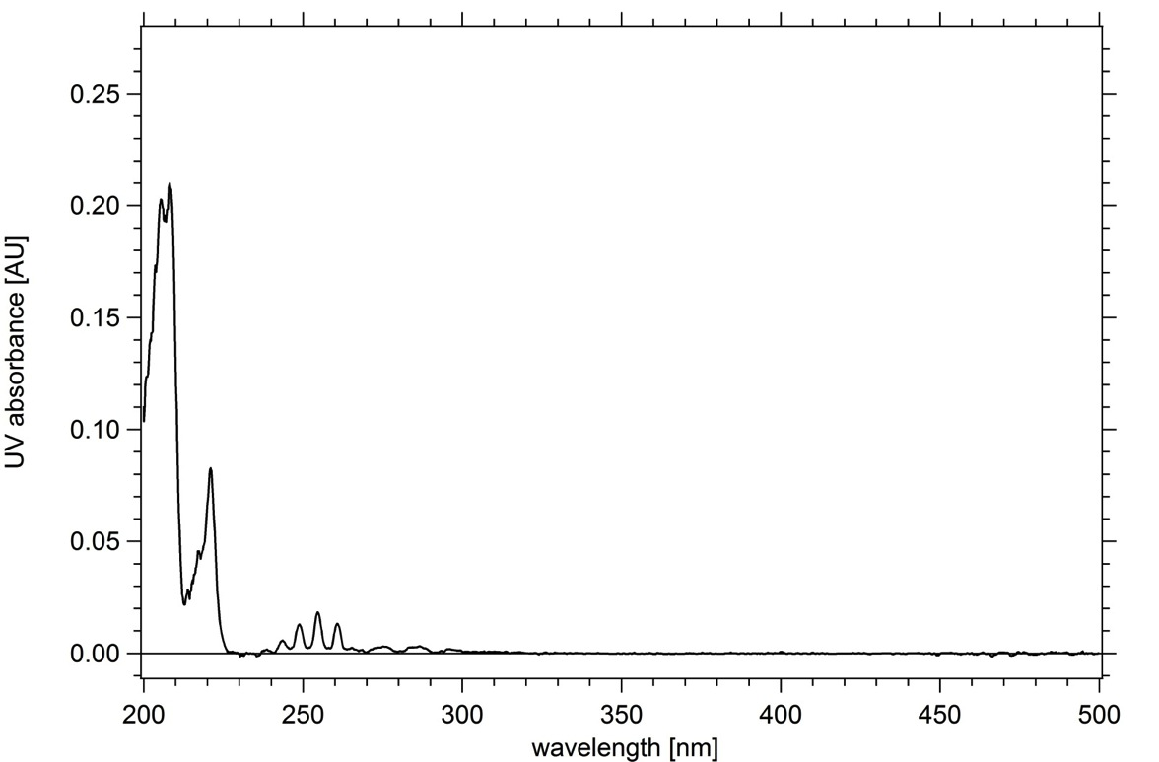
Naphthalene and benzene
Detection of both aromatic molecules in ethane at 94 K
benzene 208 nm absorbance
(not used for quantitation)
naphthalene
220 nm
benzene
254 nm
naphthalene
275 nm
Malaska and Hodyss, LPSC 45 (2014), Abstract 1170.

Slide 24
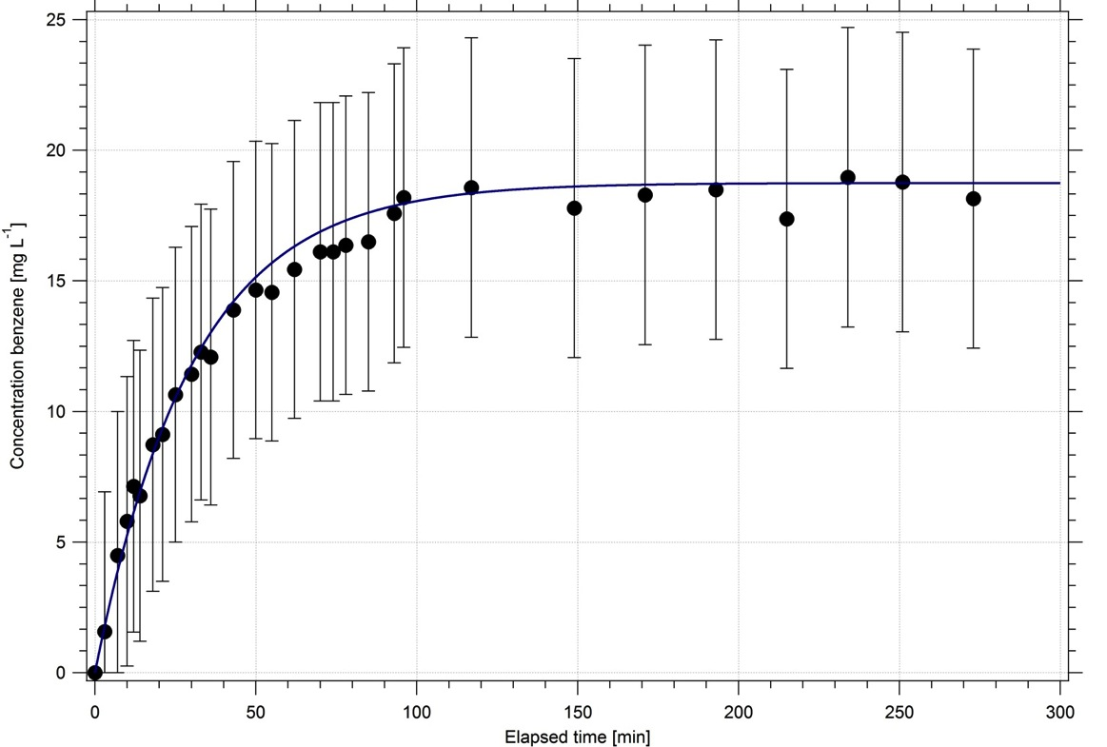

Benzene dissolution is fast at 94 K
Saturation concentration (c_{sat}) and dissolution rate constant (k_{eff}) determined from UV absorbance over time
c_{sat}
$$c\left(t\right)={c_{sat}\left(1−e^{−\left(\frac{k_{eff}At}{Vc_{sat}}\right)}\right)}^{n}$$
c_{sat} = saturation concentration
k_{eff} = effective dissolution rate constant
A = surface area
V = solvent volume
n = kinetic order
t = elapsed time
Malaska and Hodyss, Icarus 242 (2014), 74-81.

Slide 25
Lab results
How much dissolves? c_{sat}
How fast does it dissolve? k_{eff}
saturation
concentration
c_{sat}
[mg L⁻¹]
effective
rate constant
k_{eff}
[mmol m⁻² s⁻¹]
benzene
18.5 (± 1.9)
3 x 10⁻⁶
naphthalene
0.159 (± 0.003)
4 x 10⁻⁸
biphenyl
0.039 (± 0.006)
4 x 10⁻⁹
Malaska and Hodyss, Icarus 242 (2014), 74-81.

Slide 26
Experiment agrees with theoretical values
Measured
value
of benzene in ethane at 94 K [mg/L]:
18.5 mg/L
solubility
Predicted Titan solubility values from Raulin, 1987 and Cordier, 2009. (for HCN)

Slide 27
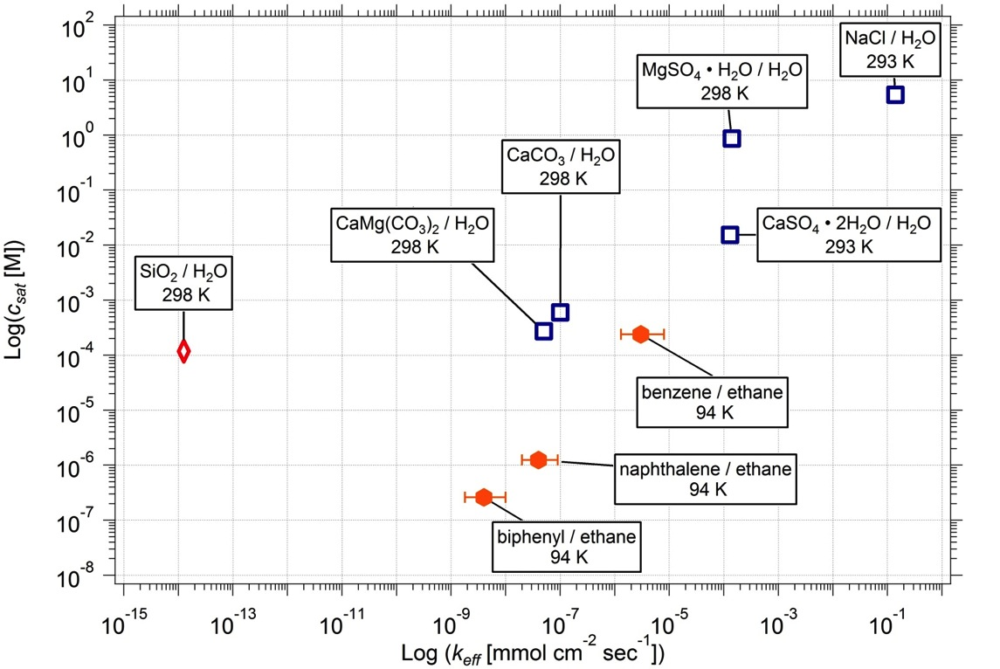
Titan materials geologically soluble
Titan molecules vs. terrestrial karst materials
Estimated
ranges for ethylene,
acetylene,
HCN,
n-butane,
and ethylene in 77% CH₄/N₂
solubility
dissolution rate
Malaska and Hodyss, Icarus 242 (2014), 74-81.

Slide 28
Lifetime of materials in a surface deposit
Surface flux vs. predicted dissolution in CH₄/N₂
Surface flux
high
Surface flux
low
Short timeframe
Solubility
high
ethylene[1]
acetylene
HCN
n-butane,
CO₂
Medium timeframe
Solubility
low
acetonitrile
acrylonitrile
1,3-butadiene
cyanoacetylene
benzene
cyanogen
butadiyne
propyne
Long timeframe
Polymer materials
H₂O
[1] not produced in Krasnopolsky, 2009 model

Slide 29
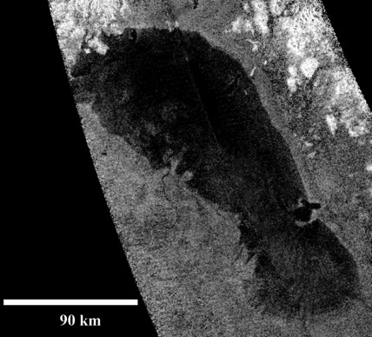
Other implications
Ontario Lacus will be saturated from benzene falling out of the atmosphere
Ontario Lacus surface: 1.5e4 km²
Ontario Lacus depth: 10 m
Ontario Lacus volume: 1.5e2 km³ (= 1.5e14 L)
Benzene atmospheric flux rate [1]: 1e6 molecules cm⁻² s⁻¹
sludge
Benzene saturation at 18.5 mg L⁻¹ reached in 4.5 Myr
[1] Cordier et al, Ap J 707, L128-L131.

Slide 30
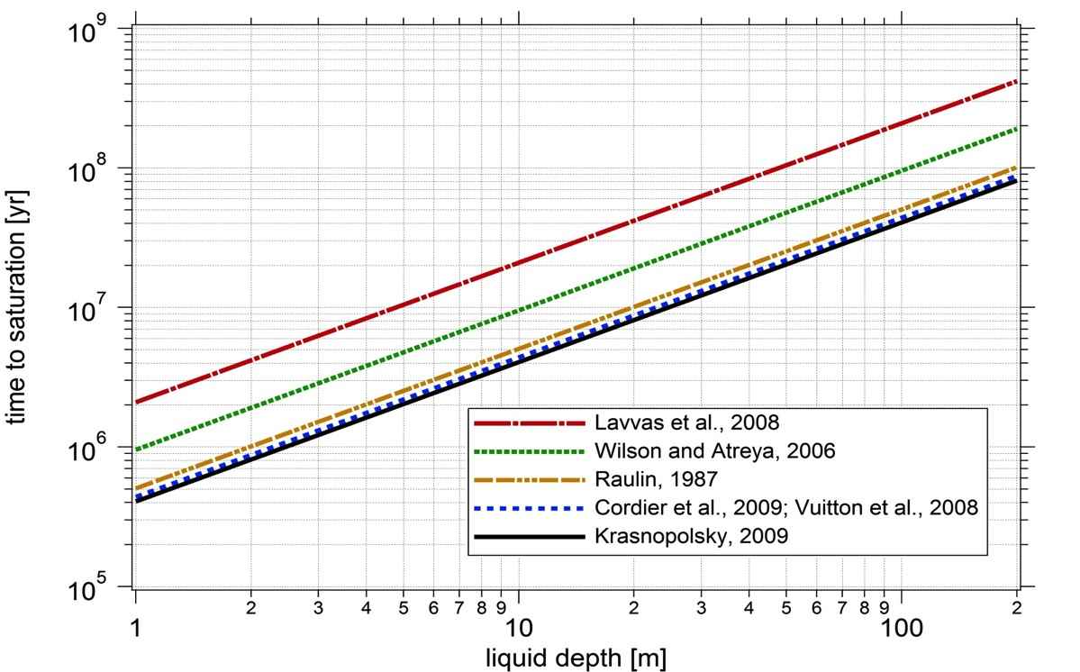
Saturation time of Titan ethane lakes from direct benzene airfall
A 100 m deep ethane lake will saturate in benzene in 100’s of Myr
Malaska and Hodyss, Icarus 242 (2014), 74-81.

Slide 31
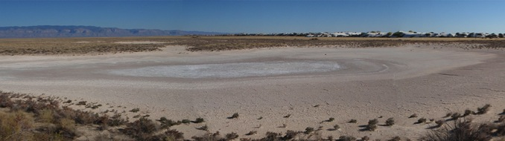
Evaporites on Titan
Transport and concentration of dissolved organic compounds
Terrestrial playa
1) Initial atmospheric chemistry products
2) Dissolution/transport
3) Soluble organics
4) Lakes dry out
5) Materials precipitate

Slide 32
Evaporation of a 10 m deep saturated aromatic-rich ethane → playa deposit
10 m deep ethane
soluble aromatic evaporite load
insoluble clastics
aromatic molecules
213 μm benzene
Saturated 10 m ethane
1.4 μm naphthalene
sludge
sludge
0.4 μm biphenyl
clastic
sludge
Fluvial
transport
Evaporation / precipitation
Evaporite deposit
Malaska et al., Workshop on the Habitability of Icy Worlds (2014), Abstract 4020.

Slide 33
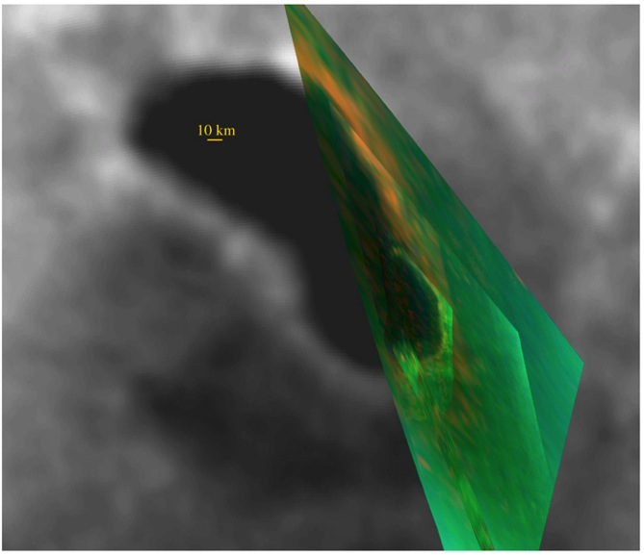
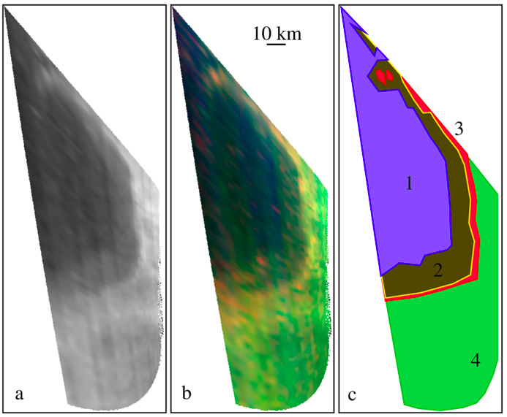
Observed Ontario Lacus evaporite deposits
Hyperspectral imaging shows "Bathtub ring"
Ontario Lacus VIMS cubes from T38
Unit 2 is dark organic mudflat
Unit 3 is 5 micron bright organic evaporite deposit
Reference:
Barnes et al., Icarus 201 (2009) 217-225. "Shoreline features of Titan’s Ontario Lacus from Cassini/VIMS observations." (Fig. 4 and 6)
doi:10.1016/j.icarus.2008.12.028

Slide 34
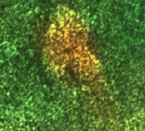
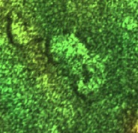
Some Titan dry lakebeds have 5 μm bright evaporite, some don't
SAR radar image + hyperspectral imaging of Titan northern lakes
Dry
Cassini SAR RADAR + VIMS RGB[5 μm, 2 μm, 1.28 μm]
25 km
25 km
Dry lake
+ evaporite
Dry lake only
Closed drainage vs. open drainage?
Barnes et al., Icarus 216 (2011) 136-140. (Figure 2 in text)

Slide 35
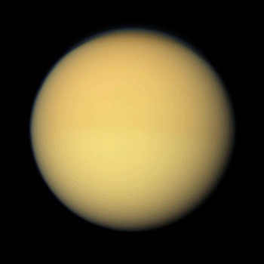
Titan observations
Dry
Evidence for dissolution geology from Cassini RADAR

Slide 36
Geomorphological evidence for dissolution geology on Titan
Karst-like features near Sikun Labyrinthus, Titan [77.9 S, 29.8 W]
Corrosion Plain
Tower Karst
Polje
Big channel
(Mississippi scale)
20 km
Polygonal Karst
Labyrinth Karst
Sapping valleys
36
Notes:
36

Slide 37
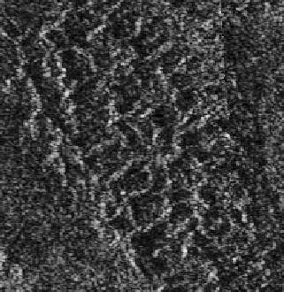
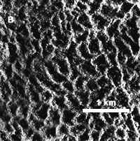
Polygonal Karst-like terrain on Titan
Closed valleys
Structural control of valleys
A
10 km
Polygonal Karst-like terrain,
Ecaz Labyrinth,
Titan [83ºS, 38ºW]
Polygonal Karst,
Darai Hills, Papua New Guinea,
Earth [6.8ºS, 143.3ºE]
(figure reproduced from [1])
[1] Williams, GSA Bulletin 82 (1972) 761-796.

Slide 38
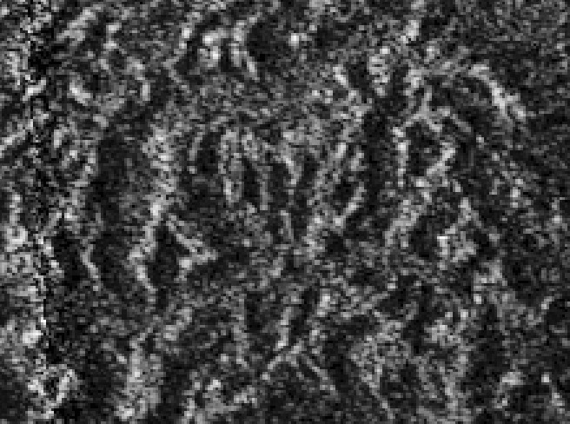
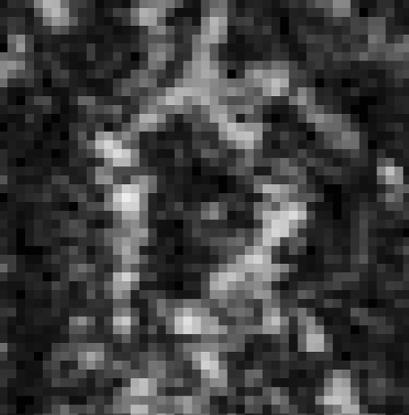
Closed valleys diagnostic for karst
Sikun Labyrinth, Titan
10 km
"Karst is always developed when dolines are found and so they can be considered index landforms of karst…" [1]
[1] Ford, D. and Williams, P. "Karst Hydrology and Geomorphology" (2007), Wiley, Chichester, Great Britain.

Slide 39
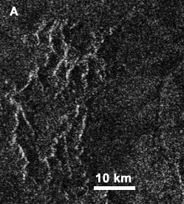
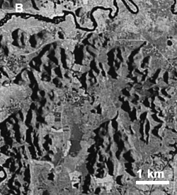
Tower Karst^{[1]}-like terrain on Titan
Tower Karst-like terrain,
Sikun Labyrinth region,
Titan [80ºS, 32.3ºW]
Tower Karst, Tanpaixiang, Guangxi Province, China Earth [23.4ºN, 108.8ºE]
(Google Earth image)
[1] U.S. EPA. "A Lexicon of Cave and Karst Terminology with Special Reference to Environmental Karst Hydrology" (2002 Edition). U.S. EPA/600/R-02/003, 2002.

Slide 40
Titan Labyrinth Terrain analog?
Purnululu National Park, Western Australia
Devonian quartz sandstone eroding out to a surrounding sand plain
“the most outstanding example of cone karst in sandstones anywhere in the world’’ UNESCO
Image credit: Philip Griffin

Slide 41
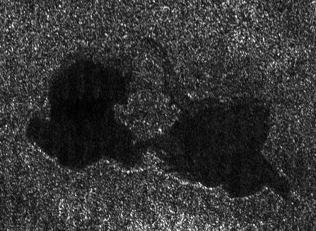
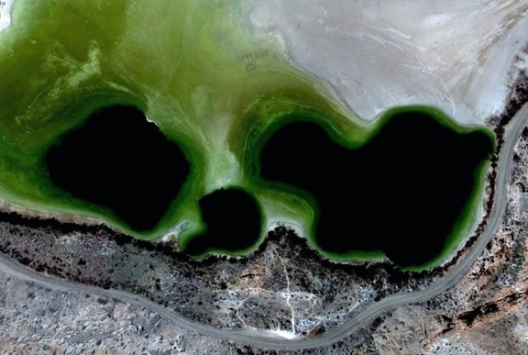
Titan similarities to Earth sinkhole lakes
SAR RADAR image of hydrocarbon karst-like lake on Titan
Titan
Earth
10 km
0.1 km
Abaya Lacus
"Kissing Lakes" T16 SAR
Titan [73ºN, 47ºW]
Lazy Lagoon in a gypsum plain,
Bottomless Lakes State Park, NM
Earth [33.3ºN, 104.3ºW]
(Google Earth image)

Slide 42


Dissolution geology on Titan
Theoretical calculations?
Yes
Laboratory simulation?
Yes
Observed evaporite deposits?
Yes
Geomorphological evidence?
Yes
Copyright 2010 Mike Malaska

Slide 43
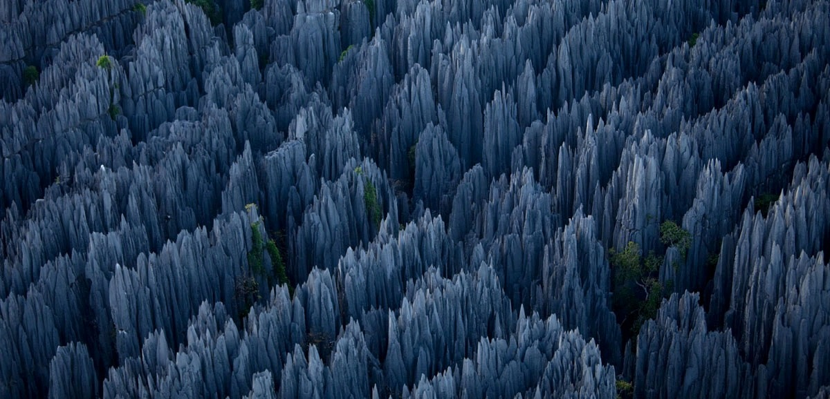
Planetary dissolution geology
– a general process?
Circulating fluids [Example: H₂O – hydrocarbons]
Soluble matrix [Example: salts – organic molecules]
Solvent exposure [fluid flux X duration]

Slide 45
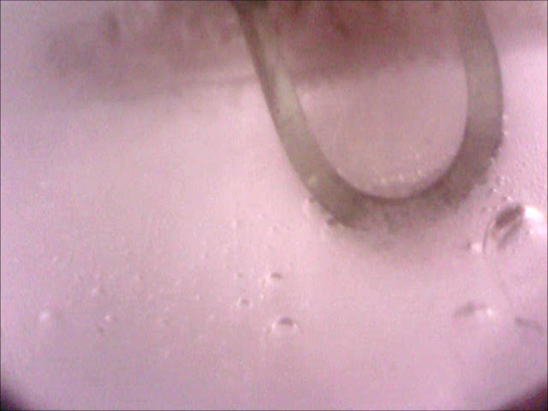
Outtake
What happens when apparatus heater connections fail?
→ Ethane freezes around 90 K
16x actual speed
(Fiber-optic ATR
probe)
Ethane freezes from the bottom, like a normal material.
Dissolved N₂ exsolvates and bubbles out.

