Slide 1
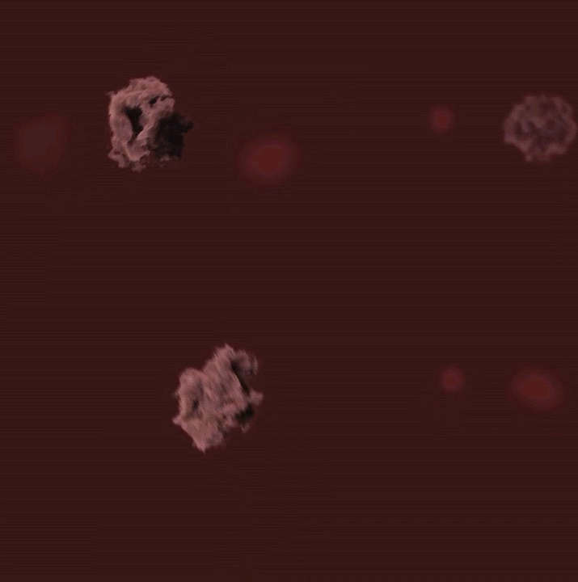
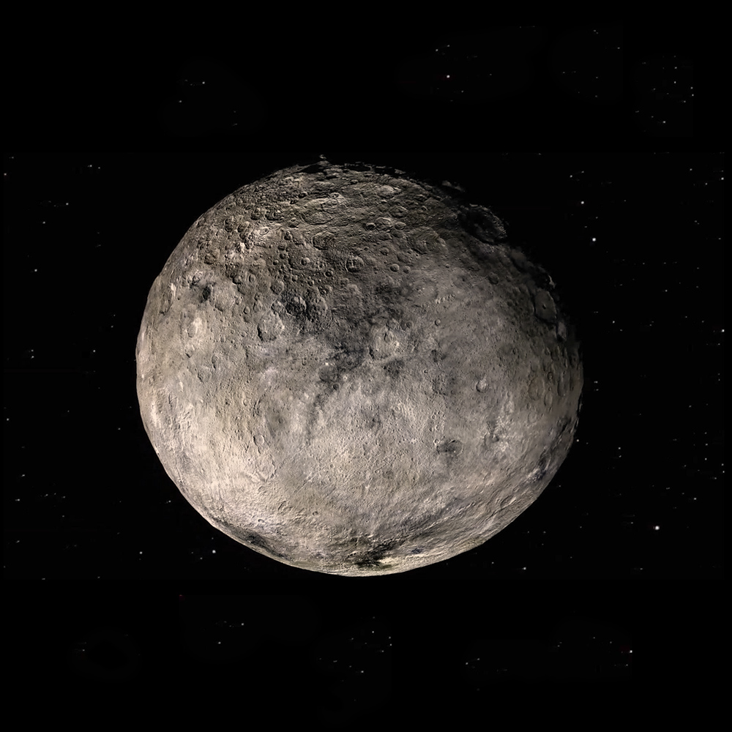
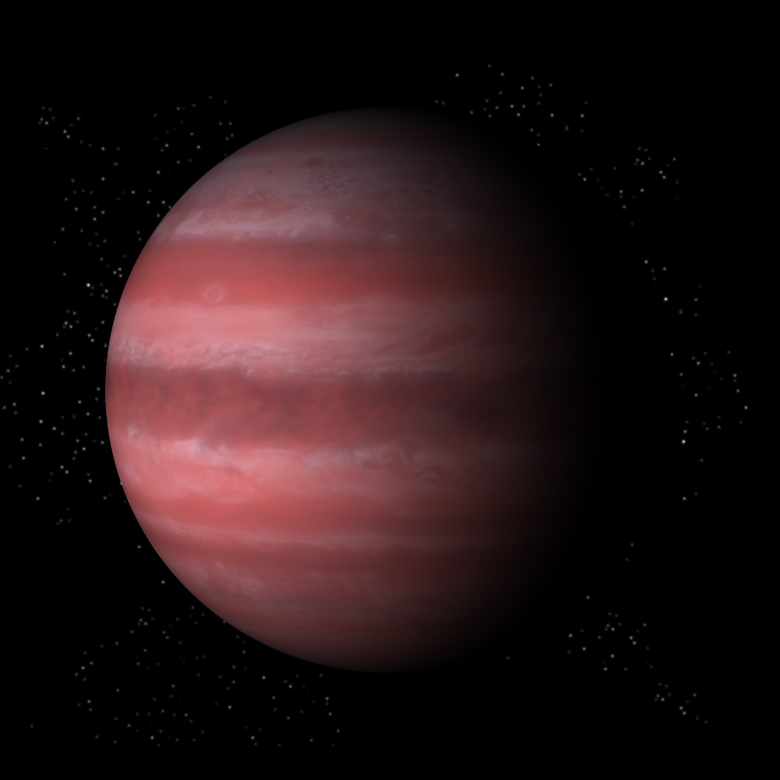
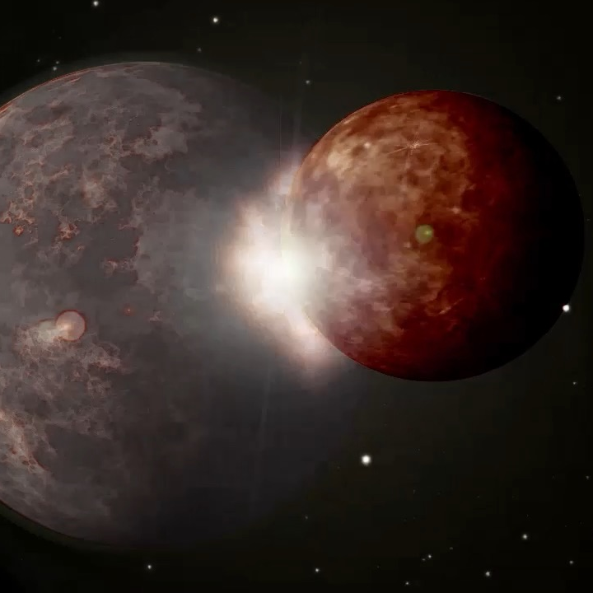
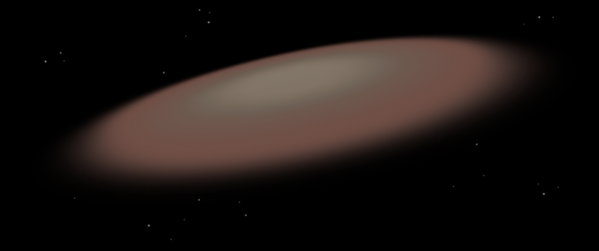
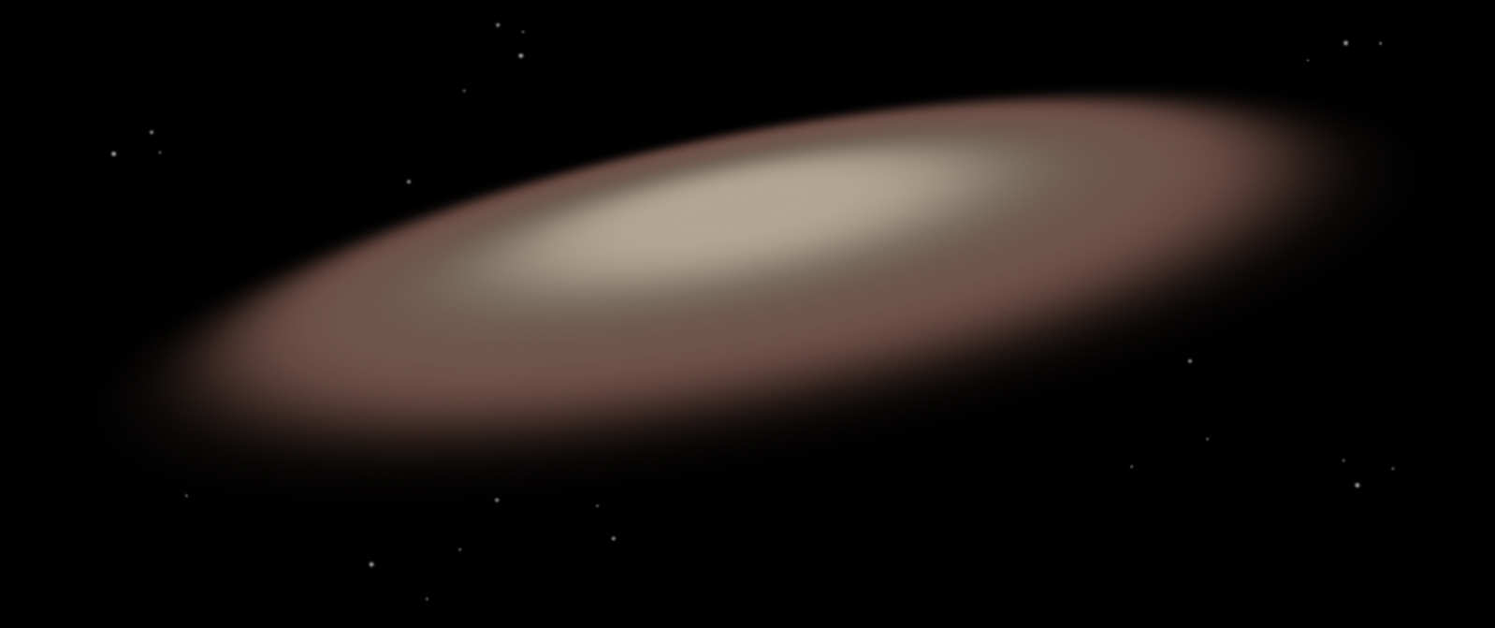
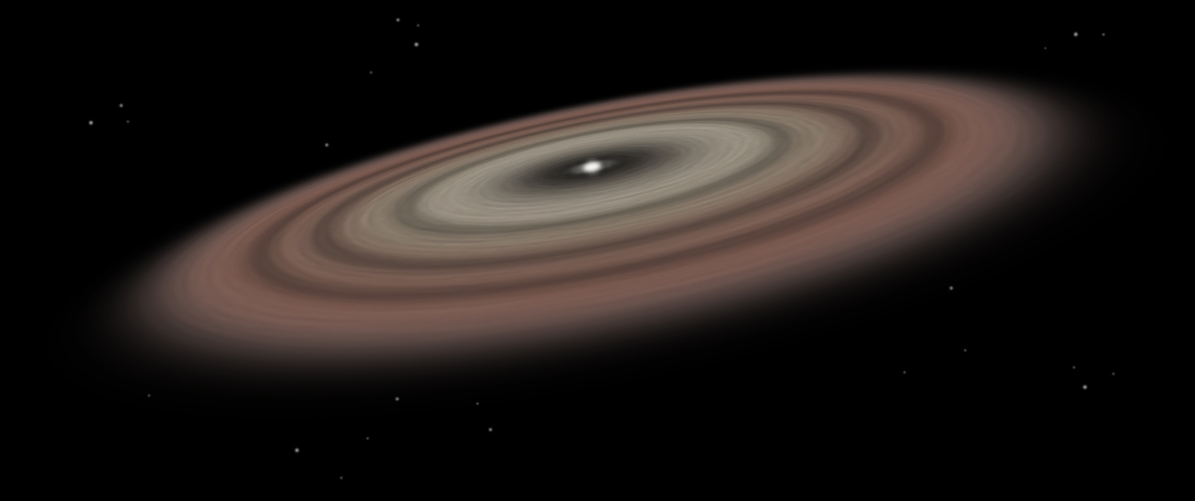
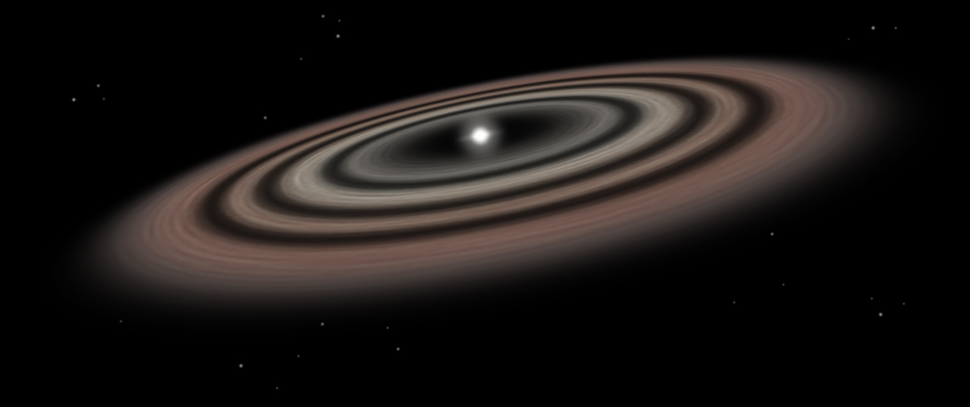
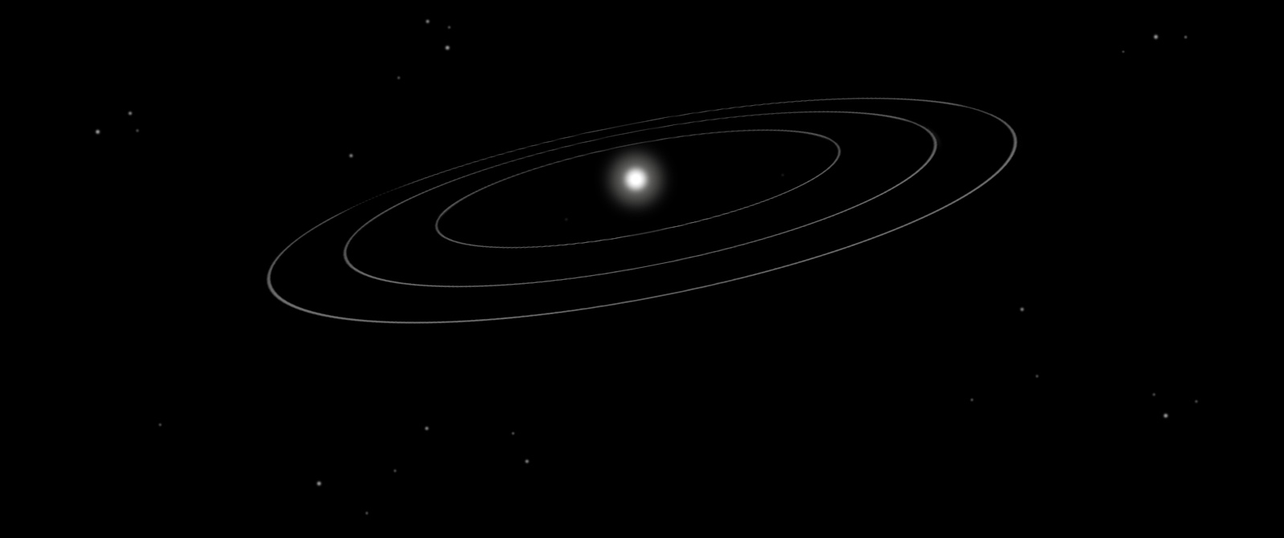
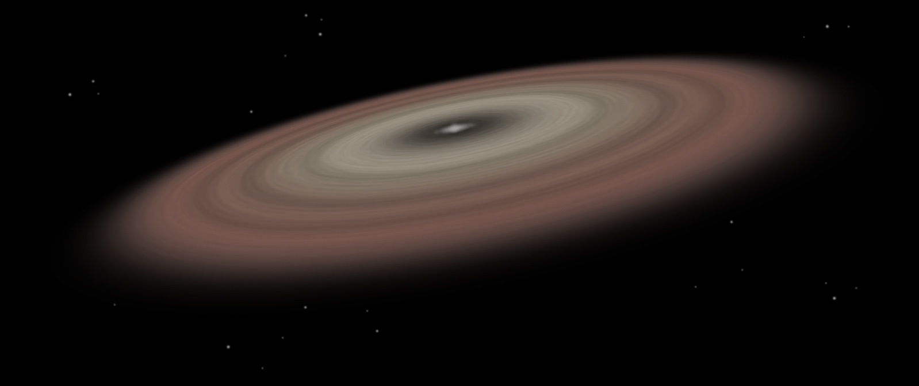
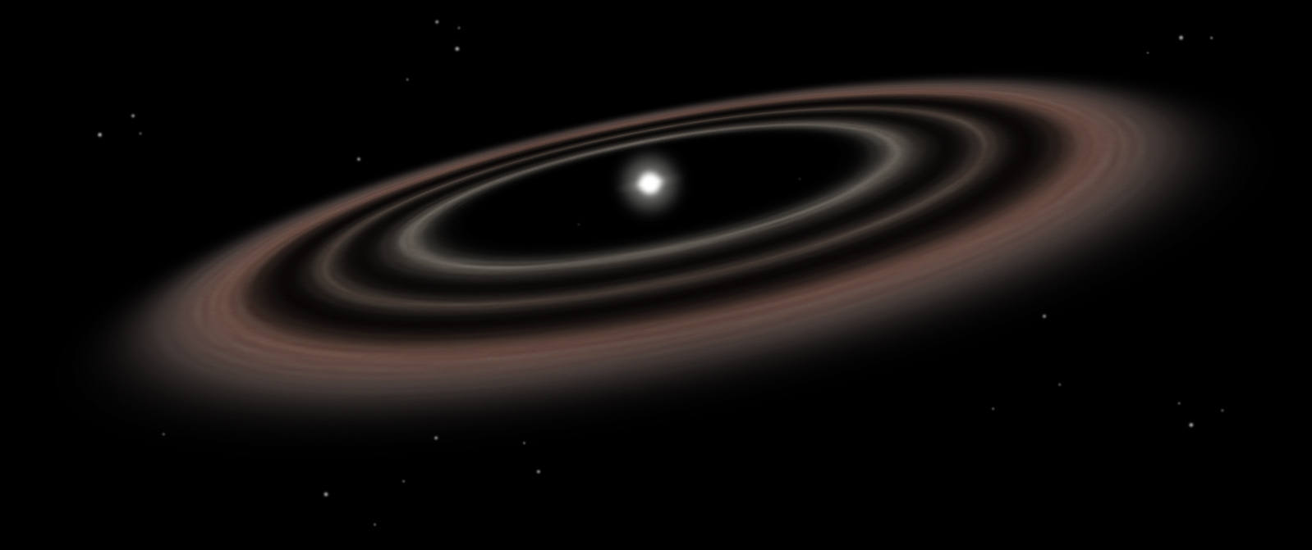
Planet Formation – from Dust to Planets
Exoplanet Communications
00
0
2
7
4
Giant planets
Formation timescale: 1-10 million years
Planet formation is complete
Timescale: ~ a few 100 million years
Protoplanets: embryos of planets
Size: ~ 1000 km or larger
Planetesimals: Building blocks of planets
Size: ~ a few km to a few 100 km
Astronomical dust
Size: ~ 0.1 micron to ~ a few mm
Protoplanetary disks: Birthplace of planets
Lifetime: 1-10 million years
Rocky, terrestrial planets
Formation timescale: 10-100 million years
6
8
exoplanets.nasa.gov
Notes:
Planet Formation Audience: 9th Grade and older.
Description:
This slide illustrates how planets form from dust in a few hundred million years. Steps illustrated include planetesimal, protoplanets, giant and rocky planets.
Click #1: Astronomical dust
Click #2: Planetesimals
Click #3: Protoplanets
Click #4: Giant planets
Click #5: Rocky, terrestrial planets
Click #6: Planet formation is complete

