Slide 1
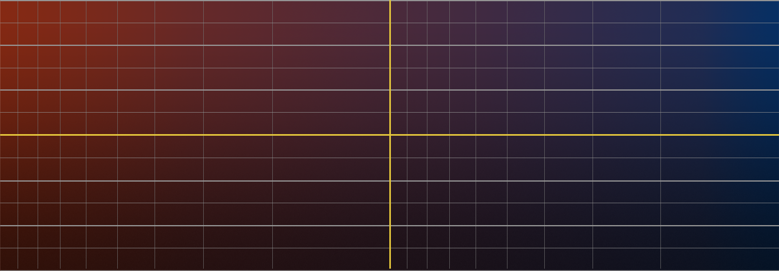
TRAPPIST-1 & Solar System Comparison
Exoplanet Communications
1.3
More
1.2
Solar System
Habitable Zones
TRAPPIST-1
1.1
b
c
Earth
g
Earth
Venus
d
e
f
Planet Density
(relative to Earth)
Mars
h
1.0
Mercury
0.9
Moon
Hot
Cold
0.8
10x
6x
4x
2x
1x
0.6x
0.4x
0.2x
0.1x
Less
Earth Illumination
Illumination from Host Star
(relative to Sun/Earth)
exoplanets.nasa.gov
Notes:
TRAPPIST-1 & Solar System Comparison Audience: 9th Grade and older.
Description:
This slide explains and illustrates what a "habitable zone" is, and how it would change based on the size of the host star.
User's notes: The represented Scale of Sun and planets are greatly exaggerated. Depending on its size, a star can be "whiter" or "redder" - as it was approximately reflected in this slide. However, the exact color of each of the three sizes of star in these slides is not accurate; the focus of these slides is to explain the "Habitable Zone" and how it changes based on the size of the hosting star.
NOTE: This PowerPoint file has built-in interactive elements. To view them, you must be in "Slide Show" mode; you can then move to the next view either by clicking your mouse, the spacebar, or the arrow keys. This slide will not work in "regular viewing mode."
Based on existing artwork
Click #1: TRAPPIST-1 planets overlay
Click #2: All planets move into position by density

