Slide 1
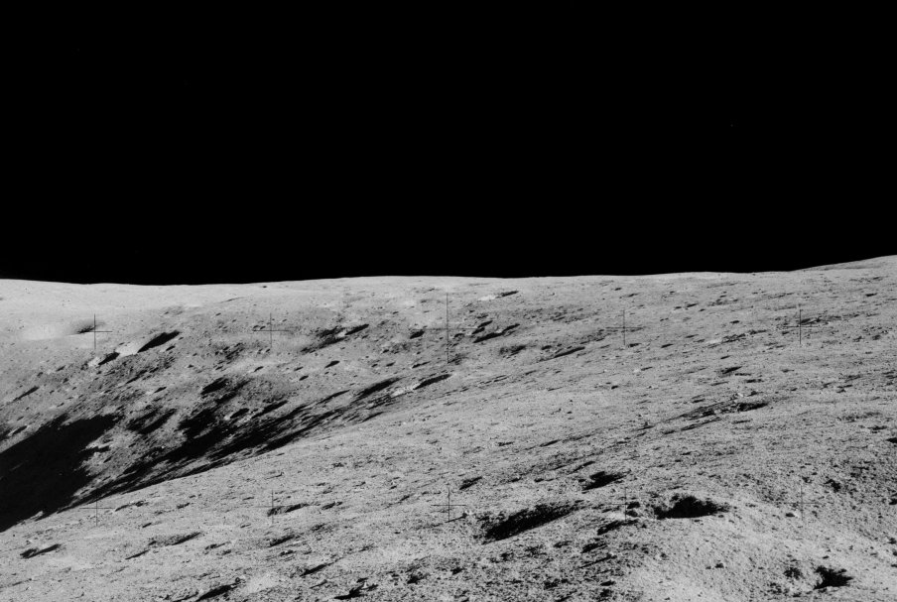
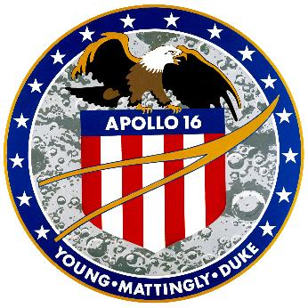
Apollo 16
Presenter’s name
Presenter’s title/position
Notes:
-Image credit: NASA → Taken by Charlie Duke during EVA-1, showing the east rim of Flag crater. Image ID: AS16-109-17781 → https://www.hq.nasa.gov/alsj/a16/AS16-109-17781.jpg
-For mission patch image, see https://history.nasa.gov/apollo_patches.html
-Note: This presentation provides a brief overview of the Apollo 16 mission to the Moon and thus does not include everything; however, links to support further research are included at the end.
-Tips:
You do not need to use everything in this presentation!
Feel free to alter/edit this presentation to fit your specific needs/audience
-Updated January 2023

Slide 2
NASA Press Releases
Notes:
-NASA press releases (April 1972): https://historydms.hq.nasa.gov/sites/default/files/DMS/e000013882.pdf

Slide 3
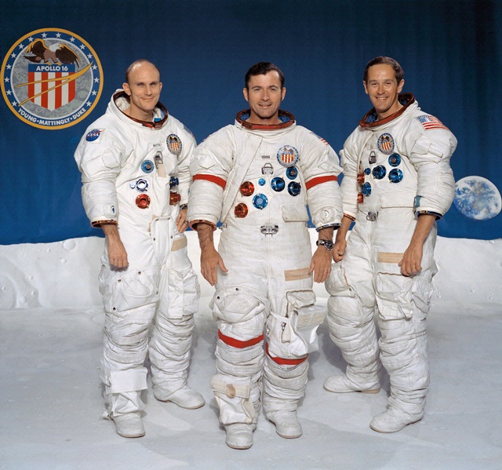
Overview
April 16-27, 1972
Thomas “Ken” K. Mattingly II
Command module pilot
John W. Young
Commander
Charles M. Duke, Jr.
Lunar module pilot
Notes:
-Image credit: NASA → The Apollo 16 prime crew mission portrait. From left: Thomas “Ken” Mattingly II (command module pilot), John Young (commander), and Charles Duke, Jr. (lunar module pilot).
-Fifth human Moon landing: Young and Duke landed on the lunar surface on April 20, 1972, at 9:23pm EST, with the first extravehicular activity beginning on April 21, 1972, at 11:47am EST.
-Apollo 16 was the second of the so-called J missions, which considerably expanded the capabilities for doing science on and near the Moon.
-The mission plan for Apollo 16 had several objectives for the crew to accomplish: perform geological inspection, survey, and sampling of materials and surface features in a preselected area of the Descartes region; emplace and activate surface experiments; and conduct inflight experiments and photographic tasks.
-John Young was the mission commander and was the pilot of Gemini 3, backup pilot for Gemini 6, command pilot on Gemini 10, backup command module pilot for Apollo 7, command module pilot for Apollo 10, and backup commander for Apollo 13.
-Ken Mattingly was the command module pilot and had been scheduled to be command module pilot on Apollo 13 but was replaced by his backup (Jack Swigert) because he had been exposed to the measles.
-Charlie Duke was the lunar module pilot and was backup lunar module pilot on Apollo 13.
-After their Apollo careers, both Young and Mattingly flew on the shuttle during NASA’s Space Shuttle program.

Slide 4
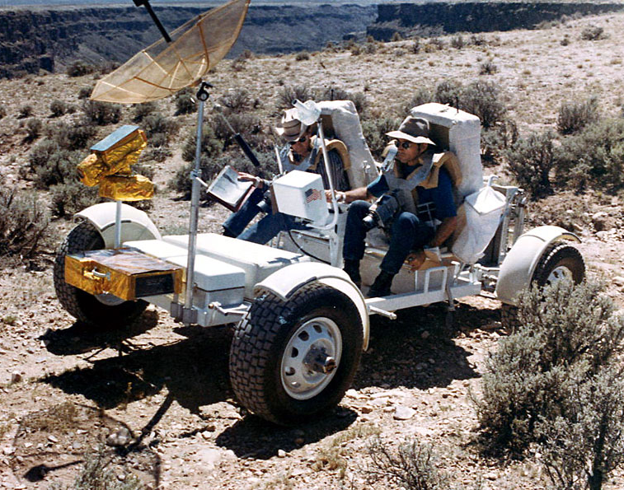
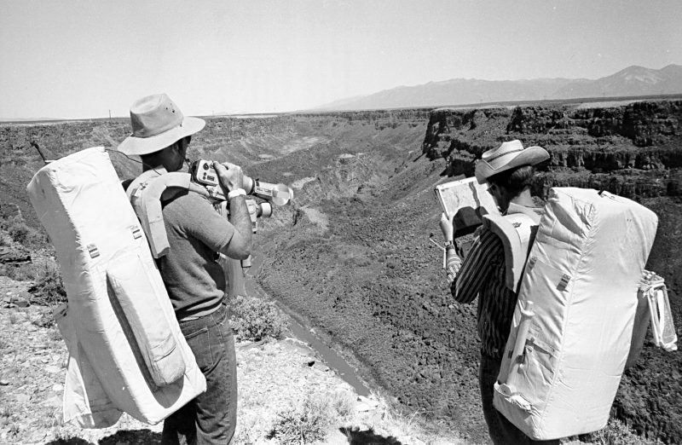
Surface Experiments on the Moon
Field Training on Earth
Notes:
-Image credits: NASA
Left: Charlie Duke (left) and John Young (right) driving the GROVER Geologic Rover built by the U.S. Geologic Survey during the Sept. 8-10, 1971, geology field trip to the Rio Grande Gorge near Taos, New Mexico. Image ID: S71-51616.
Right: John Young (left) and Charlie Duke (right) explore the Rio Grande Gorge at Taos, New Mexico during geology training. They are standing on the western rim. Young is taking pictures of the east wall with a Hasselblad equipped with a 500mm lens while Duke studies a map. Image ID: 71-H-1547.
-To prepare for their exploration of the Moon and to gain firsthand experience with a diversity of geologic formations, the Apollo 16 astronauts underwent a variety of field training.
Based on the assumption that the Descartes landing site had volcanic origins, geology training exercises focused on terrestrial sites believed to have similar pasts.
In June 1971, the prime and backup commanders and lunar module pilots John Young, Charlie Duke, Fred Haise, and Ed Mitchell traveled to the Mono Craters area – a volcanic chain consisting of craters, domes, and lava flows in eastern California – to assess the terrain. Assisted by geology principal investigator Bill Muehlberger of the University of Texas and a team of geologists, the astronauts explored the lava domes at the site, taking photographs and samples.
In July 1971, the astronauts explored the Sudbury Basin in Ontario, Canada, a meteorite impact area long misinterpreted as volcanic in origin, taking photographs and samples.
During the Sept. 8-10, 1971, geology field trip to the Rio Grande Gorge near Taos, New Mexico, for the first time, the astronauts used the GROVER, the Geologic Rover built by the U.S. Geologic Survey as a ground-based version of the Lunar Roving Vehicle that the astronauts drove on the Moon.
During this training session, the astronauts simulated an actual lunar surface traverse, using photography and sampling techniques similar to those conducted during an actual moonwalk. Astronaut Anthony W. England acted as capsule communicator during the exercise, as he would during the mission. Command module pilot Ken Mattingly utilized aerial photography of the site to correlate overhead imagery with what Young and Duke observed on the ground.
-More info: https://www.nasa.gov/feature/50-years-ago-nasa-selects-landing-site-for-apollo-16

Slide 5
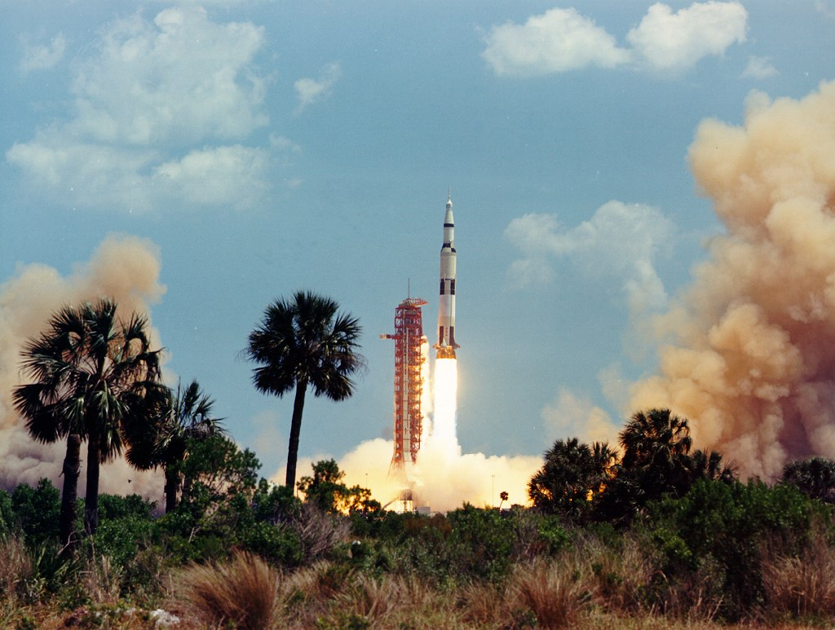
Launch
Launch
Notes:
-Image credit: NASA → Apollo 16 liftoff. Image ID: S72-35345.
-The 363-foot-tall Apollo 16 space vehicle launched from Pad A, Launch Complex 39, Kennedy Space Center, at 12:54 p.m. EST on April 16, 1972.
-More about the launch: https://history.nasa.gov/afj/ap16fj/01_Day1_Pt1.html

Slide 6
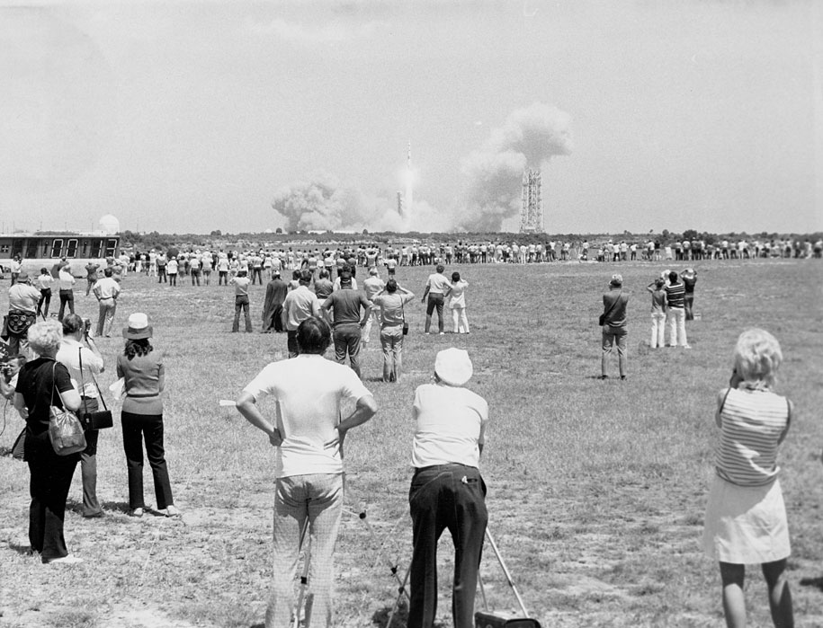
Launch
Larry Summers
Notes:
-Image credit: NASA → A view of the Apollo 16 launch from the press site. Image ID: 72-H-451.
-As with the previous Apollo crewed missions, adjacent to Kennedy Space Center (~3.5 miles away), thousands of spectators camped out on beaches and roads to watch the launch of Apollo 16. Nearly 2,000 accredited people from the media covered the mission.

Slide 7
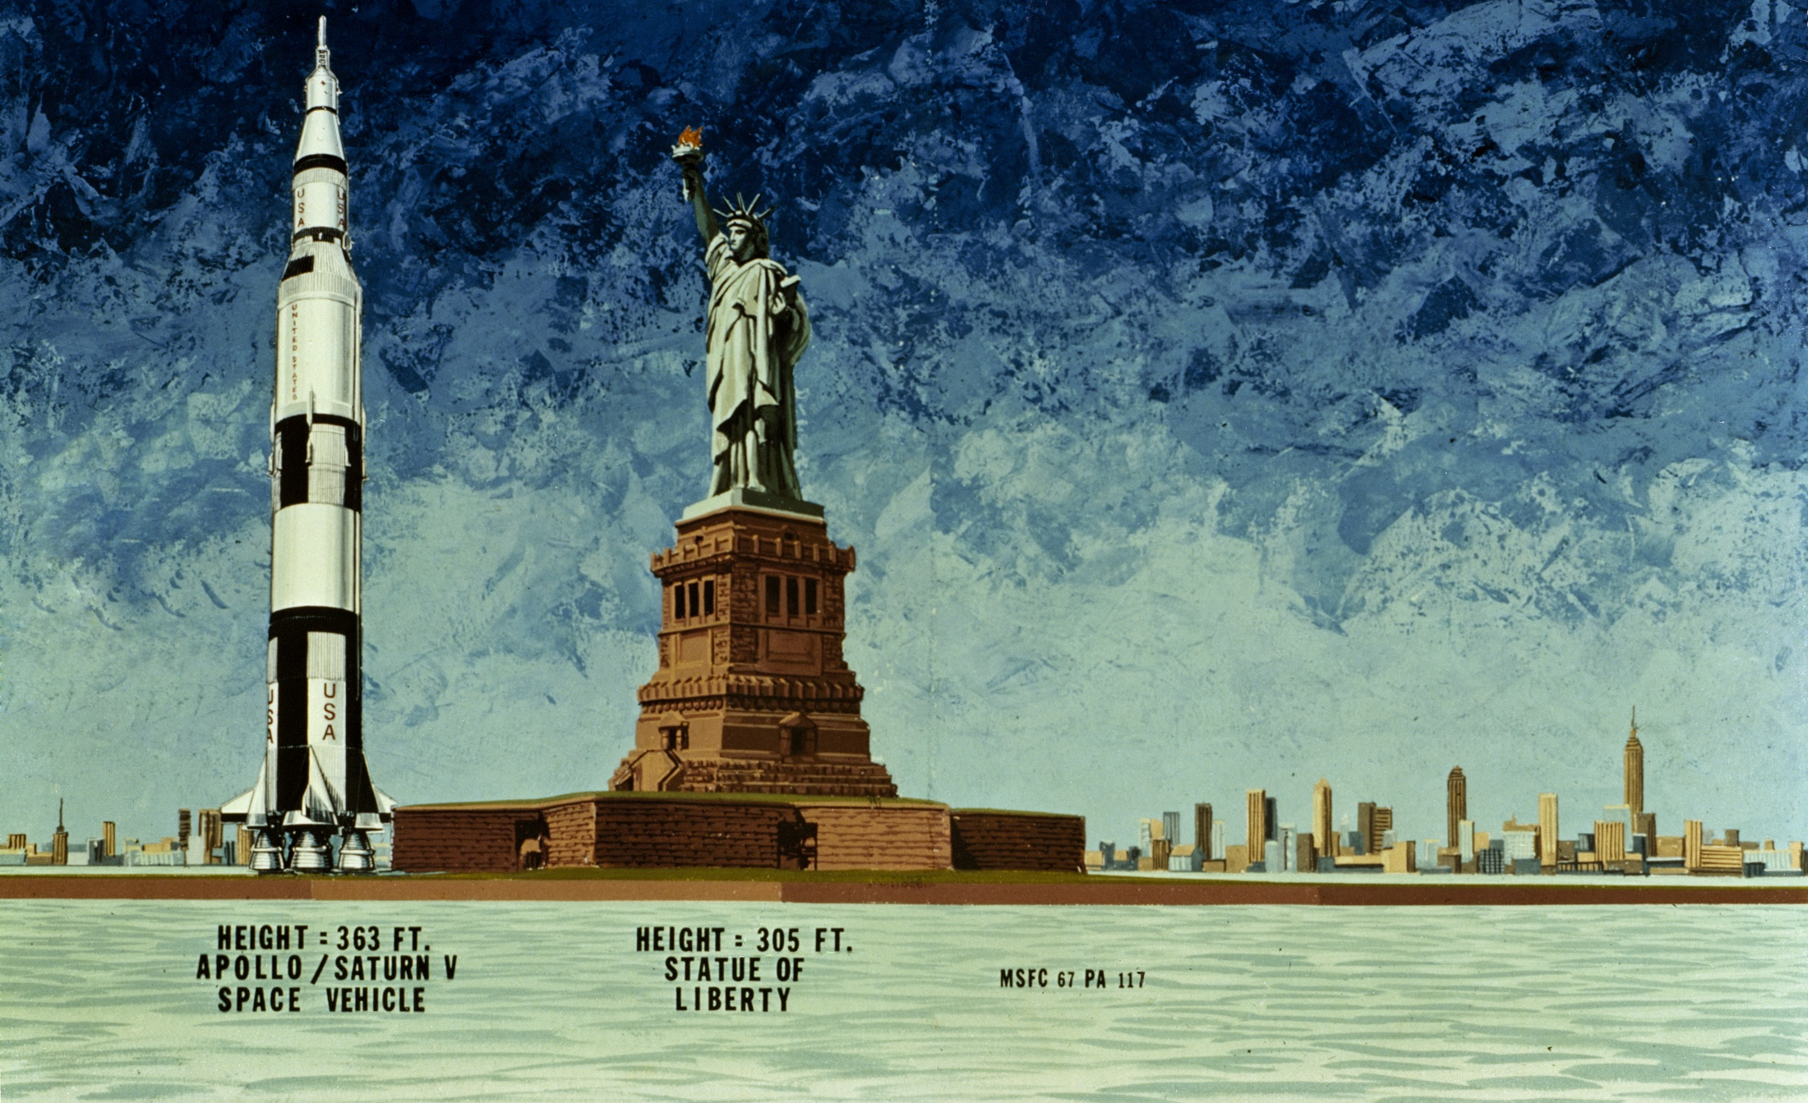
Saturn V Size Comparison
Notes:
-Image credit: NASA → 1967 illustration compares the Apollo Saturn V spacecraft (363 ft) of the Moon Landing era to the Statue of Liberty (305 ft).
-A Saturn V rocket has 3 stages, 11 powerful rocket engines, and huge tanks for kerosene (RP-1) and liquid hydrogen and oxygen. It’s still the largest crewed rocket ever flown and the only one to carry humans beyond Earth orbit.
Height: 111 meters (363 feet)
Diameter: 10 meters (33 feet)
Mass: 2,840,622 kg (6,262,500 pounds) at liftoff (about 100 fully loaded tractor-trailers – only 1% of this actually goes to the Moon)
Maiden Flight: Nov. 9, 1967 (uncrewed)
The rocket generated 34.5 million newtons (7.6 million pounds) of thrust at launch, creating more power than 85 Hoover Dams.
Could launch about 43,500 kg (50 tons) to the Moon (about the same as 4 school buses).
The Apollo 16 launch vehicle was the eleventh in the Apollo Saturn V series and was the ninth crewed Saturn V vehicle.
More info on Saturn V: https://solarsystem.nasa.gov/news/337/what-was-the-saturn-v/

Slide 8
Apollo Spacecraft Design
Apollo Spacecraft
Orion Lunar Module
Casper Command Module
Thrusters
Command Module
Service Module
High-Gain Antenna
Thrusters
Thrusters
Descent Stage
Ascent Stage
Notes:
-Image credit: NASA → Diagram of the combined Apollo command and service module/lunar module translunar coast configuration.
-The lunar module was named Orion while the command module was named Casper for Apollo 16.
-Source: https://history.nasa.gov/afj/ap13fj/04day1-end.html

Slide 9
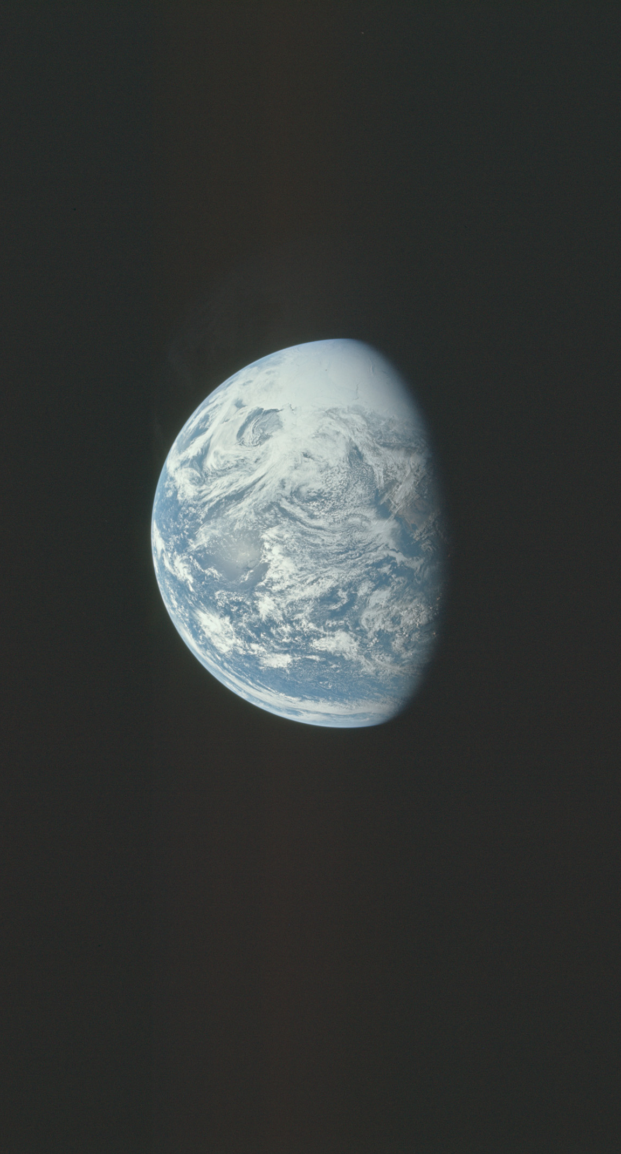
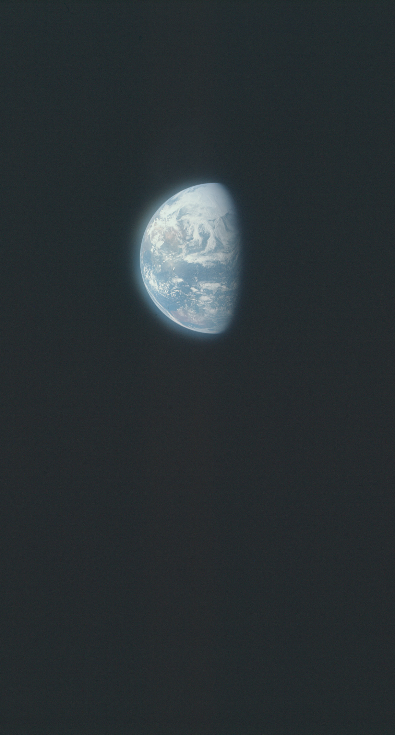
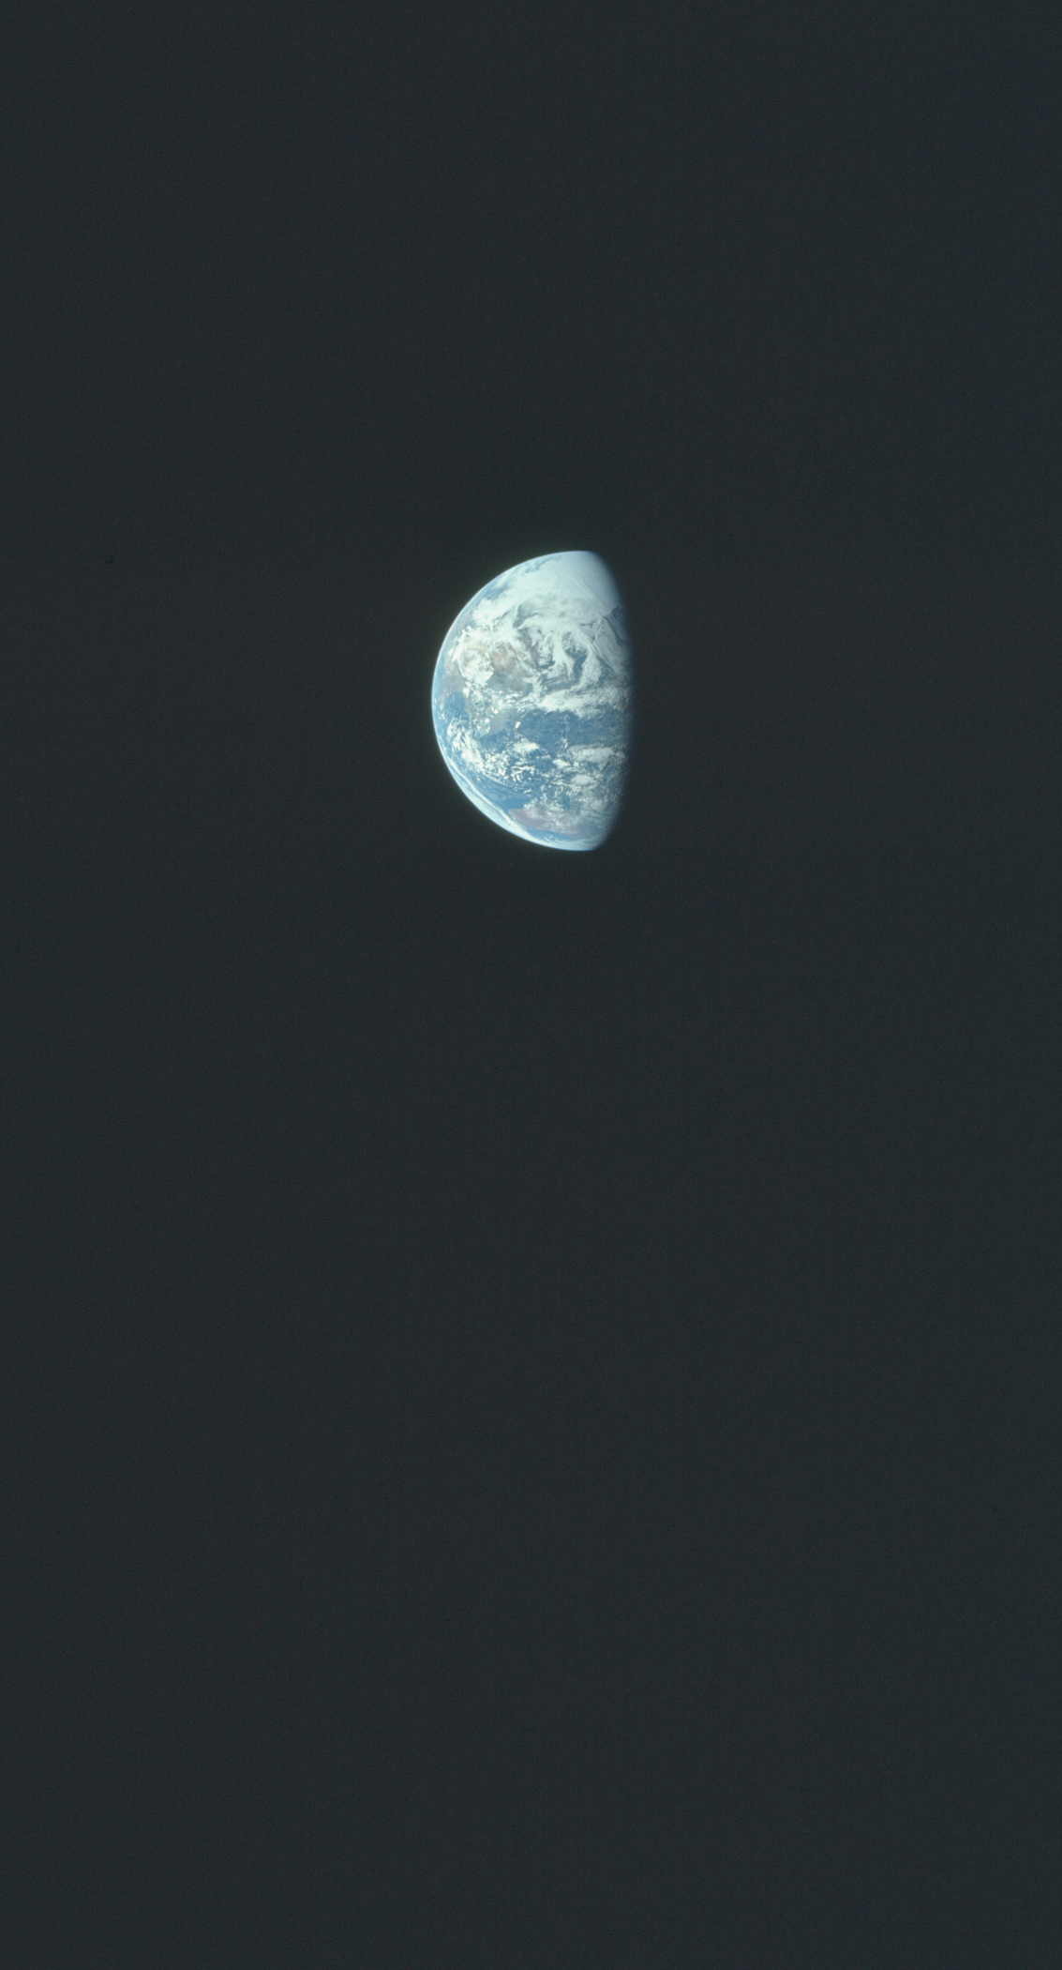
Surface Experiments on the Moon
Moon Bound
Notes:
-Image credits: NASA → Views of Earth during translunar coast (outbound journey to the Moon), with Earth growing steadily smaller as the astronauts ventured farther and farther away. The images were taken with a UV filter. Image IDs from left to right: AS16-118-18887, AS16-118-18888, AS16-118-18889.
Left image: Taken at about 7 hrs 20 min after launch, when the crew was roughly 68,000 km from Earth – looking at the Pacific Ocean with the West Coast of the U.S. near the terminator (line between light and dark).
Middle image: Taken at 12 hrs 20 min, when the crew was roughly 110,000 km from Earth – Australia and Asia are visible.
Right image: Taken about a half hour after the middle image.
-Transcript from the Apollo 16 Flight Journal: https://history.nasa.gov/afj/ap16fj/05_Day1_Pt5.html#012_57_51
After taking some images of Earth, the crew starts their Passive Thermal Control (PTC or barbecue roll) which involves them rotating the spacecraft in order to maintain proper temperatures.
Charlie Duke and John Young look at Earth out the window and mention it to the Mission Control Capsule Communicator (CapCom) Don Peterson in the following exchange:
013 10 51 (time elapsed since launch) Duke: Hey, Don.
013 10 53 Peterson: Go.
013 10 58 Peterson: Go ahead, Duke.
013 11 03 Duke: You would really love this sight. We’re - as we rotate around now, we’ve got the Earth out the window Number l, and it’s about – oh, almost – not quite down to half. And you can see India and the continent, and it’s covered with clouds, and no photograph can ever describe the way it looks. It’s really super.
013 11 27 Peterson: It really sounds fantastic. Wish I were there.
013 11 31 Duke: Yes, sir. You would love it.
013 11 36 Young: You can see all of Australia, too. It’s really something else.
013 11 41 Peterson: About what size does the Earth look from where you are?
013 11 55 Young: Looks like it’s about – it’s approximately 4,000 miles in radius.
013 12 00 Peterson: Hey, that’s a pretty good estimate.
013 12 04 Duke: No, it’s – it didn’t quite fill the window. Well, I’m not – I’m about – I’m about three – my eyes are about three feet from the window, and it didn’t quite fill it.
013 12 15 Peterson: Roger.
013 12 25 Duke: You know, a sight like that goes a long ways to make tomato soup taste good.
013 12 30 Peterson: Yeah, that’s what I’ve heard.

Slide 10
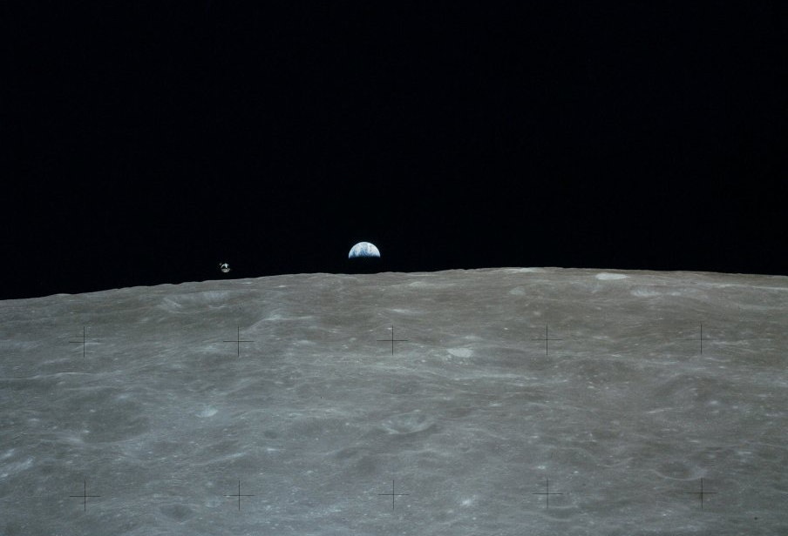
Surface Experiments on the Moon
Apollo 16 Earthrise
Notes:
-Image credit: NASA → This pre-landing photo shows the Earth rising above the lunar surface, with the command module visible just above the lunar horizon to the left of Earth. Image ID: AS16-113-18289.

Slide 11
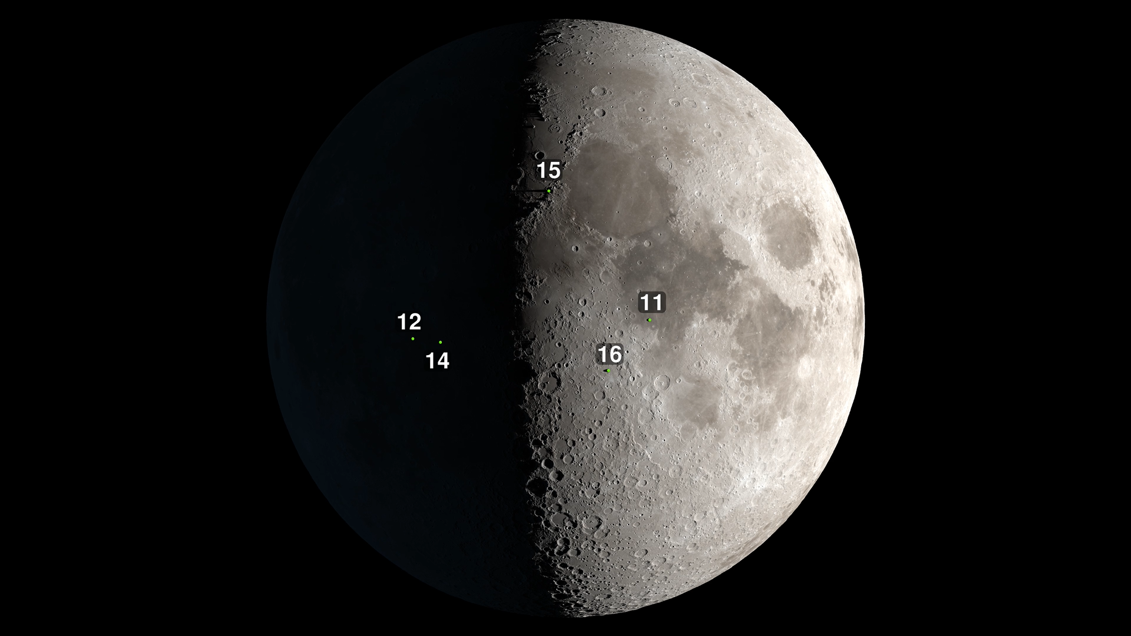
Apollo 12 Landing Site
Moon on April 20, 1972
Notes:
-Image credit: NASA's Scientific Visualization Studio → The bottom-right green dot marks the site of the Apollo 16 landing in the Moon’s Descartes region. The top-most green dot represents the Apollo 15 landing site, on the eastern margin of the Imbrium Basin. The left-most green dot represents the Apollo 12 landing site, in Oceanus Procellarum (“Ocean of Storms”), and the green dot next to Apollo 12’s landing site is that of Apollo 14 which landed in the Fra Mauro formation. Apollo 11’s landing site in Mare Tranquillitatis is shown as the green dot at the far right.
-The Apollo 16 landing occurred in the Moon’s Descartes highlands region at 9:23pm EST on April 20, 1972.
This was the first Apollo mission to land in the lunar highlands.

Slide 12
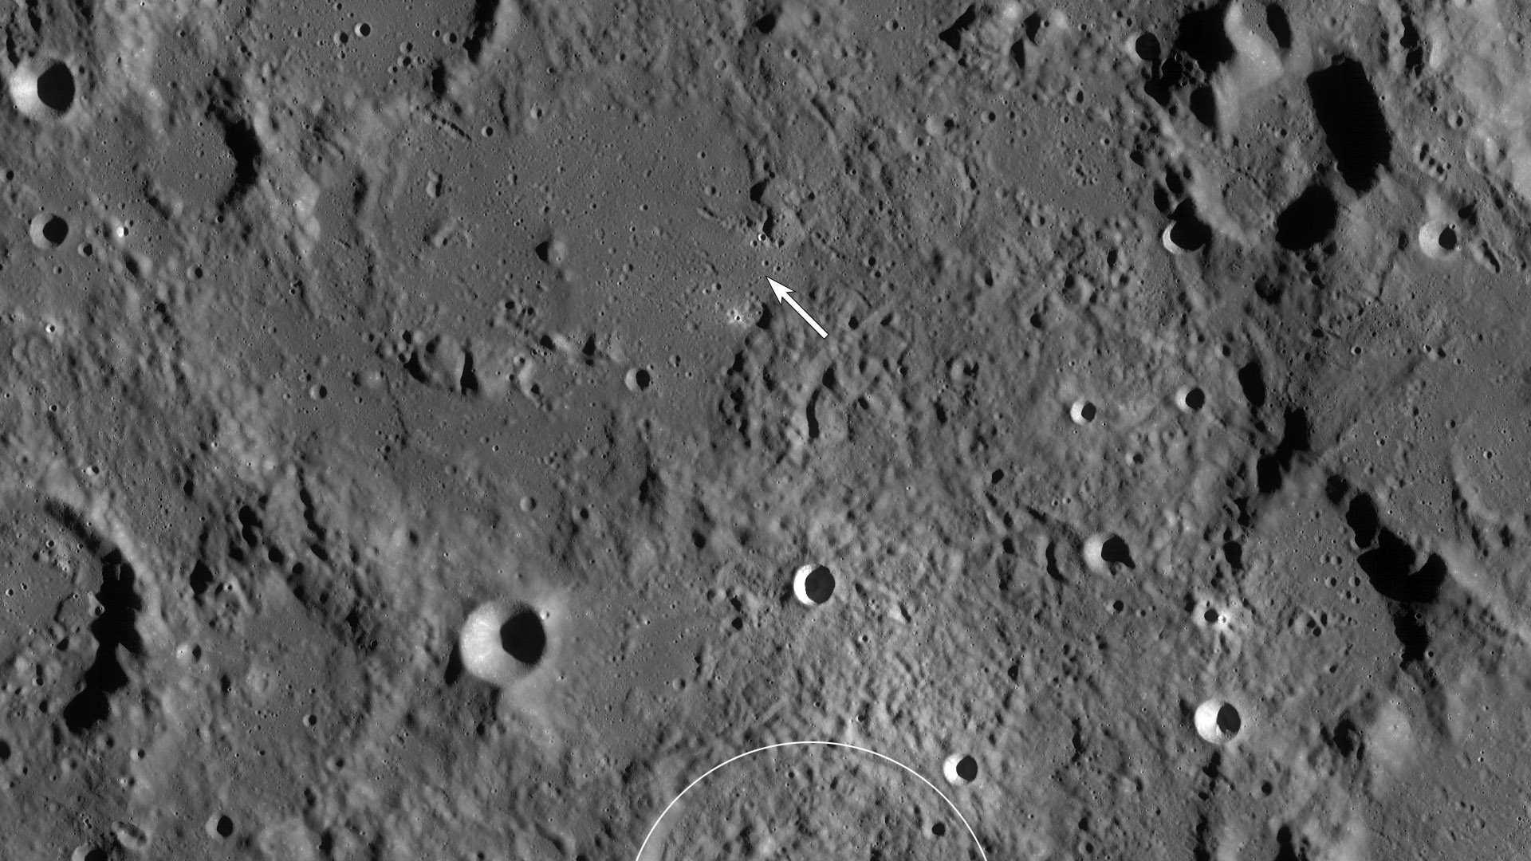
Overview
Descartes Highlands
First and only Apollo mission to the lunar highlands
NASA/GSFC/Arizona State University
Notes:
-Image credit: NASA/GSFC/Arizona State University → Lunar Reconnaissance Orbiter Wide Angle Camera image of the Cayley Plains (smooth areas) and Descartes Mountains surrounding the Apollo 16 landing site (the arrow indicates the position of the lunar module). The white arc at the bottom of the image is the rim of Descartes crater. The image is 192 km x 108 km.
-The Descartes landing site, so-called because of the nearby crater named after 17th century French philosopher and mathematician René Descartes, was the southernmost of all the Apollo landing areas.
-Located in the Moon’s central highlands, the area appealed to geologists as it represented the first location in the lunar highlands to be sampled.

Slide 13
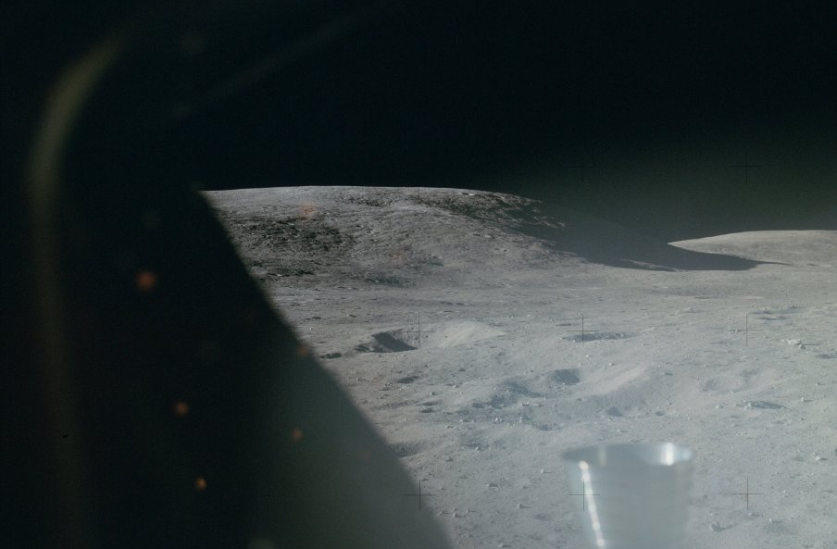
Pete Conrad stepping on the lunar surface
“Old Orion is finally here,
Houston. Fantastic!”
Notes:
-Image credit: NASA → This image was taken shortly after landing, through the windows of the lunar module, and provides a view to the south of Stone Mountain. Image ID: AS16-113-18296.
-Delayed Moon landing:
The powered descent to the lunar surface was delayed by approximately 5.75 hours. This was because of oscillations detected in a backup yaw gimbal actuator on the service propulsion system (SPS) engine during systems checks for the orbit circularization maneuver (command module pilot Ken Mattingly needed to make an SPS burn in order to put himself in a circular, 60-mile-high orbit in which he would perform three days of observations and from which, if necessary, he could maneuver to rendezvous with the lunar module in the event of an emergency lift-off).
A rendezvous was performed to place the lunar module and command-and-service module in close proximity while the problem was being evaluated. Tests and analyses showed that the redundant system was still usable and safe, had it been needed. Therefore, the lunar module and command module were separated again, and the mission continued on a revised timeline.
-One consequence of the landing delay was a postponement of the first extravehicular activity. Young and Duke had planned to perform a full, eight-hour EVA after landing. According to the original flight plan, at the end of the first EVA, they would have had a 21.5-hour day. In order to perform the EVA after the delayed landing, they were looking at a 27.5-hour day, and Flight Director Gerry Griffin was unwilling to test the crew’s endurance to that extent. This then resulted in a necessary adjustment to all the checklists and timelines.
-Upon landing on the lunar surface, Charlie Duke exclaimed: “Old Orion is finally here, Houston. Fantastic!”
-More info: https://history.nasa.gov/alsj/a16/a16.landing.html

Slide 14
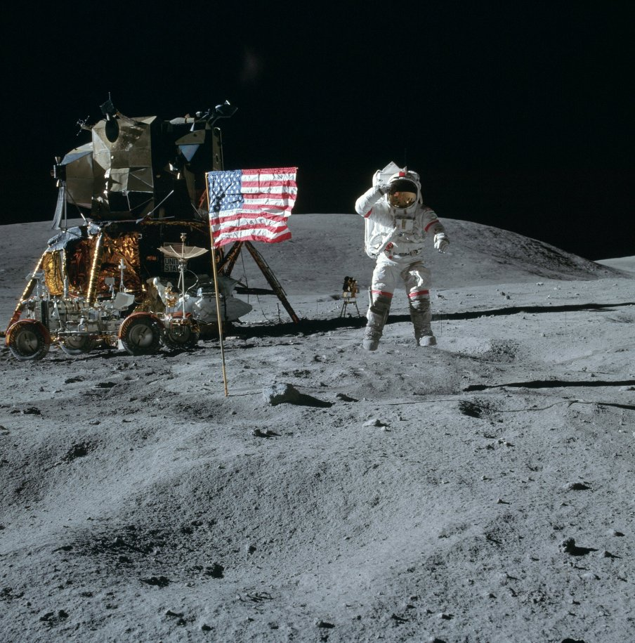
Pete Conrad coming down the ladder from the lunar module
Science-focused Mission
Lunar geology studies
Lunar sample collection
Lunar surface science experiments
Orbital science experiments
Lunar-focused
Space environment-focused
Notes:
-Image credit: NASA → John Young jumps off the ground and makes a salute. He is off the ground for about 1.45 seconds which, in the lunar gravity field (1/6 that of Earth’s gravity), means that he reached a maximum height of 0.42 m. Although the suit and backpack weigh as much as he does, his total weight is only about 65 pounds (30 kg). Image ID: AS16-113-18339.
-In addition to their geologic studies, the Apollo 16 crew performed several experiments on the lunar surface. The results of some of these experiments were either radioed to Earth by the crew or returned to Earth for laboratory analysis. Other experiments were deployed by the crew and then monitored from Earth by radio telemetry after the crew departed. This group of experiments was termed the Apollo Lunar Surface Experiment Package (ALSEP).
Soil Mechanics Investigation
Lunar Portable Magnetometer
Solar Wind Composition Experiment
Far Ultraviolet Camera/Spectrograph
Cosmic Ray Detector
Apollo Lunar Surface Experiments Package (ALSEP) deployment:
Each ALSEP experiment was connected by a cable to the ALSEP central station, which provided radio communication to Earth and electrical power from a radioisotope thermal generator.
Passive Seismic Experiment
Active Seismic Experiment
Heat Flow Experiment
Lunar Surface Magnetometer
-In addition to their studies on the lunar surface, the Apollo 16 crew performed intensive studies of the Moon from lunar orbit. Along with photography performed with hand-held cameras in the Command Module, a series of experiments were carried in the Scientific Instrument Module (SIM) on the Service Module. The same suite of SIM bay instruments was also flown on Apollo 15.
Metric and Panoramic cameras
Laser Altimeter
S-Band Transponder Experiment
X-ray Fluorescence Spectrometer Experiment
Gamma-ray Spectrometer Experiment
Alpha Particle Spectrometer Experiment
Orbital Mass Spectrometer Experiment
Bistatic Radar Experiment
Subsatellite
-In addition to their lunar studies, the Apollo 16 crew performed several experiments intended to explore various aspects of the space environment.
Window Meteoroid Experiment
Biostack Experiment
Electrophoresis Demonstration
Light Flashes Experiment
-More info: https://www.lpi.usra.edu/lunar/missions/apollo/apollo_16/experiments/

Slide 15
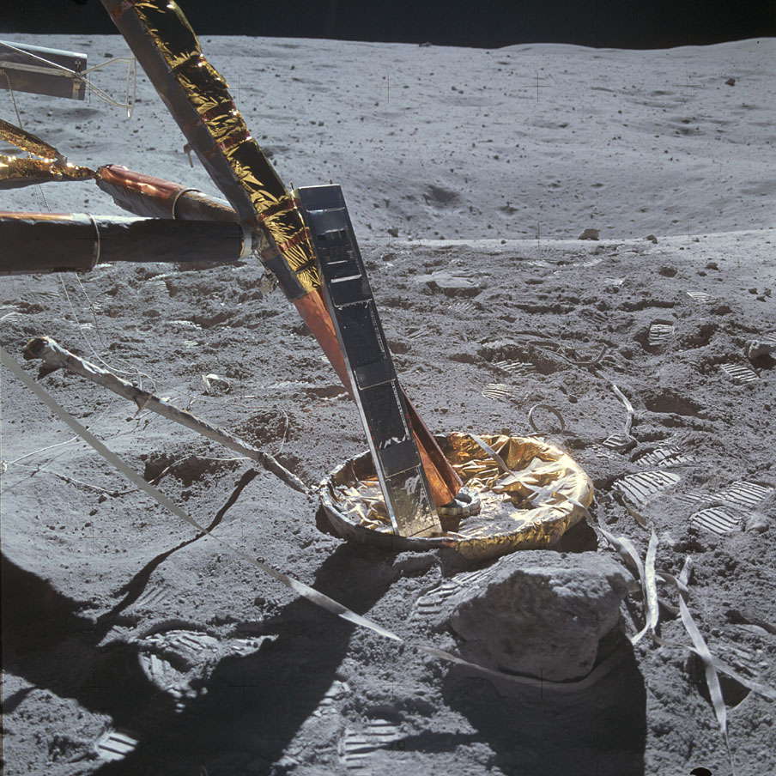
Surface Experiments on the Moon
On the Moon
Surface experiments
Soil Mechanics Investigation
Lunar Portable Magnetometer
Solar Wind Composition Experiment
Cosmic Ray Detector
Notes:
-Image credit: NASA → The Cosmic Ray Detector experiment which is sitting on one of the lunar module’s footpads. Image ID: AS16-107-17442.
-In addition to their geologic studies, the Apollo 16 crew performed several experiments on the lunar surface.
Soil Mechanics Investigation: studied the properties of the lunar soil.
Lunar Portable Magnetometer: measured the strength of the Moon’s magnetic field at different locations near the landing site.
Solar Wind Composition Experiment: collected samples of the solar wind (electrically charged particles emitted by the Sun), allowing the chemical composition of the solar wind to be measured.
The Solar Wind Composition Experiment was performed on Apollos 11, 12, 14, 15, and 16. It consisted of an aluminum foil sheet, 1.4 meters by 0.3 meters, that was deployed on a pole facing the Sun. On Apollo 16, a platinum sheet was also used.
On Apollo 16, the experiment had a total foil exposure time of 45 hours. Afterwards, the foil was removed and returned to Earth for laboratory analysis.
Cosmic Ray Detector: measured very high energy cosmic rays from the Sun and other parts of our galaxy.
-More info: https://www.lpi.usra.edu/lunar/missions/apollo/apollo_16/experiments/

Slide 16
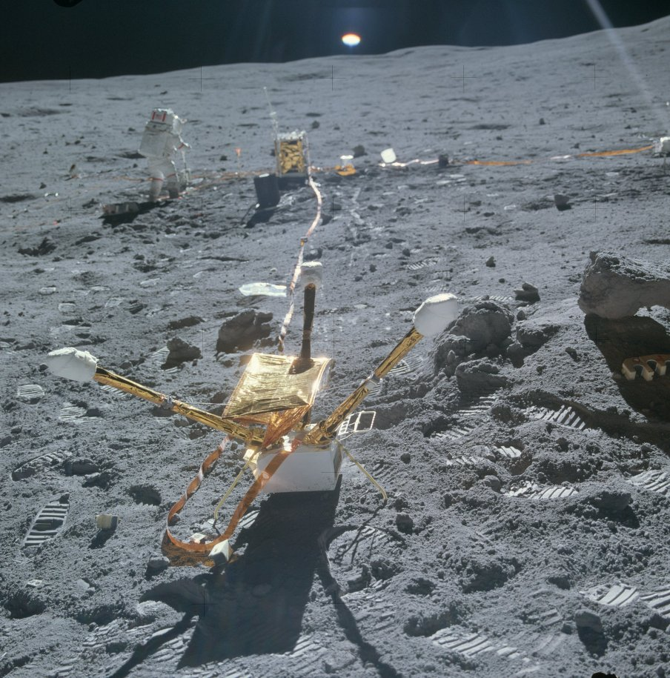
Apollo Lunar Surface Experiment Package
Apollo Lunar Surface Experiments Package (ALSEP)
Passive & Active Seismic Experiments
Heat Flow Experiment
Lunar Surface Magnetometer
Notes:
-Image credit: NASA → This up-Sun image shows that Charlie Duke has successfully deployed the magnetometer sunshade. The radioisotope thermo-electric generator (RTG) and the ALSEP Central Station are in the background. John Young is shown near the ALSEP Central Station. Image ID: AS16-113-18373.
-The Apollo Lunar Surface Experiments Package (ALSEP) system consisted of a central station with a communications package and with leads running out to the instruments placed around it.
Power was supplied by a radioisotope thermo-electric generator (RTG) – a plutonium fuel element was used.
The power required by the whole station and experiments was less than the power of a 75-watt light bulb!
-Apollo 16’s ALSEP consisted of 4 experiments: Passive Seismic Experiment, Active Seismic Experiment, Heat Flow Experiment, and Lunar Surface Magnetometer.
Passive Seismic Experiment: detected lunar “moonquakes” and provided information about the internal structure of the Moon.
On July 17, 1972, about three months after it was set up, Apollo 16’s passive seismometer registered the largest impact ever recorded on the Moon when a meteoroid hit the lunar far side near Mare Moscoviense.
Active Seismic Experiment: provided information about the structure of the upper 100 meters of the lunar regolith.
Rather than wait passively for natural events to occur on the Moon to produce shock waves (as was the case for the Passive Seismic Experiment), the Active Seismic Experiment provided its own sources. The shock waves were produced by explosions on the lunar surface. Two different kinds were used, small ones made while the astronauts were on the surface (explosive source: a “thumper”) and large ones after they left the lunar surface (explosive source: a “mortar”).
The thumper was used by the astronauts to explode “shotgun-like” charges and contained 19 such charges. It was fired at evenly spaced intervals along the geophone line. The results from this part of the experiment were available while the astronauts were still on the surface of the Moon.
The second kind of charge was similar to that of a mortar. On Apollo 16, three mortar shells were used to lob explosive charges to distances of up to 1,300 meters from the ALSEP. The mortar shells were detonated by radio control after the astronauts left the lunar surface.
Heat Flow Experiment: attempted to measure the amount of heat coming out of the Moon.
The rate at which a planet loses its internal heat to space is an important control on the level of tectonism (faulting and folding of the planet’s surface due to internal deformation) and volcanic activity on the planet. This loss of internal heat was measured by the Heat Flow Experiment on Apollos 15 and 17. This experiment was also attempted on Apollo 16 but failed due to a broken cable connection.
Lunar Surface Magnetometer: measured the strength of the Moon’s magnetic field.
-More info on ALSEP: https://www.hq.nasa.gov/alsj/HamishALSEP.html

Slide 17
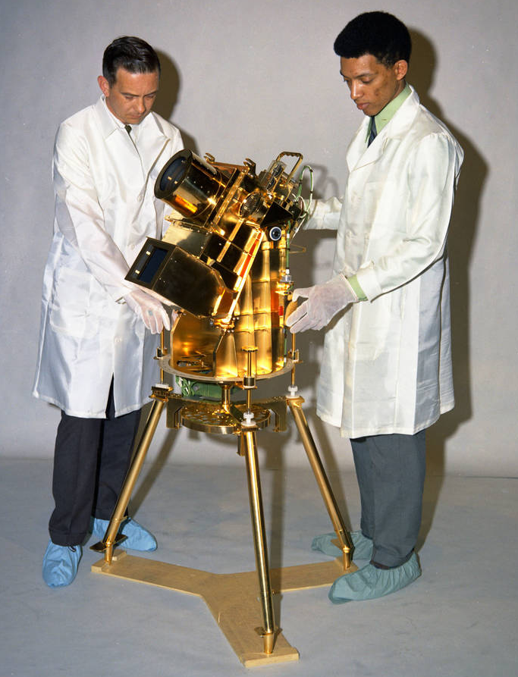
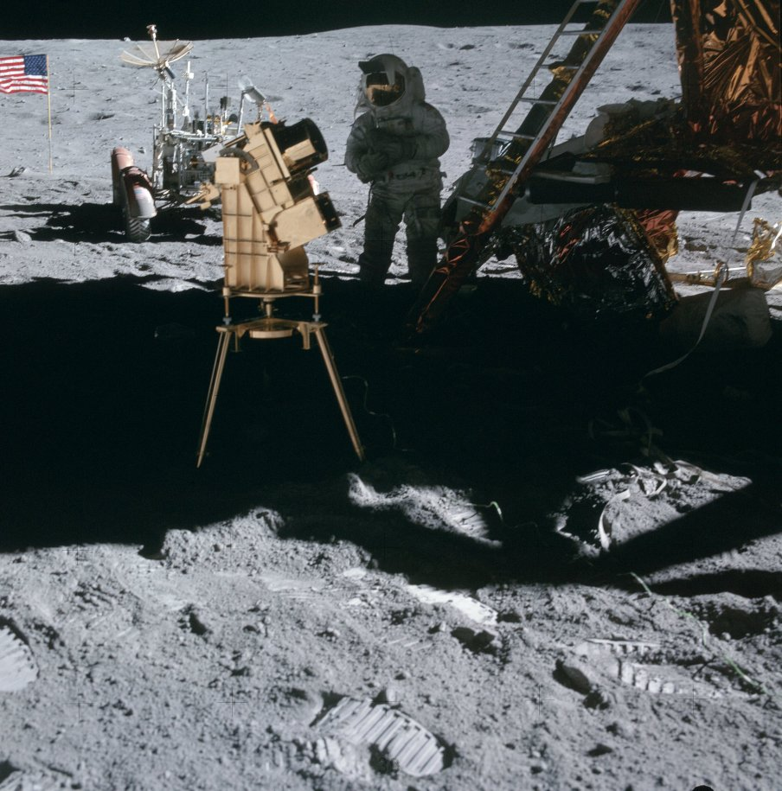
Surface Experiments on the Moon
First Moon-Based Telescope
U.S. Naval Research Laboratory
Notes:
-Image credits:
Left: U.S. Naval Research Laboratory → Dr. George Carruthers, right, and William Conway, a project manager at the Naval Research Institute, examine the gold-plated ultraviolet camera/spectrograph, the first Moon-based observatory that Carruthers developed for the Apollo 16 mission.
Right: NASA → The ultraviolet astronomy camera, showing Charlie Duke in the background with the rover and the flag to the left. Image ID: AS16-114-18439.
-During Apollo 16, a telescope explored the vastness of space from the surface of another world for the very first time.
-The telescope, called the Far Ultraviolet Camera/Spectrograph, looked at distant objects in ultraviolet light, a type of radiation invisible to our eyes. While some ultraviolet rays from the Sun reach the Earth’s surface (which is why we need to wear sunscreen), our planet’s atmosphere absorbs a lot of the most high-energy rays. Stars and other astronomical objects hotter than the Sun give off a lot of short-wavelength ultraviolet light, but from our planet’s surface, we wouldn’t be able to detect it.
The Moon, on the other hand, has no substantial atmosphere to block out such signals, making it a great venue not just for stargazing, but exploring deep into the universe.
While on the surface, John Young took the telescope out of its plastic bag and planted it on a tripod in the shadow of the lunar module, so that the instrument wouldn’t receive any direct sunlight.
The astronauts re-oriented the telescope several times during their stay so that they could see different parts of the sky and to keep it in the lunar module’s shadow.
It is called a “Camera/Spectrograph” because it had two modes of operating: “direct images,” which are pictures as from a regular camera, and “spectrograph” which is a way of splitting light to look for the fingerprints of atoms and molecules in astronomical objects.
-The Moon-based telescope studied a variety of star clusters as well as nebulae which are clouds of gas and dust where new stars are born.
The astronauts also pointed it at the Large Magellanic Cloud which is a small galaxy orbiting the Milky Way.
-More info: https://www.nasa.gov/feature/remembering-the-first-moon-based-telescope ; https://www.nasa.gov/image-feature/looking-back-dr-george-carruthers-and-apollo-16-far-ultraviolet-cameraspectrograph

Slide 18
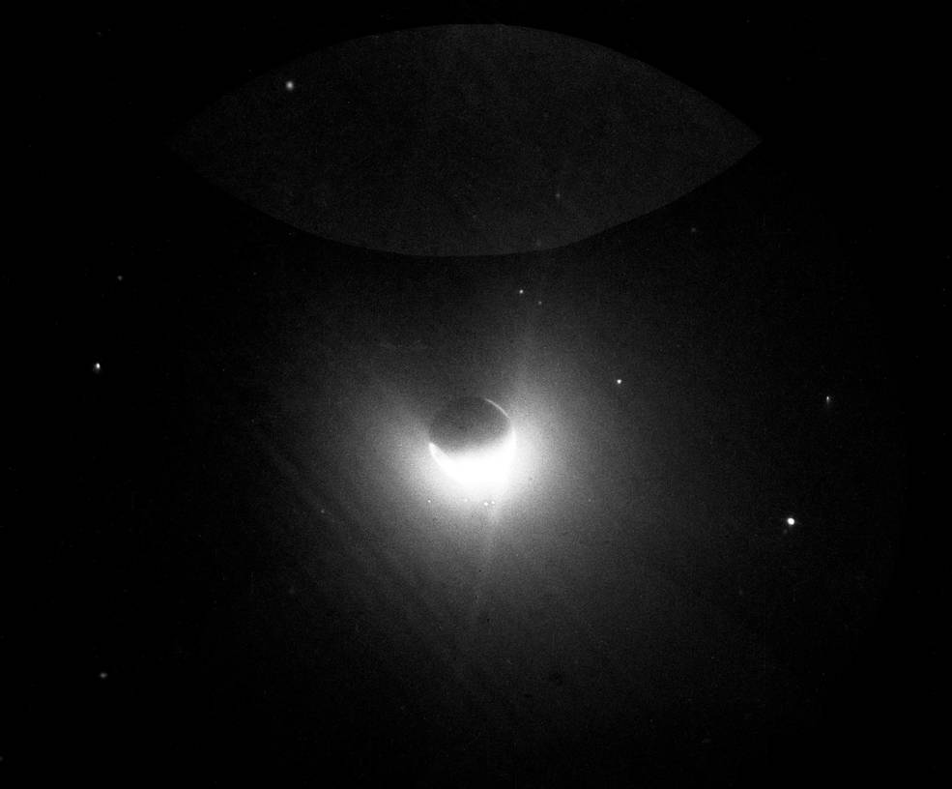
Surface Experiments on the Moon
A View of Earth’s Atmosphere from the Moon
Notes:
-Image credit: NASA → This image, taken by the first telescope on the Moon during the Apollo 16 mission, shows Earth’s outermost atmosphere, or geocorona, a region where oxygen and nitrogen glow brightly in ultraviolet light.
-The telescope also looked back at Earth, viewing its upper atmosphere, called the “geocorona,” and aurorae. The principal investigator, George Carruthers, who had received a patent for such a camera while at the Naval Research Laboratory, said afterward: “The most immediately obvious and spectacular results were really for the Earth observations, because this was the first time that the Earth had been photographed from a distance in ultraviolet light.”
-More info: https://www.nasa.gov/feature/remembering-the-first-moon-based-telescope ; https://www.nasa.gov/image-feature/looking-back-dr-george-carruthers-and-apollo-16-far-ultraviolet-cameraspectrograph

Slide 19
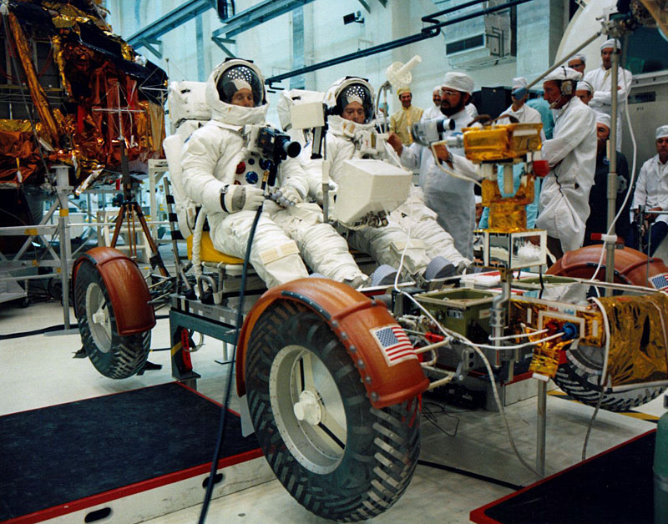
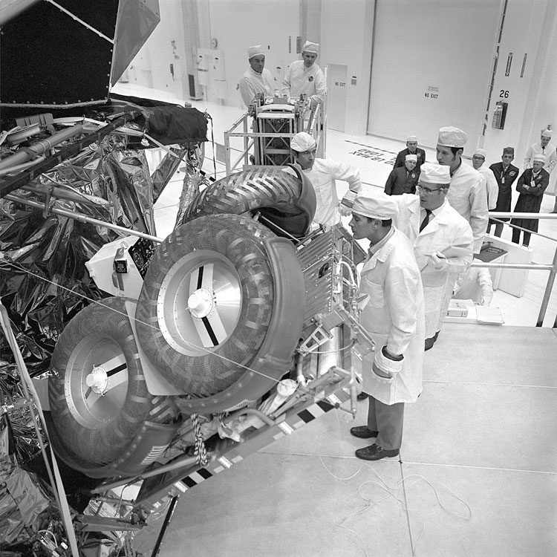
Lunar Roving Vehicle
Notes:
-Image credits: NASA
Left: Charlie Duke (left) and John Young (right) on the flight Rover during a pre-stowage checkout. Image ID: KSC-71PC-730.
Right: Charlie Duke (foreground) and John Young (beyond the wheels) examine the flight Rover during its installation on the outside of the lunar lander’s descent stage. Charlie is standing at the hinge connecting the aft and center sections. Image ID: KSC-71P-543.
-Apollo 16 saw the second flight of the Lunar Roving Vehicle (LRV). With the Lunar Roving Vehicle, total surface traverses increased from hundreds of meters during earlier missions to tens of kilometers during Apollos 15, 16 and 17. Astronauts were thus able to venture farther from the Lunar Module (LM).
On Apollo 16, the vehicle traversed 26.7 km in 3 hours 26 minutes of driving. The longest traverse was 11.6 km, and the LRV reached a distance of 4.5 km from the LM.
-The empty weight of the rover was 462 lb (210 kg) on Earth and only 77 lb (35 kg) on the Moon, so the astronauts could use the U-shaped handles on the outer edges of the vehicle to lift and reposition the rover.

Slide 20
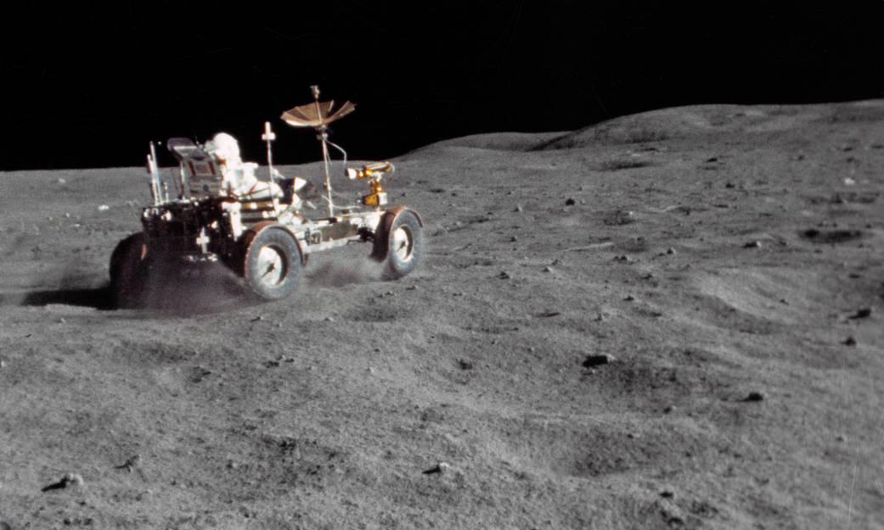
Lunar Grand Prix
Notes:
-Image credit: NASA → The Lunar Roving Vehicle (LRV) gets a high-speed workout by astronaut John Young in the “Grand Prix” run during the first Apollo 16 extravehicular activity. Image ID: S72-37002.
This view is a frame from motion picture film exposed by a 16mm Maurer camera held by astronaut Charlie Duke.
-To learn how the LRV handles driving on the lunar surface, the Apollo 16 “Grand Prix” was held – John Young drove the rover at speeds up to 10 km/hr (6.2 mi/hr) and performed sharp turns and stops so that Charlie Duke could record it on film for the rover engineers to analyze. The rover fenders were very effective in keeping dust from being thrown up onto the vehicle.
-Apollo Lunar Surface Journal Transcript: https://www.hq.nasa.gov/alsj/a16/a16.trvlm1.html
-Apollo Flight Journal YouTube video: https://www.youtube.com/watch?v=X30z82aeSHw

Slide 21
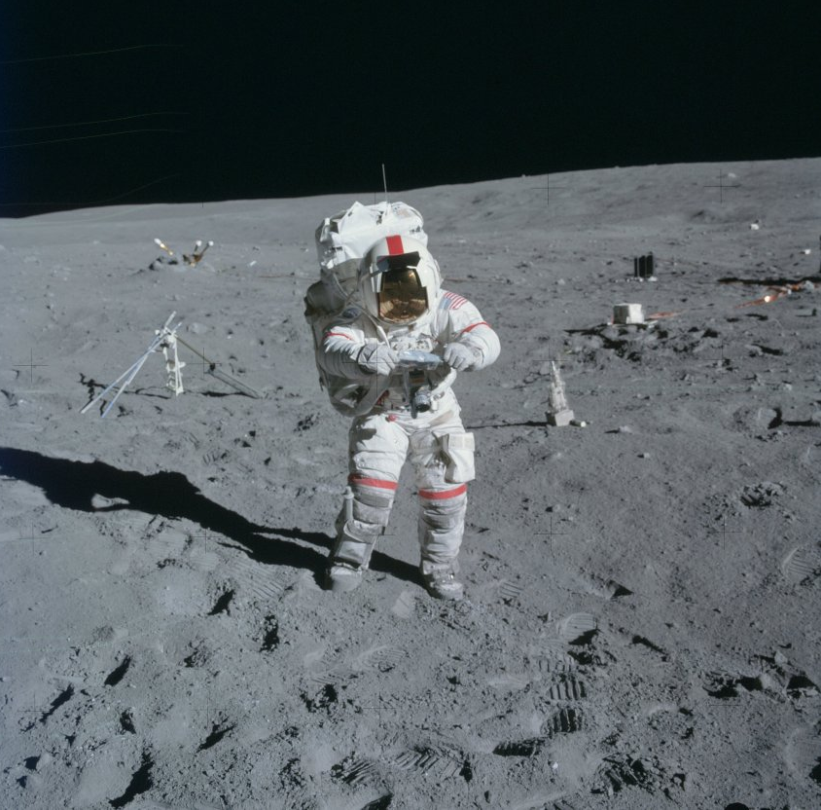
Apollo Lunar Surface Experiment Package
Lunar Sample Collection
Notes:
-Image credit: NASA → John Young is bagging a sample from a small crater behind the rover at the ALSEP site. Image ID: AS16-114-18387.
-A variety of tools were used to collect samples on the Moon’s surface: these included drills, hammers, rakes, tongs, and core tubes.
-More info on Apollo lunar surface geological sampling tools: https://curator.jsc.nasa.gov/lunar/catalogs/other/jsc23454toolcatalog.pdf

Slide 22
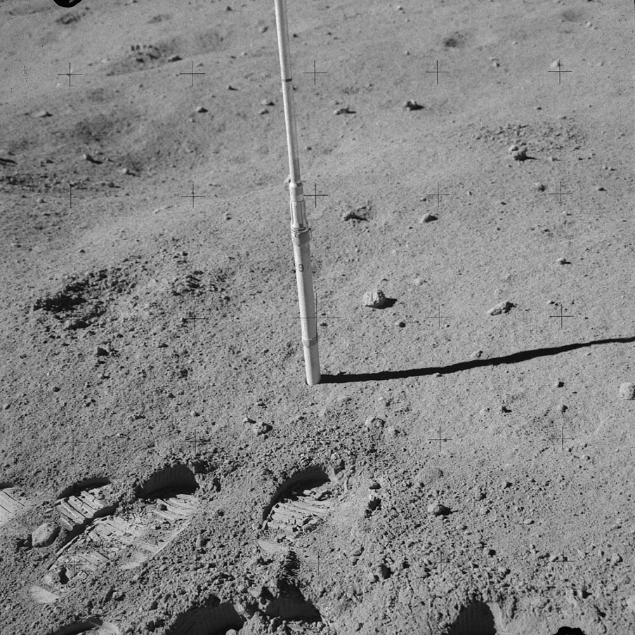
Apollo Lunar Surface Experiment Package
Sample Core Tubes
Notes:
-Image credit: NASA → Charlie Duke took this picture of the EVA-2 Station 8 double core tube. Image ID: AS16-108-17682.
-Core tubes were used to obtain samples from below the Moon’s surface using the Apollo Lunar Surface Drill (Apollos 15-17).
-Two styles of core tubes were used on the Moon to obtain continuous soil columns down to 70 cm in depth.
The initial style, used on Apollos 11, 12, & 14, was a thick-walled, small diameter (2 cm) tube called a core tube. This tube was designed to be easily opened in the laboratory; however, the soil column obtained in this type of tube was disturbed by the collection process.
Therefore, a wider diameter (4 cm) tube with thinner walls was designed and fabricated for the last three missions (Apollos 15, 16, & 17). This tube was called a drive tube to distinguish it from the earlier core tube (both tubes took cores and both tubes were driven into the lunar regolith). A soil column collected in a drive tube was not significantly distorted by the coring process.
-More info on Apollo lunar surface geological sampling tools: https://curator.jsc.nasa.gov/lunar/catalogs/other/jsc23454toolcatalog.pdf

Slide 23
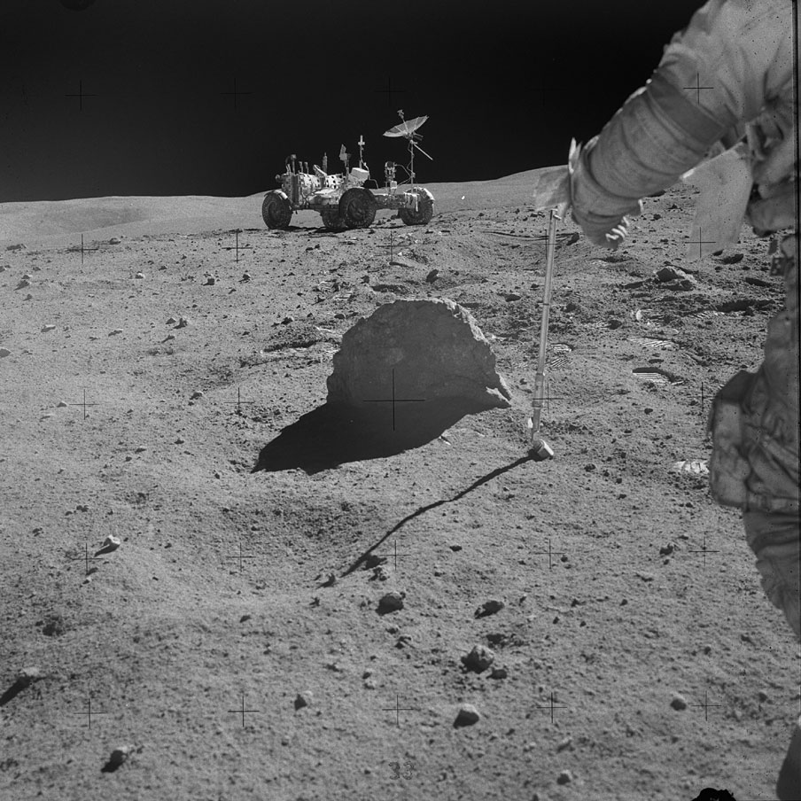
Exploring the Surface
Notes:
-Image credit: NASA → A view of the “Great Sneak” sample site at EVA-2 Station 9, with the Lunar Roving Vehicle in the background. Image ID: AS16-108-17741.
When collecting samples, the astronauts were trained to approach the rock in question very slowly to avoid kicking soil on the sampling area so that the sample would remain pristine. During training, this became known as “sneaking up on a rock.”
-During the second extravehicular activity (EVA), a geological traverse was made south of the landing site to the Cinco Crater area of Stone Mountain. The traverse covered 11.1 kilometers and included stops at six field stations. The planned Station 7 was omitted in order to spend additional time at the other stations.
Station 4 – Stone Mountain (Cinco Crater): marked the highest point reached at Stone Mountain. The astronauts gathered samples at two locations, including a double-length core tube sample and a soil trench sample.
Station 5 – Stone Mountain (Slope): This site, approximately 0.5 km downslope from Station 4, was on a topographic bench about 50 meters wide. The astronauts gathered samples, took panoramic photography, and obtained a Lunar Portable Magnetometer measurement.
Station 6 – Stone Mountain (Base): At this site on the Cayley Plain, the astronauts gathered samples and performed panoramic photography.
Station 8 – Wreck Crater: located near two 15 to 20-meter craters approximately 2.8 km south-southwest of the lunar module. Sampling activities included collecting a double-length core tube sample and boulder samples.
Station 9 – This station was just south of a 50-meter crater and northeast of Station 8. Here, the crew gathered a number of different types of samples: They obtained more boulder samples, a single-length core tube sample, two special contact soil samples, and samples taken from beneath a boulder that was overturned.
Station 10 – LM/ALSEP Site: This was another visit to the area around the lunar module and the ALSEP site. Activities during this visit included gathering samples, taking a core tube sample, performing penetrometer measurements (to measure mechanical properties of the lunar soil), and taking panoramic photographs.
-Commentary from the Apollo Lunar Surface Journal: https://history.nasa.gov/alsj/a16/a16.sta9.html
-More info: https://www.lpi.usra.edu/lunar/missions/apollo/apollo_16/surface_opp/

Slide 24
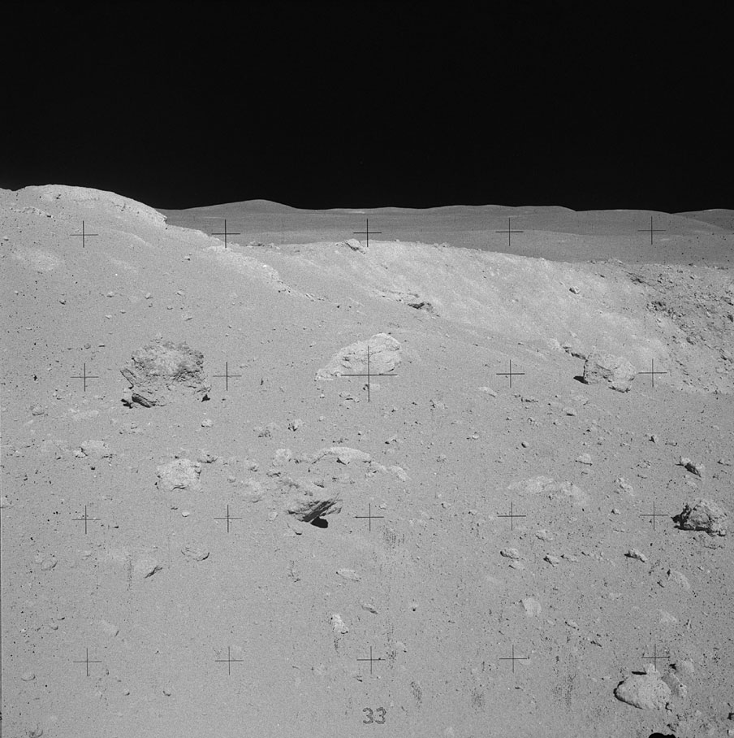
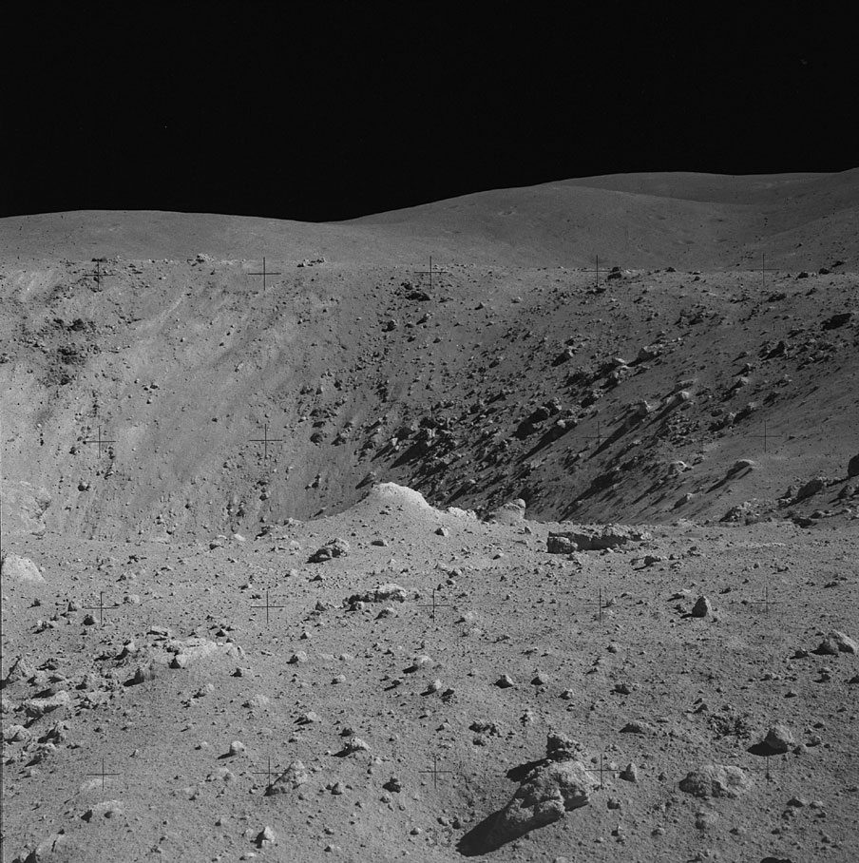
Exploring the Surface
Notes:
-Image credits: NASA
Left: The interior of the left side of North Ray Crater, taken during EVA-3. Image ID: AS16-106-17249.
Right: The interior of the right side of North Ray Crater, taken during EVA-3. Image ID: AS16-106-17239.
-More info on the third extravehicular activity: https://www.lpi.usra.edu/lunar/missions/apollo/apollo_16/surface_opp/

Slide 25
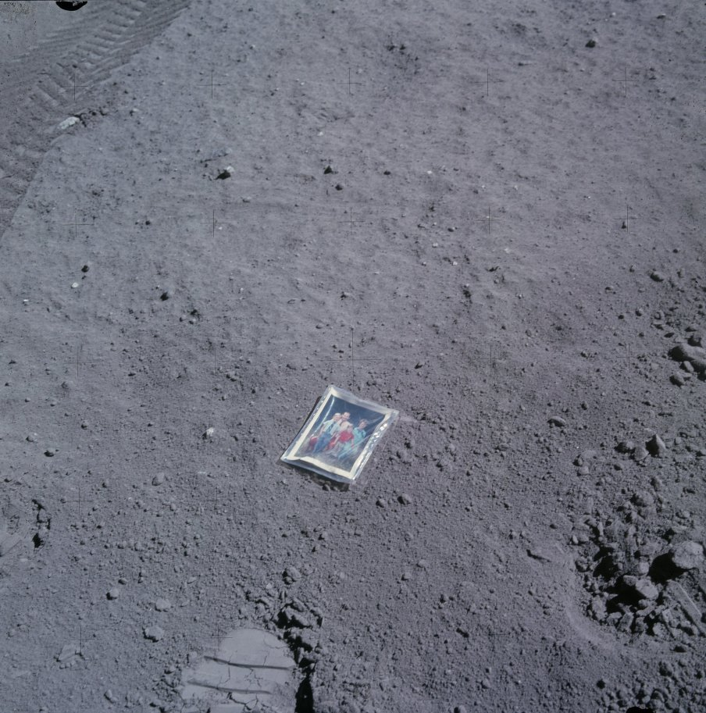
Apollo Lunar Surface Experiment Package
A Family Portrait
Charlie Duke’s family portrait placed on the Moon
Notes:
-Image credit: NASA → Charlie Duke placed a picture of the Duke family on the lunar surface. Image ID: AS16-117-18841.
-Each Apollo crew member had the opportunity to bring personal materials with them on their mission to the Moon.
Charlie Duke wanted to pay tribute to his family in a way that would last forever, so he brought along a family photo which was placed in a plastic wrapper.
He had asked his kids if they wanted to go to the Moon with him, and this was a way that he could fulfill this offer.
-More info: https://www.kennedyspacecenter.com/blog/featured-flashback-bringing-the-family-to-the-moon

Slide 26
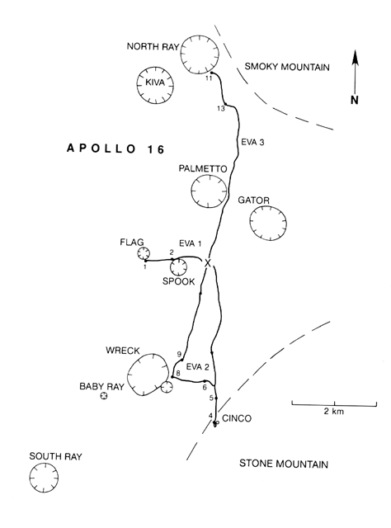
Apollo 12 Traverses
Notes:
-Image source: https://www.lpi.usra.edu/publications/slidesets/apollolanding/ApolloLanding/slide_31.html
-The Apollo 16 traverses.
-The thick lines indicate the paths taken by the astronauts during the three EVAs. Numbered spots indicate sampling stations along the individual traverses.
During the first EVA (beginning at 11:47 a.m. EST on April 21): the crew deployed the lunar rover and the Apollo Lunar Surface Experiments Package (ALSEP). The geologic traverse to the region west of the landing site covered 4.2 kilometers and included stops at two field stations. The EVA lasted approximately 7 hours and 11 minutes, ending at 6:58 p.m. EST.
During the second EVA (beginning at 11:33 a.m. EST on April 22): the crew made a geological traverse south of the landing site to the Cinco Crater area of Stone Mountain. The traverse covered 11.1 kilometers and included stops at six field stations. The planned Station 7 was omitted so that the crew could spend additional time at the other stations. The duration of the second EVA was approximately 7 hours and 23 minutes, ending at 6:56 p.m. EST.
During the third EVA (beginning at 10:25 a.m. EST on April 23): the crew made a geological traverse to North Ray Crater, and to save time, several planned stops were omitted, with their work focused at three field stations instead. The total traverse covered 11.4 kilometers. Because of the delayed lunar landing, the time for the third EVA was reduced to 5 hours and 40 minutes, ending at 4:05 p.m. EST.
-The diagram is based on the Apollo 16 Traverses Lunar Photomap, Edition 1, Sheet 78D2S2[25].

Slide 27
Apollo 12 Traverses
Apollo 16 Traverses ←→ Sydney
Thomas Schwagmeier
Notes:
-Image credit: Thomas Schwagmeier
-The Apollo 16 traverse map superimposed on a simplified map of Sydney.
-Source: https://www.hq.nasa.gov/alsj/TraverseMapsEarth.html

Slide 28
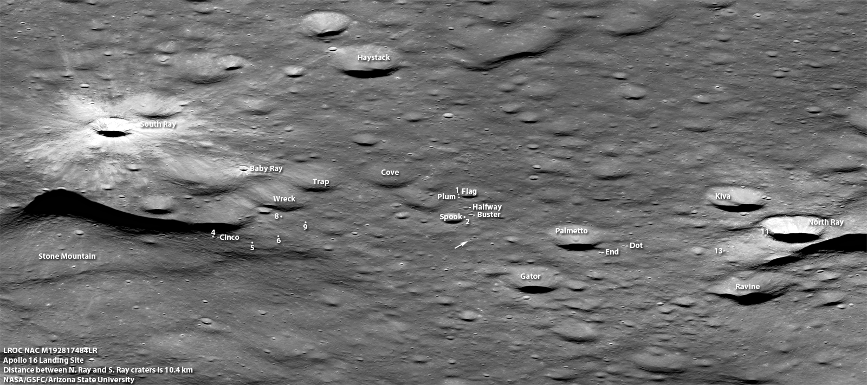
Apollo 12 landing site, as imaged by the Lunar Reconnaissance Orbiter Camera
Notes:
-Image credit: NASA/GSFC/Arizona State University → http://www.lroc.asu.edu/posts/529
The Lunar Reconnaissance Orbiter captured this view which is centered on the Apollo 16 landing site, with key craters and astronaut sampling stations labeled (the arrow shows the location of the lunar module descent stage and lunar rover).
This is close to the view that command module pilot Ken Mattingly would have seen as he passed over the site at an altitude of 120 km (75 mi).
The distance between South Ray crater and North Ray crater is 10.5 km.

Slide 29
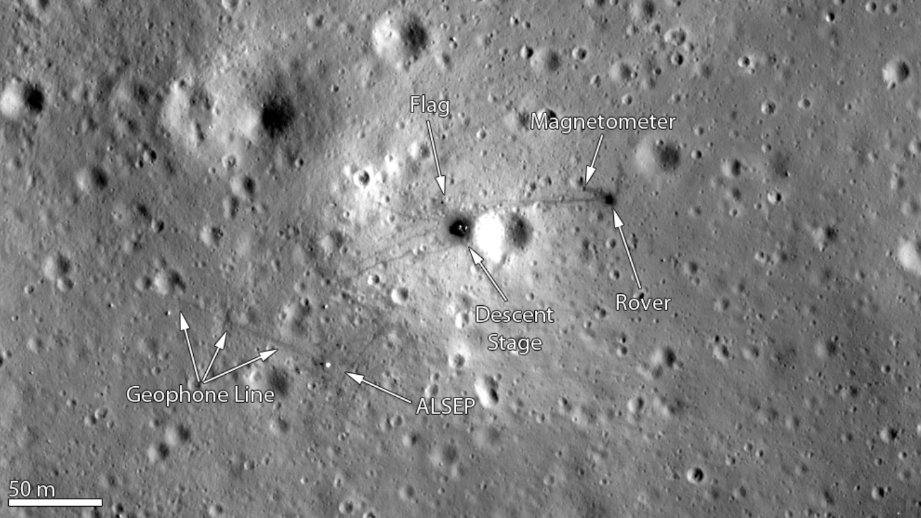
Apollo 12 landing site, as imaged by the Lunar Reconnaissance Orbiter Camera
Notes:
-Image credit: LROC → http://www.lroc.asu.edu/featured_sites/view_site/5
-A zoomed in version of the Apollo 16 landing site, as imaged by the Lunar Reconnaissance Orbiter Camera (taken on May 22, 2010). Note that this zoomed in version doesn’t show all of the EVA traverses, which had a maximum range of about 2.8 miles from the lunar module.

Slide 30
A Lunar Ascent
Notes:
-Video credit: NASA → The Apollo 16 lunar module ascent stage lifting off from the Moon’s surface, with John Young and Charlie Duke onboard.
-More info: https://www.hq.nasa.gov/alsj/a16/a16.launch.html#1752950

Slide 31
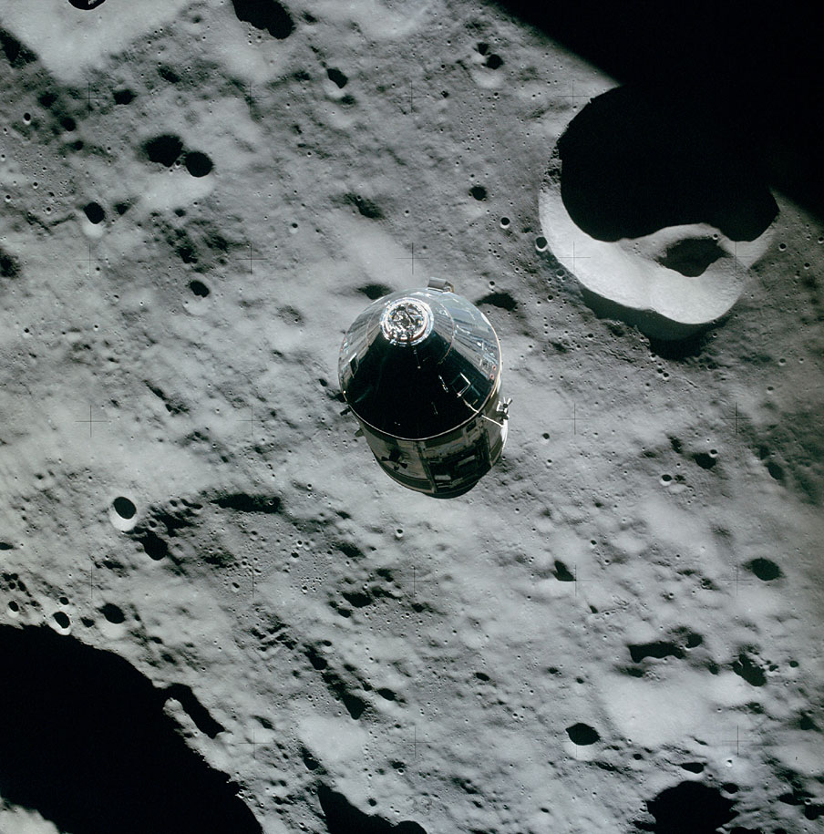
Surface Experiments on the Moon
Science Experiments in Orbit (1)
Metric and Panoramic Cameras
Laser Altimeter
S-Band Transponder Experiment
X-ray Fluorescence Spectrometer Experiment
Notes:
-Image credit: NASA → The command and service module as viewed from the lunar module, with the hilly terrain near the northwest rim of Valier crater in the background. Image ID: AS16-113-18294.
-In addition to their studies on the lunar surface, the Apollo 16 crew performed intensive studies of the Moon from lunar orbit. Along with photography performed with hand-held cameras in the command module, a series of experiments were carried in the scientific instrument module (SIM) on the service module. The same suite of SIM bay instruments was also flown on Apollo 15.
Metric and Panoramic cameras: provided systematic photography of the lunar surface
Laser Altimeter: measured the heights of lunar surface features
S-Band Transponder Experiment: measured regional variations in the Moon’s gravitational acceleration
X-ray Fluorescence Spectrometer Experiment: measured the composition of the lunar surface
-More info: https://www.lpi.usra.edu/lunar/missions/apollo/apollo_16/experiments/

Slide 32
Surface Experiments on the Moon
Science Experiments in Orbit (2)
Gamma-ray Spectrometer Experiment
Alpha Particle Spectrometer Experiment
Orbital Mass Spectrometer Experiment
Bistatic Radar Experiment
Notes:
-Image credit: NASA → The command and service module as viewed from the lunar module, with the hilly terrain near the northwest rim of Valier crater in the background. Image ID: AS16-113-18294.
-In addition to their studies on the lunar surface, the Apollo 16 crew performed intensive studies of the Moon from lunar orbit. Along with photography performed with hand-held cameras in the command module, a series of experiments were carried in the scientific instrument module (SIM) on the service module. The same suite of SIM bay instruments was also flown on Apollo 15.
Gamma-ray Spectrometer Experiment: measured the composition of the lunar surface
Alpha Particle Spectrometer Experiment: measured radon emission from the lunar surface
Orbital Mass Spectrometer Experiment: measured the composition of the lunar atmosphere
Bistatic Radar Experiment: measured the scattering of radar waves from the lunar surface
The Apollo 16 Particles and Fields Subsatellite (PFS-2): Prior to their return to Earth, the crews of both Apollos 15 and 16 deployed small, 38-kilogram subsatellites into lunar orbit. These subsatellites were identical on both missions and performed three experiments which continued the study of the lunar environment.
The subsatellites measured regional variations in the Moon’s gravitational acceleration and magnetic field and the distribution of charged particles around the Moon.
-In addition to their lunar studies, the Apollo 16 crew performed several experiments intended to explore various aspects of the space environment.
Window Meteoroid Experiment: studied impacts on the windows of the Apollo 16 command module to obtain information about the size distribution of very small micrometeorites
Biostack Experiment: studied the effects of cosmic rays on several types of biological materials, including bacteria spores, seeds, and brine shrimp eggs
Electrophoresis Demonstration: studied the separation of organic molecules in an electric field
Light Flashes Experiment: studied light flashes seen by the crew that are related to charged particles in space
-More info: https://www.lpi.usra.edu/lunar/missions/apollo/apollo_16/experiments/

Slide 33
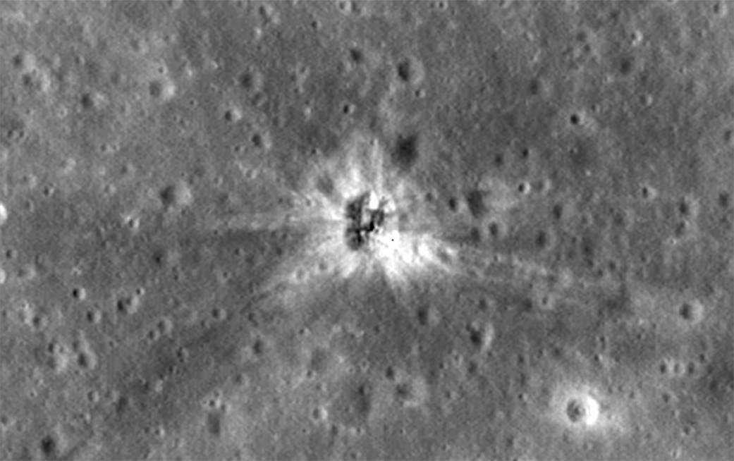
Surface Experiments on the Moon
S-IVB Rocket Stage Impact Site
NASA/GSFC/Arizona State University
Notes:
-Image credit: NASA/GSFC/Arizona State University → The Lunar Reconnaissance Orbiter (LRO) captured this image of the impact site of the Apollo 16 S-IVB stage.
S-IVBs were portions of the Saturn V rockets that brought astronauts to the Moon.
Beginning with Apollo 13, the S-IVB rocket stages were deliberately impacted on the lunar surface after they were used.
Seismometers placed on the Moon by earlier Apollo astronauts measured the energy of these impacts to shed light on the internal lunar structure.
Apollo 16’s S-IVB stage is at Mare Insularum, about 160 miles southwest of Copernicus crater.
-More info: https://www.nasa.gov/image-feature/goddard/lro-finds-apollo-16-booster-rocket-impact-site

Slide 34
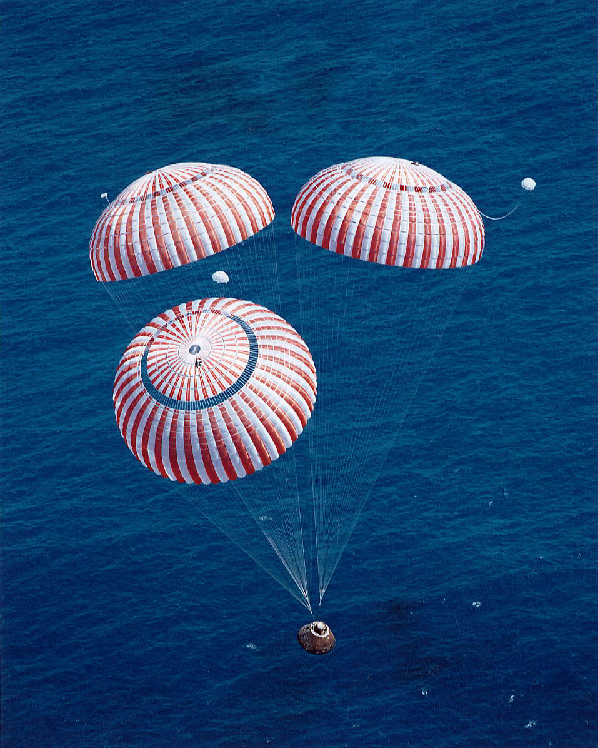
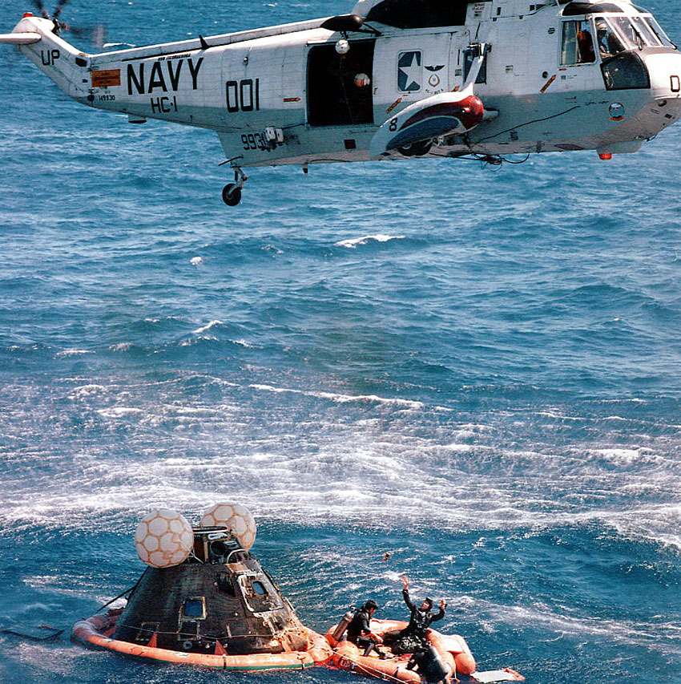
Splashdown
Splashdown
Notes:
-Image credits: NASA
Left image: Apollo 16 descends toward splashdown. Image ID: S72-36289.
Right image: Recovery helicopter hovers over the Apollo 16 command module while Navy divers work in the raft after splashdown. Image ID: S72-36282.
-The Apollo 16 splashdown occurred at 2:45 p.m. EST on April 27, 1972, in the Pacific Ocean.
The crew was picked up by helicopters from the prime recovery ship, the USS Ticonderoga.

Slide 35
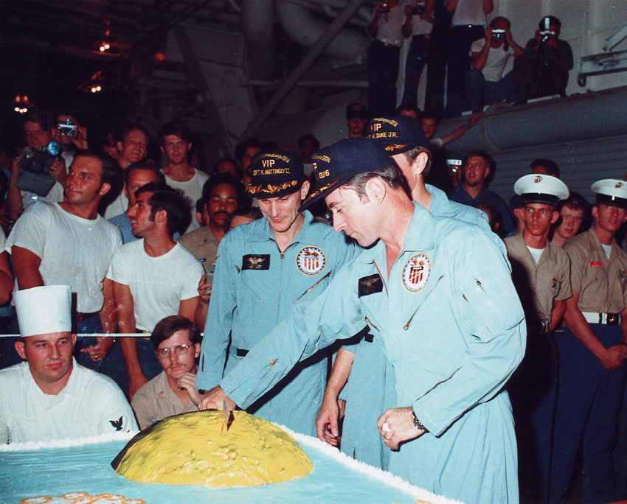
Splashdown
Moon Cake!
Notes:
-Image credit: NASA → John Young (right) cuts into a lunar cake watched by Ken Mattingly (left) and Charlie Duke (partly hidden by Young) aboard the recovery carrier, USS Ticonderoga, after splashdown. Image ID: S72-36361.

Slide 36
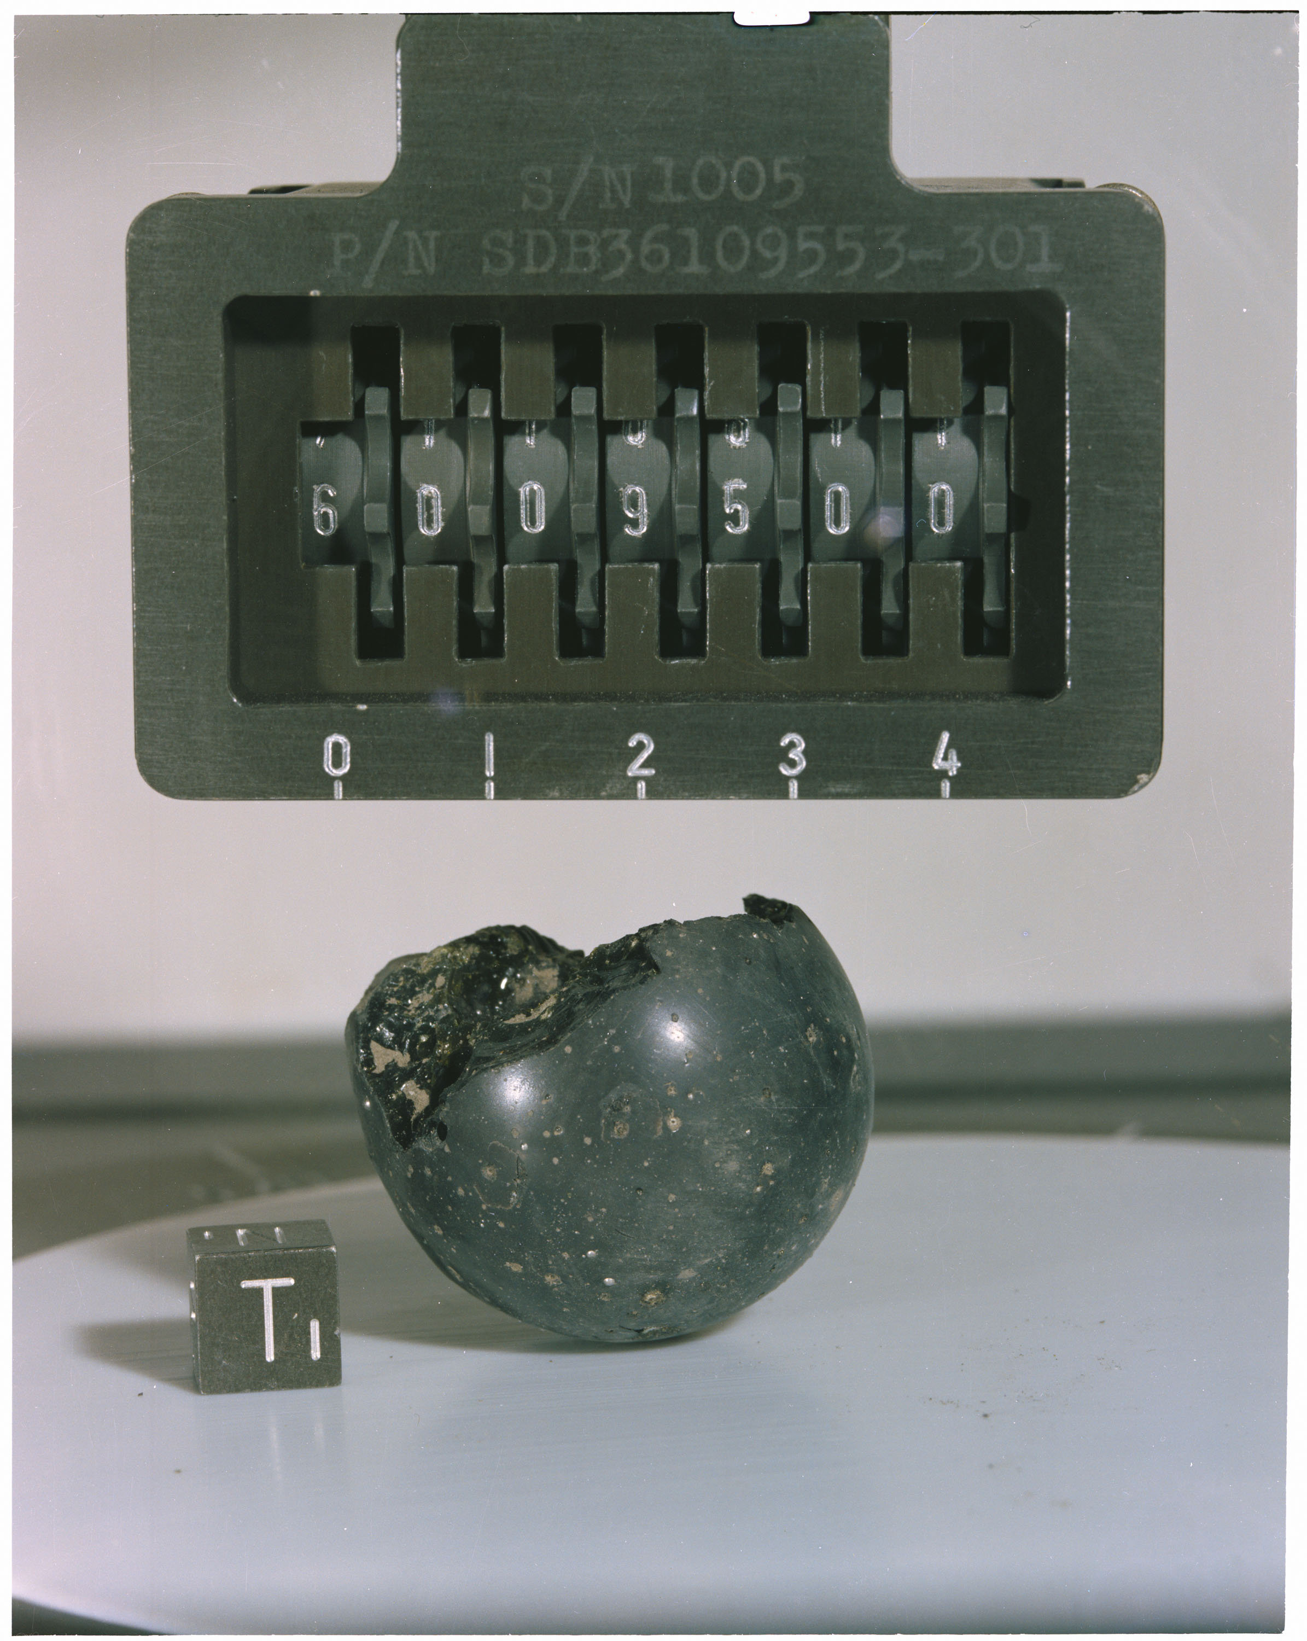
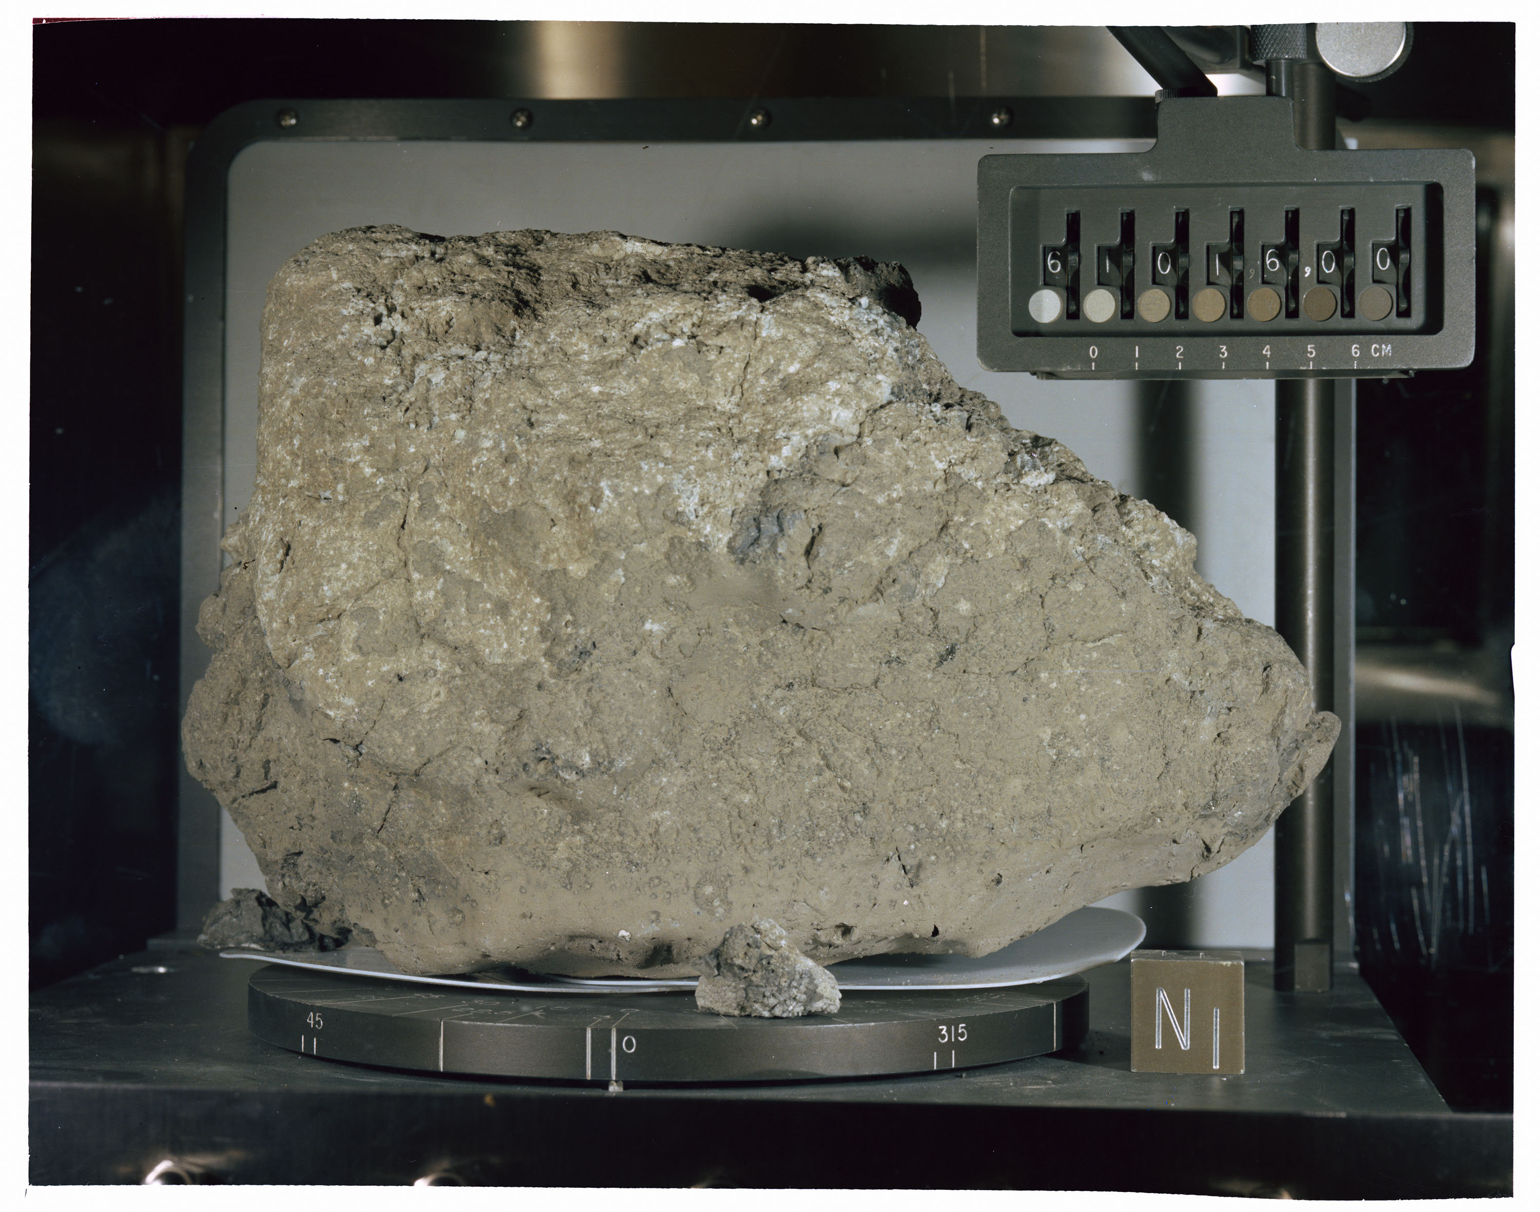
Returned Samples
Returned Samples
Notes:
-Image credits: NASA/JSC
Left: Apollo 16 sample 61016 – this sample is an impact melt breccia found perched on the east rim of Plum Crater. It is known as “Big Muley” (named after Bill Muehlberger, the leader of the Apollo 16 field geology team) and was the largest rock collected during the Apollo missions. It has a mass of 11,729 grams. Image ID: S72-38975.
Right: Apollo 16 sample 60095 – this sample is a fractured spheroid of yellow-green to light brown glass that was collected about 175 m southwest of the lunar module. This type of glass is produced during impact events when the rocks become shocked. Image ID: S72-39421.
-The Apollo 16 landing site is located in the Moon’s central highlands, and this area appealed to geologists as it represented the first location in the lunar highlands to be sampled.
At the time, most geologists believed the highlands to be of volcanic origin, featuring lava domes similar to those seen in volcanic regions on Earth. However, the samples returned by Apollo 16 actually indicated that the highlands of the Moon primarily consist of impact-formed rocks (called breccias).
Breccias are rocks that are composed of fragments of other, older rocks. The Moon has been bombarded by countless meteorites over its history, and these impacts have broken many rocks up into smaller fragments. The heat and pressure of these impacts can fuse small rock fragments into new rocks, called breccias.
Many of the samples collected during Apollo 16 were breccias. The most likely source for all the impact debris found at the Apollo 16 landing site is large impact basins which can distribute ejecta material over very long distances.
-The Apollo 16 crew collected 731 individual rock and soil samples, including a deep drill core with material from 2.2 meters below the lunar surface, with a total mass of 96 kilograms.
-Apollo 16 sample catalog: https://www.hq.nasa.gov/alsj/a16/a16sampcat.html
-More about the returned samples: https://www.lpi.usra.edu/lunar/missions/apollo/apollo_16/samples/ ; https://www.lpi.usra.edu/lunar/samples/atlas/#Apollo%2016
-JSC Lunar Sample Compendium: https://curator.jsc.nasa.gov/lunar/lsc/index.cfm

Slide 37
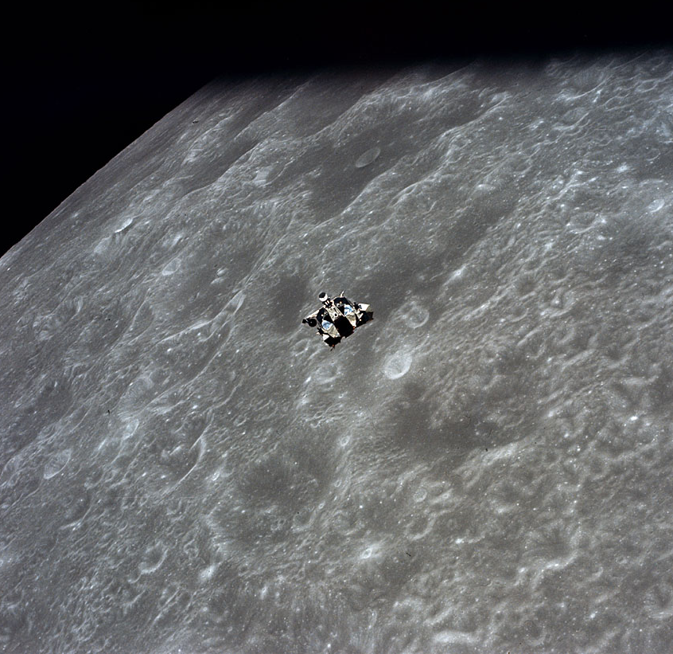
By the Numbers
By the Numbers
20 hrs, 18 min spent outside the lander
16.6 mi (26.7 km) total length of EVA drive traverses
212 lbs (96 kg) of samples collected
About 266 hrs (~11 days) total mission time
Notes:
-Image credit: NASA → Lunar module Orion approaching the command module Casper during rendezvous. Image ID: AS16-122-19530.
-Farthest point traveled from the LM: ~2.8 mi (~4.5 km)
-Compare to Apollo 11:
60 m – farthest point traveled from the LM
2.5 hrs spent outside the lunar module
47.8 lbs of samples collected
195 hrs, 18 min, 35 sec (~8 days) total mission time

Slide 38
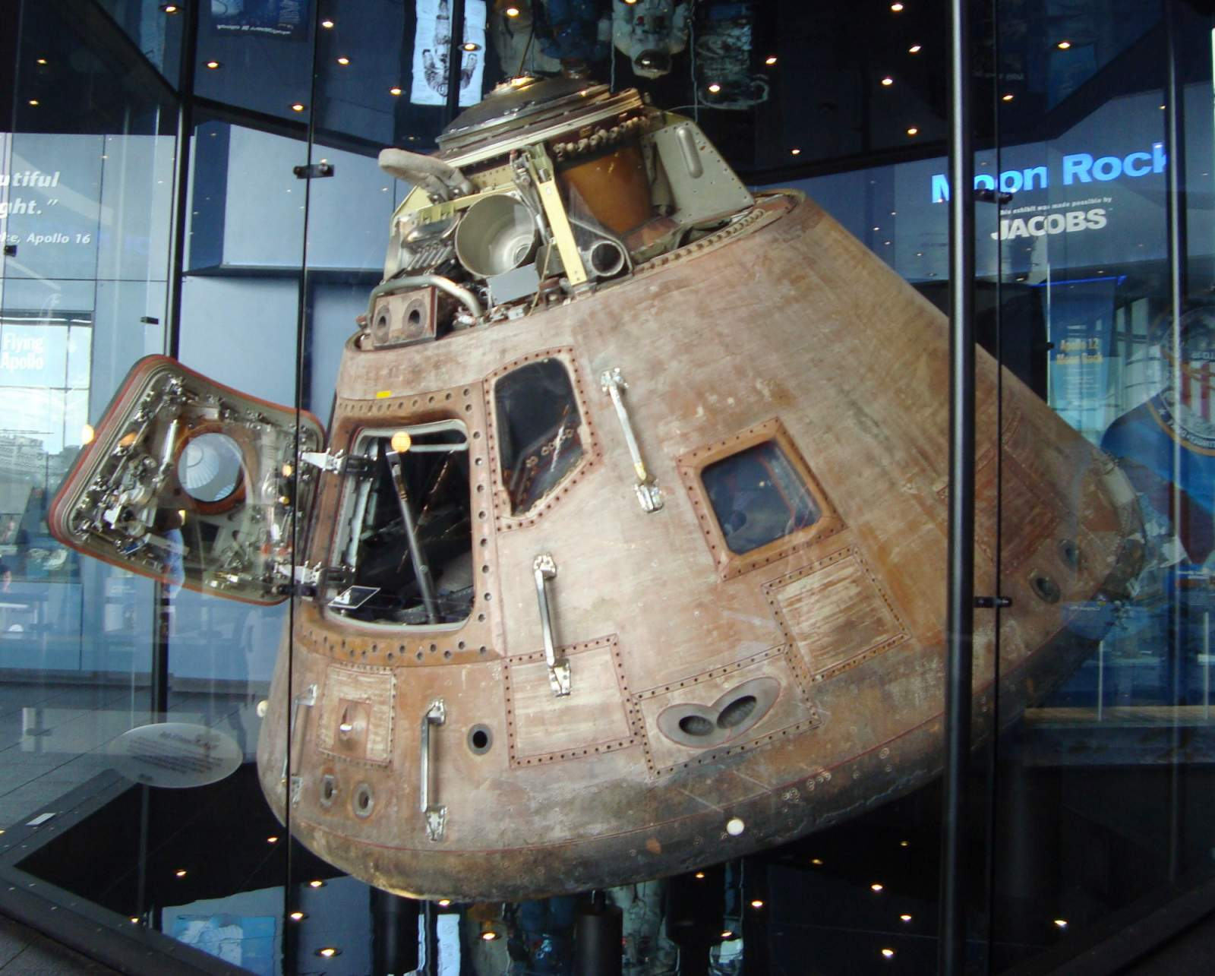
Apollo 16 Command Module
Name: “Casper”
Location:
U.S. Space & Rocket Center
Huntsville, AL
National Air and Space Museum
Notes:
-Image credit: National Air and Space Museum → https://airandspace.si.edu/collection-objects/command-module-apollo-16
-The color of the command module is due to the mylar material used.

Slide 39
More Info
More Info
Notes:
-Image credit: NASA → Apollo 16 panorama, showing Charlie Duke next to the rover, with the lunar module in the distance. This panorama, taken by John Young, includes Image IDs AS16-114- 18449 to 18467.

Slide 40
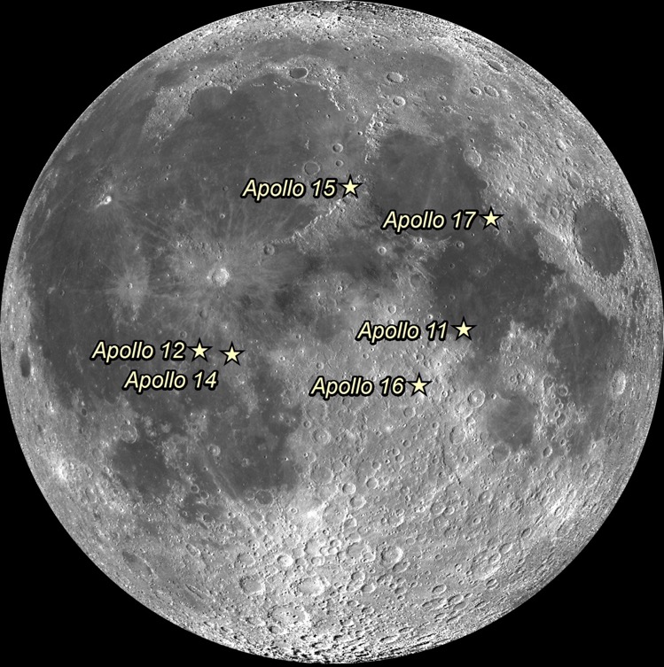
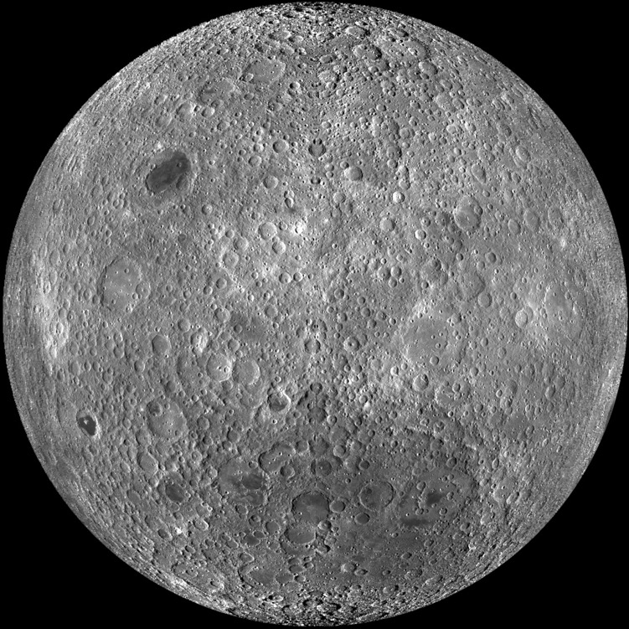
Apollo Landing Sites
Apollo Landing Sites
NASA/GSFC/Arizona State University
Notes:
-Image credit: NASA/GSFC/Arizona State University
-Left: Apollo landing sites (lunar near side)
-Right: Lunar far side
(captured by the Lunar Reconnaissance Orbiter spacecraft)

Slide 41
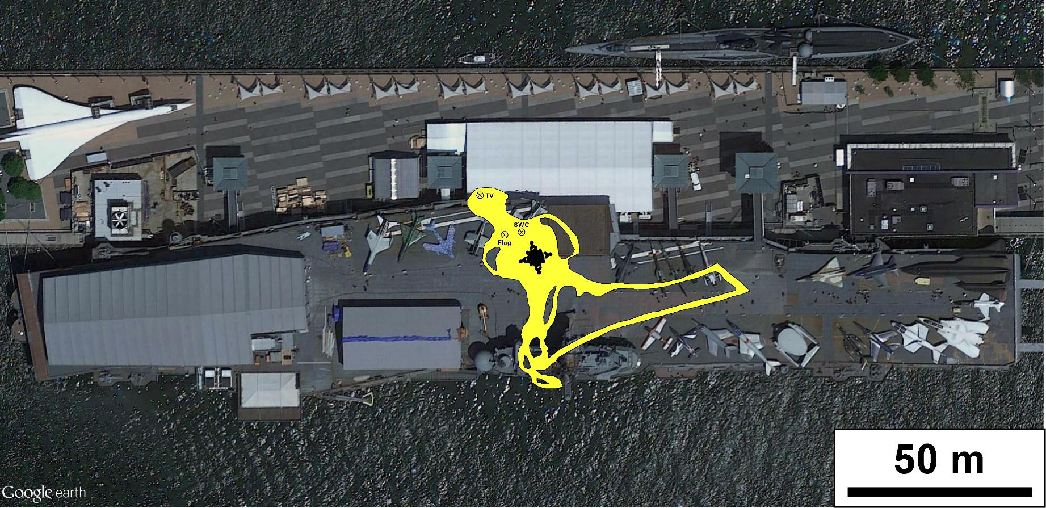
Apollo 11 Traverses
Apollo 11 Traverses ←→ New York City
NASA/GSFC/Brent Garry
Notes:
-Image credit: NASA/GSFC/Brent Garry
-Apollo 11 tracks overlain on the Intrepid Sea, Air & Space Museum in New York City, NY.
-Future Apollo missions would travel up to ~5 mi from the lunar module (Apollo 17).

Slide 42
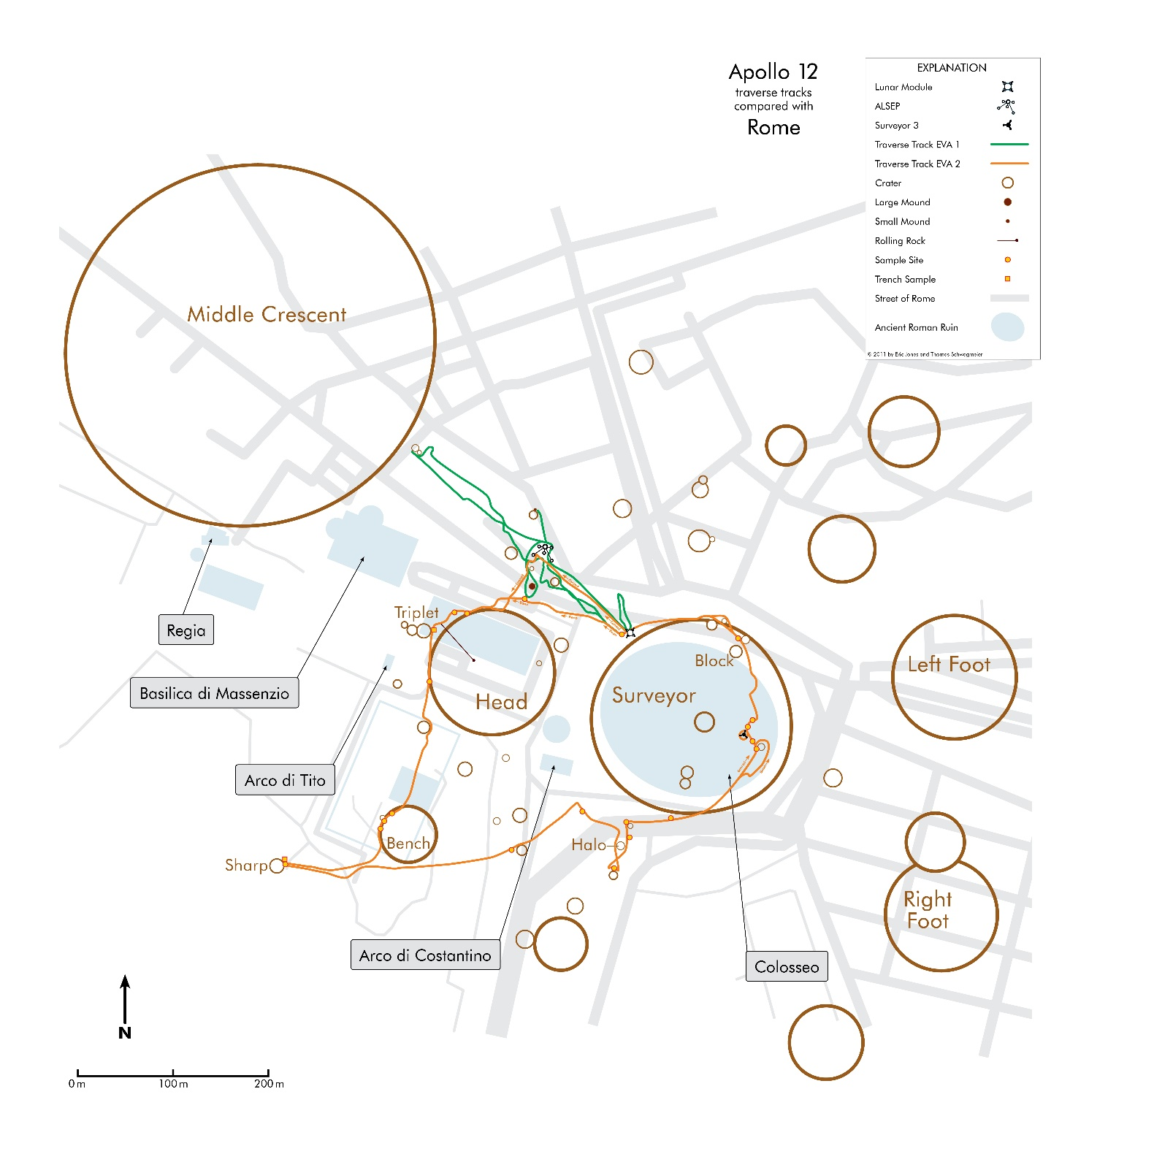
Apollo 12 Traverses
Apollo 12 Traverses ←→ Rome
Thomas Schwagmeier
Notes:
-Image credit: Thomas Schwagmeier
-The Apollo 12 traverse map superimposed on a simplified map of Rome.
-Note that Surveyor Crater is slightly larger than the Coliseum.
-Source: https://www.hq.nasa.gov/alsj/TraverseMapsEarth.html

Slide 43
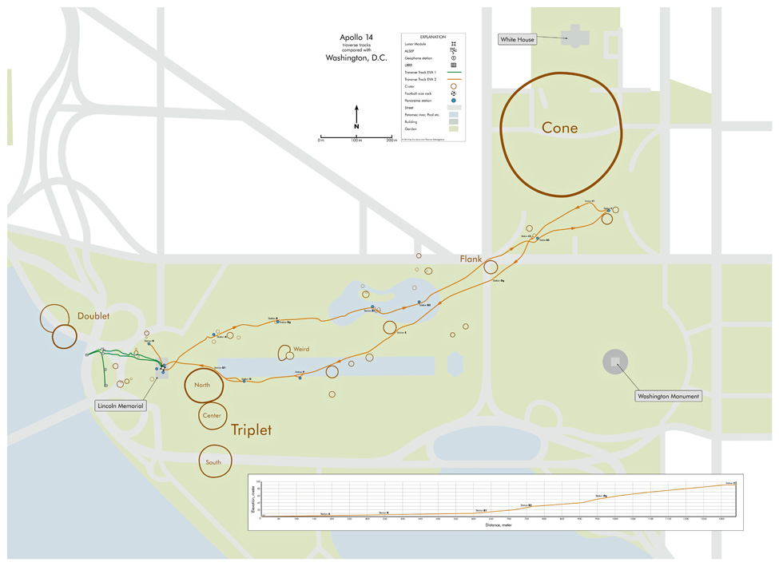
Apollo 12 Traverses
Apollo 14 Traverses ←→ Washington, D.C.
Thomas Schwagmeier
Notes:
-Image credit: Thomas Schwagmeier
-Overlay of the Apollo 14 traverse map, derived from high-resolution Lunar Reconnaissance Orbiter Camera images, on a simplified map of Washington D.C.
-With the lunar module placed at the Lincoln Memorial, the center of Cone crater is on E Street between the South Lawn of the White House and the Ellipse.
-Source: https://www.hq.nasa.gov/alsj/TraverseMapsEarth.html

Slide 44
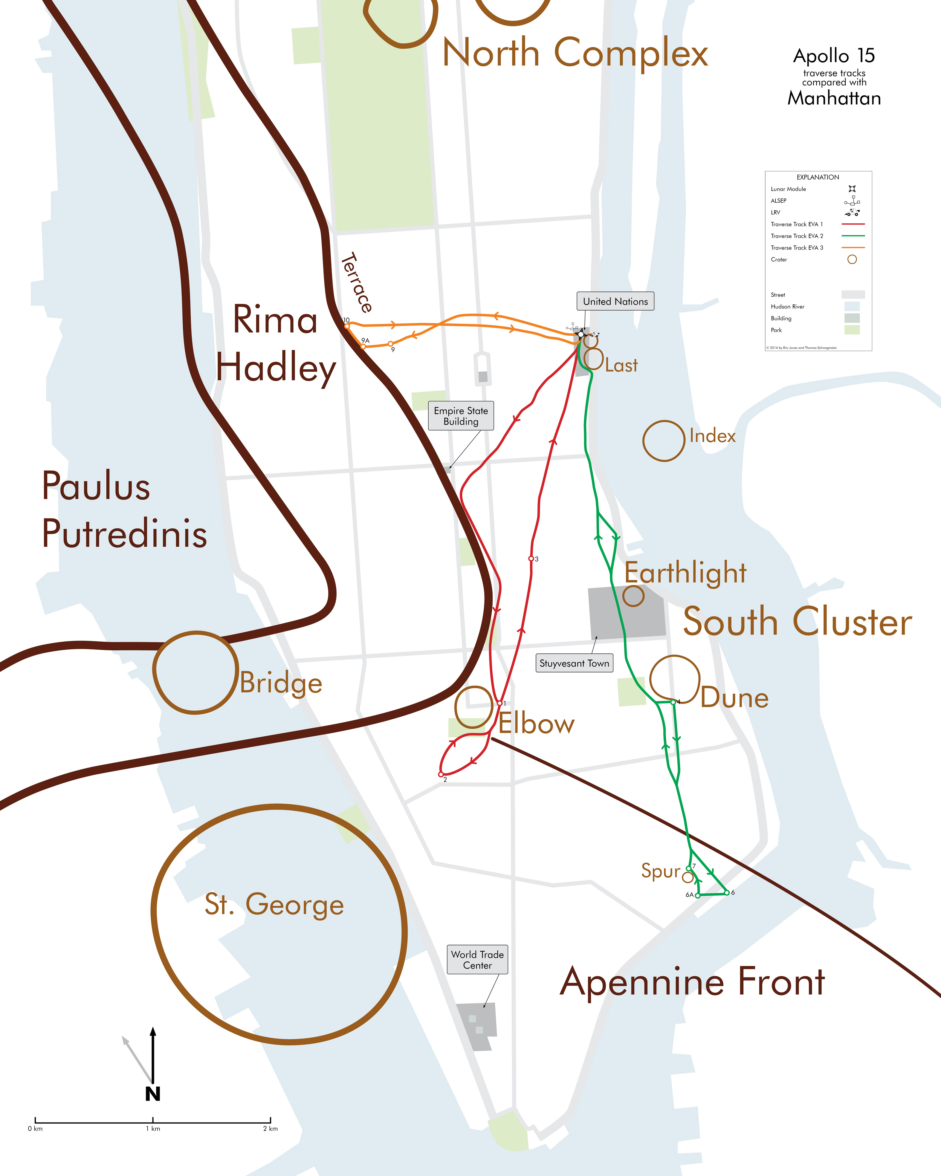
Apollo 12 Traverses
Apollo 15 Traverses ←→ New York City
Thomas Schwagmeier and Eric M. Jones
Notes:
-Image credit: Thomas Schwagmeier and Eric M. Jones
-Overlay of the Apollo 15 traverse map on Manhattan, New York City.
-Because of the Lunar Roving Vehicle, the Apollo 15 crew was able to travel much farther from the lunar module than any of the previous Apollo missions.
-Source: https://www.hq.nasa.gov/alsj/TraverseMapsEarth.html

Slide 45
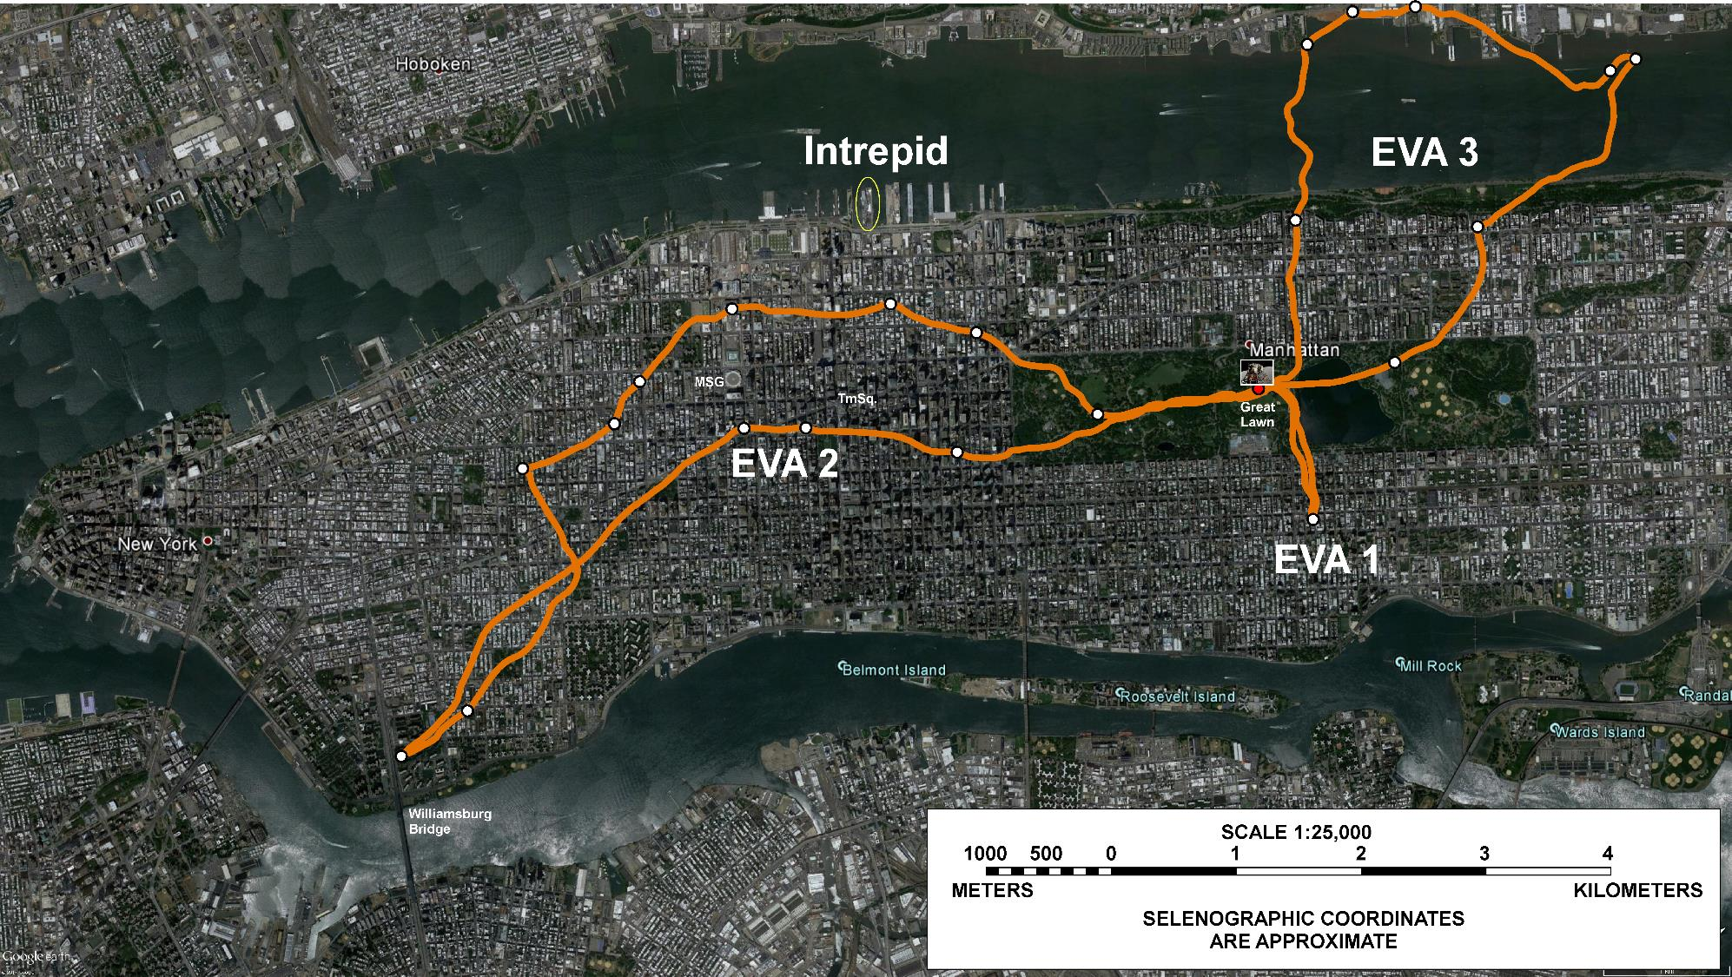
Apollo 17 Traverses
Apollo 17 Traverses ←→ New York City
NASA/GSFC/Brent Garry
Notes:
-Image credit: NASA/GSFC/Brent Garry
-Apollo 17 tracks overlain on New York City, NY.

Slide 46
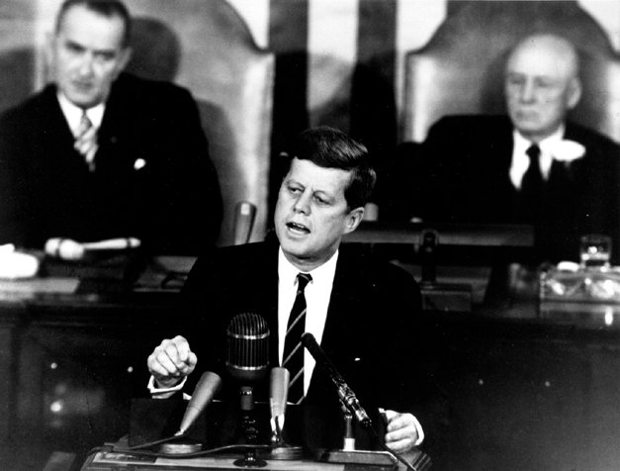
JFK’s Speech
JFK’s Speech
The Decision to Go to the Moon
May 25, 1961
We Choose to Go to the Moon
September 12, 1962
Notes:
-Image source: https://history.nasa.gov/moondec.html → JFK’s address to Congress.
-”The Decision to Go to the Moon”: President John F. Kennedy's May 25, 1961 Speech before Congress. JFK announced before a special joint session of Congress the dramatic and ambitious goal of sending an American safely to the Moon before the end of the decade.
-”We choose to go to the Moon” is the famous tagline of a speech about the effort to reach the Moon delivered by President John F. Kennedy to a large crowd gathered at Rice Stadium in Houston, Texas on September 12, 1962.

Slide 47
Additional Resources
Additional Resources
Apollo Images:
https://images.nasa.gov/
https://www.hq.nasa.gov/alsj/a16/images16.html
http://lroc.sese.asu.edu/featured_sites#ApolloLandingSites
Apollo Videos:
https://svs.gsfc.nasa.gov/Gallery/apollo.html
Apollo 16 General:
https://nssdc.gsfc.nasa.gov/planetary/lunar/apollo16info.html
https://www.lpi.usra.edu/lunar/missions/apollo/apollo_16/overview/
Preliminary Science Report: https://history.nasa.gov/alsj/a16/a16psr.html

