Slide 1
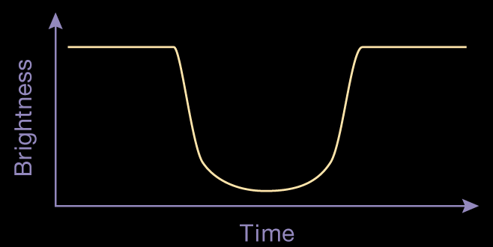
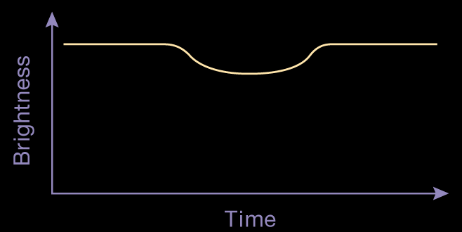
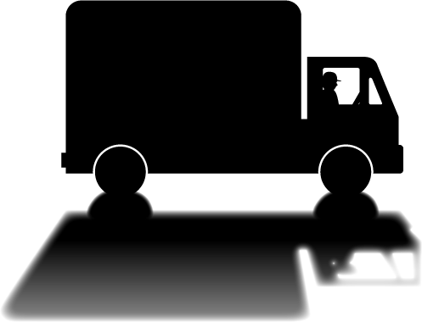
Exoplanet Detection – Transit Method
Exoplanet Communications
A car’s headlights on a dark street.
Astronomers use this same trick to discover exoplanets.
Any amount of decrease in the light’s brightness,
brought about by the passing object,
can be documented using a “light curve.”
Unseen objects may reveal themselves when passing in front of a light source.
The presence (and motion) of objects far too small to be seen can be revealed by observing changes in a star’s brightness.
exoplanets.nasa.gov
Notes:
This slide starts automatically, then requires 6 clicks:
First click = first appearance of the truck and bicycle
Second click = statement about light curves
Third click = example of light curve (empty)
Forth click = completion of light curve with example of truck
Fifth click = example of light curve with bicycle
Sixth click = statement regarding astronomers
Seventh click transitions to next slide
Audience:
4th Grade and older.
Description:
This slide explains and illustrates how a phenomenon called transit is used to detect exoplanets.
This is a commonplace analogy of transit
User's notes:
The shapes (and depths) of light curves for the truck and bicycle are approximate.
NASA Kepler space telescope and TESS use this method.
The additional information can be available at e.g., https://exoplanets.nasa.gov/what-is-an-exoplanet/in-depth/
NOTE:
This PowerPoint file has built-in interactive elements.
To view them, you must be in "Slide Show" mode; you can then move to the next view either by clicking your mouse, the spacebar, or the arrow keys.
This slide will not work in "regular viewing mode."
Credit:
NASA/JPL-Caltech

Slide 2
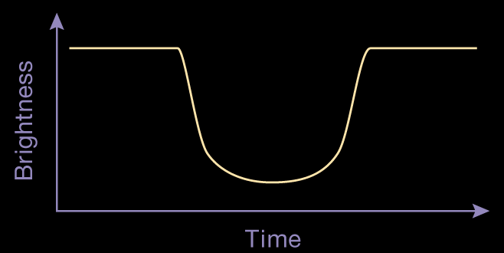
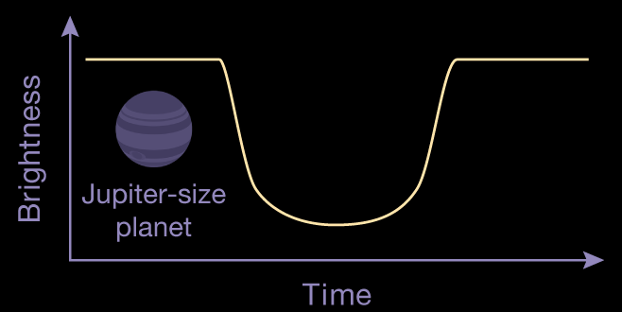
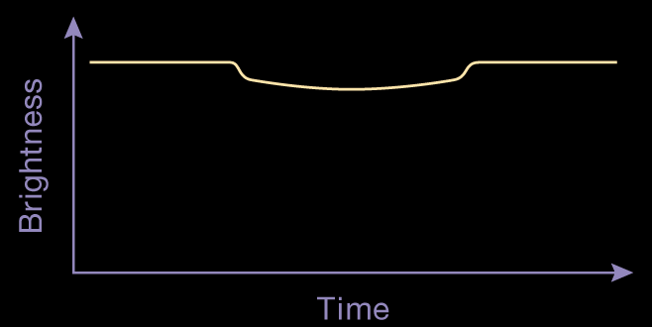
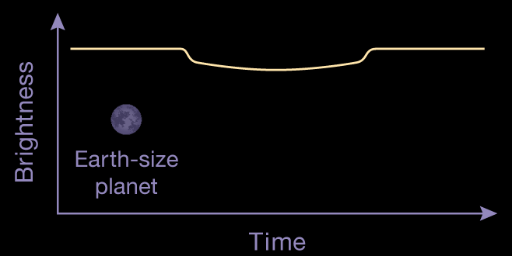
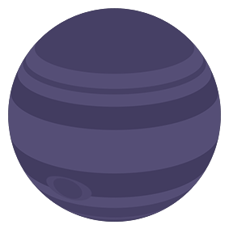
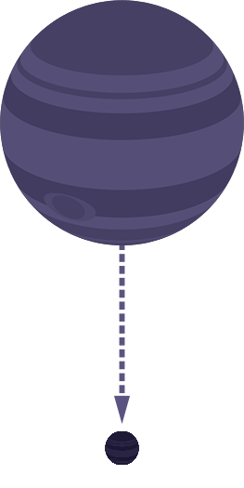
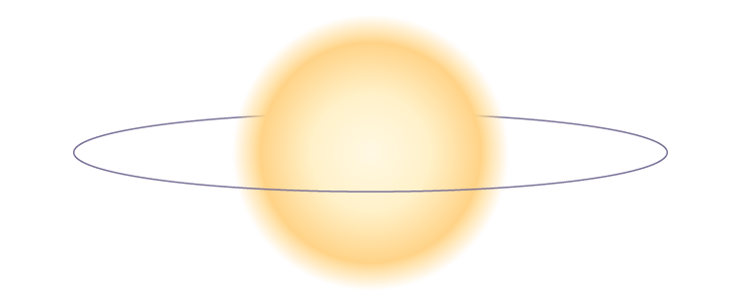
Exoplanet Detection – Transit Method
Exoplanet Communications
(Depth exaggerated for clarity)
(Depth exaggerated for clarity)
However, these observed changes to a star’s brightness are incredibly tiny, making the study of them very challenging.
Jupiter-size
planet
Earth-size
planet
exoplanets.nasa.gov
Notes:
This slide requires 3 clicks:
First click starts = demonstration of Jupiter-size planet light curve
Second click = demonstration of Earth-size planet light curve
Third click = discussion of the scale of light curves
Forth click transitions to next slide
Description:
This slide explains and illustrates how a phenomenon called transit is used to detect exoplanets.

Slide 3
Exoplanet Detection – Transit Method
Exoplanet Communications
Only a small 1% decrease in brightness
The depth of this curve
=
An incredibly tiny 0.01% decrease in brightness
The depth of this curve
=
exoplanets.nasa.gov
Notes:
This slide starts animation automatically after the slide change, then requires 1 click:
First click = discussion of the Earth-size planet light curve
Second click transitions to next slide

Slide 4
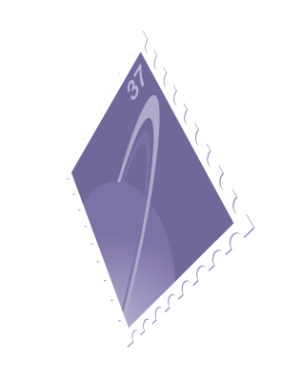
Exoplanet Detection – Transit Method
Exoplanet Communications
Imagine an impossibly large container of ice cream.
No, no, much larger.
1%
1% would be about equal to scooping
1cm deep.
That’s about the thickness of a cell phone.
Whereas 0.01% would be like scooping only the thickness of a postage stamp!
1 meter
(39 inches)
0.01%
exoplanets.nasa.gov
Notes:
This slide requires 3 clicks:
First click = starts a comparison between the light curve depths and the scooping of ice cream (stops at container dimensions)
Second click = continues comparison of light curve with scooping ice cream (stops after cell phone depth)
Third click = compares light curve depth of 0.01% to a postage stamp
Forth click transitions to next slide
Description:
This slide explains and illustrates how tiny transit depths are to discover exoplanets, using commonplace examples.

