Slide 1
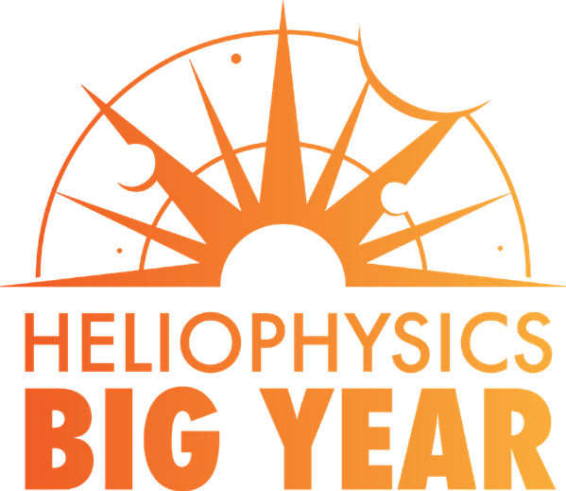
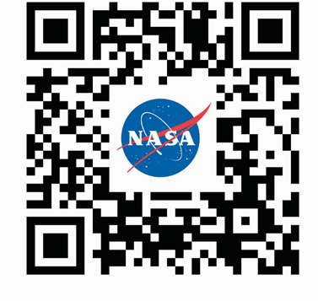
4
3
2
1
Join us Oct. 2023
to Dec. 2024 for a global celebration of solar science and the Sun’s influence on Earth and the entire solar system.
Visit go.nasa.gov/HelioBigYear
to learn more!
5
6
Back Cover
Front Cover

