Slide 1
Prelude to the STM
Betsy Pugel
NASA Goddard Space Flight Center
Betsy.Pugel@nasa.gov

Slide 2

About me
PI Launchpad 2023 - STM Prelude - Pugel

Slide 3

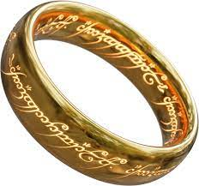
Goals
Objectives
Requirements
STM

Slide 4
Goals
Objectives
Requirements
STM

Slide 5


In the hours ahead…
Foundations…
science case development
Communicating the science case…
storytelling
Why?...
…this mission?
…this science?
…this planetary body?
…this series of measurements?
…now?
Day 1: Goals and Objectives
PI Launchpad 2023 - STM Prelude - Pugel

Slide 6
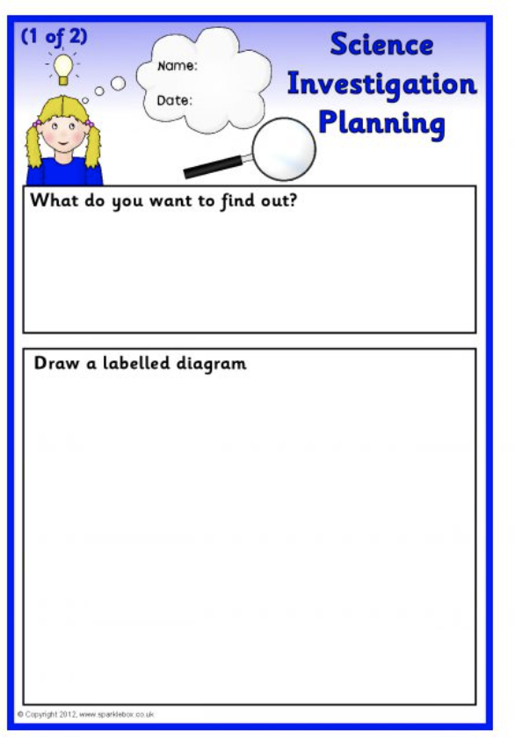
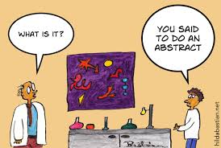
In the days ahead…
The language and mechanics
of requirements
Organizing
Science Traceability Matrix
Day 2: Requirements → STM
PI Launchpad 2023 - STM Prelude - Pugel

Slide 7
Goals
Objectives
Requirements
STM

Slide 8
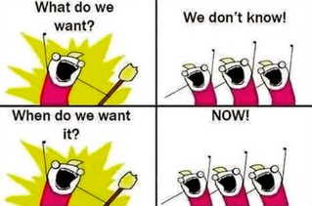
In the days ahead…
The language and mechanics
of requirements
Benevolent introduction to requirements:
Language & structure
Levels and use
Connection to the STM
PI Launchpad 2023 - STM Prelude - Pugel

Slide 9

Requirements
Requirement: The agreed-upon need, desire, want, capability, capacity, function or demand for instruments, personnel, equipment, facilities, or other resources or services by specified quantities for specific periods of time or at a specified time expressed as a “shall” statement.
General Language:
The [noun] shall [quantitative verb] [aspect of the physical system] [preposition] [verification parameter(s) ].
PI Launchpad 2023 - STM Prelude - Pugel

Slide 10
In the days ahead…
Does the science address NASA goals?
Does the investigation address the science?
Does the instrument/mission implement the investigation robustly?
Organizing
Science Traceability Matrix
Science Traceability Matrix is a tool to:
Track the overall mission requirements
Provide engineers with fundamental requirements needed to design the mission
Show effects of any descoping or losses of elements to the overall science
ChatGPT3’s answer wasn’t too shabby:
“Building a science traceability matrix is an important aspect of scientific research and experimentation. A traceability matrix helps establish clear links between requirements, specifications, test cases, and other project elements, ensuring that each requirement is properly verified and validated. “
PI Launchpad 2023 - STM Prelude - Pugel

Slide 11
Goals
Objectives
Requirements
STM

Slide 12
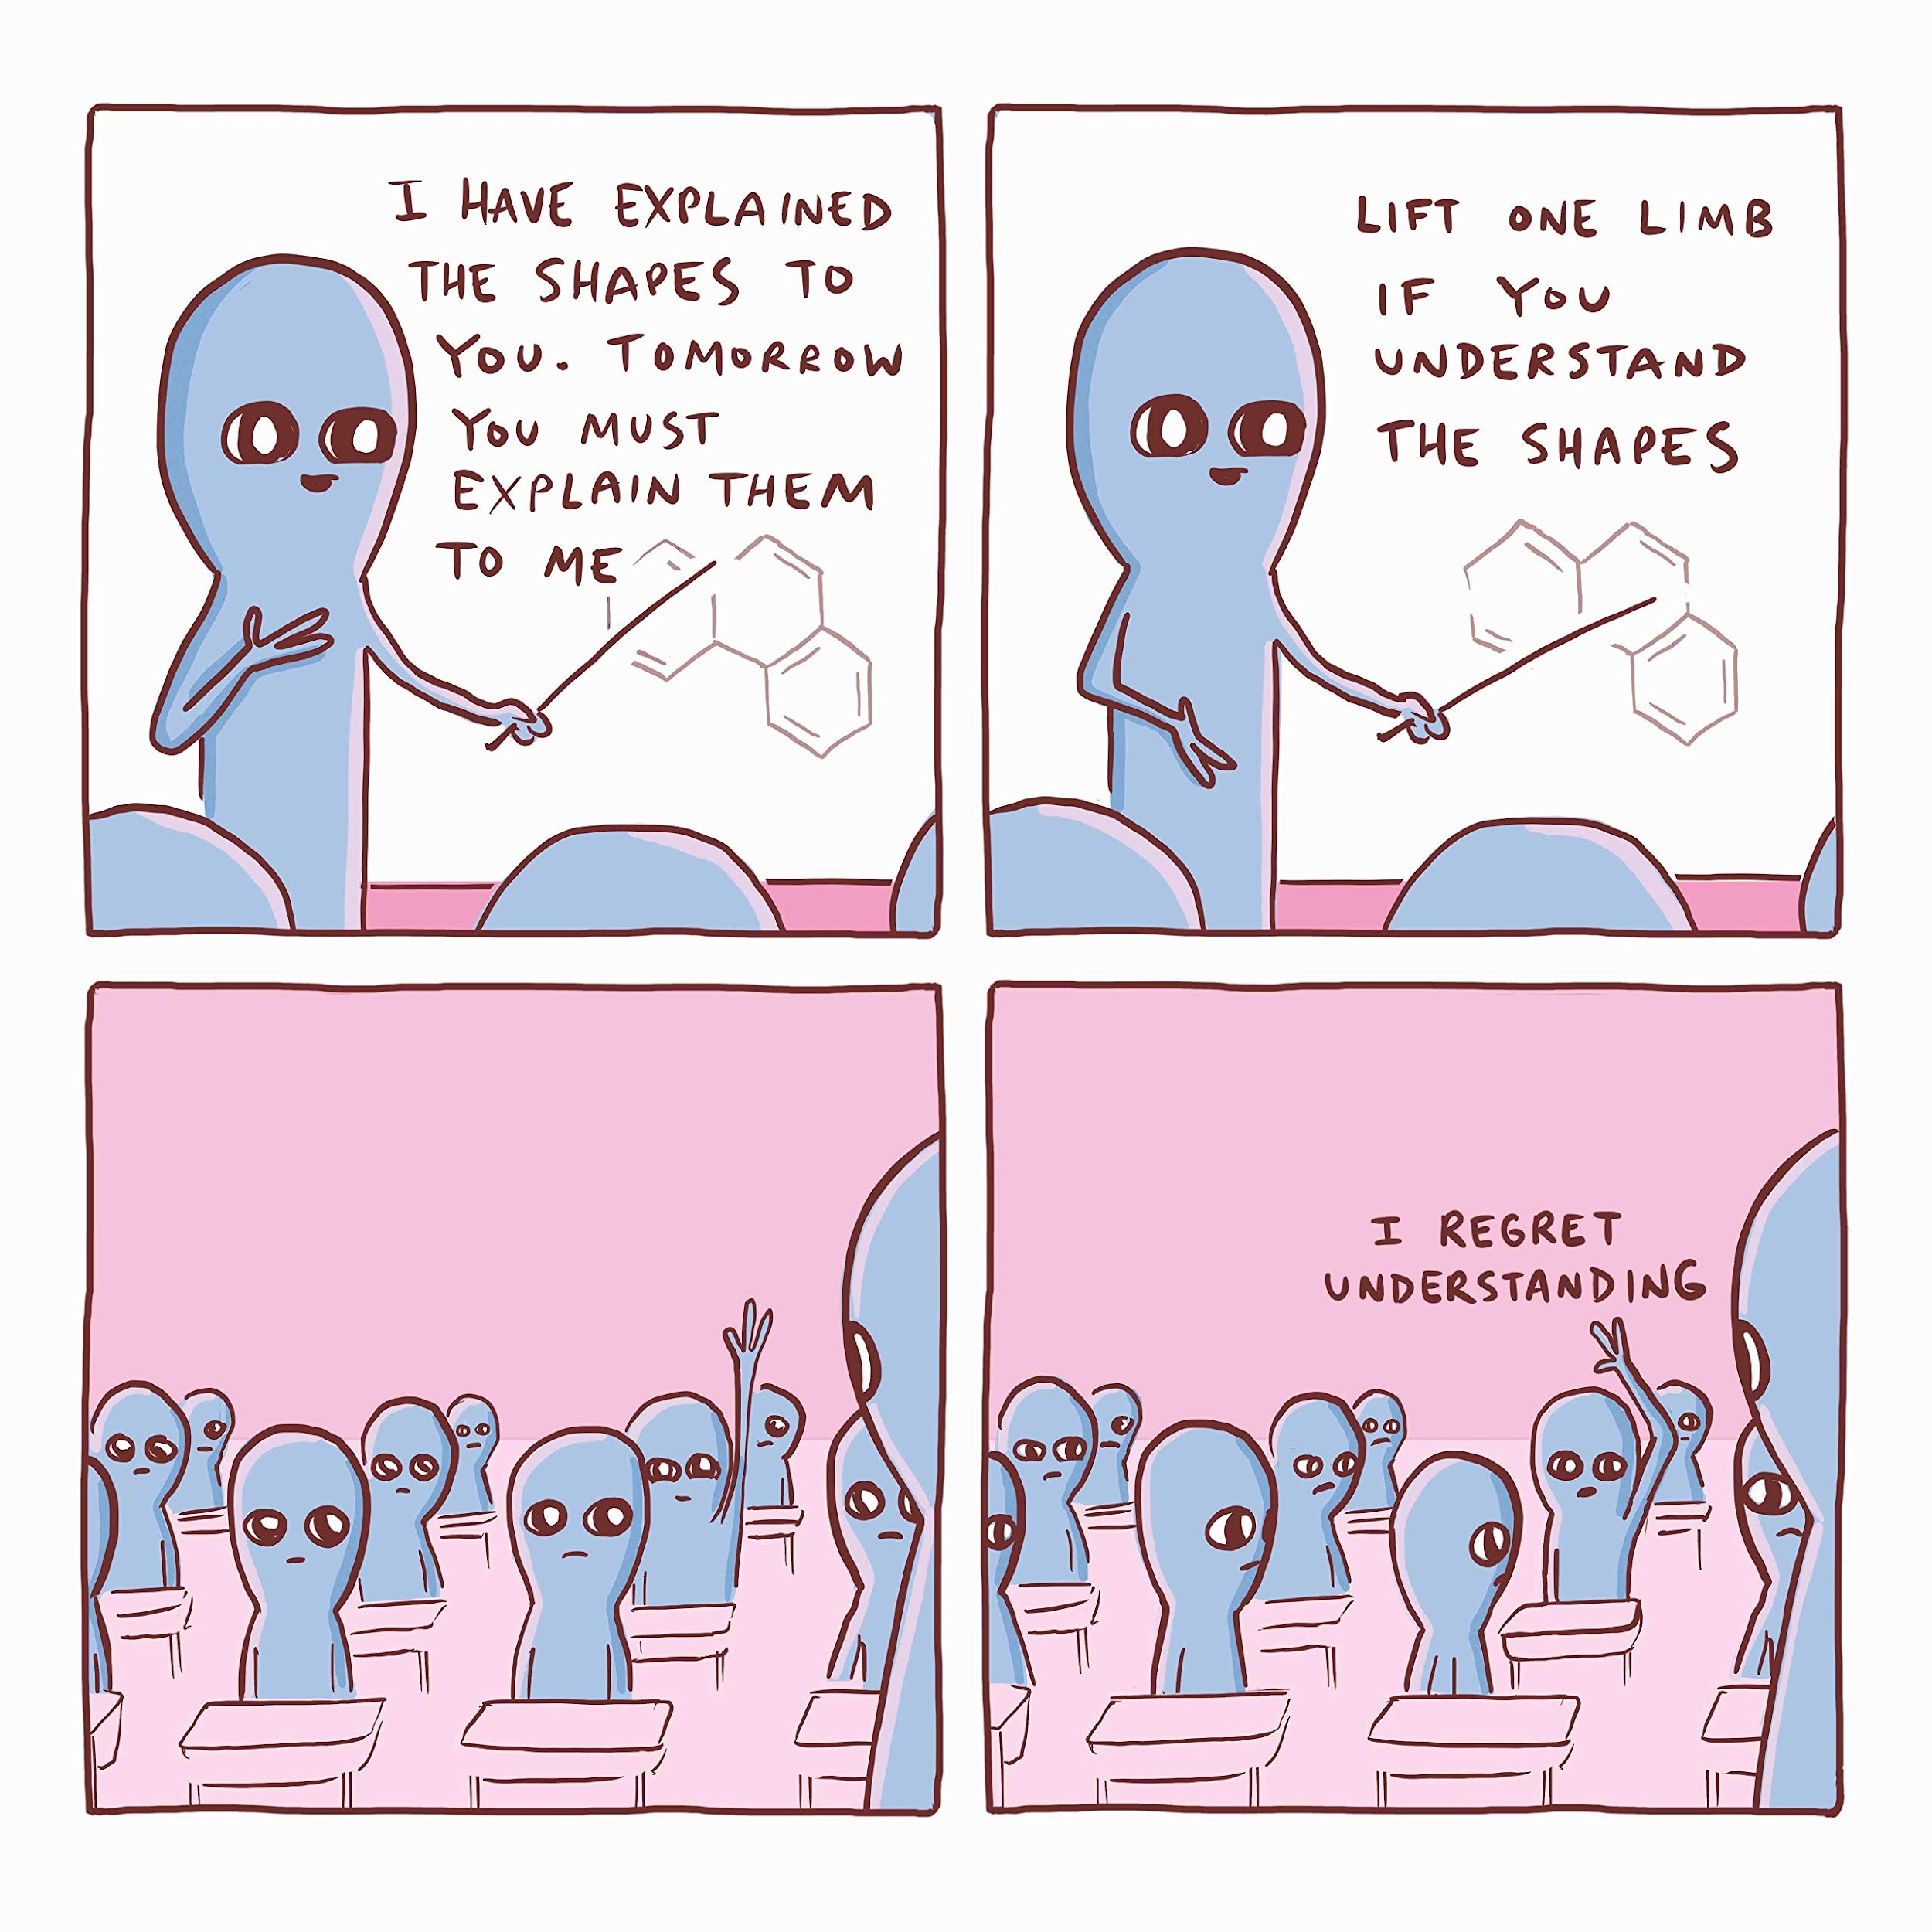
Betsy Pugel
NASA Goddard Space Flight Center
Betsy.Pugel@nasa.gov
(301) 286-6607

Slide 13
Backup Slides

Slide 14
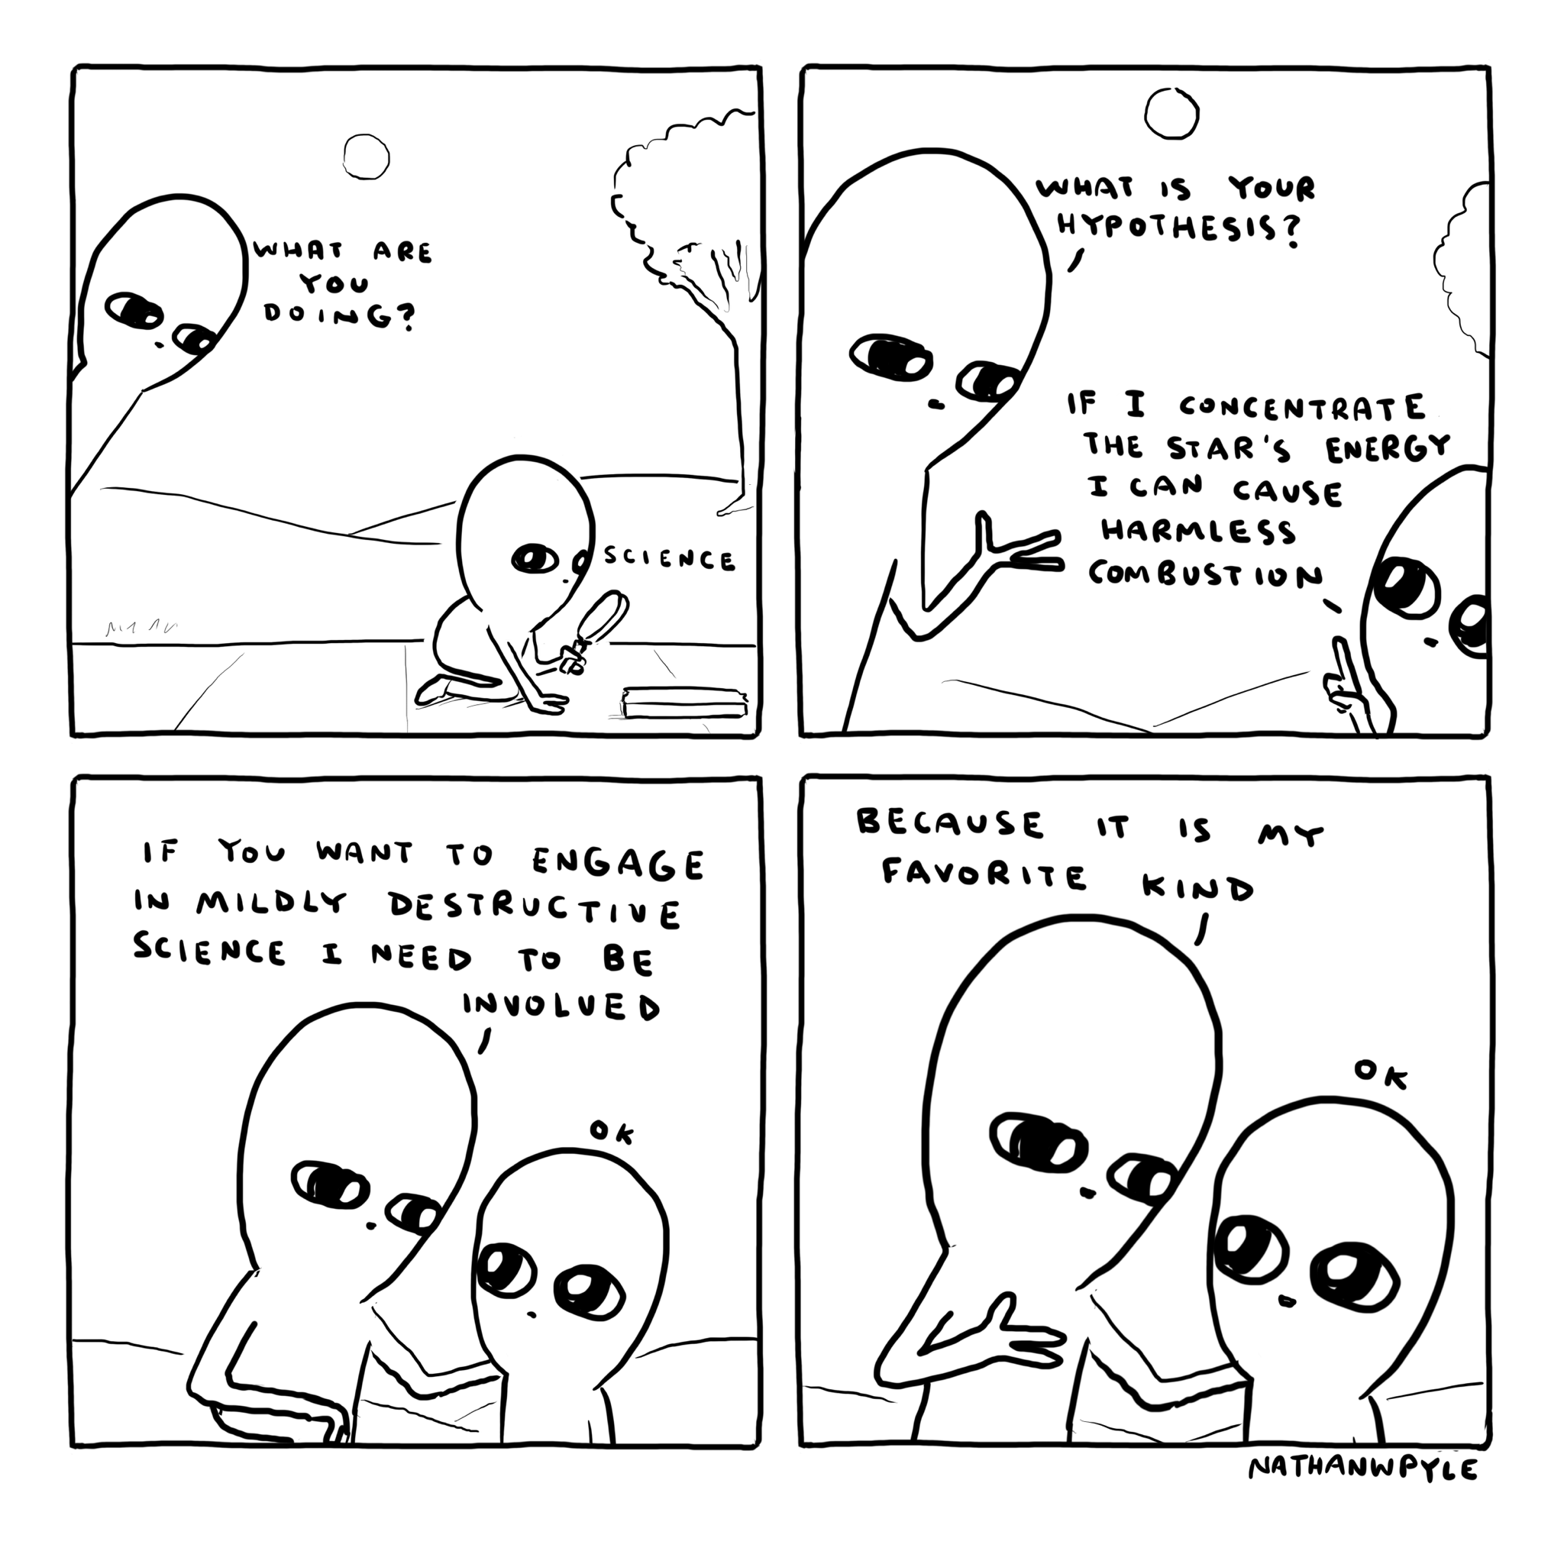
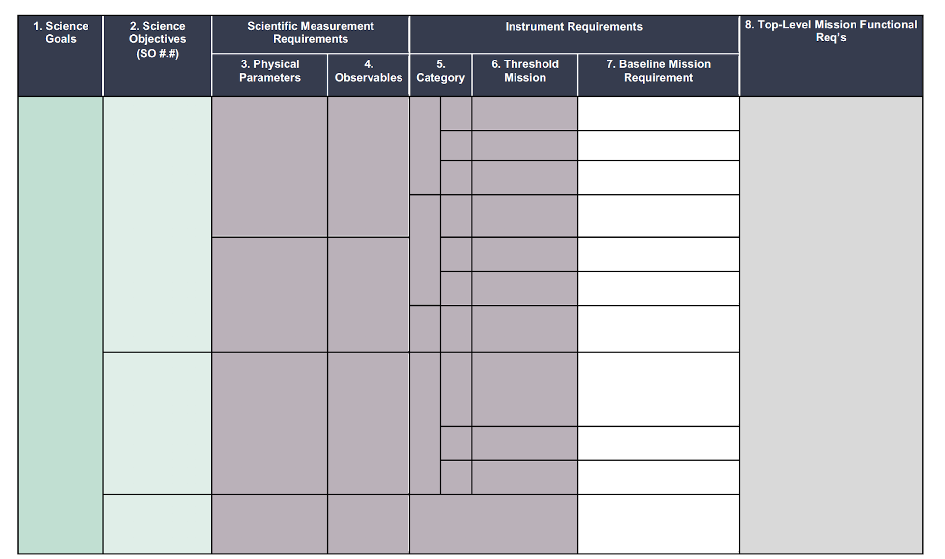
Why?...
…this mission?
…now?
Science
Goals
&
Objectives
Science
Question
…this science?
…this planetary body?
…this series of measurements?
STM
COLUMN 1: Science goals are:
Broad
Identified by NASA as “high value”
Established by relevant priorities from NASA and National Academies documents
Science
Goals &
Objectives
COLUMN 2: Science Objectives are:
      Specific
    Capable of being validated

Slide 15
Observable 1
Science
Goals
&
Objectives
Observable 2
…
Observable n
STM
Scientific Measurement Requirements
Observable 1
COLUMN 3: Physical Parameter
Real-world property of the target under investigation
Observable 2
Science
Goals &
Objectives
…
COLUMN 4: Observables
Measured observables to determine/infer physical parameters of the body under investigation
Quantify how well those parameters need to be determined to meet your science objectives.
Observable n
Notes:
In your workbooks you have a science traceability matrix and in this example, it’s broken down into 8 parts.
In this talk, I’m going to chunk those parts in a way that will help frame the general concept of how an STM comes together with all of the things we will talk about this week..

Slide 16
Instrument Requirements:
Functional requirements for each instrument
STM
You can’t always get what you want, but if you try sometimes, you just might find, you get what you need…
I want it all, I want it all, I want it all…
Observable 1
Variable 1A
, 1B, 1C, …
Variables measured on
Science
Goals &
Objectives
Observable 2
Variable 2A
, 2B, 2C, ...
Instrument 1
…
Instrument n
…
…
Observable n
Variable nA
, nB, nC, ...
‹#›
Photo - https://www.loc.gov/exhibits/british/brit-7.html
Notes:
Instrument Performance Requirements.: what is needed to make a measurement? Two categories—baseline and threshold…
Baseline:full scie
Threshold: minimum science
You’ll hear this from me again on Thursday when we come back to all of this and talk about requirements, so don’t worry, but this is a fun digression so….back to the connectedness of everything

Slide 17

STM
Observable 1
Variable 1A
, 1B, 1C, …
Variables measured on
Observable 2
Variable 2A
, 2B, 2C, ...
Instrument 1
…
Instrument n
Science
Goals &
Objectives
…
…
Observable n
Variable nA
, nB, nC, ...
Notes:
In your workbooks you have a science traceability matrix and in this example, it’s broken down into 8 parts.
In this talk, I’m going to chunk those parts in a way that will help frame the general concept of how an STM comes together with all of the things we will talk about this week..

Slide 18
Observable 1
Variable 1A
, 1B, 1C, …
Variables measured on
Observable 2
Variable 2A
, 2B, 2C, ...
Instrument 1
Instrument n
Science
Goals
…
…
…
Observable n
Variable nA
, nB, nC, ...
Technology Development &
Technology Readiness Levels (TRL)
Data Sufficiency
Risk
Instrument
Observable
5/10/21
PI Launchpad Title
‹#›

Slide 19
Observable 1
Variable 1A
, 1B, 1C, …
Observable 2
Variable 2A
, 2B, 2C, ...
Science
Goals
…
…
Observable n
Variable nA
, nB, nC, ...
Variables measured on
Instrument 1
…
Instrument n
Technology Development &
Technology Readiness Levels (TRL)
Team Building
5/10/21
PI Launchpad 2023 – STM Prelude
‹#›

Slide 20
Observable 1
Variable 1A
, 1B, 1C, …
Variables measured on
Observable 2
Variable 2A
, 2B, 2C, ...
Instrument 1
Instrument n
Science
Goals
…
…
…
Observable n
Variable nA
, nB, nC, ...
Functional/Engineering Requirements:
Instrument 1
Detector
Optics
Readout
Thermal
Notes:
And instruments have parts to them too, so let’s not forget the magic that happens when science and engineering come together!

Slide 21
Observable 1
Variable 1A
, 1B, 1C, …
Variables measured on
Observable 2
Variable 2A
, 2B, 2C, ...
Instrument 1
Instrument n
Science
Goals
…
…
…
Observable n
Variable nA
, nB, nC, ...
Instrument 1
Detector
Optics
Readout
Thermal
Notes:
If we group things like this we can see how this connects to the Science Traceability Matrix.

Slide 22
Science
Payload
Observable 1
Variable 1A
, 1B, 1C, …
Variables measured on
Science
Goals
&
Objectives
Observable 2
Variable 2A
, 2B, 2C, ...
Instrument 1
Instrument n
…
…
…
Observable n
Variable nA
, nB, nC, ...
Instrument
Instrument 1
Detector
Optics
Readout
Thermal
Notes:
Grouping all the diagrams by science, instrument group and instrument itself, the folks managing a project use this kind of grouping to help them keep track of budget and schedule. You’ll hear about this in detail later next week from Keith Walyus

Slide 23


STM
Technology Development
& Technology Readiness Levels
Risk
Data Sufficiency
Team Building
Observable 1
Variable 1A
, 1B, 1C, …
Variables measured on
WBS
Observable 2
Variable 2A
, 2B, 2C, ...
Instrument 1
…
Instrument n
Science
Goals &
Objectives
…
…
Goals
Observable n
Variable nA
, nB, nC, ...
Objectives
Architecture
Science Question
Storytelling
Requirements
Notes:
.

Slide 24
Science Work Breakdown Structure (WBS)
Payload WBS
Observable 1
Variable 1A
, 1B, 1C, …
Variables measured on
Science
Goals
&
Objectives
Observable 2
Variable 2A
, 2B, 2C, ...
Instrument 1
Instrument n
…
…
…
Observable n
Variable nA
, nB, nC, ...
Instrument WBS
Instrument 1
Detector
Optics
Readout
Thermal
Subsystem WBS
Notes:
These are called WBS or Work Breakdown Structures and they help maintain awareness of cost/schedule in different areas.

Slide 25
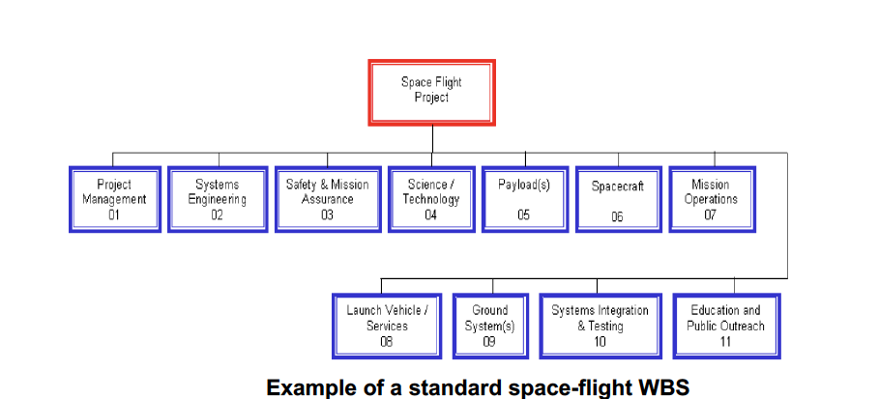
Payload WBS
Science Work Breakdown Structure (WBS)
Variables measured on
Observable 1
Variable 1A
, 1B, 1C, …
Science
Goals
&
Objectives
Observable 2
Variable 2A
, 2B, 2C, ...
Instrument 1
…
Instrument n
…
…
Observable n
Variable nA
, nB, nC, ...
Notes:
You’ll hear about this in week 2, though it connects back to the Science Traceability Matrix via these parts that I’ve grouped, so I’m mentioning it here.

