Slide 1
Inspired Science:
Powered by NASA
Dr. Nicola Fox
Associate Administrator, Science Mission Directorate
July 24, 2023

Slide 2
AGENDA
01
04
GETTING TO SPACE
INTRODUCTION
02
SO YOU WANT TO BE A PI?
05
FINAL THOUGHTS
03
EFFECTIVE LEADERSHIP

Slide 3
Should You Aspire to Be a PI?
Being a PI is not for everyone - you can be a successful scientist without ever leading a mission and it typically takes more than two proposals to win
Most organizations are not equipped to support a PI-class proposal
Being a PI will keep you constantly busy for four or more years, delaying other options and decreasing your publication rate
Your life will be taken over, including evenings and holidays
You do it because you truly desire it; it is the most important thing you want to do
NASA is always in the market for great PIs, including people with great ideas who have not proposed in the past

Slide 4
PIs Come from a Variety of Organization Types
Universities
Non-Profits
For Profits NASA Centers + JPL
Other Government Agencies
The CIRBE (Colorado Inner Radiation Belt Experiment) satellite is a 3U (10cm x 10cm x 30cm) CubeSat with the mission of allowing scientists to gain a better understanding of the formation of the inner radiation belt electrons as well as determine where these particles come from and how they behave. The proposed goal of the CIRBE mission is to provide state-of-the-art measurements of .3-3.5 MeV electrons (and 6-35 MeV protons) in the Earth’s radiation belt in a highly inclined Low Earth Orbit.

Slide 5
Imagine Being a PI…
You receive a call informing you that your mission was selected for development
Your life changes in a heartbeat; you have already invested a significant fraction of at least two years with your project, and know strengths and weaknesses of your partners and team
You have survived two major down-selects; you have managed to raise support measured in millions of dollars and in work-years from your team
You know you have lots of autonomy, but you have lots of responsibility as well; you will represent your mission, NASA, and an entire science discipline
You know that you need to keep your mission within the cost cap or NASA can cancel it; this is how NASA controls risk
You know this will be one of the toughest things you will ever do; you WILL have problems and the team and your community are depending on you to succeed

Slide 6
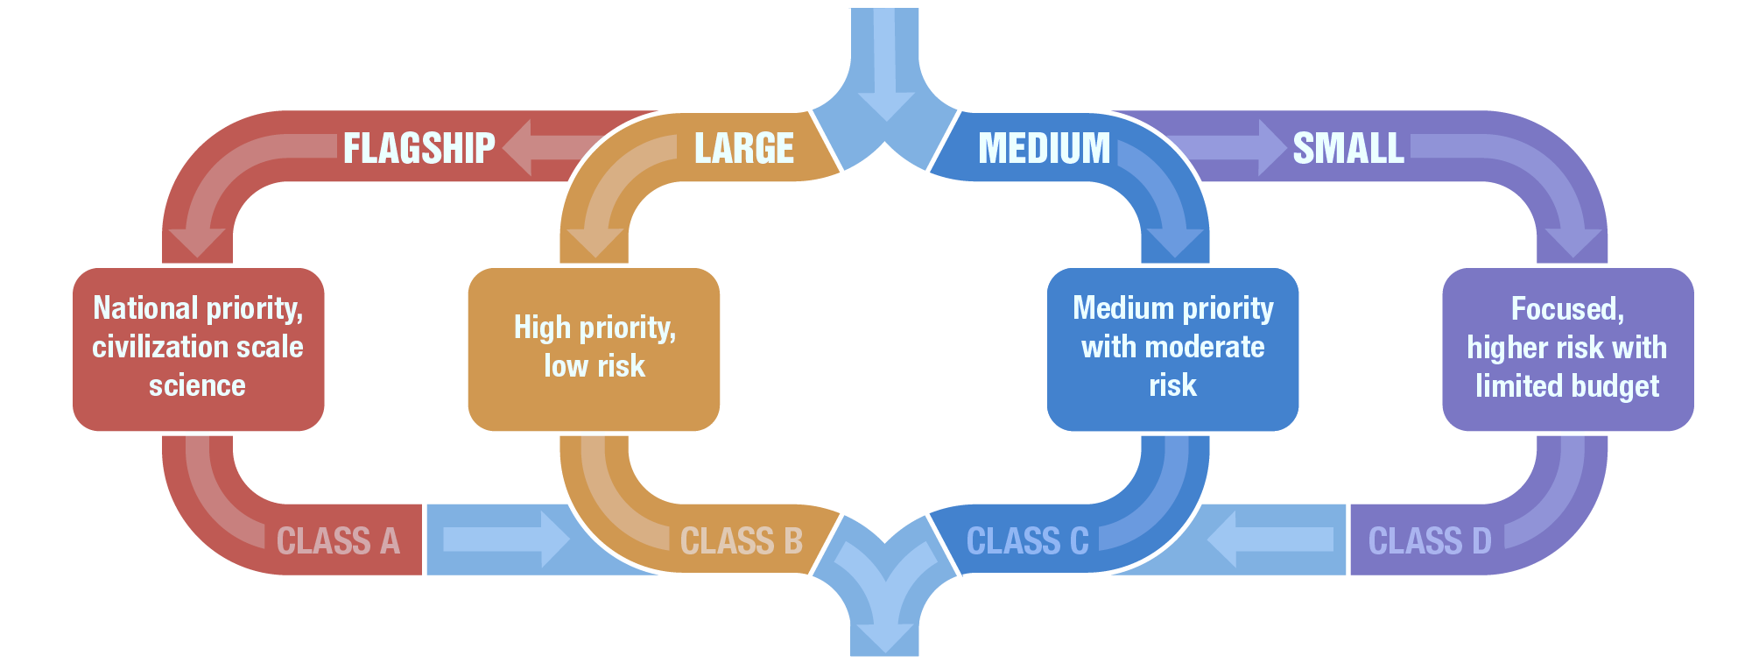
Balanced Mission Portfolio
Great Science

Slide 7
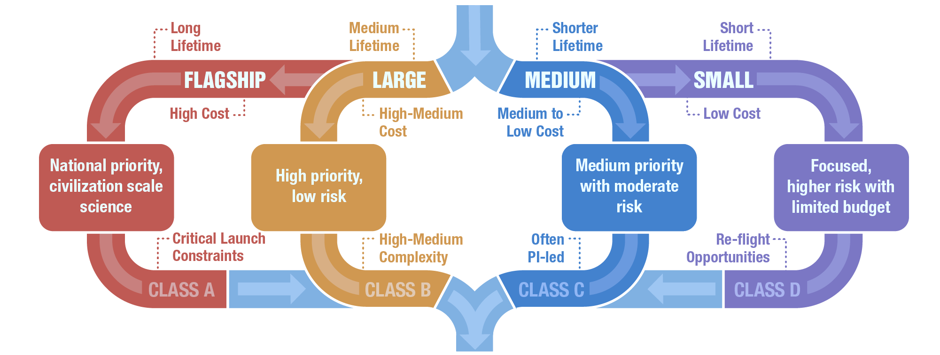
Balanced Mission Portfolio
Great Science

Slide 8
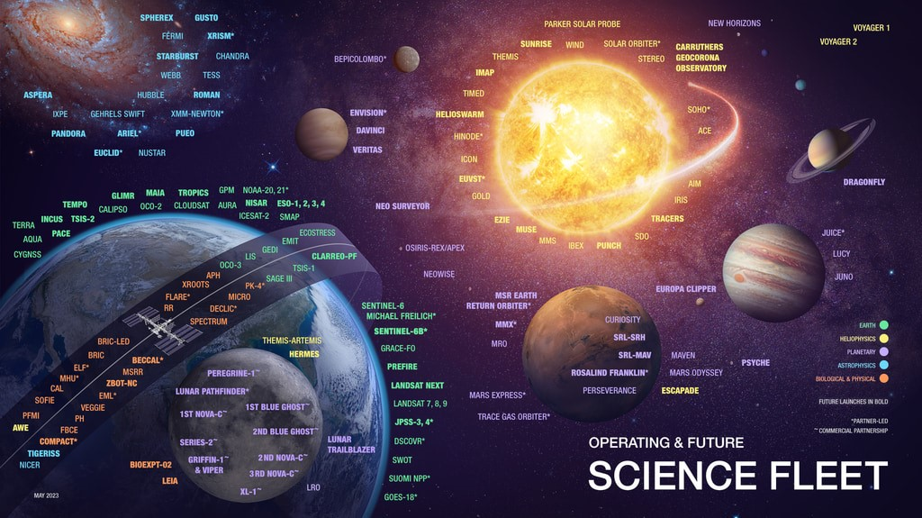

Slide 9
EFFECTIVE LEADERS

Slide 10
What is an Effective Leader?
EFFECTIVE LEADERS
Trustworthy – NASA and community depend on PI
Shares NASA’s values and sets consistent culture – excellence, leadership, integrity, teamwork, safety
Scientifically credible – spokesperson to science community and beyond
Know what you don’t know, and be willing to learn – excellence comes from your team
Listen first and then be decisive – make informed decisions and stick to them
Able to make hard decisions that may trade science to maintain integrity of overall mission
Know how to lose and persevere – without perseverance, you will never succeed
Be aware that you are spending taxpayer’s money

Slide 11
Skills and Experiences that Make You Effective
EFFECTIVE LEADERS
Demonstrated leadership
Understands and has worked with NASA missions in formulation, development, and operations
May have developed space instruments
Basic bilingual capabilities in science and engineering, understands tenets of systems engineering
Ability to make science accessible for multiple audiences – without it, tough to motivate own team or give Step 2 presentation
Know how to work within NASA's culture; focus on successes, not obstacles
A 'glass-half-full' attitude – difficult for a pessimist to inspire
Is perfectly ok to ask for help, and knows when to ask!

Slide 12
Key Takeaways on Effective Leadership
EFFECTIVE LEADERS
Best predictor of PI’s leadership ability is by how they bring their team together to write a proposal and to make tough decisions; NASA Science notices this during proposal process and Phase A, particularly at site visits
Team members cannot compensate for significant character weaknesses of PIs, such as arrogance, inability to listen, and inability to make decisions; in Step 2, NASA Science evaluates how teams have evolved
Proposal writing is a fundamentally innovation-based activity; diversity of PIs and teams will make proposals stronger
NASA Science is actively discussing how to do a better job developing PIs

Slide 13
EXCELLENT TEAMS

Slide 14
What Makes An Excellent Team?
EXCELLENT TEAMS
Industrious individuals exhibiting quality work able to come together with one objective
Reflect multiple dimensions of diversity to avoid group-think
Inclusive - team members have a voice and struggle to find best solutions
Structured for duration of mission - consider succession planning at the start
Complementary and cross-functional skills
Right-sized for mission, thinking of all Phases

Slide 15
Key Takeaways on Excellent Teams
EXCELLENT TEAMS
NASA Science considers team composition from the perspective of excellence and vitality for each proposal received
Lead and manage your teams – welcome well-motivated changes to team composition
Selected teams should have a strong code of conduct that prohibits instances of inappropriate behavior; e.g., harassment, suppression of opinions, etc.
NASA Science welcomes mission teams purposeful about growing talent as part of their mission and is considering new models to include apprenticeship opportunities into mission teams

Slide 16
GETTING TO SPACE

Slide 17
Importance of Small, Innovative Missions
Expand science programs to take advantage of small satellite rapid innovation to achieve breakthrough science
Enable fast access to space with focused science measurements to fill a critical gap between large flight projects
Leverage technology investments to further improve potential of science instruments
Partner with commercial entities to acquire new capabilities of small satellite platforms

Slide 18
Missions of Opportunity, Small Complete Missions
MISSIONS OF OPPORTUNITY
Solicited by all Divisions
Typically cost-capped at $70M and below
These are the smallest PI-led spaceflight investigations
SmallSats/CubeSats to be co-manifested with other missions or launched on their own on Venture-class launch vehicles
Investigations to be mounted on the ISS, Gateway, commercial or non-NASA satellites
Hardware contributions to international missions
These are the perfect scope for very targeted investigations
Many more organizations should be able to manage these than even the smallest full mission
BUT: smaller missions are not easier to do - there are often fewer ways to get out of trouble than in a larger mission

Slide 19
Other Ways to Get to Space
Three divisions offer opportunities for SmallSat or CubeSat missions through “Research Opportunities and Space and Earth Science (ROSES)”
Astrophysics solicits science investigations and/or technology development utilizing payloads flown on CubeSats ” through “Astrophysics Research and Analysis (APRA)” program
Earth Science solicits for the demonstration of new technologies and/or Earth science measurements from CubeSats through the “In-Space Validation of Earth Science Technologies (InVEST)” program
Heliophysics solicits technology and associated science investigations with instruments flown on SmallSats or payloads on the International Space Station (ISS), or other rideshare opportunities through the “Heliophysics Flight Opportunities for Research and Technology (H-FORT)” program

Slide 20
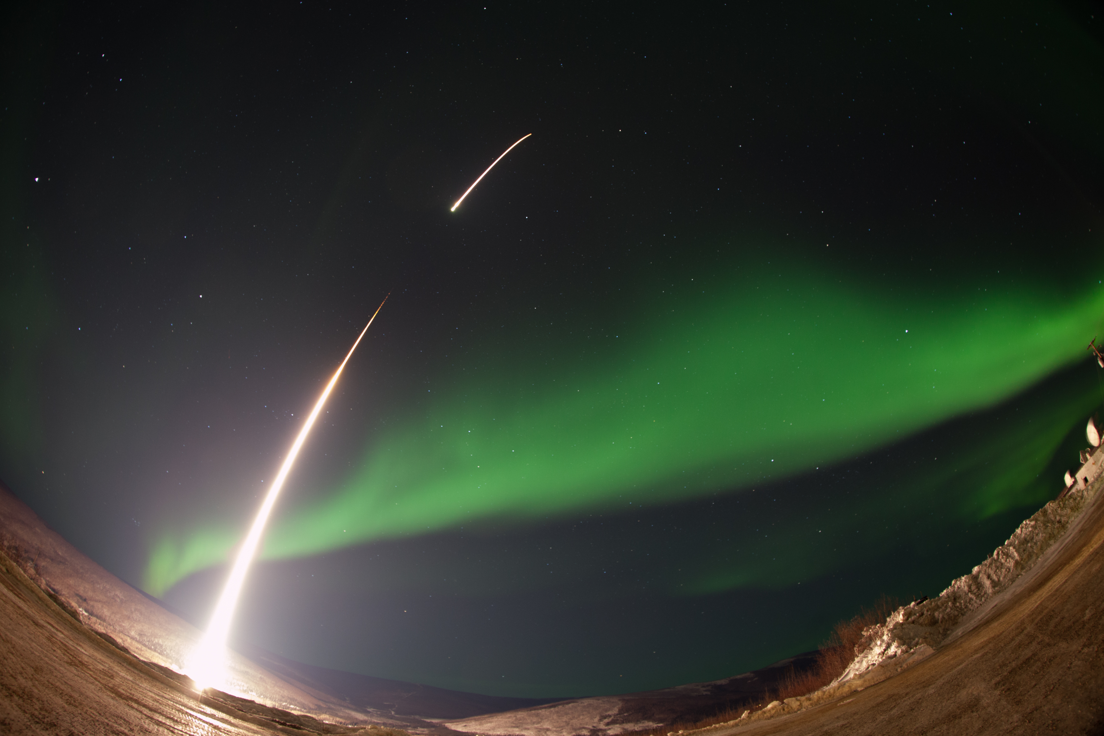
Sounding Rockets
The Ground-to-Rocket Electrodynamics – Electron Correlative Experiment (GREECE) sounding rocket mission studies how certain structures form in the aurora

Slide 21
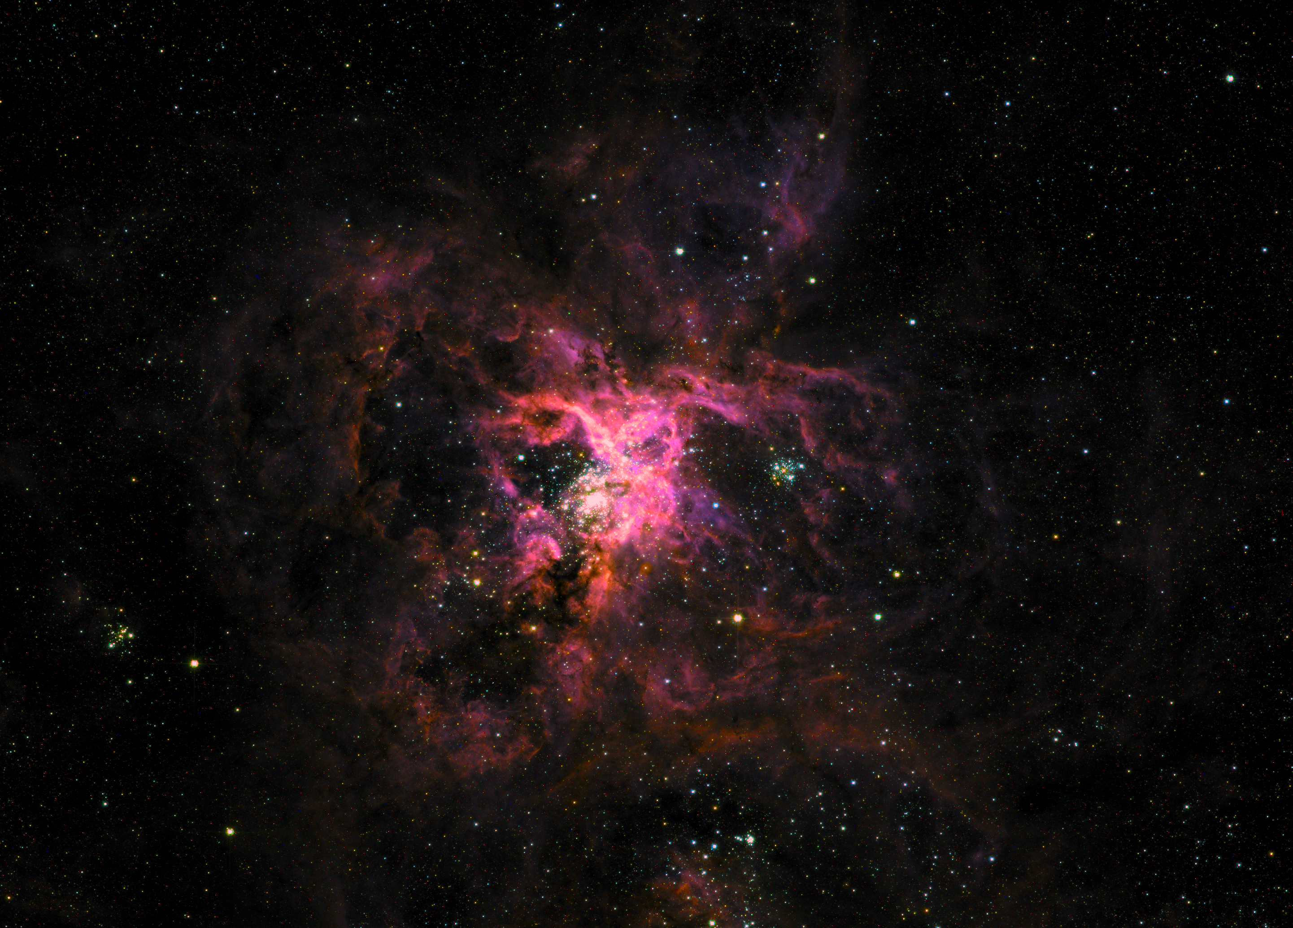
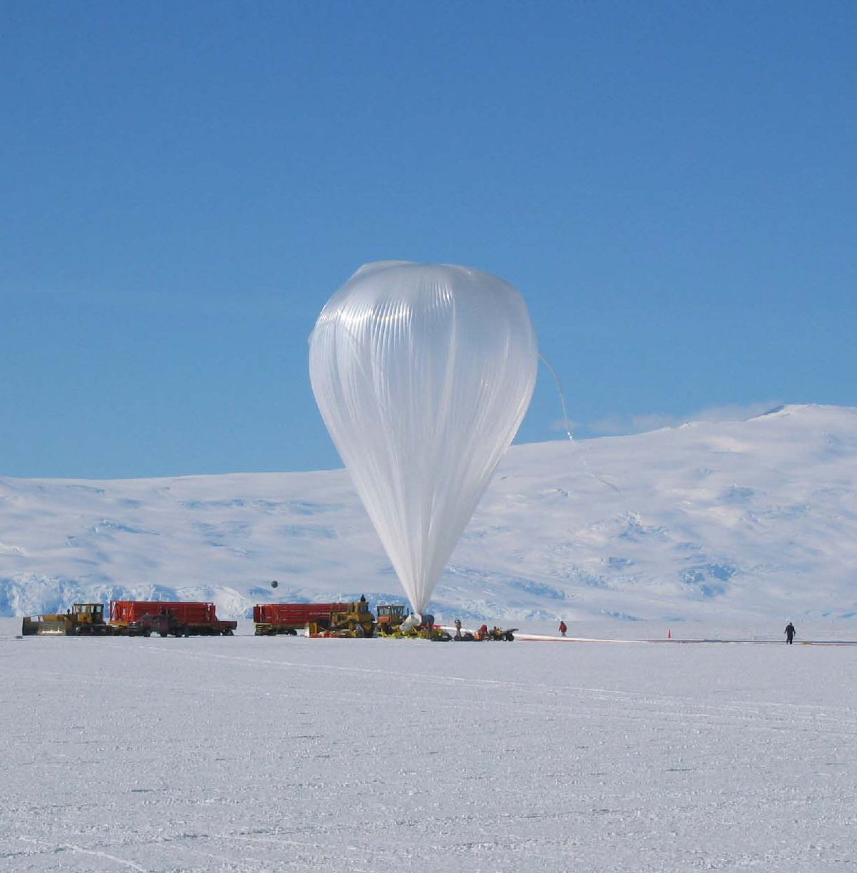
Scientific Balloons
An image of the Tarantula Nebula taken by SuperBIT, a balloon-borne telescope
The Galactic/Extragalactic ULDB Spectroscopic Terahertz Observatory (GUSTO) mission will fly an Ultralong-Duration Balloon (ULDB) to study the Milky Way

Slide 22
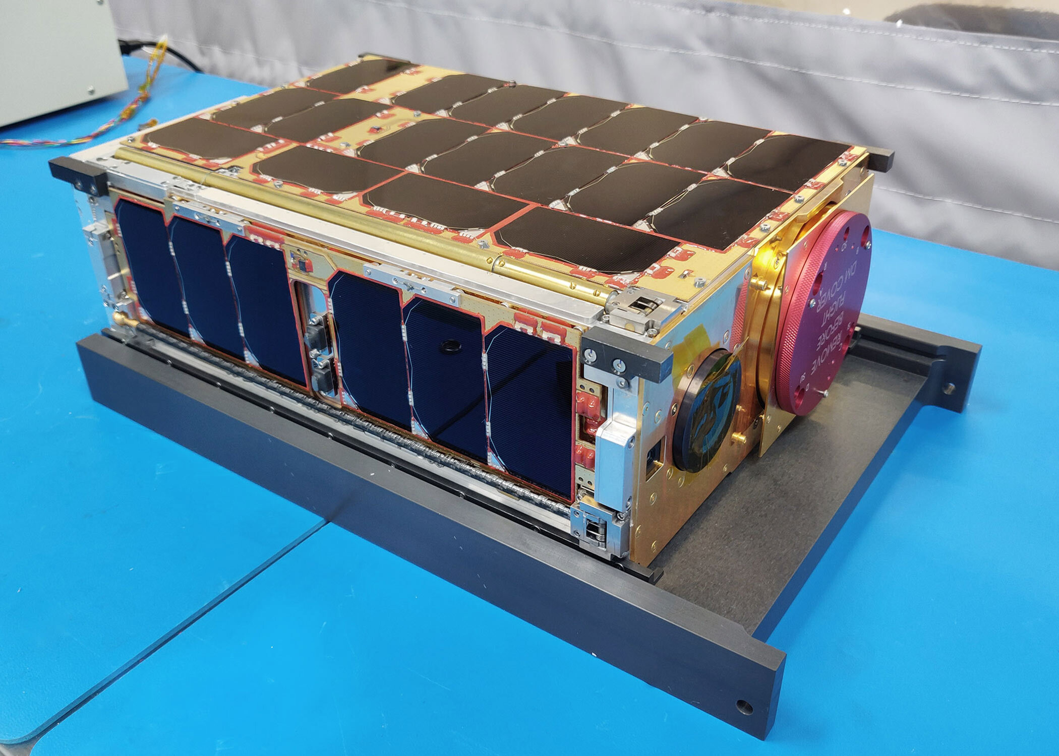
CubeSats
MISSIONS OF OPPORTUNITY
The Low-Latitude Ionosphere/Thermosphere Enhancements in Density (LLITED)
The Scintillation Prediction Observations Research Task (SPORT)
SmallSat/CubeSat commercial engagement opportunities are essential to
NASA Science’s balanced portfolio, achieving distinct science objectives
Notes:
The Low-Latitude Ionosphere/Thermosphere Enhancements in Density (LLITED) mission will measure and study the equatorial temperature and wind anomaly (ETWA) that occurs in the neutral atmosphere, and the equatorial ionization anomaly (EIA) that occurs in the region containing charged particles.
Photo credit: Courtesy of The Aerospace Corporation
The Scintillation Prediction Observations Research Task (SPORT) explores where Earth’s weather meets space weather in the upper atmosphere—a dynamic region that plays a major role in the safety of our satellites and reliability of communication signals.

Slide 23
With Us

