Slide 1
Day 3
7/26/23

Slide 2
Day 2 Recap
The mechanics of STMs and Requirements
Working on STMs
Evaluation and SOMA
North Campus Lab Tours
PI Panel and all about SmallSats
7/26/23
Day 2

Slide 3
Day 3
No changes from the Printed Schedule
Panels and CRLT Players!
More to life than being a PI
Getting on a Center’s Radar
After Lunch
Finding an Industry Partner
Center for Research on Learning and Teaching Players

Slide 5
There is more to life than being a PI!
Moderator: Betsy Pugel (GSFC)
Shannon Curry (Berkeley)
Steve Unwin (JPL)
Rob Lillis (SSL)

Slide 6
Getting on a Center’s Radar
Moderator: Paul Propster (JPL)
Richard Quinn (Ames)
Keith Grogan (JPL)
Rita Sambruna (GSFC)

Slide 7
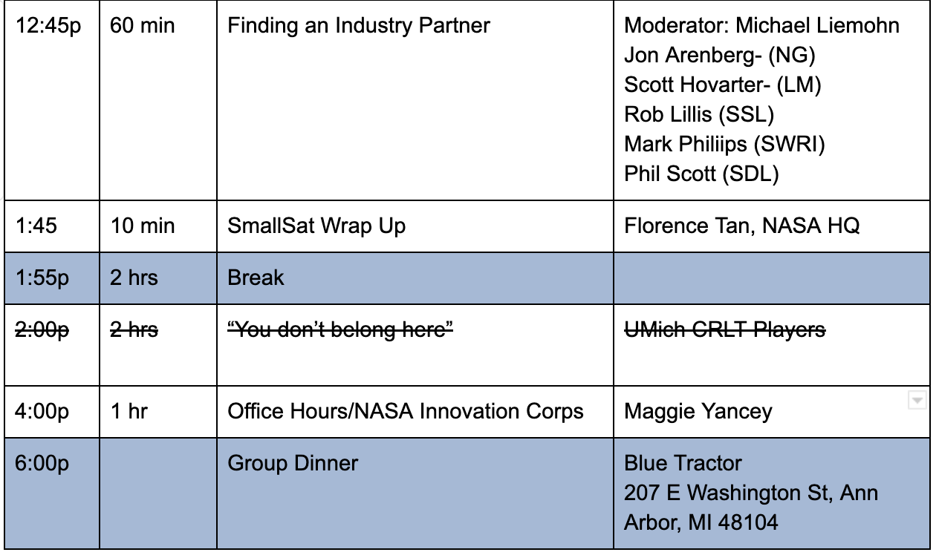
Changes to the afternoon schedule

Slide 8
Industry Partner Panel
Moderator: Michael Liemohn
Jon Arenberg- Northrup Grumman
Scott Hovarter- Lockheed Martin Space
Rob Lillis (SSL)
Mark Philiips (SWRI)
Phil Scott (SDL)

