Slide 1
NASA Innovation Corps Pilot
Maggie Yancey
NASA HQ | Entrepreneurship Lead

Slide 2
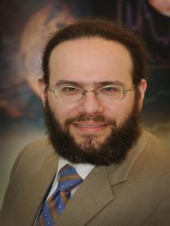
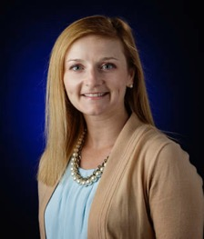
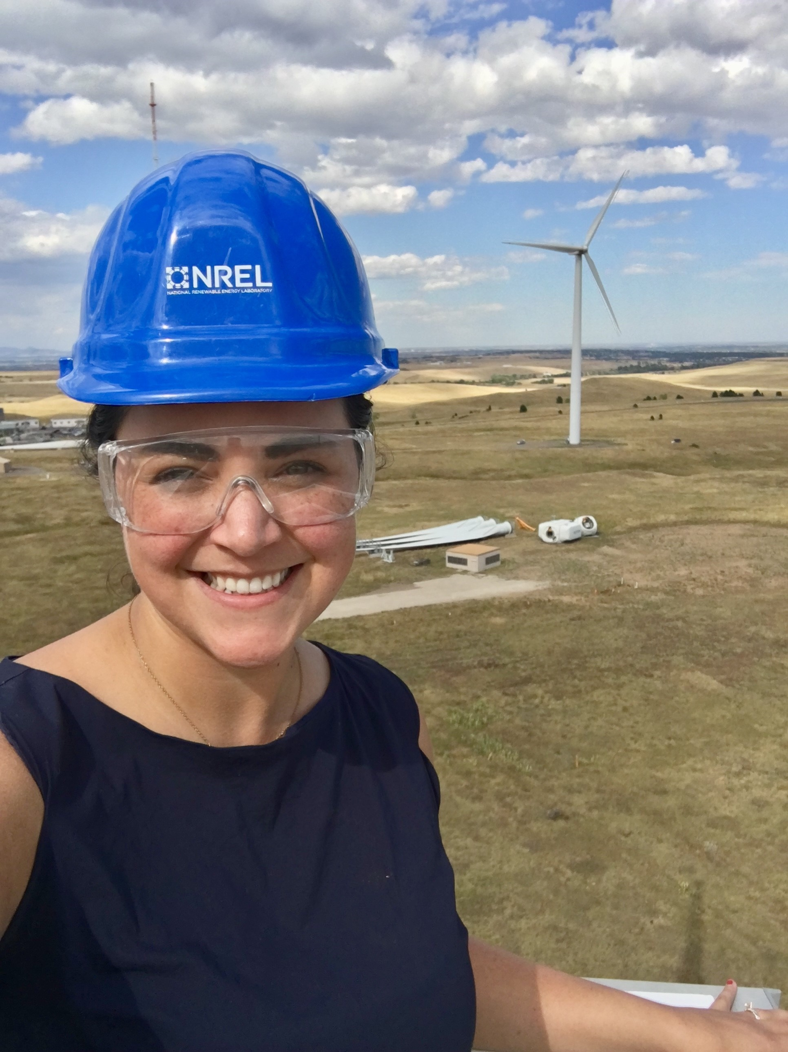
NASA
About Me:
Professional experience and background in renewable energy in wind and water power technologies. At NASA, I pursue designing and creating interventions for more equitable and accessible outcomes for scientists and technologists across SMD and STMD.
I live in Tuscaloosa, Alabama and work at NASA HQ in DC.
I love trivia, climbing high places like wind turbines and mountains, and playing sand volleyball.
Dr. Michael New (he/him)
Deputy Associate Administrator for Research within NASA's Science Mission Directorate
Jenn Gustetic (she/her)
Director of Early Stage Innovations and Partnerships within NASA’s Space Technology Mission Directorate
Maggie Yancey (she/her) Entrepreneurship Lead within both the Science Mission Directorate and the Space Technology Mission Directorate
PI Launchpad Title

Slide 3
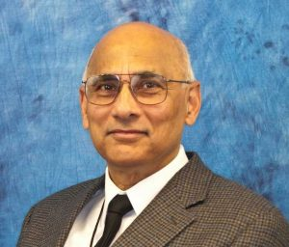
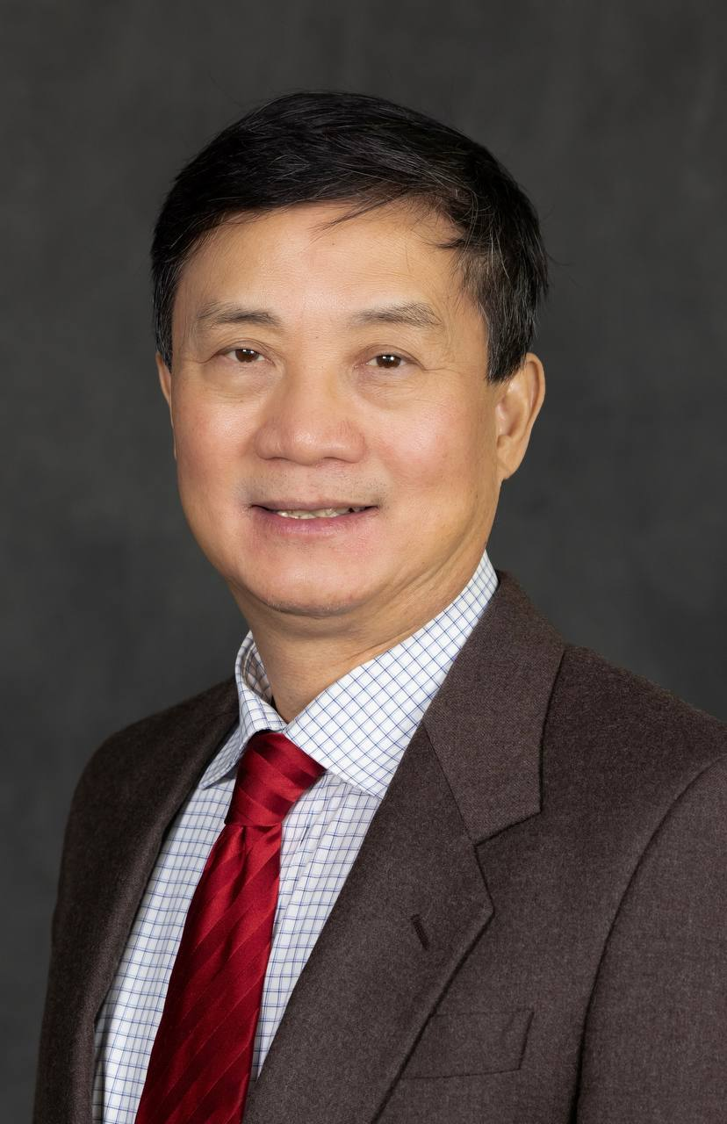
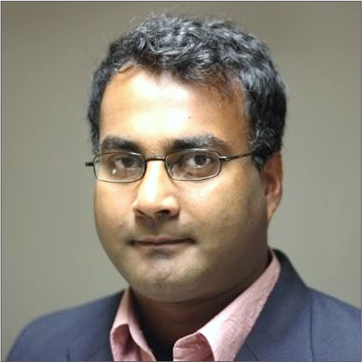
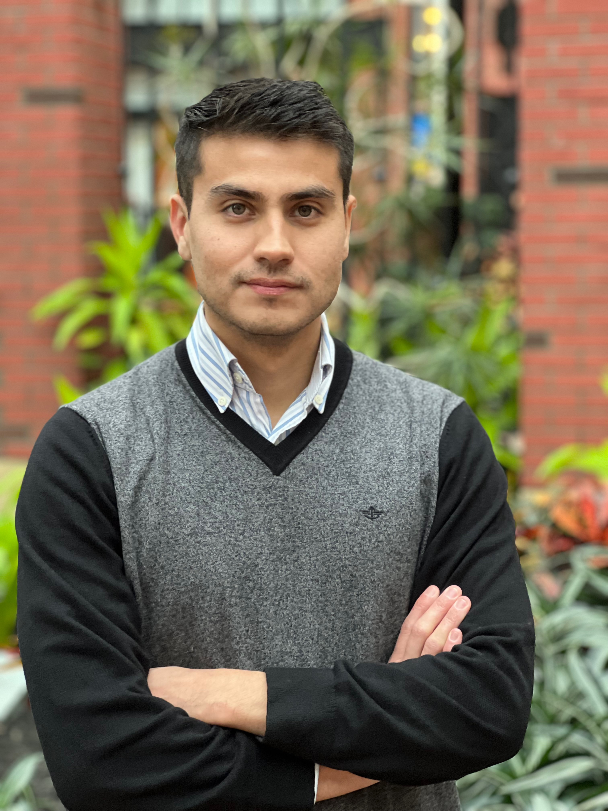
National Science Foundation &
Innovation Corps Participants
Fireside Chat
Rathindra “Babu” DasGupta
I-Corps Outreach Specialist &
Regional I-Corps Instructor
University of Michigan
Great Lakes Region I-Corps Hub
Royan Demello
Title: Assistant Research Scientist
Organization: Aerospace Engineering, University of Michigan
Pursued technology area: Finite element based software tool for progressive damage and failure modeling in composite materials and structures.
Fernando Rojas
Title: Graduate Student Research Assistant
Organization: Composite Structures Laboratory, Aerospace Engineering Department, University of Michigan
Pursued technology area: Failure modeling of fiber reinforced composites
Sean Wu
Title: University Distinguished Professor
Organization: Wayne State University
Pursued technology area: Laser-assisted see-through technology

Slide 4
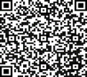
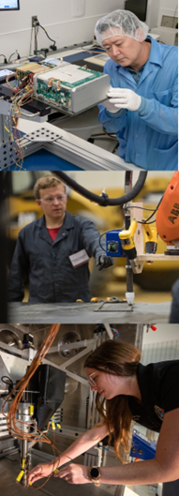
Innovation Corps (I-Corps) Pilot Overview
Are you ready for your innovation to take off?
Join NASA’s Innovation Corps Pilot today
Apply to participate in an immersive entrepreneurship training designed to help you take your idea from the lab to the marketplace. The opportunity is designed for not-for-profit entities, such as academia & nonprofit research institutions.
Interested in exploring potential customers? Form your team and apply today for a $10k grant to support your team & customer discovery. Subsequent funding up to $40k will also be available.
Easy lift proposal - 6 pages or less - due to NSPIRES by:
September 8, 2023
January 26, 2024
March 29, 2024
Stay Connected
Create a NSPIRES account and subscribe to the newsletters for reminders and updates and read the full solicitation for the most accurate and up-to-date information.
Build your capabilities through the NASA
Innovation Corps:
Informed decision-making to facilitate research and/or technology transitions and new NASA funding opportunities
Facilitated focus and inspiration on the commercial potential of proposed research and/or technology
Advanced workforce development opportunities in science missions and space technology by preparing students with a foundational education in entrepreneurship
Enhanced entrepreneurial mindsets
Notes:
To provide a quick snap shot of I-Corps, this program is deigned to provide researchers an immersive experience to learn and develop entrepreneurship skills. The opportunity is designed for not-for-profit entities, such as academia & nonprofit research institutions. The program provides funding for researchers to have the time and attention to pursue more informed decision making about their research, facilitated skill development to understand commercial potential, to provide workforce development opportunities for rockstar undergraduate, graduate, or post doc students, and finally seeding an entrepreneurial mindset to provide a wider aperture of the impact potential of your research or technology. This is a two step grant, step one is to take the short course which is the main focus of our attention today and allow for up to $10K for customer discovery. Step 2 is up to $40K for interested teams to participate in the National Course, but all teams must first participate in the short course. The application for funding is easy through NSPIRES and the next due date is Sept 8. The first step is creating a NSPIRES account to get your application going.

Slide 5
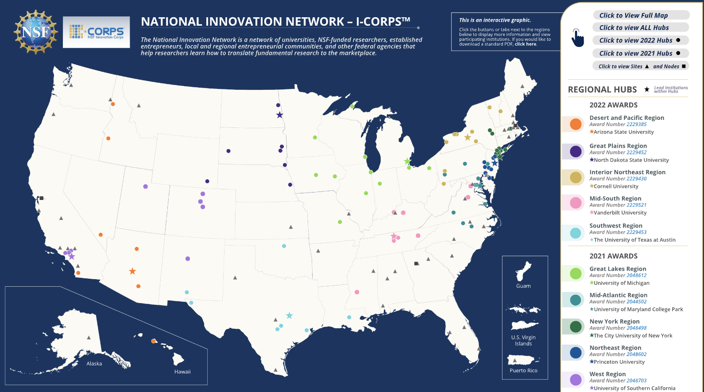
NSF I-Corps Partners:
Sign-Up with a Regional Hub
Notes:
When we are talking about Regional I-Corps hubs – our NSF partner has created a robust National innovation Network across the country. Selected teams may go through the Hubs that are closest in geographic proximity to their location.

Slide 6
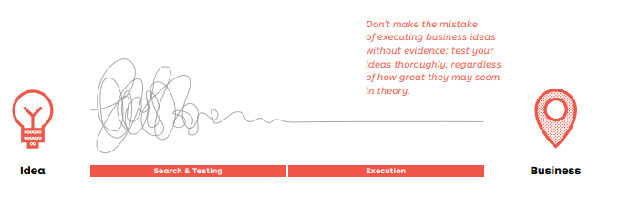

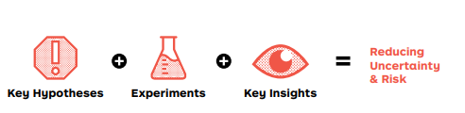
FAITH-BASED ENTREPRENEURSHIP
Web Van, Pets.com
Solyndra
VS
EVIDENCE-BASED ENTREPRENEURHIP

Slide 7
Technology Innovation Spectrum
(The Theory)
Industry
Resources Available ($)
Valley of Death
Academia
Discovery
Development
Commercialization
Level of Development
NSF
From
Angus Kingon

Slide 8
Technology Innovation Spectrum
(The Reality)
?
Resources Available ($)
Discovery
Development
Commercialization
Level of Development
Source: Errol Arkilic
Notes:
What is the most common toolset known to man to explore the unkown?

Slide 9
Innovation Spectrum
Industry
Investors
Resources Available ($)
Valley of Death
Small Business
Unbridgable
Gulf of Death
Academia
Discovery
Development
Commercialization
Level of Development
Source: Errol Arkilic

Slide 11






Space Science and Technology Innovation Journey: Innovation Corps
B: Not yet a prototype
Our Role: How can we accelerate or enhance impact of point A to point D?
Tests Hypothesis
Receives some validation
A: Starts with a hunch
D: Pursues further R&D aimed at market needs
Scientist/Technologist
Ideation
Optimized research
C: Applications for the Science or Technology?
Exploring potential markets for science or technology
E: OR…
Understand the need to pivot and goes back to basic research
Notes:
I’m going to ground this conversation taking a wider aperture at the innovation journey, and this certainly isn’t linear or the case for everybody – but it’s a common one. Point A: A scientist or technologist has a hunch and hypothesis – they may be pre proto-type but they have conducted some type of validation to demonstrate there is something with the integrity of their research. Now the big question for their research evolving, is who may be interested in funding or finding value in this? This is often referred to as the customer discovery phase. The scientist has to have some idea of that in order to pursue big research funding or other funding opportunities. Some of the relevant science and tech finds their way to us organically or through a journey all its own. We are interested in providing tools to accelerate and optimize that process and learning for PIs. Sometimes it leads to starting all over again (see point to E back to A), but it also can lead to more optimized research outcomes – which hopefully will lead to pursuing further R&D aimed at market needs that are of interest to NASA .

Slide 12



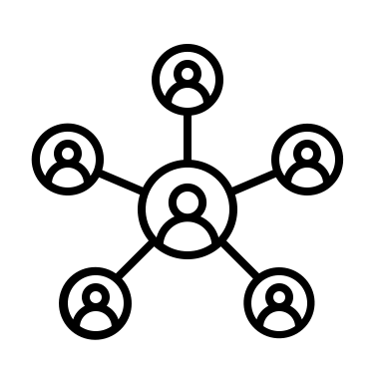



What is the Proposal and Participation Process:
Innovator Connects idea with clear connections to SMD/STMD strategic objectives
Innovator forms a team with a Technical Lead, Entrepreneur Lead, and Industry Mentor
Innovator and team submit proposal to NASA I-Corps Program
By Sept 8 Deadline
During application review, Innovator and team research NSF Regional Hubs
Innovator and team receive notification that they will receive funding and sign-up for NSF Regional Course
Innovator and team successfully complete NSF Regional Course
Innovator and team determine if they will apply to the NSF National Course
Notes:
Zooming a little more in the process if you are at that sweet spot on the road with your research development, then once you validate that you can connect your idea back to STMD or SMD then form your team,, submit an proposal by the Sept 8 deadline, and while your proposal is being considered (it takes about 45 days for review and notification of acceptance or decline) then during that time research and connect with the Regional Hubs, and if the team is accepted then they can proceed with signing up for the regional course, and then the short course is approximately 2-4 weeks in duration, but it may take a little longer for the team to conduct customer discovery – the hear of what is I-Corps, and then finally – the team can determine whether or not to pursue the national course.

Slide 13
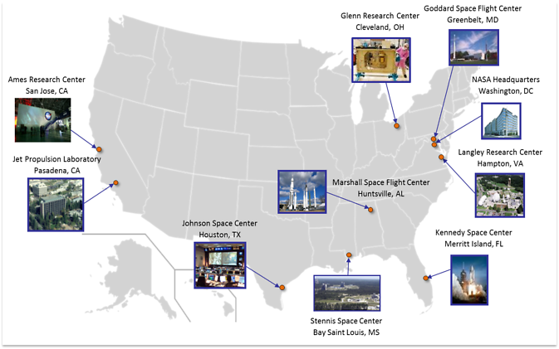

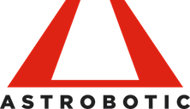
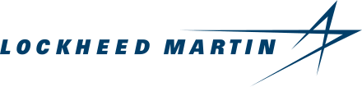

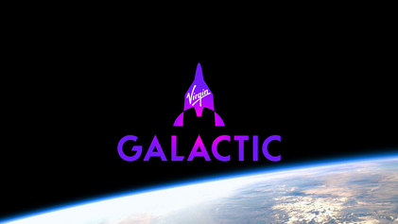


What is NASA I-Corps: Customer Discovery?
Notes:
So why is NASA interested in I-Corps? First off, NASA is a large agency, and while we MAY be a customer – there are multiple interests and entities within NASA, we have 9 Centers and multiple mission directorates as well the newly formed U.S. Space Force, presenting new opportunities for partners and other customer potential. Not to mention the emerging space marketplace that is growing rapidly and changes by the day, just a few of the companies are listed here and represent many of NASA’s partners. I-Corps provides an avenue to better understand how to place your research or technology with the right interests leading to more successful scientific and technological endeavors.

Slide 14








What Do You Need to Participate in I-Corps?
Relevance
Research Milestone
Innovation demonstrates clear connections to SMD/STMD strategic objectives
Teams have an innovation and/or commercially viable science/tech to test
Comply with Eligibility
Form a Team
The team is with a not for profit institution
Form a team with a Technical Lead, Entrepreneur Lead, and Industry Mentor
Notes:
So what do you need to get started? So, you first – you have a clear link to the relevance of the Science and/or Space Technology Mission Directorate. Then you comply with eligibility, by being at an academic institution or a non profit. Third, your research is past the conceptual idea stage of the process and they have a research milestone that they have hit that makes it worth their wild to explore the commercial viability and you form the team. Let’s discuss this further.

Slide 15
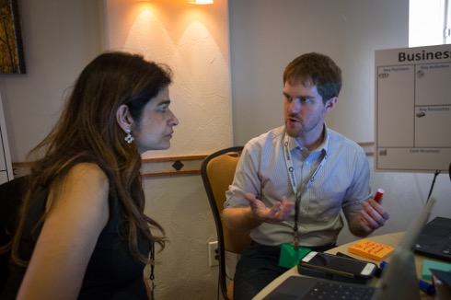
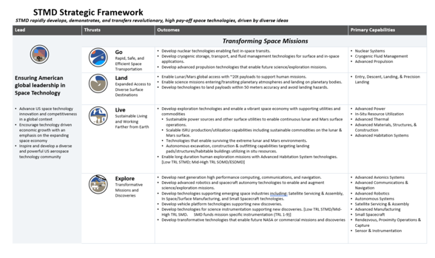

Solicitation Details: NASA I-Corps Pilot Team Eligibility
Eligibility: Only non-profit (non-governmental) organizations are eligible to propose. Civil servants are not eligible to participate. A Technical Lead may not hold more than one currently active NASA I-Corps Pilot Short Course or National Course award. Proposing team(s) need not have received a previous NASA award to apply.
(Photo by John De La Rosa / NREL). Alt text: A person providing another person a practice pitch during the course.
Image of the NASA Science Strategy or Plan for the Science Mission Directorate entitled Science 2020-2024: A Vision for Scientific Excellence and the webpage hosting the NASA Space Technology Mission Directorate Strategic Framework www.nasa.gov/directorates/spacetech/strategic_framework
Notes:
Eligibility for this award applies to only non-profit and non-governmental organizations. This includes, higher educational institutions and nonprofits with a research emphasis. If you are a small business, you can apply through our Small Business Innovation Research solicitation and if awarded, you can participate in I-Corps as an SBIR.
Proposing teams that meet the eligibility requirement, do not need a previous or current NASA award to apply. If you have received a NASA award or currently hold one – you are eligible to submit a proposal. Our intention is to create opportunities to increase diversity, equity, inclusion, and accessibility for teams hoping to work with NASA.
Proposals must also show alignment with the Science Mission Directorate and/or Space Technology Mission Directorate strategic objectives. Because current or previous awards are not necessary to apply, it’s critical to clearly articulate the impact and relevance to the Mission Directorates strategic areas. Please review and pull from those strategic documents to connect to the relevance of a proposal’s impact.
And in general, these documents may be helpful guideposts to what NASA does and how to work with us.

Slide 16
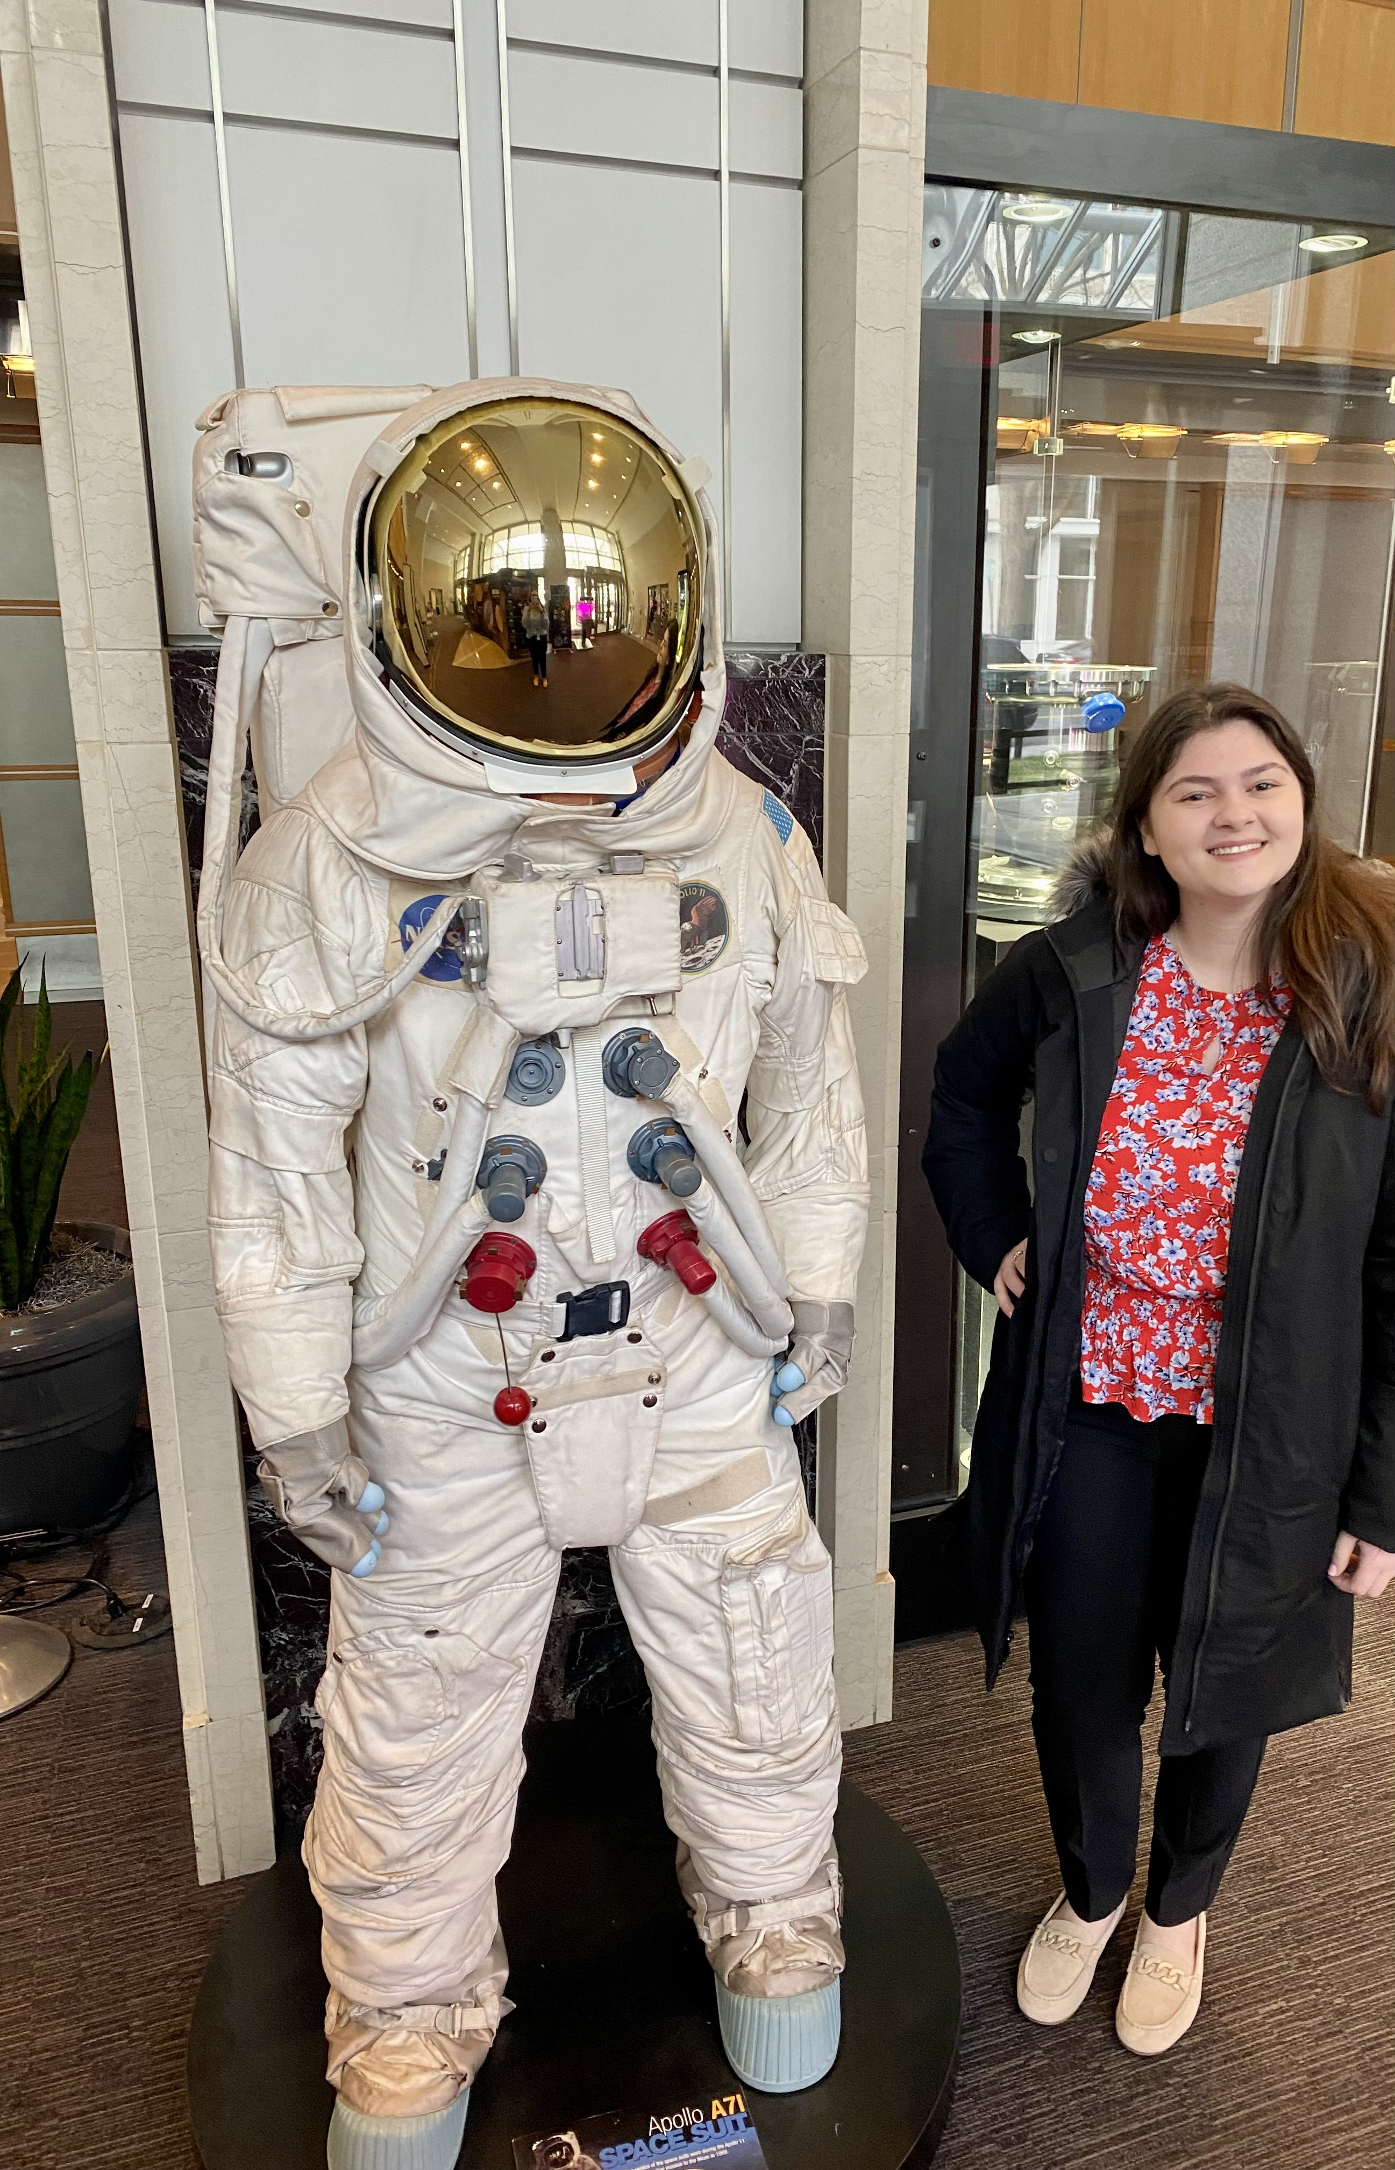
NASA I-Corps Pilot Team Composition
A NASA I-Corps Pilot team must include a Technical Lead, an Entrepreneurial Lead.
"Participating in the NASA Innovation Corps Pilot was a tailored, intense, and well-structured experience that got the wheels turning in my brain. Through customer discovery, I gained a deeper understanding of how my research can explore potential real-world applications and it opened up numerous options for me, and I personally benefited greatly from participating."
The Technical Lead serves as the Principal Investigator (PI) of the award, the Entrepreneurial Lead should be listed as a Co-I, and the Industry Mentor as a collaborator. The Technical Lead provides a deep and direct technical expertise in the relevant core research and/or technology area the I-Corps team is exploring.
The Entrepreneurial Lead has relevant knowledge of the research and/or technology area and guides translation of the research and/or technology if the project demonstrates the potential for commercial viability.
The Industry Mentor is responsible for advising the team through the duration of the course(s) and usually has contacts in the industry area being explored. The Industry Mentor MAY receive a stipend or consultancy fees through the ROSES-2023 grant.
Erina Vela, Queens College – Entrepreneurial Lead for
NASA Short Course Team
Notes:
For the team to participate in the Short Course--- Participants must have a team composition of two members including a Technical Lead, Entrepreneur Lead, and as the Hub requires, sometimes an Industry Mentor. An Industry Mentor is required for the National Course so this will be helpful to incorporate early-on. These roles must be outlined in the proposal and often are post-docs, grad students, and Erina Vela, who recently participated this last in the NASA I-Corps Pilot, was a undergraduate. She said:
"Participating in the NASA Innovation Corps Pilot was a tailored, intense, and well-structured experience that got the wheels turning in my brain. Through customer discovery, I gained a deeper understanding of how my research can explore potential real-world applications and it opened up numerous options for me, and I personally benefited greatly from participating."

Slide 17


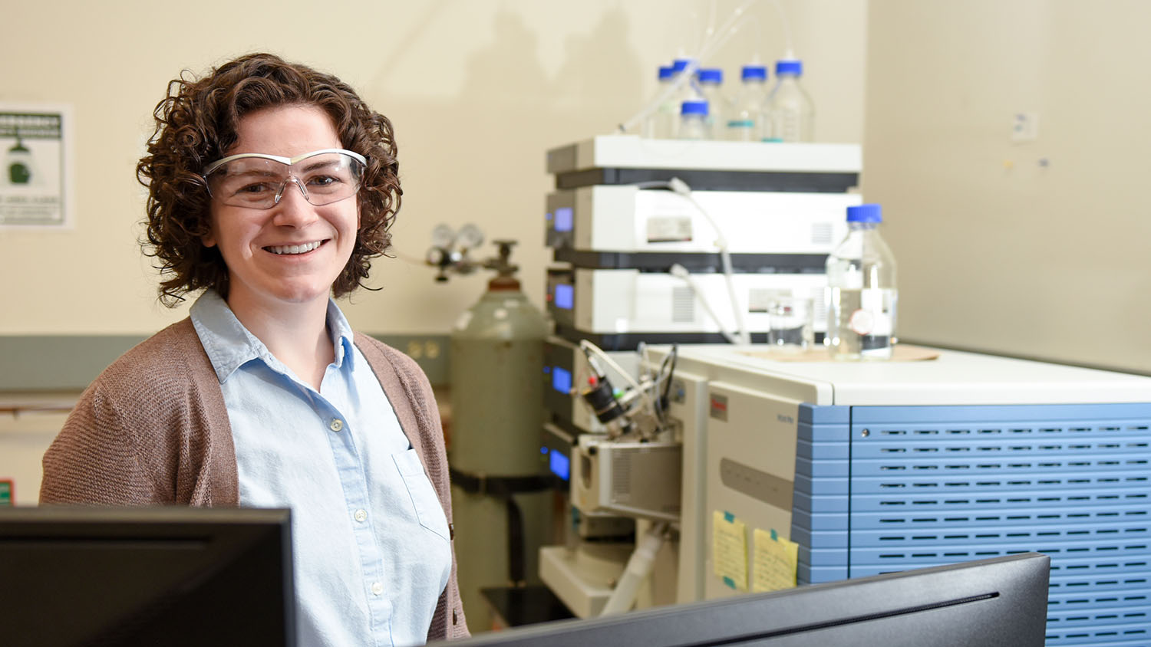


I-Corps Success Stories
Over 1,000+
Startups
$760 Million+
Follow-on funding raised since program inception
Texas A&M Doctoral student, Ciera Cipriani (NSTGRO20), participated in the NSF I-Corps Regional Short Course:
“I met with over 30 experts from various fields, including construction, aerospace, and materials development, to learn about the applications and current challenges of 3D printing in these areas…[It] left me with a better understanding of the requirements for a 3D printable material and the uses for 3D printing in space.”
Notes:
As I mentioned earlier in the presentation, there are lot of potential outcomes for success. The NSF I-Corps program has had over 1000 start-ups result from participation in the program and over $760 million dollars of follow-on funding raised since program inception. However, of start up and venture funding isn’t the only path for success, for instance on of our space technology research grant recipients doctoral student Ciera si·pree·aa·nee participated in the short Course and received key intelligence for her research for 3D printing in space.

Slide 18
Q&A
Maggie Yancey
EMAIL: Margaret.A.Yancey@nasa.gov

