Slide 1
The Proposal Process
Patricia M. Knezek, NASA Astrophysics Division
7/24/2023

Slide 2
The Proposal Process
Focus on Announcements of Opportunity
Lifecycle of an Announcement of Opportunity
Overview of the Process
Some key highlights from the Proposing/Study Team point of view
New things to pay attention to
Simplified Standard AO Template (SSAOT)
Inclusion Plans
Citizen Science
7/24/2023
The Proposal Process

Slide 3
Lifecycle of an Announcement of Opportunity
Community Announcement of Major Policies
Release of Draft AO
Release of Final AO
Proposals Due
Released up to one year before release of Final AO
Contains current best guess dates for release of Draft and Final AO and proposal Due Date
Contains key parameters such as expected cost cap, launch readiness period, allowed or excluded targets, etc.
Community may comment on the key parameters informally.
Typically released 2-6 months before release of Final AO
Contains current best guess dates for release of Final AO and proposal Due Date
Contains all
requirements and key parameters.
Community comments are expected and welcomed.
A public Q&A document is maintained.
Released ~90 days before proposal due date
Contains final proposal Due Date
Contains all requirements and key parameters.
Questions may be submitted until several weeks before due date.
A public Q&A document is maintained.
Complete solicitation process can take 12 months or longer.
Review of proposals can last about another 6-8 months.
Proposals submitted through NSPIRES.
Additional electronic files submitted via Box (new tool).
It is REALLY important to read things carefully and address everything that the AO indicates needs to be addressed!

Slide 4
Step 1 Proposal Flow
REALLY important step!
Prepare, Partner, Plan
Community Announcement Released
Draft AO Released
Steering Committee Meeting 1
Final AO Released
Preproposal Conference
Notices of Intent Due
Proposals Due
Steering Committee Meeting 1
Technical, Management and Cost
(TMC) Evaluation
TMC
Plenary Meeting
Compliance
Check of
Proposals
Evaluation Kickoff
Clarifications
Scientific Merit & Scientific Implementation Merit and Feasibility Evaluation
Science Evaluation
Plenary Meeting
Categorization
Committee Meeting
Scientific Merit & Scientific Implementation Merit and Feasibility Evaluation
Clarifications
No mission flies with only good science
Target your message for your audience
Tell a compelling story
Debriefings to
Proposers
Selection by SMD AA
Steering Committee Meeting 2
7/24/2023
The Proposal Process

Slide 5
Really Important Step! The Core Team
Instrument Providers
Spacecraft Providers
PI Institutions
Principal Investigator
Co-I’s Institutions
Mission Management Organization
Science Co-I’s
New Technology Providers/Users
7/24/2023
The Proposal Process

Slide 6
Step 1 Touch Points
What goes on in a Step 1 review from the proposing team point of view?
For Step 1 AOs, the review is a true “procurement”. This means that NASA and review panels can have limited interaction with the proposing team.
Before the submission date – Questions & Answers based on the Community Announcement(s) and Draft AO.
Much of the “real work” for proposers happens before release of the final AO!
After the release of the final AO, there is a preproposal conference for all proposing teams to discuss the evaluation process and some key aspect to consider, such as international participation, launch services, etc.
During the review process – a limited opportunity to respond to requests for clarification from the Science and Technical, Cost, & Management (TMC) panels. (Note: the Science & TMC panels have very little interaction at Step 1)
Post-selection, the AO Program Scientist with offer to debrief all the teams on their evaluations.
This debrief is limited to trying to clarify the review materials the proposing team receives, the results are considered final at that point.
Post-selection, a NASA Program Office will work with the selected teams to get Study Contracts in place.
7/24/2023
The Proposal Process

Slide 7
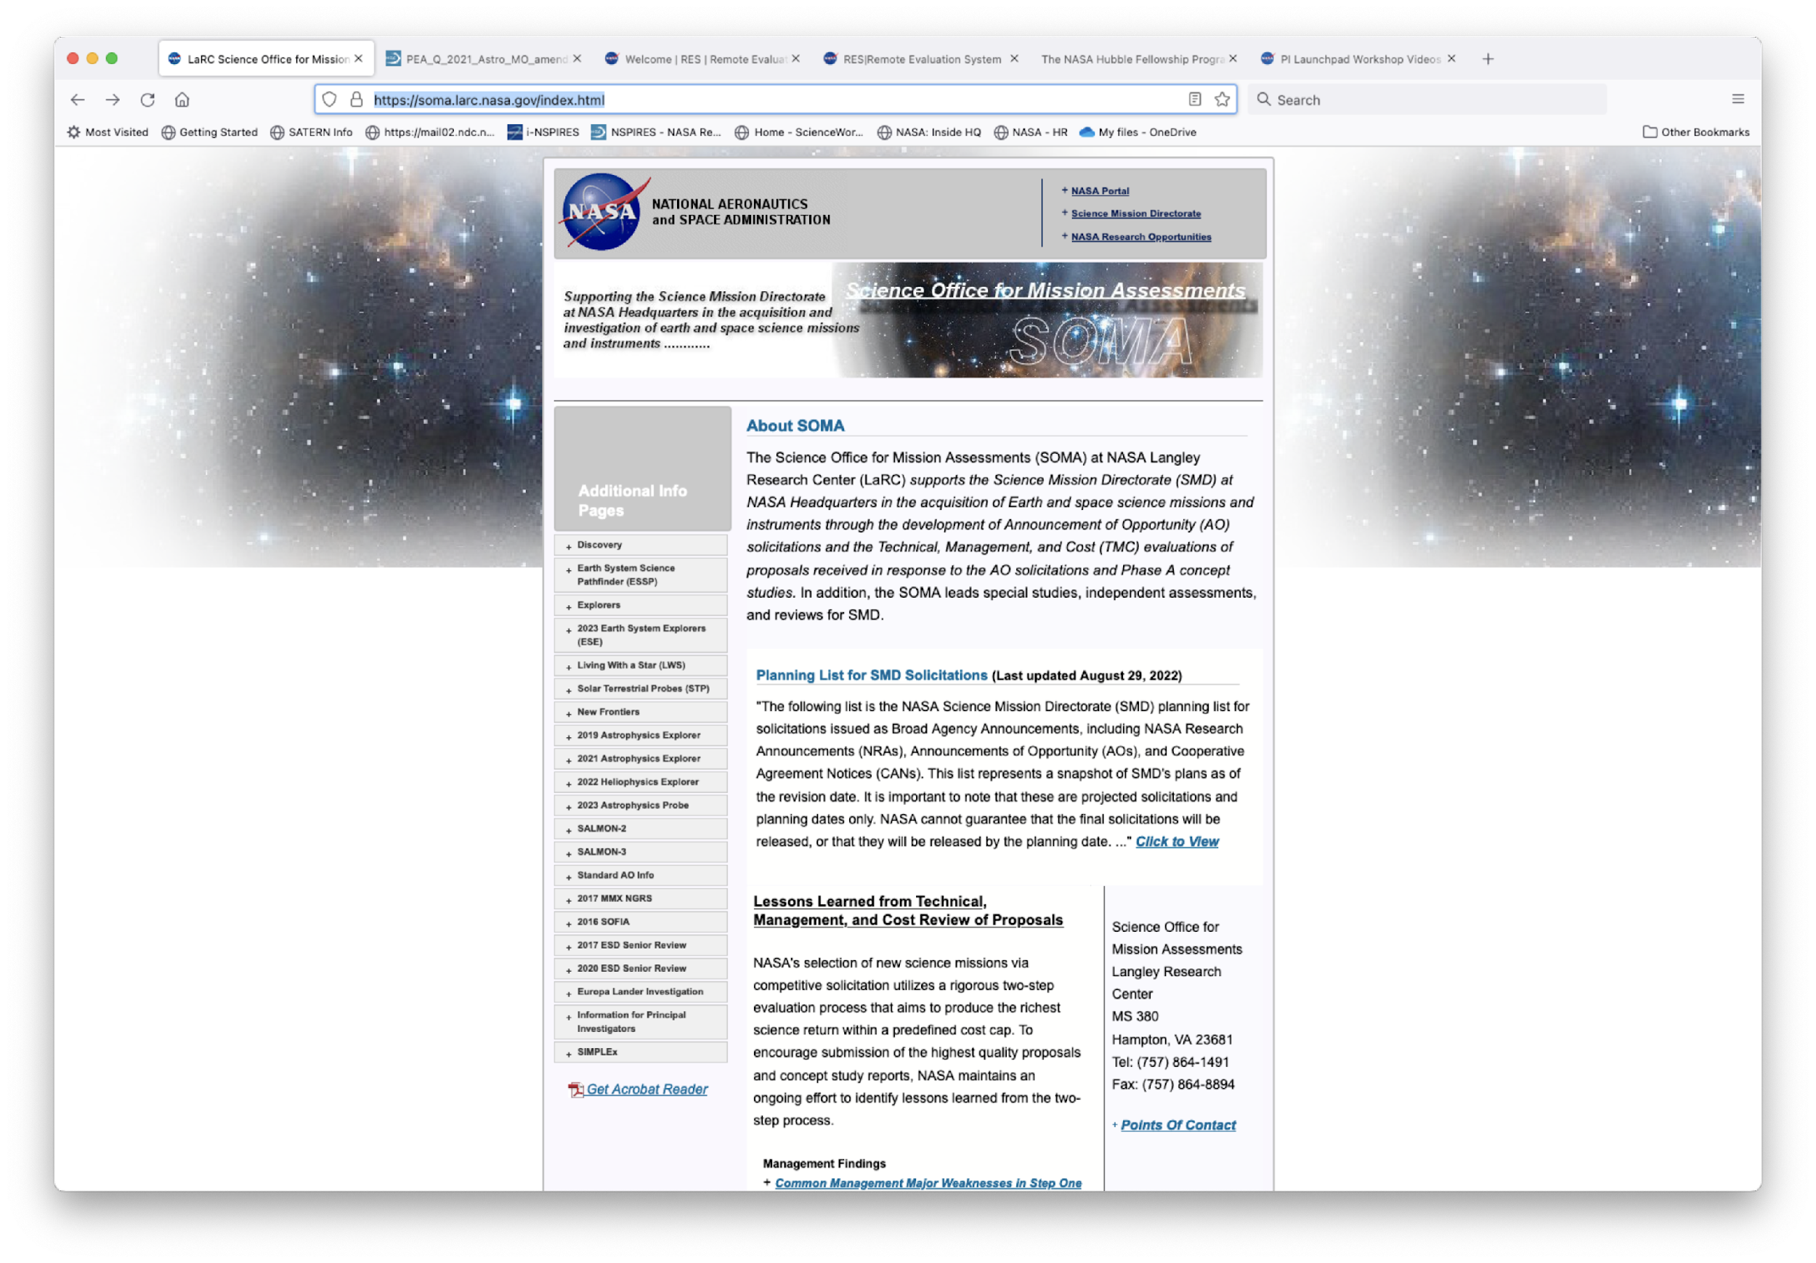
Watch This Space!
https://soma.larc.nasa.gov/index.html
7/24/2023
The Proposal Process

Slide 8
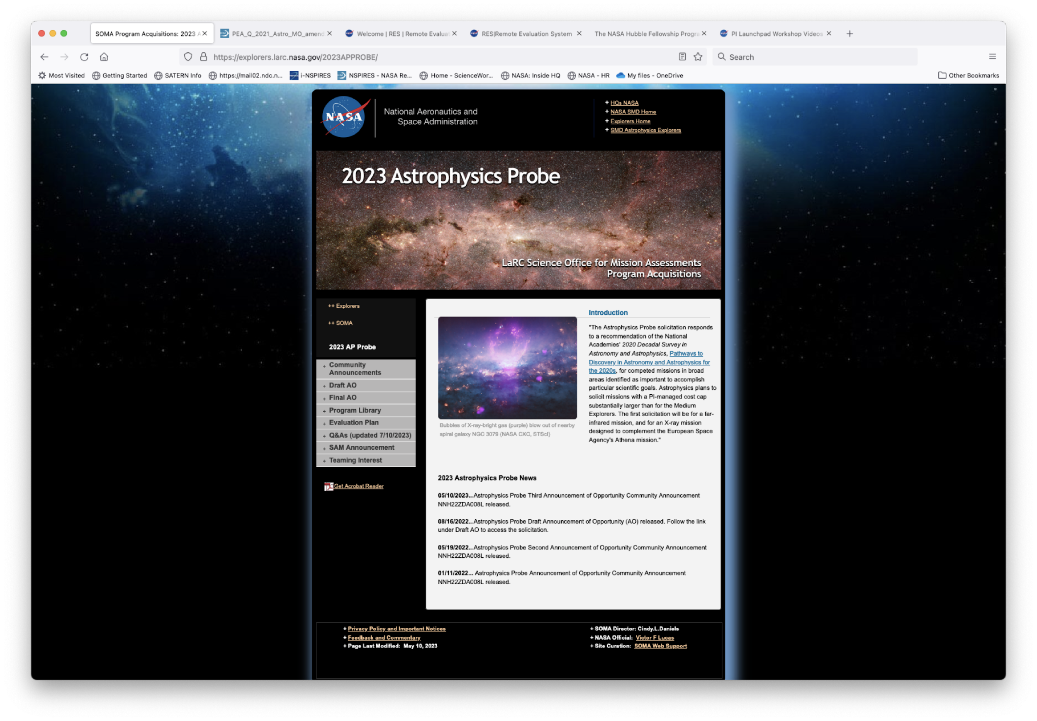
Look Early, Look Often, Ask Early, Ask Often…
https://soma.larc.nasa.gov/index.html
7/24/2023
The Proposal Process

Slide 9
Step 2 Proposal Flow
Step 1
Selections by
NASA HQ
Concept Study Report Kickoff Telecon
Steering
Committee
Meeting 1
Receipt of
CSRs
Compliance
check of
CSRs
Science check
of CSRs
Site Visits
Significant Weaknesses, Questions, Requests for Information
Initial A*/B & C
Plenaries
Individual
Reviews &
Telecons for
Forms A*, B, C, D
and E
Re-eval Science & convene Form A panel if necessary
Significant Weaknesses, Questions, Requests for Information
Final A*/B & C
Plenaries
Steering
Committee
Meeting 2
PIs brief
NASA HQ
Debriefings &
Contracts
Down-selection
announced by
NASA HQ
Down-selection
by NASA HQ
*If required due to change in Science. If not required, use Forms A from Step 1.
7/24/2023
The Proposal Process

Slide 10
Step 2 Touch Points
What goes on in a Step 2 review from the proposing team point of view?
There is a Concept Study Report (CSR) kickoff telecon for selected Study Teams
For Two-Step AOs, the second step is not considered to be a true “procurement”. This means that NASA can have much more interaction with the Study Teams than it can with proposers (in Step 1).
Before submission, the Teams work to add details to their mission concept and address the significant weaknesses found in the original proposal.
Part of the process is an ~8 hour “site visit” where questions may be asked, directly, and the teams’ dynamics are on display.
During the Step-2 evaluation, the evaluation team will communicate with the Study Teams, providing them with lists of significant weaknesses, questions, and requests for information. These can happen before, during, and after site visits. The Science & TMC panels can pass findings back and forth and interact at the site visits.
All Teams will debrief SMD management about their proposed missions.
Post-selection, the AO Program Scientist with offer to debrief all the Teams on their evaluations, clarifying materials sent to Teams.
Post-selection, a down-selected Team(s) will debrief a NASA Program Office that will work with the selected teams to get Phase B Contracts in place.
7/24/2023
The Proposal Process

Slide 11
New Things to Pay Attention To
Simplified Standard AO Template (SSAOT)
Attempt to reduce the burden on the proposing teams at Step 1.
Some requirements in the AO, e.g. Science Enhancement Options (SEOs), detailed plan for orbital debris and disposal, are deferred to Step 2.
This does not mean you shouldn’t think about them at all during proposal preparation for Step 1!
The SSAOT is customizable, and every AO is a little bit different.
Diversity and Inclusion Plans
NASA is committed a culture of inclusion, diversity, equity, and accessibility (IDEA) where all employees feel welcome, valued, respected, and engaged. Inclusion is a NASA core value.
Recent and upcoming AOs now require the inclusion of plan describing how they will create and maintain a diverse and inclusive team over the entire lifecycle, i.e. Phases A-F.
The plan is evaluated by a panel of experts, that evaluation feeds into the overall science evaluation.
Citizen Science
SMD has been developing requirements for the inclusion of citizen science as a part of AO proposals.
Citizen Science Projects are defined in Science Mission Directorate Policy Document SPD-33 as science projects that rely on volunteers. For a list of active SMD citizen science projects, and more resources for developing new projects, see the SMD citizen science website, http://science.nasa.gov/citizenscience.
How Citizen Science is incorporated into an AO can vary, so closely read the guidelines.
7/24/2023
The Proposal Process

Slide 12
Remember – a compelling science case is necessary, but insufficient for a competitive AO Proposal!
Rough Weighting of Evaluation Factors
Criteria | Weight
Scientific Merit of the Proposed Investigation – Form A | 40%
Scientific Implementation Merit and Feasibility – Form B | 30%
Feasibility of the Mission Implementation, Including Cost Risk– Form C | 30%

Slide 13
Thank you and GOOD LUCK!
Questions? Comments?
patricia.m.knezek@nasa.gov

