Slide 1
Creating Diverse and Inclusive Science Teams
Lindsey Malcom-Piqueux, Ph.D.
Assistant Vice President, Diversity, Equity, Inclusion, & Assessment; Chief Diversity Officer; Chief Institutional Research Officer
PI Launchpad
July 27, 2023

Slide 2
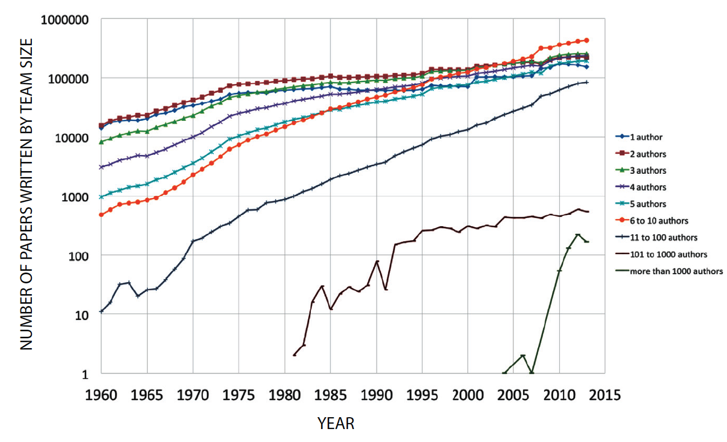
The Rise of Team Science
The prevalence of scientific collaboration (i.e., team science) has risen over the past several decades.
Teams are getting larger, more interdisciplinary, and increasingly diverse.
The process and outcomes of team science have been empirically investigated to identify the benefits and challenges.
Frequency of author team sizes in S&E, 1960-2013
Source: National Academies of Sciences, Engineering, and Medicine. (2015). Enhancing the effectiveness of team science.
Notes:
Why is this topic relevant? Team science is on the rise due to the benefits associated with this collaborative approach.
Benefits: investigation of multifaceted problems; greater scientific expertise; more advanced instrumentation; productivity; specialists for specific tasks; Diversity
Challenges: More time needed for communication and coordination of work; multiple (perhaps misaligned, competing) goals; dynamic group (entering and exiting team); task interdependence and potential for conflict; Diversity

Slide 3
The Benefits and Challenges of Team Science
Benefits | Challenges
Increased expertise | Knowledge integration
Greater access to resources via multi-institutional collaboration | More time spent communicating and coordinating
Increased productivity | Potential conflict over misaligned goals or working styles
Ability to onboard additional expertise as needed | Difficult to maintain team cohesion
Diversity of the team enhances creativity and innovation | Realizing the benefits of diversity requires intentional, inclusive approaches
Source: National Academies of Sciences, Engineering, and Medicine. (2015). Enhancing the effectiveness of team science.
Notes:
There are two sides of every coin, so for each benefit associated with this approach there is a corresponding potential challenge.
Read challenges: Last one, is a benefit that is not always tapped perhaps due to a lack of understanding how to make diversity work. For example, the thought that someone may not “Fit” sometimes translates to a fear that making it work would be too difficult or too time consuming. However diversity is worth the benefits.
Benefits: investigation of multifaceted problems; greater scientific expertise; more advanced instrumentation; productivity; specialists for specific tasks; Diversity
Challenges: More time needed for communication and coordination of work; multiple (perhaps misaligned, competing) goals; dynamic group (entering and exiting team); task interdependence and potential for conflict; Diversity

Slide 4
What is Diversity?
Demographic Diversity
Gender identity Race Ethnicity Nationality Linguistic | Ability Status Sexual Orientation Class Background Age Etc.
Cognitive Diversity
Experiential Diversity
Information Knowledge Heuristics Rules of Thumb | Causal Models Frameworks Processing Perspectives
Degree field Academic Discipline Academic Genealogy | Alma Mater Career path Expertise
Notes:
Due to the way in which we come to understand the world can be shaped by our background, our experiences, and how we think, all of these forms of diversity have the potential to bring creativity and innovative approaches to how we think about and solve problems, which of course matters in the work that you do in your own disciplinary areas.

Slide 5
The Diversity Effect
Diversity Interrupts Group Think
Group Think: Overly cohesive teams ignore information or ideas that challenge group norms or flow.
Diversity leads to generative “friction that enhances deliberation and upends conformity.”¹
Diversity results in a wider range of information exchange, more discussion, and fewer errors. ²
Diversity Leads to Innovative Solutions
Diversity encourages us to anticipate differences.^{3,4}
Diverse perspectives lead groups to consider alternatives.
Resolving dissent requires novel, integrative, complex solutions.
Sources: ¹ S. S. Levine et al. (2014). Ethnic diversity deflates price bubbles. PNAS, 111(52).
² S. R. Sommers. (2016). On racial diversity and group decision-making: Identifying multiple effects of racial composition on jury deliberations. Journal of Personality and Social Psychology, 90(4), 597.
³ S. E. Page (2007). The difference: How the power of diversity creates better groups, firms, schools, and societies. Princeton University Press.
⁴ S. E. Page (2017). The diversity bonus. Princeton University Press and Andrew W. Mellon Foundation.
Notes:
There have been numerous studies done that empirically illustrate the value that diversity brings to our work. (SLIDE)

Slide 6
The Benefits of Diversity in Team Science
“When trying to solve complex problems, progress often results from diverse perspectives. That is, the ability to see the problem differently, not simply “being smart,” often is the key to a breakthrough. As a result, when groups of intelligent individuals are working to solve hard problems, the diversity of the problem solvers matters more than their individual ability. Thus, diversity is not distinct from enhancing overall quality—it is integral to achieving it.”
-- The Difference, S. E. Page (2008)
From a pool of agents of similar ability, diverse groups outperform homogenous groups because…
…Diverse groups draw from a larger space of:
Perspectives (i.e., internal representations of problems)
Heuristics (i.e., algorithms used to locate solutions)
Source: L. Hong & S.E. Page (2004). Groups of diverse problem solvers can outperform groups of high-ability problem solvers. PNAS, 101(46).
https://doi.org/10.1073/pnas.0403723101
Notes:
Hong and Page conducted a series of computational experiments based on their framework in which problem-solving agents possess representations of problems and algorithms that they use to locate solutions.
They found that a collection of diverse agents can be highly effective collectively, locating good and often optimal solutions. More interestingly, we find that a random collection of agents drawn from a large set of limited-ability agents typically outperforms a collection of the very best agents from that same set. This result is because, with a large population of agents, the first group, although its members have more ability, is less diverse. To put it succinctly, diversity trumps ability.

Slide 7
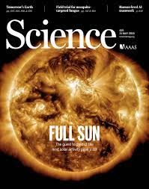
The Benefits of Diversity in Team Science
In a review of 2.57 million scientific papers published between 1985-2008 across 11 scientific fields…
…Papers written by ethnically diverse groups:
Were more highly cited
Were published in journals with higher impact factors.
*After controlling for the number of authors and population density of author locations.
Similar findings for gender diversity (Campbell et al., 2013).
Sources: R. B. Freeman & W. Huang (2014). NBER Working Paper No. 19905.
L.G. Campbell, S. Mehtani, M. E. Dozier, J. Rinehart (2013). PLoS ONE 8(10).
Notes:
Groups of diverse problem solvers can outperform groups of homogenous high-ability problem solvers

Slide 8
Creating the Conditions to Realize the Benefits of Diversity
Establish inclusive systems to increase and retain the diversity of the research team (e.g., admissions, hiring, evaluation).
Build capacity for inclusive interactions and behaviors among team members.
Plan for the collaborative and interpersonal aspects of the research as well as the scientific and technical aspects:
Decision-making
Conflict resolution
Providing and receiving feedback
Team development and cohesion
Diversity
Difference
Sense of Belonging
Inclusion
Sources: NASEM. (2015). Enhancing the effectiveness of team science.
R. Tulshyan (2022). Inclusion on purpose.
F. Dobbins & A. Kalev (2022). Getting to diversity: What works and what doesn’t.
Notes:
This only works under certain conditions. Rather than forgo the benefits of diversity, we can concentrate on how to make it work once it is in place. What are some of the barriers to each of these, and how can we surmount them?

Slide 9
Barriers to Diverse and Inclusive Systems: Homophily
Academic Parent
(Mission PI)
Thermophysics
IR Spectroscopy
VISNIR Spectroscopy
Children
(Mission PI)
Homophily is common in research collaboration.
Academic pedigree and genealogy shape primary collaborative units.
Areas of expertise structure teams and lead to bridging ties.
Familiarity, particularly when formed on other funded projects, can increase network closure.
There is also evidence of gender disparities in access to research networks.
Grandchildren
Sources: Li, W., Zhang, S., Zheng, Z. et al. Untangling the network effects of productivity and prominence among scientists. Nat Commun 13, 4907 (2022). https://doi.org/10.1038/s41467-022-32604-6
Schwartz LP, Liénard JF, David SV. (2022). Impact of gender on the formation and outcome of formal mentoring relationships in the life sciences. PLoS Biol 20(9): e3001771. https://doi.org/10.1371/journal.pbio.3001771
Notes:
There is evidence of gender disparities in access to training from life science faculty who have been granted outstanding research distinctions (e.g., NAS membership, Nobel Prize, HHMI grantee). When left up to our nature for homophily and affinity bias, we can reduce diversity.
As we form teams, we need to be aware of these tendencies so that we can critically reflect on them. We also need to find ways to mitigate the biases that we all have.

Slide 10
Barriers to Diverse and Inclusive Systems: Biases
Team formation requires that we make judgments about people, their competence and abilities. These judgments can be influenced by implicit and explicit biases.
Confirmation Bias
Tendency to (consciously or unconsciously) seek out information that conforms to your pre-existing viewpoint, while ignoring information that goes against your pre-existing view.
Attribution Bias
Judgment of a person’s behaviors based on prior observations and interactions you have had with that individual.
Affinity Bias
Tendency to prefer people who share similar interests, backgrounds, and experiences.
Confirmation Bias
Attribution Bias
Affinity Bias
Halo/Horn Effects
Judgment of a person’s character is generalized from a positive (halo) or negative (horn) impression in one specific area.
Halo/Horn Effects
Stereotyping
Stereotyping
Expecting a group or person to have certain qualities without having real information about the person; generalizing while ignoring individual difference.
Contrast Effect
Comparison of two or more things that you have been in contact with simultaneously or one right after the other, causing you to exaggerate the performance of one in contrast to the other.
Contrast Effect
Anchor Bias
Tendency to hold onto an initial, singular piece of information to make decisions.
Conformity Bias
Increased likelihood to adopt a belief as more people hold that belief; groupthink.
Anchor Bias
Conformity Bias
Notes:
Bias consists of attitudes, behaviors, and actions that are prejudiced in favor of or against one person or group compared to another.
Biases may be held by an individual, group, or institution and can have negative or positive consequences.
Conscious bias (i.e., explicit bias)
Unconscious bias (i.e., implicit bias)
Given social hierarchies and systems of power and privilege, implicit biases are widely culturally shared:
All people, even those committed to egalitarian values who believe that they are not biased can hold implicit associations that influence their judgments.
All people, even members of minoritized groups, hold implicit biases about others based on characteristics like race, ethnicity, gender, age, and appearance.
Both implicit and explicit biases can unfairly affect the lives of others, undermining efforts to advance diversity and inclusion.

Slide 11
Barriers to Diverse and Inclusive Systems: Biases
Team formation requires that we make judgments about people, their competence and abilities. These judgments can be influenced by implicit and explicit biases.
Affinity Bias
Tendency to prefer people who share similar interests, backgrounds, and experiences.
Confirmation Bias
Tendency to (consciously or unconsciously) seek out information that conforms to your pre-existing viewpoint, while ignoring information that goes against your pre-existing view.
Attribution Bias
Judgment of a person’s behaviors based on prior observations and interactions you have had with that individual.
Halo/Horn Effects
Judgment of a person’s character is generalized from a positive (halo) or negative (horn) impression in one specific area.
Stereotyping
Expecting a group or person to have certain qualities without having real information about the person; generalizing while ignoring individual difference.
Contrast Effect
Comparison of two or more things that you have been in contact with simultaneously or one right after the other, causing you to exaggerate the performance of one in contrast to the other.
Anchor Bias
Tendency to hold onto an initial, singular piece of information to make decisions.
Conformity Bias
Increased likelihood to adopt a belief as more people hold that belief; groupthink.
Notes:
Bias consists of attitudes, behaviors, and actions that are prejudiced in favor of or against one person or group compared to another.
Biases may be held by an individual, group, or institution and can have negative or positive consequences.
Conscious bias (i.e., explicit bias)
Unconscious bias (i.e., implicit bias)
Given social hierarchies and systems of power and privilege, implicit biases are widely culturally shared:
All people, even those committed to egalitarian values who believe that they are not biased can hold implicit associations that influence their judgments.
All people, even members of minoritized groups, hold implicit biases about others based on characteristics like race, ethnicity, gender, age, and appearance.
Both implicit and explicit biases can unfairly affect the lives of others, undermining efforts to advance diversity and inclusion.

Slide 12
Biases Can Affect Our Assessments of High-Ability STEM Talent
In an experimental study, biology and physics faculty were asked to evaluate postdoc candidates based on otherwise identical CVs with gendered/racialized names.
Gender Bias
Racial Bias
Hireability and Competence: Male = Female | Hireability and Competence: Asian > Black Hireability: Asian > Latinx
Hireability and Competence: Male > Female | Hireability and Competence: Asian and White > Black and Latinx
Biology
Physics
Source: Eaton, A. A., Saunders, J. F., Jacobson, R. K., & West, K. (2020). How gender and race stereotypes impact the advancement of scholars in STEM: Professors’ biased evaluation of physics and biology post-doctoral candidates. Sex Roles, 82, 127-141.
Notes:
Gender bias varied by discipline:
Biology: No differences in hireability and competence ratings of female and male candidates.
Physics: Male candidates viewed as more competent and more hirable.
Racial bias was present in biology and physics:
Biology: Asian applicants were viewed as more competent and hirable than Black applicants. Asian applicants were viewed as more hirable than Latinx applicants.
Physics: Asian and White applicants were rated as more competent and hirable than Black and Latinx applicants.
Appearance also makes a difference: STEM faculty at Caltech, MIT, and other elite universities. More feminine presenting women were judged as less likely to be a scientist than more “masculine presenting” women. For men, appearance made no difference.
Not just hiring but the science itself: Whose ideas we see as valid; what evidence we might weigh more heavily or what evidence we might dismiss.

Slide 13
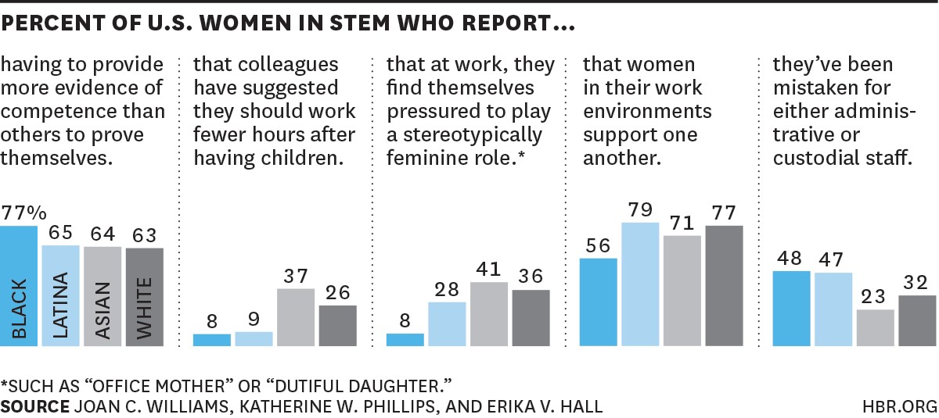
Biases Can Contribute to Inequitable Experiences
Sources: Williams, J. C., Phillips, K. W., & Hall, E. V. (2014). Double jeopardy? Gender bias against women in science. UC Hastings College of Law, San Francisco, CA.
Williams, J. C. (2015). The 5 biases pushing women out of STEM. Harvard Business Review.
Notes:
Biases can also contribute to the work that we do in the research environment.
Two-thirds of the women interviewed, and two-thirds of the women surveyed, reported having to prove themselves over and over again. three-fourths of black women did. (And few Asian-American women felt that the stereotype of Asian-Americans as good at science helped them; that stereotype may well chiefly benefit Asian-American men.)
More than a third (34.1%) of scientists surveyed reported feeling pressure to play a traditionally feminine role, with Asian Americans (40.9%) more likely than other groups of women to report this. About half of the scientists we surveyed (53.0%) reported backlash for displaying stereotypically “masculine” behaviors like speaking their minds directly or being decisive.
Nearly two-thirds of the scientists with children reported running into this form of bias, across all races and ethnic groups. Women felt they were competing with men who had stay-at-home wives, and that colleagues often assumed that they would lose their drive after they had children. “There is an assumption,” noted a black microbiologist, “that your career is more of a hobby than a career, and you’re only going to do it until you find a husband and/or have a family.”
Our new study uncovered a fifth pattern of bias that seems to apply mainly to black and Latina women. On our survey, 42% of black women agreed that “I feel that socially engaging with my colleagues may negatively affect perceptions of my competence,” only slightly more often than Latinas (38%), Asian-American women (37%), and white women (32%) – but in our interviews, black women mostly mentioned this pattern. ISOLATION
https://‹#›/2015/03/the-5-biases-pushing-women-out-of-stem
Biases can also affect the scientific outcomes: As objective as we purport to be, several sociologists of science have found evidence that personal biases and judgements about team members, their identities, and our relationships can lead us to more easily accept or reject their scientific ideas and theories.

Slide 14
Strategies to Mitigate the Influence of Bias
Practice De-biasing Techniques
Stereotype Replacement
Counter-Stereotypic Imaging
Increase opportunities for contact.
Avoid Your Triggers for “Biased” Decision-making
Doubt your own objectivity
Improve conditions of decision-making (maximize time, minimize stress)
Rely on data, not perceptions of “fit”
Use Tools to Optimize Decision-Making
Seek clarity in criteria and how to evaluate performance before evaluation begins.
Be consistent and apply criteria to all candidates.
Articulate the reasoning for every decision.
Look for other/outside perspectives.
Source: J. Moody (2010). Rising above cognitive errors: Guidelines to improve faculty searches, evaluations, and decision-marking.
Notes:
Build Critical Self-Awareness
Recognize and accept that you are susceptible to the influence of bias and assumptions and be motivated to change.
Test your own biases using Implicit Association Test (IAT) or other assessments. (https://implicit.harvard.edu/implicit/)
Pay attention to your triggers and know the conditions that activate your biases.
Practice De-biasing Techniques
Re-Association (Stereotype Replacement)
Refuting (Counter-Stereotypic Imaging)
Perspective-Taking
Increasing Opportunities for Positive Contact
Avoid Your Triggers for “Biased” Decision-making
Doubt Your Own Objectivity
Improve Conditions of Decision-making
Rely on Data
Create Opportunity and Accountability for Optimal Decision-Making
Clarity in criteria and how to evaluate performance before evaluation.
Empower an advocate for best practices/processes
Be consistent and apply criteria to all candidates
Allow for anonymous voting (when possible)
Articulate the reasoning for every decision
Include diverse representation of voices with decision-making authority in all processes

Slide 15
Constructing a Diverse Science Team
Be Intentional
Include personnel from historically underrepresented populations
Seek out those who have done training in a range of geographical locations, institutions
Represent a range of career stages
Look to different types of institutions and organizations (e.g., MSIs: HBCUs, HSIs; research active and/or master’s level institutions (e.g., R2s); Non-IHEs)
Consider individuals from varying scientific fields to contribute to transdisciplinary aspects of the proposed work
Be Strategic
Think about diversity early, and play the long game
Seek out ways to build in training and mentorship opportunities for diverse student- and postdoctoral researchers
Cultivate reciprocal relationships and partnerships

Slide 16
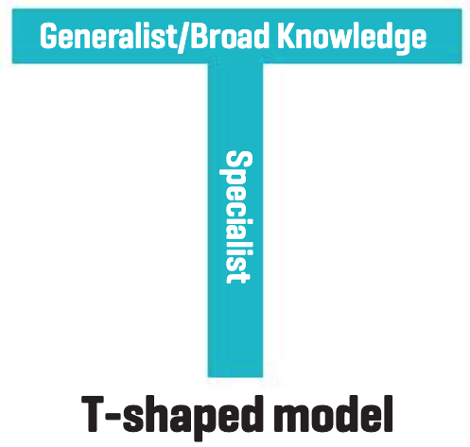
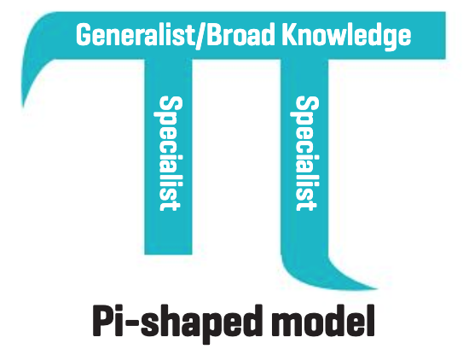
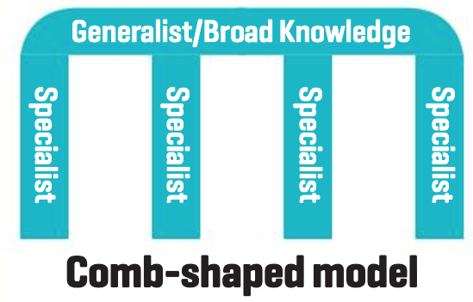
Constructing a Diverse Science Team
Consider multiple profiles of knowledge, deep expertise, and skill sets
Increases pool of potential collaborators/team members
Broadens possibilities for reaching outside of your network
Counterforce against network closure

Slide 17
Build Capacity for Inclusive Interactions and Behaviors
Psychological Safety
Shared perception among team members that they will not be embarrassed, rejected, or punished for speaking up with ideas, questions, concerns, or mistakes.
Inclusive Behaviors
Develop the ability to think with others.
Value the diverse ways people frame questions, process new information, and innovate new ideas.
Sense of Belonging
Mutual Respect
Interpersonal Trust
Sources: NASEM. (2015). Enhancing the effectiveness of team science; R. Tulshyan (2022). Inclusion on purpose.
Notes:
Facilitate psychological safety:
Supports risk taking and learning from errors and the development of innovative solutions.
How? Normalize failure; establish a process to discuss and learn from failure
Encourage inclusive behaviors:
Develop a code of conduct that describes what exclusionary behaviors look like.
Create team tenets around how exclusionary or discriminatory behaviors will be handled.

Slide 18
Build Capacity for Inclusive Interactions and Behaviors
Create a culture of psychological safety
Normalize failure.
Establish a process to discuss and learn from failure.
Encourage inclusive behaviors
Develop a code of conduct that describes what exclusionary behaviors look like.
Create team tenets around how exclusionary or discriminatory behaviors will be handled.
Sense of Belonging
Mutual Respect
Interpersonal Trust
Sources: NASEM. (2015). Enhancing the effectiveness of team science; R. Tulshyan (2022). Inclusion on purpose.
Notes:
Facilitate psychological safety:
Shared perception among team members that they will not be embarrassed, rejected, or punished for speaking up with ideas, questions, concerns, or mistakes. Supports risk taking and learning from errors and the development of innovative solutions.
Edmonson (1999)
Edmonson & Nembhard, 2009
Bell & Kozlowski (2011)
Bell et al (2011)
Hall et al. 2012a
Encourage inclusive behaviors:
Ability to think with others
Valuing the diverse ways people frame questions, process information and innovate new ideas.

Slide 19
Recognize Subtle Acts of Exclusion
VERBAL
”You’re so articulate."
NONVERBAL
Avoiding Eye Contact or Interaction
ENVIRONMENTAL
Only pictures of white male physicists in the hallways
Sue, D. W., Capodilupo, C. M., Torino, G. C., Bucceri, J. M., Holder, A. M. B., Nadal, K. L., & Esquilin, M. (2007). Racial microaggressions in everyday life: Implications for clinical practice. American Psychologist, 62(4), 271–286. https://doi.org/10.1037/0003-066X.62.4.271
Solorzano, E., Perez Huber, L., & Huber-Verjan, L. (2020). Theorizing racial microaffirmations as a response to racial microaggressions: Counterstories across three generations of critical race scholars. Seattle Journal for Social Justice. 18(2).
Notes:
Recognize that STEM disciplines, despite valuing objectivity, are not value-neutral.
Reckon with history of exclusion and discrimination, and the fact that sexism, racism, ableism, and other forms of oppression persist within society, the disciplines, and our institutions.
Examine our own personal beliefs, biases, and stereotypes that may inadvertently shape how we interact with peers/colleagues and influence who we believe has the capacity to succeed.
Microaggressions:
Intentional or unintentional brief exchanges that communicate hostile, derogatory, negative slights and insults that result in harmful or unpleasant psychological influence on an individual or group.
Microinvalidations:
Verbal remarks or behaviors that exclude, negate, or nullify the psychological thoughts, feelings, or experiential reality of a minoritized person.
“Some of my best friends are…”
“I don’t think of you as…”
“It was only a joke! Don’t take things so seriously…”
“Where are you from? Where are you really from? “
“People with disabilities are courageous…”
“I don’t see difference/color…”
“You speak good English…”
“You people...”
Imitating accents or dialects

Slide 20
Strategies For Addressing Subtle Acts of Exclusion:
Assume good intent, explain impact
I know what you meant….but the impact of it….
2. Ask a question about it
What do you mean by that?
3. Interrupt the sentence/behavior and redirect the conversation
Let’s talk about _______
4. Broaden it back out to a universal human behavior
I think that applies to just about anyone….
5. Help individualize it
Is there someone in particular you’re talking about?
6. OUCH
ouch, that hurts
Notes:
Your role is to engage
Engage publicy –
Speak with someone more privately at another point
May look different –
We want to offer you some approaches
Judgement call on when to say thsese publicly or privately
Immediacy of later?
Keep these in mind for the scenarios that are coming up – see how they fit into your style

Slide 21
Establish Team Processes: Conflict Resolution
Type
Management Strategies
Relationship Conflict
Reactive Approach
Working through disagreements via problem solving, compromise, and flexibility.
Task Conflict
Preemptive Approach
Anticipating and guiding conflict in advance via cooperative norms, charters, or other structures to shape conflict processes.
Process Conflict
Source: NASEM. (2015). Enhancing the effectiveness of team science.
Notes:
Relationship conflicts involve disagreements among group members about
interpersonal issues, such as personality differences or differences in norms
and values. Task conflicts entail disagreements among group members
about the content and outcomes of the task being performed, whereas process
conflicts are disagreements among group members about the logistics
of task accomplishment, such as the delegation of tasks and responsibilities
(de Wit, Greer, and Jehn, 2012, p. 360).

Slide 22
Establish Team Processes: Reporting and Addressing Harassment and/or Bias
RE-FRAME | Research integrity and ethical behavior includes maintaining a research environment free from harassment, bias, and discrimination.
PREVENT | Develop a shared understanding of what is meant by harassment and engage in regular training to prevent it.
SET STANDARDS | Maintain clear, unambiguous standards of professional behavior and policies.
FACILITATE REPORTING | Provide accessible and effective means for reporting in all research environments, and ensure process is well-known by all team members.
LEVERAGE RESOURCES | Partner with the Title IX or similar office to ensure the safety of all parties, investigate the allegations, and determine the appropriate sanctions in the event of findings.
Sources: NASEM. (2022). Action collaborative on preventing sexual harassment in higher education: Year three annual report of activities.
NSF. (2023). Stop harassment: Promising practices.
Notes:
Reframing responsibility: Cultivating a research environment free from harassment, bias, and discrimination is a component of research integrity and ethical behavior.
Training and education are a means to establishing a shared understanding of what is meant by harassment.
Ensure team members are made fully aware and regularly reminded of institutional policies or codes of conduct with respect to harassment.
Provide accessible and effective means for reporting in all settings (e.g., field sites, research centers, conference settings, etc.).
Inform all team members of their right to report allegations or findings of harassment to funding agencies.
Reporting practices entail protection from retaliation.
Respond to allegations promptly: Ensure safety, due diligence in investigating allegations, and undertaking appropriate sanctions in the event of findings.

Slide 23
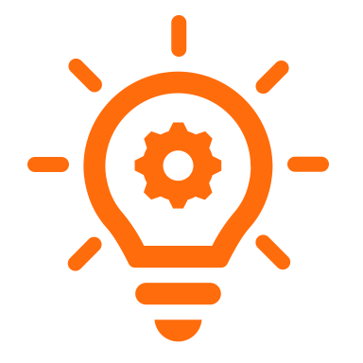
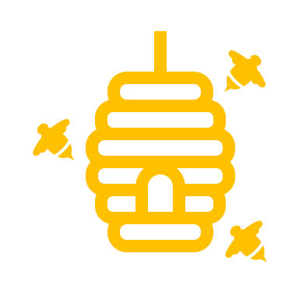
Establish Team Processes: Giving and Receiving Feedback
Ensure feedback is timely, specific, actionable, candid
Reflect on your intention for giving feedback
Examine how biased norms can lead to biased feedback
Deliver feedback with the
Situation-Behavior-Impact framework
Get comfortable feeling uncomfortable
Focus on substance, not style
Sources: NASEM. (2015). Enhancing the effectiveness of team science; R. Tulshyan (2022). Inclusion on purpose.

Slide 24
Case Study Activity
Use the QR Code to download the case study.
Take the time you need to read the case study.
Work in small groups to complete the worksheet in the PI Launchpad workbook.
https://tinyurl.com/LMPLaunchpad

Slide 25
Questions and Discussion
Lindsey Malcom-Piqueux, Ph.D.
Assistant Vice President, Diversity, Equity, Inclusion & Assessment
Chief Diversity Officer, Chief Institutional Research Officer
malcom@caltech.edu

Slide 26
What is Implicit Bias?
There are two types of preferences…
Psychological
“Hard-wired” patterns of preferences (e.g., aversion and avoidance of danger).
Biological preference for people “in-group.”
Sociocultural
Cultural influences, such as how people are raised, or past experiences, create favorable or unfavorable feelings (often unconscious).
Together these preferences create…
Which can…
Influence our decisions and behaviors.
Manifest themselves as micro-behaviors.
Unconscious Biases
Bypass our normal, rational, and logical thinking
Often labeled as intuition
Implicit biases are activated unintentionally, without our awareness
Most active when we are stressed, frustrated, angry or feel threatened
Notes:
Biases can be an impediment to equity.
They are consequential, yet often hidden.
Bias can be implicit or explicit.
Both types must be addressed to achieve equity.
Why do we have Unconscious Biases?
Biases may be automatically formed based upon:
• An evolutionary response to protect us from potential threats
• How (dis)similar another person is from us
• Our upbringing and the social structure and culture we’ve been part of
• Our own experiences and events that have impacted our lives and careers
• Things told by other people or things observed in the (social) media.
We use mental shortcuts and make automatic assumptions to classify situations, things, or people. This categorization can be useful at times, for example it helps us to make quick decisions when under threat. However, other incorrect biases may negatively affect our personal and professional lives and may unjustly affect the lives of others.

