Slide 1
PI Opportunities
Michael H. New, PhD
Deputy Associate Administrator for Research, NASA SMD
7/24/23

Slide 2
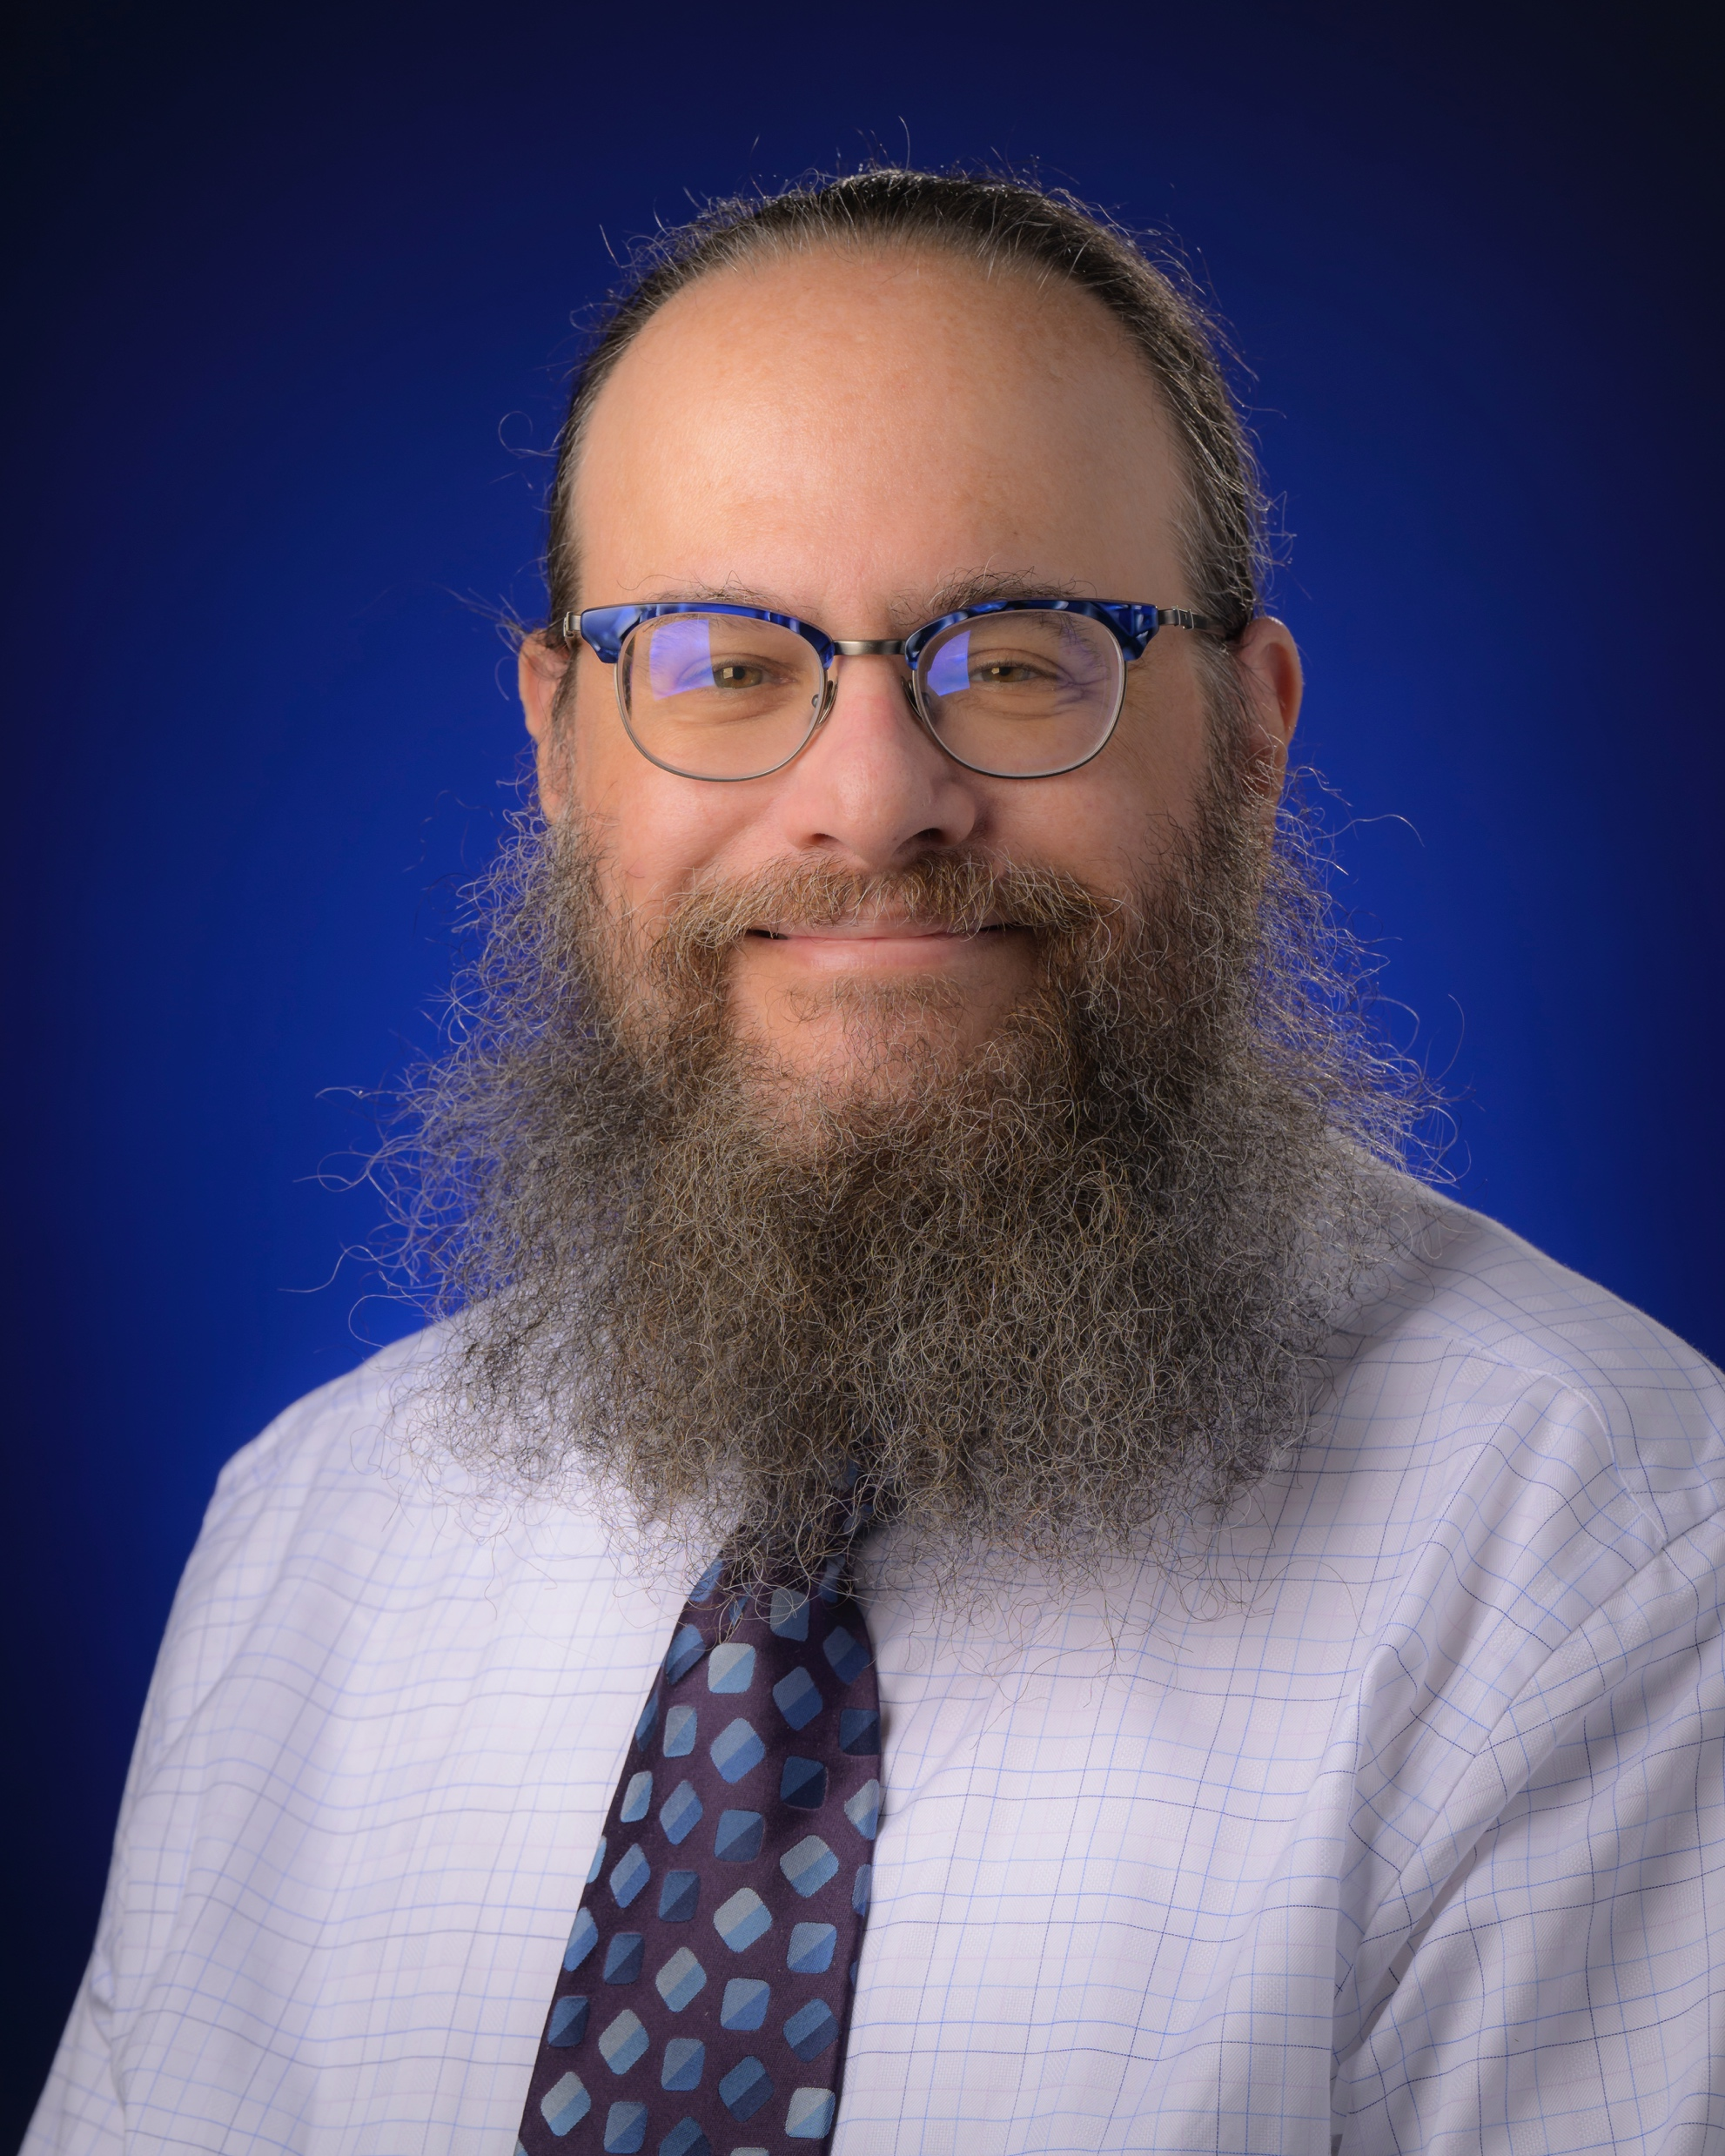
About me
Born and raised in NYC.
PhD in Chemical Physics. At NASA for 25 years. Astrobiologist.
Became Deputy Associate Administrator for Research (DAAR) about 6 years ago.
Mission of my office:
To ensure the quality, efficiency, fairness, inclusiveness, equity, accessibility, and transparency of SMD’s science competition processes,
to improve innovation within SMD and the science community, and
to broaden participation within the SMD research portfolio.
My pronouns are he, him, his.
Description: I have a large, dark beard and a ponytail. I wear glasses. Medium height.

Slide 3
A bit of a disclaimer
Being the PI of a flight project (mission or instrument) is a highly demanding, ultimately rewarding, and not always pleasant job. It’s perfectly acceptable to decide that it’s not for you.
There are plenty of flight project science positions short of being the PI.
Deputy PI
Project Scientist
Deputy Project Scientist
Instrument Scientist
Co-Investigator
My goal with this presentation is to provide information about the multiple programs SMD offers for becoming involved with or leading flight projects.

Slide 4
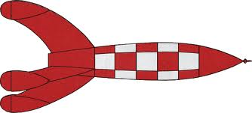
The Landscape
Broadly, there are two ways that SMD solicits for flight projects:
Program elements in ROSES
These are usually lower cost, higher risk, and have fewer requirements to meet on the way to the launchpad.
Funded through grants or cooperative agreements.
Evaluation of proposals similar to evaluation of research proposals with a single panel of experts.
Announcements of Opportunity (AOs)
Projects selected from AOs are usually higher cost, lower risk and subject to more requirements.
Funded through contracts.
Evaluation of proposals follows a two-panel approach: a science evaluation of science merit and implementation and an independent assessment of technical, cost, and management risks

Slide 5
A plethora of opportunities
AO-solicited Opportunities
ROSES-solicited Opportunities
Division | Program | Representative Cost ($M)
PSD | SIMPLEx (min) | 15
ESD | Earth Venture Instruments (Class D) | 35
HPD | Heliophysics Msn of Opp SmallSat | 35
APD | Astro Msn of Opp SmallSat | 40
PSD | SIMPLEx (max) | 55
HPD | Heliophysics Msn of Opp Std | 70
APD | Astro Msn of Opp Std | 80
ESD | Earth Venture Instruments (Class C) | 108
APD | Small Explorer | 145
ESD | Earth Venture Continuity | 150
HPD | Small Explorer | 150
ESD | Earth Venture Missions | 190
HPD | Medium Explorer | 250
APD | Medium Explorer | 290
ESD | Earth Sys Explorer | 310
PSD | Discovery | 500
PSD | New Frontiers | 900
APD | Astro Probes | 1,000
Division | Program | Representative Cost ($M) | Notes
HPD | Heliophysics Low-Cost Access to Space (HLCAS) | 3.5 | Sounding rockets and balloons
APD | Astro Research & Analysis (suborbital) (APRA) | 4.33 | Sounding rockets, balloons, and CubeSats
ESD | In-space Validation of Earth Science Technology (InVEST) | 7.5
HPD | Helio Flight Opportunities for Research and Technology (HFORT) | 11.25
APD | Pioneers | 20 | SmallSats/CubeSats
XDV | Payloads and Research Investigations on the Surface of the Moon (PRISM) | 50 | Payloads for CLPS
There is a wide variety of solicitations that would allow you to get your first opportunity to be a flight-project PI. Most AOs are not issued every year. Many ROSES program elements are solicited every year or every other year.
These opportunities include hosted instruments, CubeSats, SmallSats, sounding rockets, balloons, and full missions.
Investigate them. See what fits your science and your personal goals and principles. Then try!

Slide 6
Developing some “mission cred”
If you feel that you need to develop a better reputation as a flight-project team member, there are things that you can do short of leading a flight-project proposal.
A time-tested way is to study with or do a post-doc with someone already on a mission team.
If you are hardware-oriented, consider applying to one of the technology/instrument development programs (e.g., APRA, SAT, HTIDS, IIP, PICASSO)
Consider gaining experience in working with mission science data through proposals to data analysis, Guest Investigator, or Guest Observer programs.
Finally, when solicitations are released for “science team members”, “interdisciplinary scientists”, or “participating scientists”, consider applying.

Slide 7
Questions? Comments? Anecdotes?

Slide 8
5/10/21
PI Launchpad Title

Slide 9
5/10/21
PI Launchpad Title

