Slide 1
PI Launchpad Forum
Lockheed Martin PI-Led Mission Approach
Scott Hovarter, Deep Space Exploration Business Development
© 2023 Lockheed Martin Corporation. All Rights Reserved

Slide 2




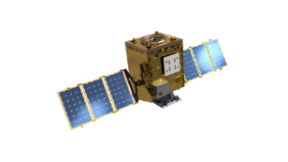
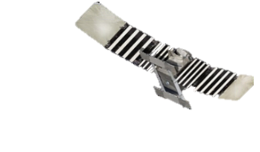
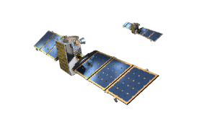
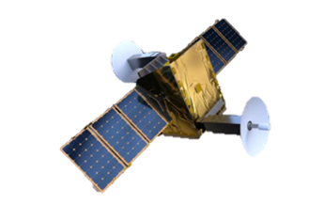
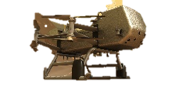
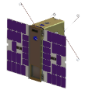

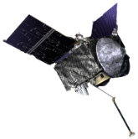
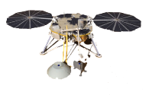
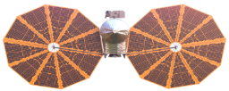



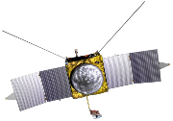
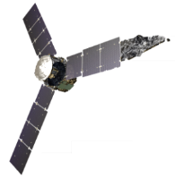
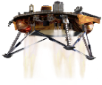
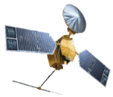
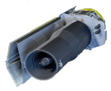
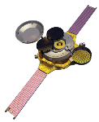
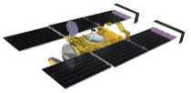
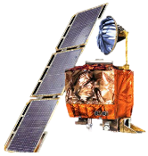
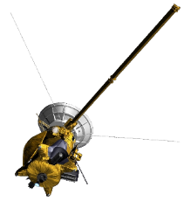

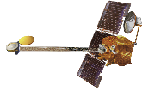
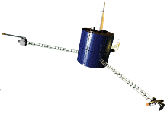
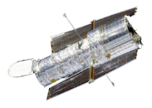






Lockheed Martin’s Deep Space Exploration Heritage
BLUE: Completed Mission
GREEN: Operational Mission
YELLOW: Development Mission
PURPLE: Spacecraft Lost on Arrival
WHITE: Year of Launch
Lunar Trailblazer
2023
Mars Sample Return
2027/2028
VERITAS
2031
Mars Aeroshells
M2020, MSL, Spirit & Opportunity, Pathfinder
2020, 2011, 2003, 1996
Parsec®
2025
Dragonfly 2027
DAVINCI
2029
Lucy
2021
LunIR CubeSat
2022
Janus
TBD
InSight
2018
MAVEN
2013
OSIRIS-REx
2016
GRAIL
2011
Juno
2011
Spitzer
2003
Mars Climate Orbiter and Polar Lander
1998 & 1999
Genesis
2001
Mars Odyssey
2001
Stardust & NExT
1999
Mars Global Surveyor
1996
Lunar Prospector
1998
Cassini Propulsion
1997
Hubble
1990
Magellan
1989
Viking 1 & 2
1975
Phoenix
2007
Mars Reconnaissance Orbiter
2005
Images: NASA/JPL
Supported exploration of every planet in the
Supported Every NASA Mission to
100%
90+
45
MARS
On-Time Spacecraft Delivery for Planetary Launch Windows
Payloads over
Years
SOLAR SYSTEM
August 2020
Notes:
3/22/23: Received direction from Scott Hovarter and Tim Linn to remove LunIR. (Note: we do not list Mars ’98/Polar Lander failed mission on this chart)
Updated: VERITAS Launch Date and mission order.

Slide 3
Lockheed Martin’s Approach to PI-led Missions
Principal Investigator is the Mission Lead
Our job is to support the PI in achieving science goals
We support:
  Mission feasibility trades,
  Definition of science objectives,
  cost and affordability trades, and
  overall mission design, thru operations
All to ensure the mission design is achievable within cost, schedule, and technical constraints
LM is a major partner to the PI and the selected mission implementation institution
LM is a subcontractor to the implementing institution
We support their proposal process while ensuring LM’s value proposition to NASA and delivery approach are highlighted in our proposal input

Slide 4
Lockheed Martin’s Approach to PI-led Missions
LM costs are based on a proven formula
Costs generated using a parametric model derived specifically for science mission program performance
Over the last 6 missions, our cost has been 0.3% to as much as 8.7% under budget
Per GAO report our schedule performance is flawless
InSight
(Delay not caused by LM)
LM has best-in-class cost performance and had never caused a launch schedule slip
Data courtesy of GAO

