Slide 1
Evaluation Process, SMD AOs
PI Launchpad 2023
Dr. Jared Leisner
Heliophysics Division
Science Mission Directorate

Slide 2
Introduction
AO Solicitation, Evaluation Overview
NASA process
Announcement of Opportunity, accompanying documents
Evaluation Criteria, Factors
What is the logic?
What is the evaluation based on?
How are findings classified?
How are proposals rated?
Selection Process
Categorization, Steering Committee
Selection Official
Notes:
The architecture -- science/TMC (aka forms A/B/C and D/O)
What the reviewers do and where do they come from?
Form/Factors
Leveling
Factors in Form A and B
What are the "scales" of findings that feed into an evaluation: Major/Minor Strengths/Weaknesses
Feel free to model off of what Tom Wagner in 2021: https://www.youtube.com/watch?v=J9EmaWsh9U4

Slide 3
NASA Staff
NASA Staff
for
DYNAMIC AO
Evaluation Panel
Dr Jared Leisner, Program Scientist
Heather Futrell, Program Executive
Science Mission Directorate (SMD), NASA Headquarters
Science Evaluation Panel
Dr Jared Leisner, Program Scientist
Heather Futrell, Program Executive
Heliophysics Division, SMD
TMC Evaluation Panel
Elisabeth Morse, Acquisition Manager (AM)
Behzad Raiszadeh, Backup AM
Omar Torres, Backup AM
NASA Science Office for Mission Assessments (SOMA)
Notes:
The architecture -- science/TMC (aka forms A/B/C and D/O)
What the reviewers do and where do they come from?
Form/Factors
Leveling
Factors in Form A and B
What are the "scales" of findings that feed into an evaluation: Major/Minor Strengths/Weaknesses
Feel free to model off of what Tom Wagner in 2021: https://www.youtube.com/watch?v=J9EmaWsh9U4

Slide 4
Evaluation Process

Slide 5
Evaluation Process
AO Released
Pre-Proposal Conference
Notices of Intent Due
Steering Committee Meeting 1
Proposals Due
Compliance
Check of
Proposals
Day 0
+21 days
+40 days
+90 days
Technical, Management and Cost
(TMC) Evaluation
TMC
Plenary Meeting
Evaluation Kickoff
Clarifications
Comments & Clarification Responses
Finalize Evaluation Documentation
Scientific Merit & Scientific Implementation Merit and Feasibility Evaluation
Science Evaluation
Plenary Meeting
Clarifications
Categorization
Committee Meeting
Steering Committee Meeting 2
Selection by SMD AA
Debriefings to
Proposers
Note: Days are estimates. Each AO sets its own milestone dates.
Notes:
The architecture -- science/TMC (aka forms A/B/C and D/O)
What the reviewers do and where do they come from?
Form/Factors
Leveling
Factors in Form A and B
What are the "scales" of findings that feed into an evaluation: Major/Minor Strengths/Weaknesses
Feel free to model off of what Tom Wagner in 2021: https://www.youtube.com/watch?v=J9EmaWsh9U4

Slide 6
Evaluation Process
AO Released
Pre-Proposal Conference
Notices of Intent Due
Steering Committee Meeting 1
Proposals Due
Compliance
Check of
Proposals
Day 0
+21 days
+40 days
+90 days
Technical, Management and Cost
(TMC) Evaluation
TMC
Plenary Meeting
Proposers start work as early as they can
NASA releases information ahead of the Final AO
Draft AO, 2-3 months before Final AO
Community Announcements, key information before the Draft AO (schedule, cost cap, etc.)
Evaluation Kickoff
Clarifications
Comments & Clarification Responses
Finalize Evaluation Documentation
Scientific Merit & Scientific Implementation Merit and Feasibility Evaluation
Science Evaluation
Plenary Meeting
Clarifications
Categorization
Committee Meeting
Steering Committee Meeting 2
Selection by SMD AA
Debriefings to
Proposers
Note: Days are estimates. Each AO sets its own milestone dates.
Notes:
The architecture -- science/TMC (aka forms A/B/C and D/O)
What the reviewers do and where do they come from?
Form/Factors
Leveling
Factors in Form A and B
What are the "scales" of findings that feed into an evaluation: Major/Minor Strengths/Weaknesses
Feel free to model off of what Tom Wagner in 2021: https://www.youtube.com/watch?v=J9EmaWsh9U4

Slide 7
Evaluation Process
AO Released
Pre-Proposal Conference
Notices of Intent Due
Steering Committee Meeting 1
Proposals Due
Compliance
Check of
Proposals
Day 0
+21 days
+40 days
+90 days
Technical, Management and Cost
(TMC) Evaluation
TMC
Plenary Meeting
NASA holds Pre-Proposal Conferences to
Highlight key aspects of the opportunity
Describe evaluation criteria, process
Introduce legal, programmatic topics
Program management
Export control
International partnerships
Answer questions on the opportunity
Evaluation Kickoff
Clarifications
Comments & Clarification Responses
Finalize Evaluation Documentation
Scientific Merit & Scientific Implementation Merit and Feasibility Evaluation
Science Evaluation
Plenary Meeting
Clarifications
Categorization
Committee Meeting
Steering Committee Meeting 2
Selection by SMD AA
Debriefings to
Proposers
Note: Days are estimates. Each AO sets its own milestone dates.
Notes:
The architecture -- science/TMC (aka forms A/B/C and D/O)
What the reviewers do and where do they come from?
Form/Factors
Leveling
Factors in Form A and B
What are the "scales" of findings that feed into an evaluation: Major/Minor Strengths/Weaknesses
Feel free to model off of what Tom Wagner in 2021: https://www.youtube.com/watch?v=J9EmaWsh9U4

Slide 8
Evaluation Process
AO Released
Pre-Proposal Conference
Notices of Intent Due
Steering Committee Meeting 1
Proposals Due
Compliance
Check of
Proposals
Day 0
+21 days
+40 days
+90 days
Technical, Management and Cost
(TMC) Evaluation
TMC
Plenary Meeting
NASA internal processes ensure soundness of the solicitation process and evaluation outcomes
Evaluation Kickoff
Clarifications
Comments & Clarification Responses
Finalize Evaluation Documentation
Discussed later
Scientific Merit & Scientific Implementation Merit and Feasibility Evaluation
Science Evaluation
Plenary Meeting
Clarifications
Categorization
Committee Meeting
Steering Committee Meeting 2
Selection by SMD AA
Debriefings to
Proposers
Note: Days are estimates. Each AO sets its own milestone dates.
Notes:
The architecture -- science/TMC (aka forms A/B/C and D/O)
What the reviewers do and where do they come from?
Form/Factors
Leveling
Factors in Form A and B
What are the "scales" of findings that feed into an evaluation: Major/Minor Strengths/Weaknesses
Feel free to model off of what Tom Wagner in 2021: https://www.youtube.com/watch?v=J9EmaWsh9U4

Slide 9
Evaluation Process
AO Released
Pre-Proposal Conference
Notices of Intent Due
Steering Committee Meeting 1
Proposals Due
Compliance
Check of
Proposals
Day 0
+21 days
+40 days
+90 days
Technical, Management and Cost
(TMC) Evaluation
TMC
Plenary Meeting
Evaluation Kickoff
Clarifications
Comments & Clarification Responses
Finalize Evaluation Documentation
Scientific Merit & Scientific Implementation Merit and Feasibility Evaluation
Science Evaluation
Plenary Meeting
Clarifications
Categorization
Committee Meeting
Steering Committee Meeting 2
Selection by SMD AA
Debriefings to
Proposers
Note: Days are estimates. Each AO sets its own milestone dates.
Notes:
The architecture -- science/TMC (aka forms A/B/C and D/O)
What the reviewers do and where do they come from?
Form/Factors
Leveling
Factors in Form A and B
What are the "scales" of findings that feed into an evaluation: Major/Minor Strengths/Weaknesses
Feel free to model off of what Tom Wagner in 2021: https://www.youtube.com/watch?v=J9EmaWsh9U4

Slide 10
Competitive Phase A
CSR Criteria and Requirements Released
Phase A Kick-Off
Steering Committee Meeting 1
CSRs Due
Compliance
Check of
CSRs
Technical, Management and Cost
(TMC) Evaluation
TMC
Plenary Meeting
Evaluation Kickoff
Comments, Discussion
Site Visit,
SQRLs
Discussion, Overlap
Finalize Evaluation Documentation
Scientific Merit & Scientific Implementation Merit and Feasibility Evaluation
Science Evaluation
Plenary Meeting
Steering Committee Meeting 2
Down-selection
by SMD AA
Debriefings to
Phase A PIs
Notes:
The architecture -- science/TMC (aka forms A/B/C and D/O)
What the reviewers do and where do they come from?
Form/Factors
Leveling
Factors in Form A and B
What are the "scales" of findings that feed into an evaluation: Major/Minor Strengths/Weaknesses
Feel free to model off of what Tom Wagner in 2021: https://www.youtube.com/watch?v=J9EmaWsh9U4

Slide 11
Competitive Phase A
CSR Criteria and Requirements Released
Phase A Kick-Off
Steering Committee Meeting 1
CSRs Due
Compliance
Check of
CSRs
Technical, Management and Cost
(TMC) Evaluation
TMC
Plenary Meeting
Evaluation Kickoff
Comments, Discussion
Site Visit,
SQRLs
Discussion, Overlap
Finalize Evaluation Documentation
Scientific Merit & Scientific Implementation Merit and Feasibility Evaluation
Science Evaluation
Plenary Meeting
In Step-2, there is no wall between the Science and the TMC reviewers. They participate in the Site Visit together and can directly discuss during the evaluation process
Steering Committee Meeting 2
Down-selection
by SMD AA
Debriefings to
Phase A PIs
Notes:
The architecture -- science/TMC (aka forms A/B/C and D/O)
What the reviewers do and where do they come from?
Form/Factors
Leveling
Factors in Form A and B
What are the "scales" of findings that feed into an evaluation: Major/Minor Strengths/Weaknesses
Feel free to model off of what Tom Wagner in 2021: https://www.youtube.com/watch?v=J9EmaWsh9U4

Slide 12
Guiding Documents

Slide 13
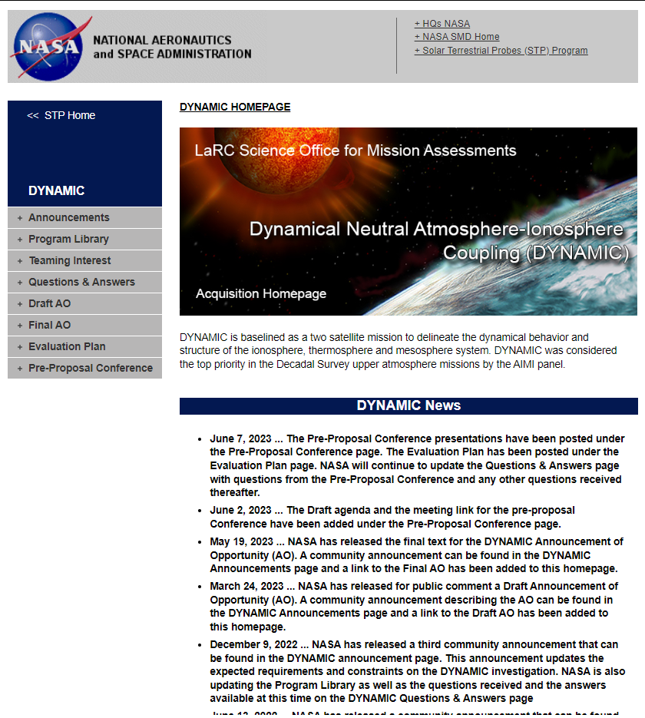
Acquisition Homepage
Acquisition Homepage has all the information for a solicitation.
If it is here, you are responsible for knowing about it. If it is not here, NASA is not responsible for it.
It looks like a lot (and it is!), but it is all necessary and NASA puts it there for your benefit.
Check it regularly for AOs you are proposing to. Look back at past AOs for insights.
https://soma.larc.nasa.gov

Slide 14
Acquisition Homepage
Important information from NASA
Important documents
Clarifications
AO documents themselves
More (and more) important information
https://soma.larc.nasa.gov/STP/DYNAMIC/index.html

Slide 15
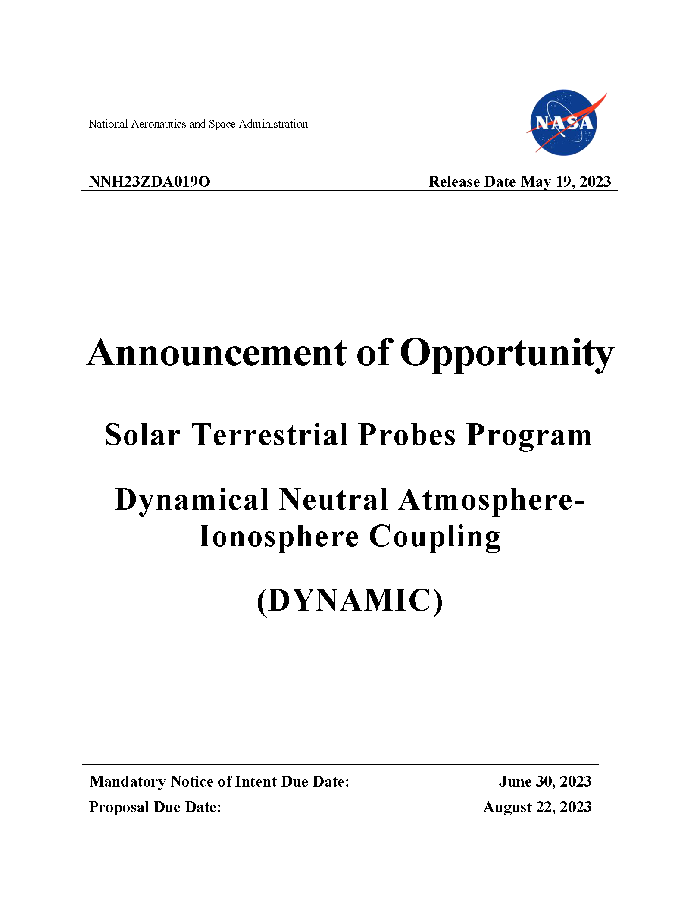
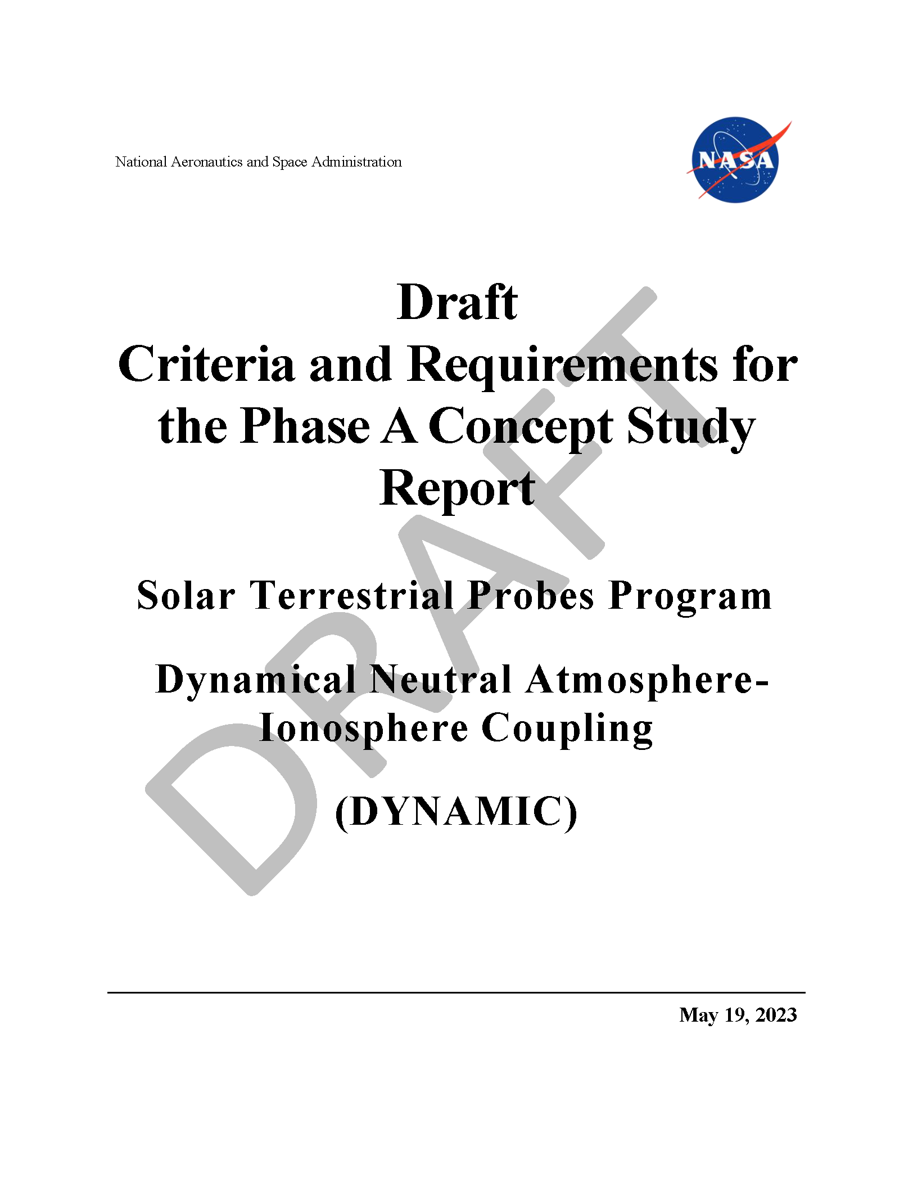
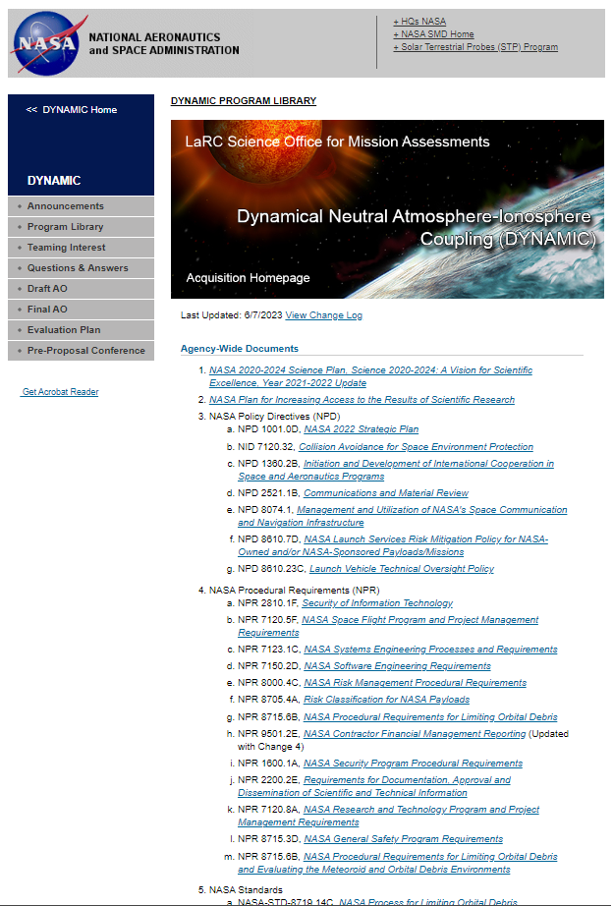
Guiding Documents
NASA Evaluation Process
AO overview [recap]
AO evaluation process
Criteria (Factors)
TMC cost assessment
AO Clarification Process
Competition/Project Rules
What NASA wants
What a project must do
What a proposal must contain
How a proposal must be written
NASA Project Requirements

Slide 16
Guiding Documents
Key investigation elements/info to look for:
Allowable topics
Any agency focus?
Previous selections (for context)
Relationship to other programs/projects
Key technical elements/info to look for:
Risk class
Access to space
Launch Readiness Date
Key programmatic constraints
Cost cap
Limit on contributions
NASA Evaluation Process
AO overview [recap]
AO evaluation process
Criteria (Factors)
TMC cost assessment
AO Clarification Process
Competition/Project Rules
What NASA wants
What a project must do
What a proposal must contain
How a proposal must be written
NASA Project Requirements

Slide 17
Guiding Documents
~60 slides
~150 pages
~70 pages
108 Requirements
85 Requirements
NASA Evaluation Process
AO overview [recap]
AO evaluation process
Criteria (Factors)
TMC cost assessment
AO Clarification Process
SMD’s detailed commitment to how the evaluation will be conducted.
Competition/Project Rules
What NASA wants
What a project must do
What a proposal must contain
How a proposal must be written
NASA Project Requirements
34 Agency-wide docs
23 Program-level docs
15 AO-specific refs

Slide 18
Pre-Proposal Conference Documents
Pre-Proposal Conference is the one opportunity to hear the emphasis (or emphases) of the AO in the words of the people that
wrote the solicitation,
run the evaluation, and
make recommendations to SMD leadership.

Slide 19
Pre-Proposal Conference Documents
Pre-Proposal Conference is the one opportunity to hear the emphasis (or emphases) of the AO in the words of the people that
wrote the solicitation,
run the evaluation, and
make recommendations to SMD leadership.
What aspects are new in this solicitation?
What are the key aspects of the Science Review?
What standards are proposals assessed against in TMC?
Note: These are open to the public. Even if you are not proposing to a particular AO, you can listen to hear the types of things that get discussed. Both what is important and what is not.

Slide 20
Criteria, Findings

Slide 21
Evaluation Criteria
Criteria are sets of factors that structure of the evaluation
Criteria do not overlap with each other
Factors within a criterion do not overlap with one another
Each criterion is assigned a weight that shows approximate relative significance
Standard AO Template has three criteria, CSR G&R adds criteria
Standard AO
Scientific Merit…: How compelling are the science objectives proposed? Will the investigation complete the science objectives?
Scientific Implementation Merit and Feasibility…: Will the mission provide the needed measurements within the technical implementation? Will the science team be able to complete the necessary work?
TMC Feasibility…: How feasible is the technical implementation?
CSR G&R
Merit of the Student Collaboration; Science Enhancement Options
Merit of the Small Business Subcontracting Plans
Form A
Form B
Form C
See Washito’s talk
Notes:
The architecture -- science/TMC (aka forms A/B/C and D/O)
What the reviewers do and where do they come from?
Form/Factors
Leveling
Factors in Form A and B
What are the "scales" of findings that feed into an evaluation: Major/Minor Strengths/Weaknesses
Feel free to model off of what Tom Wagner in 2021: https://www.youtube.com/watch?v=J9EmaWsh9U4

Slide 22
Evaluation Criteria
Always read a solicitation’s evaluation criteria closely. They can be and are tailored for an AO!
Scientific Merit…
Investigation goals: Are they clear and specific? Do they translate into progress on program priorities?
Investigation objectives: Are they clear and specific? Do their completion translate into progress on the investigation goals?
Investigation research plan: Is it able to complete the investigation objectives? Can it be completed using the anticipated data sets?
Scientific Impl. Merit and Feasibility
Anticipated data sets: Does the mission design provide sufficient/appropriate observing time to generate anticipated data sets from anticipated measurements? Can the anticipated measurements be obtained from the anticipated observations?
Instruments: Can they provide the anticipated observations? Can they provide the planned observations in this space environment?
Resiliency: Can the mission withstand anomalies, missed observations, and/or performance degradation?
Data analysis, archiving
Science team performance/capability
Assumes no issues
in Forms B or C
Assumes no issues
in Forms A or C
Notes:
The architecture -- science/TMC (aka forms A/B/C and D/O)
What the reviewers do and where do they come from?
Form/Factors
Leveling
Factors in Form A and B
What are the "scales" of findings that feed into an evaluation: Major/Minor Strengths/Weaknesses
Feel free to model off of what Tom Wagner in 2021: https://www.youtube.com/watch?v=J9EmaWsh9U4

Slide 23
Evaluation Criteria
Always read a solicitation’s evaluation criteria closely. They can be and are tailored for an AO!
Translation: What
NASA cares about.
Scientific Merit…
Investigation goals: Are they clear and specific? Do they translate into progress on program priorities?
Investigation objectives: Are they clear and specific? Do their completion translate into progress on the investigation goals?
Investigation research plan: Is it able to complete the investigation objectives? Can it be completed using the anticipated data sets?
Scientific Impl. Merit and Feasibility
Anticipated data sets: Does the mission design provide sufficient/appropriate observing time to generate anticipated data sets from anticipated measurements? Can the anticipated measurements be obtained from the anticipated observations?
Instruments: Can they provide the anticipated observations? Can they provide the planned observations in this space environment?
Resiliency: Can the mission withstand anomalies, missed observations, and/or performance degradation?
Data analysis, archiving
Science team performance/capability
The evaluation flow mirrors the flow of your investigation requirements!
Notes:
The architecture -- science/TMC (aka forms A/B/C and D/O)
What the reviewers do and where do they come from?
Form/Factors
Leveling
Factors in Form A and B
What are the "scales" of findings that feed into an evaluation: Major/Minor Strengths/Weaknesses
Feel free to model off of what Tom Wagner in 2021: https://www.youtube.com/watch?v=J9EmaWsh9U4

Slide 24
Evaluation Factors [Form A]
Standard AO Template
Form A
A-1. Compelling nature and scientific priority of the proposed investigation's science goals and objectives.
A-2. Programmatic value of the proposed investigation.
A-3. Likelihood of scientific success.
A-4. Scientific value of the Threshold Science Mission.
DYNAMIC AO
Form A
A-1. Scientific value and priority of the proposed investigation’s goals.
A-2. Compelling nature and scientific value of the proposed investigation's science objectives.
A-3. Likelihood of the research plan to complete the investigation's science objectives.
A-4. Scientific value of the Threshold Science Investigation.
Form D
D-1. Programmatic value of the proposed science investigation.
D-2. Programmatic value of the proposed technical implementation.
Note: Recent AOs have tailored A-3 and B-1 (next slide) in different ways.
Notes:
The architecture -- science/TMC (aka forms A/B/C and D/O)
What the reviewers do and where do they come from?
Form/Factors
Leveling
Factors in Form A and B
What are the "scales" of findings that feed into an evaluation: Major/Minor Strengths/Weaknesses
Feel free to model off of what Tom Wagner in 2021: https://www.youtube.com/watch?v=J9EmaWsh9U4

Slide 25
Evaluation Factors [Form B]
Standard AO Template
Form B
B-1. Merit of the instruments and mission design for addressing the science goals and objectives.
B-2. Probability of technical success.
B-3. Merit of the data analysis, data availability, and data archiving plan.
B-4. Science resiliency.
B-5. Probability of science team success
B-6. Merit of the Diversity and Inclusion Plan.
DYNAMIC AO
Form B
B-1. Merit of the proposed mission design and measurement techniques for providing the anticipated data sets.
B-2. Merit of the proposed instruments for providing the anticipated observations.
B-3. Merit of the data analysis, data publication, and data and software management plans.
B-4. Merit of the investigation design for science resiliency.
B-5. Merit of science team management and structure.
B-6. Merit of the Diversity and Inclusion Plan.
Note: CSR G&R adds a Factor assessing Level 1 and Level 2 Requirements.
Notes:
The architecture -- science/TMC (aka forms A/B/C and D/O)
What the reviewers do and where do they come from?
Form/Factors
Leveling
Factors in Form A and B
What are the "scales" of findings that feed into an evaluation: Major/Minor Strengths/Weaknesses
Feel free to model off of what Tom Wagner in 2021: https://www.youtube.com/watch?v=J9EmaWsh9U4

Slide 26
Evaluation Findings
Major Strength A facet of the implementation response that is judged to be of superior merit and can substantially contribute to the ability of the project to meet its scientific objectives.
Major Weakness A deficiency or set of deficiencies taken together that are judged to substantially weaken the project’s ability to meet its scientific objectives.
Minor Strength A strength that is worthy of note and can be brought to the attention of Proposers during debriefings, but is not a discriminator in the assessment of merit.
Minor Weakness A weakness that is sufficiently worrisome to note and can be brought to the attention of Proposers during debriefings, but is not a discriminator in the assessment of merit.
Notes:
The architecture -- science/TMC (aka forms A/B/C and D/O)
What the reviewers do and where do they come from?
Form/Factors
Leveling
Factors in Form A and B
What are the "scales" of findings that feed into an evaluation: Major/Minor Strengths/Weaknesses
Feel free to model off of what Tom Wagner in 2021: https://www.youtube.com/watch?v=J9EmaWsh9U4

Slide 27
Evaluation Ratings
Excellent A comprehensive, thorough, and compelling proposal of exceptional merit that fully responds to the objectives of the AO as documented by numerous and/or significant strengths and having no major weaknesses.
Very Good A fully competent proposal of very high merit that fully responds to the objectives of the AO, whose strengths fully outbalance any weaknesses.
Good A competent proposal that represents a credible response to the AO, having neither significant strengths nor weakness and/or whose strengths and weaknesses essentially balance
Fair A proposal that provides a nominal response to the AO, but whose weaknesses outweigh any perceived strengths.
Poor A seriously flawed proposal having one or more major weaknesses (e.g., an inadequate or flawed plan of research or lack of focus on the objectives of the AO).
Note: Only Major findings contribute to the Step-1 ratings.
Notes:
The architecture -- science/TMC (aka forms A/B/C and D/O)
What the reviewers do and where do they come from?
Form/Factors
Leveling
Factors in Form A and B
What are the "scales" of findings that feed into an evaluation: Major/Minor Strengths/Weaknesses
Feel free to model off of what Tom Wagner in 2021: https://www.youtube.com/watch?v=J9EmaWsh9U4

Slide 28
Reviewers
Program Scientist selects individuals to provide a robust review for each proposal
Scientific topic, general and specific
Technical aspects (e.g., instrumentation, measurement techniques)
Best practices are to have multiple reviewers for every needed expertise
A “simple” proposal still has a significant number of reviewers!
Each reviewer is usually welcome (and encouraged) to participate in discussions outside of their identified expertise “type”
These reviewers are experts, but not assume that they have identical expertise to you!
Req. B-1: […] [A proposal] shall contain all data and other information that will be necessary for scientific and technical evaluations…

Slide 29
How Do Reviewers Evaluate?
Reviewers evaluate the proposal that they read
There are three proposals:
The one you think you wrote
The one you wrote
The one they read
Your job is to write a proposal where these three are as close to one another as possible.
Clearly tell them what you are doing. Do not ask “Science Questions”, as those invite the reviewer to tell you what the answer should be!
The proposal determines the material reviewers do and do not see.
Do not give them control of the narrative.
Give them what they need
Do not give them what they do not need
No loose ends. Everything branches off of and ties back to the proposal backbone. All requirements are checked off.
Reviewers are human that want closure and will fill in gaps. No extraneous information, no off-handed comments, no unfired Chekhov’s Guns.

Slide 30
Selection Process

Slide 31
Post-Evaluation Committees
Independent assessments of evaluation process and outcome before the (Step-1) selection decision:
Categorization Committee: Considers the evaluation results, categorizes the proposals for the Selection Official (see next slide)
Steering Committee: Assesses evaluation process, reviews results of proposal evaluation and categorizations
Steering Committee is chaired by SMD DAAR and writes a memo, with any recommendations, to the Selection Official
Committees are composed of only NASA Civil Servants and unconflicted Intergovernmental Personnel Act (IPA) appointees

Slide 32
Categorization
Category I Well-conceived, meritorious, and feasible investigations pertinent to the goals of the program and the AO's objectives and offered by a competent investigator from an institution capable of supplying the necessary support to ensure that any essential flight hardware or other support can be delivered on time and that data can be properly reduced, analyzed, interpreted, and published in a reasonable time. Investigations in Category I are recommended for acceptance and normally will be displaced only by other Category I investigations.
Category II Well-conceived, meritorious, and feasible investigations that are recommended for acceptance, but at a lower priority than Category I.
Category III Meritorious investigations that require further development. Category III investigations may be funded for development and may be reconsidered at a later time for the same or other opportunities.
Category IV Proposed investigations that are recommended for rejection for the particular opportunity under consideration, whatever the reason.

Slide 33
Categorization
Category I Well-conceived, meritorious, and feasible investigations pertinent to the goals of the program and the AO's objectives and offered by a competent investigator from an institution capable of supplying the necessary support to ensure that any essential flight hardware or other support can be delivered on time and that data can be properly reduced, analyzed, interpreted, and published in a reasonable time. Investigations in Category I are recommended for acceptance and normally will be displaced only by other Category I investigations.
Category II Well-conceived, meritorious, and feasible investigations that are recommended for acceptance, but at a lower priority than Category I.
Category III Meritorious investigations that require further development. Category III investigations may be funded for development and may be reconsidered at a later time for the same or other opportunities.
Category IV Proposed investigations that are recommended for rejection for the particular opportunity under consideration, whatever the reason.
Qualitatively different

Slide 34
Selection Decision
Selection Official is the SMD Associate Administrator
May delegate selection authority for a particular solicitation
May consult with senior SMD and Agency leaders on selection decision
Sponsoring Division prepares for the selection decision
Final evaluation results
One or more options for the selection decision
Selection recommendation
Selection Official may consider a wide range of programmatic factors [AO §7.3]
Based on proposal categorization and evaluations, influenced by Division programmatic considerations
Overriding consideration will be to maximize scientific value while advancing NASA's science goals and objectives

Slide 35
Questions?

Slide 36
Solicitation Process
AO Released
Pre-Proposal Conference
Notices of Intent Due
Steering Committee Meeting 1
Proposals Due
Compliance
Check of
Proposals
Day 0
+21 days
+40 days
+90 days
Technical, Management and Cost
(TMC) Evaluation
TMC
Plenary Meeting
NASA has internal processes that ensure soundness of the solicitation process and evaluation outcomes
Evaluation Kickoff
Clarifications
Comments & Clarification Responses
Finalize Evaluation Documentation
Scientific Merit & Scientific Implementation Merit and Feasibility Evaluation
Science Evaluation
Plenary Meeting
Clarifications
Categorization
Committee Meeting
Steering Committee Meeting 2
Selection by SMD AA
Debriefings to
Proposers
Note: Days are estimates. Each AO sets its own milestone dates.
Notes:
The architecture -- science/TMC (aka forms A/B/C and D/O)
What the reviewers do and where do they come from?
Form/Factors
Leveling
Factors in Form A and B
What are the "scales" of findings that feed into an evaluation: Major/Minor Strengths/Weaknesses
Feel free to model off of what Tom Wagner in 2021: https://www.youtube.com/watch?v=J9EmaWsh9U4

Slide 37
Competitive Phase A
CSR Criteria and Requirements Released
Phase A Kick-Off
Steering Committee Meeting 1
CSRs Due
Compliance
Check of
CSRs
Technical, Management and Cost
(TMC) Evaluation
TMC
Plenary Meeting
Evaluation Kickoff
Comments, Discussion
Site Visit
Discussion, Overlap
Finalize Evaluation Documentation
Scientific Merit & Scientific Implementation Merit and Feasibility Evaluation
Science Evaluation
Plenary Meeting
NASA has internal processes that ensure soundness of the solicitation process and evaluation outcomes
Steering Committee Meeting 2
Down-selection
by SMD AA
Debriefings to
Phase A PIs
Notes:
The architecture -- science/TMC (aka forms A/B/C and D/O)
What the reviewers do and where do they come from?
Form/Factors
Leveling
Factors in Form A and B
What are the "scales" of findings that feed into an evaluation: Major/Minor Strengths/Weaknesses
Feel free to model off of what Tom Wagner in 2021: https://www.youtube.com/watch?v=J9EmaWsh9U4

