Slide 1
Elements of a Proposal
Stephen Unwin
Jet Propulsion Laboratory,
California Institute of Technology
© 2023 California Institute of Technology
Government sponsorship acknowledged

Slide 2

About me
Born and raised in England
PhD University of Cambridge – Radio Astronomy
Postdoc at Caltech – VLBI imaging
at JPL
  Deputy Project Scientist – Space Interferometry Mission
  Deputy Program Scientist – Navigator Program
  Proposal Capture Lead
  Proposal Manager, several missions in Earth Science and Astrophysics, including SPHEREx
(Former) Vice President, American Astronomical Society

Slide 3
Summary
NASA Announcement of Opportunity
Proposal writing team
Pre-Proposal Conference and NOI
NSPIRES cover page
The proposal itself

Slide 4
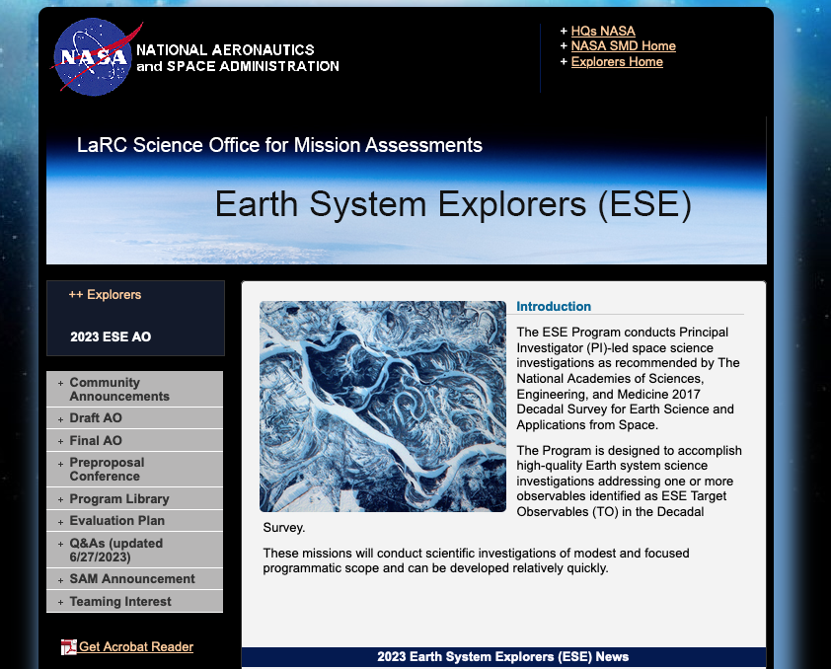
NASA Announcement of Opportunity
Website: Science Office for Mission Assessments (SOMA) at NASA Langley
Sign up for NSPIRES emails
AOs announced on NSPIRES
Watch this space for all the details

Slide 5
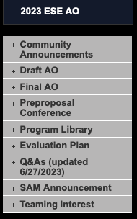
NASA Announcement of Opportunity
Be ready when these are announced !
Draft Announcement of Opportunity
  Almost always precedes the Final AO
  Usually ~3 months prior
Proposal Q & A on the Draft
  NASA may opt to provide clarifications
  Responses posted on the SOMA website
Final Announcement of Opportunity
  Sometimes has significant differences
  Sets a deadline of 90 days to submission
For the proposal team, the clock is now running!

Slide 6
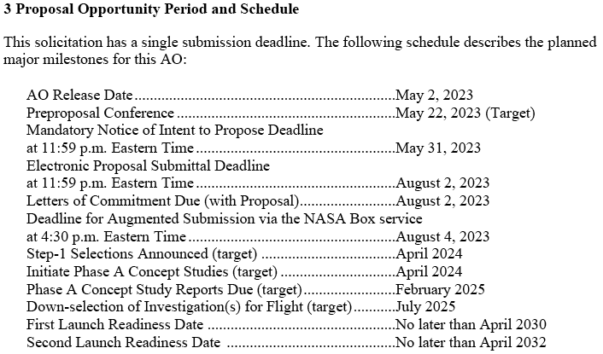
Schedule for the AO
This is the Roadmap to your Proposal Writing
AO schedule has three parts:
Milestones to proposal submission
Milestones for selection and Step 2 Proposal
Milestones for the mission (included in the proposal)

Slide 7
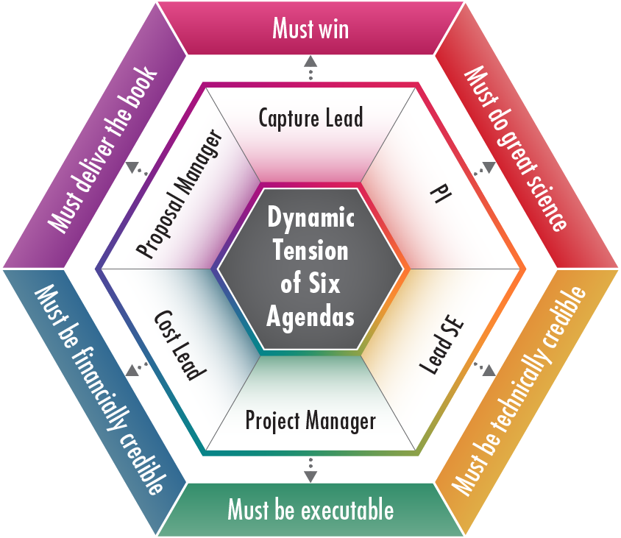
Proposal Writing Team
“It takes a Village”
No one person, perhaps not even the PI, is the ‘most important’ during the proposal phase!
A range of skills is required in the writing team
Helpful to think of 6 roles must be filled – either by individuals or combinations
Tension between roles is healthy as long as the roles remain balanced
If you’re missing expertise, seek to bring in talent as needed

Slide 8
Pre-Proposal Conference and FAQs
This is an opportunity to ask for clarifications on the AO
NASA answers to community questions are always shared publicly
Don’t expect to learn anything specific to your proposal
You may not wish to ask anything that could reveal aspects of your proposal

Slide 9
Notice of Intent to Propose
Submitted by the PI via NSPIRES, and includes briefly:
  summary of the planned science, team members and institutions
Provides a way for NASA to notify proposers of late changes in the Announcement of Opportunity
Helps NASA identify people to exclude from the pool of possible reviewers
The NOI is treated as confidential by NASA
It’s in the PI’s interest to be as helpful as possible in the NOI

Slide 10
The Proposal Itself
AO describes the required content
Each AO follows the same general pattern
  But the AO is customized for each proposal campaign
  Beware of assuming that the specific content is the same as a previous AO !
Compliance with the AO is very important !
  The AO includes a Compliance Checklist (Appendix F)
Pay special attention to page limits for each Section
  NASA will discard pages in excess of the stated limits
  The proposal team should pay attention to this early
  Beware: “Let’s throw in everything, then decide later what to keep” !

Slide 11
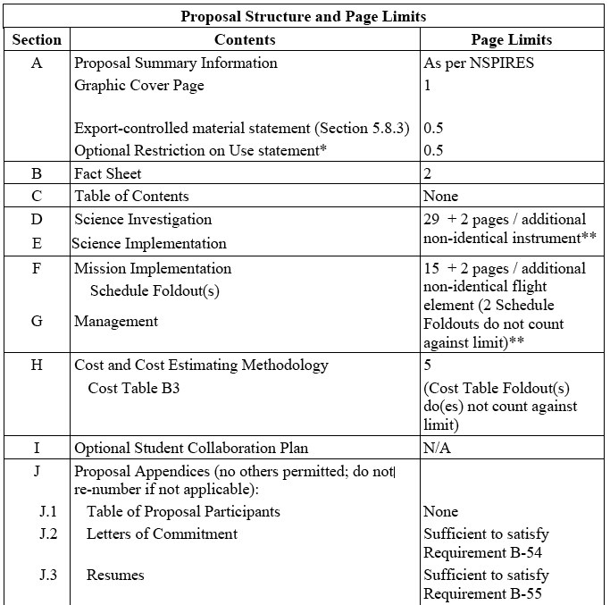
Typical AO Section Layout
Page 1/2

Slide 12
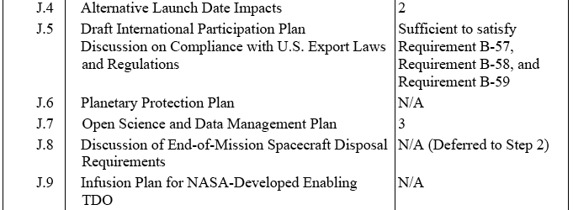
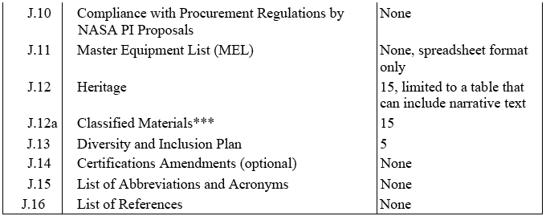
Typical AO Section Layout
Page 2/2

Slide 13
Logical flow of the Proposal
Why the proposal sections are in this order
Cover Page §A – Every book needs an attractive cover
Fact Sheet §B – Quick 2-page summary of the whole proposal
Science Investigation §D – Science objectives
Science Implementation §E – Instrument(s), measurements to be made, and the science team that will do the work
Mission Implementation §F – Spacecraft, mission design, duration
Management §G – How the project will be managed and tracked
Cost §H – What it will all cost, with justification
Appendices §J.1-3 – Participants, Commitments, Resumes
Appendix J.11 – Master Equipment List
Appendix J.12 – Heritage – what, specifically, isn’t new
Appendix J.n – All the rest – multiple required appendices

Slide 14
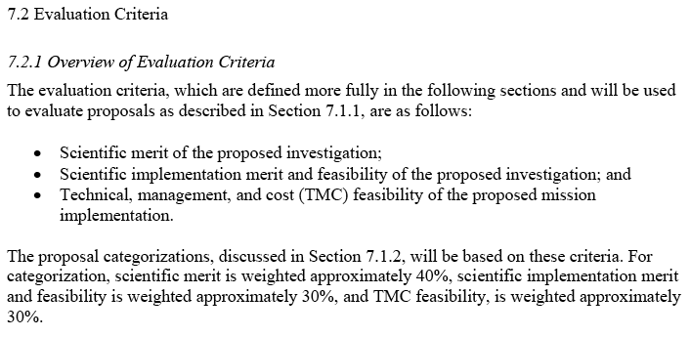
Evaluation Criteria
AO lays out what you must include and how it will be evaluated
AO Section 7 – “Proposal Evaluation, Selection, and Implementation”
  Lays out the criteria in considerable detail
Everything you write should keep the reviewers in mind:
  Is it true? Is it necessary?
  Is detail obscuring your main point?
  Does it help convince a reviewer you meet the evaluation criteria?

Slide 15
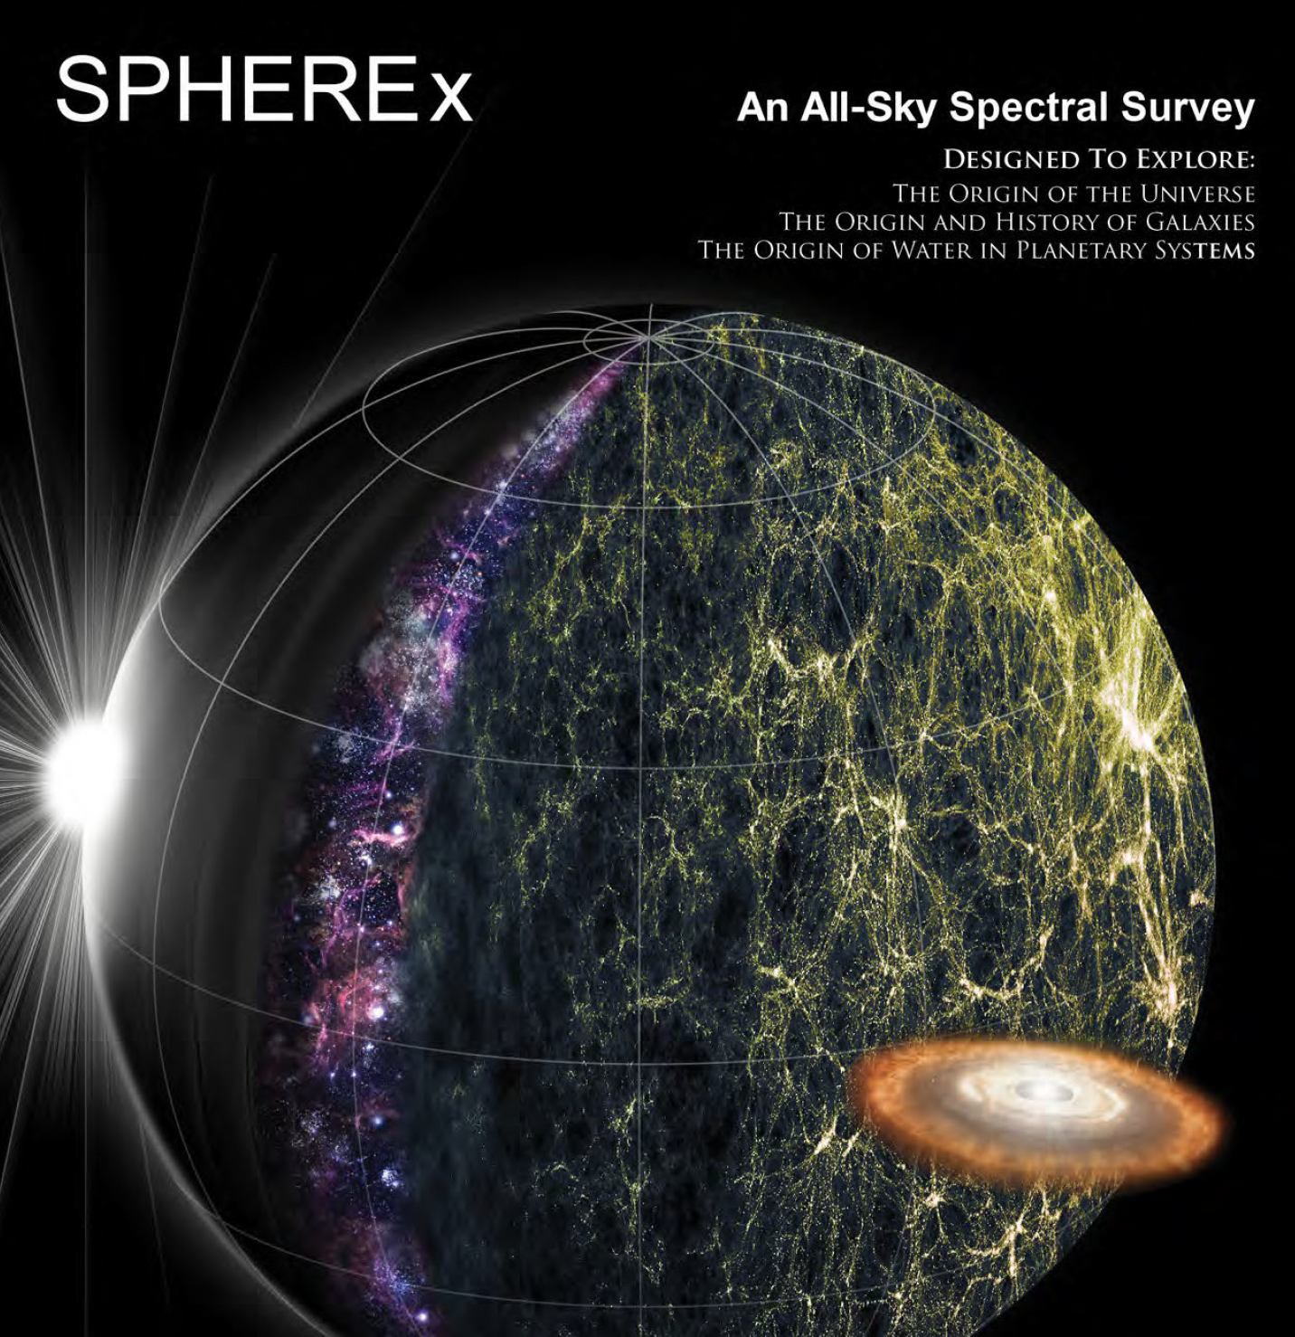
Graphic Cover Page §A
Every book needs an attractive cover
An opportunity to ‘brand’ your proposal
  A compelling science message in an eye-catching image
  Define a color scheme, fonts, logo, for the proposal etc.
The AO defines a few things that must appear:
  Title, PI, proposing organization, organizational signature
  Don’t include any material not in the main body of the proposal

Slide 16
Fact Sheet §B
This is your ‘elevator speech’
Two-page fact sheet is a summary of the proposal
Required elements:
  Science, instrument(s), spacecraft, mission design, technology, partners, schedule, total cost and PI-managed cost
Opportunity to establish your ‘brand’
  Highlight compelling nature of the science
  ‘Enabling’ instrument capabilities and/or new technologies
  Projected performance and measurement capabilities
  Proposal strengths through partner organizations
  Robustness and low-risk claims (if justified!)

Slide 17
Science Investigation §D
Make the case for your science objectives
Scientific Background, Goals, and Objectives
  Make the case for the science understanding to be gained
Science Requirements
  What science measurements, observations are needed
Emphasis is on scientific quantities to be measured
Threshold Science Mission
  The minimum mission that the PI deems worth doing
Science Traceability Matrix
  STM converts these to instrument requirements
  Lots more on this critical table today and Tuesday !
Lay out the science case convincingly, but beware of too much detail
Reviewers are smart, but don’t assume they are experts

Slide 18
Science Implementation §E
Show how your experiment can achieve the science objectives
Instrumentation
  Instruments proposed and why; capabilities
Data Sufficiency
  Often misunderstood by proposers
  Not just the ability to return the data claimed
  When the data are in hand, can you now meet the science objectives?
Science Mission Profile
  Trajectory, orbit, navigation, mission duration
Data Plans
  Data retrieval, validation, pipeline processing, distribution
Science Team
  Who will do the work, and what are their qualifications

Slide 19
Mission Implementation §F
Describe the mission to conduct the science experiment
General Requirements and Mission Traceability
  Mission requirements levied by science objectives
Mission Concept Descriptions
  AO lays out these requirements in great detail !
  Spacecraft, mission design, duration, launch window, etc.
Development Approach
  System Engineering specific to the mission (not generic)
New Technologies/Advanced Engineering Developments
  Technology development plans; and a backup plan
Assembly, Integration, Test, and Verification – timeline
Foldout Schedule – Including critical path, mandatory reviews/gates

Slide 20
Management §G
Show how you, as PI, will manage the project
Management approach; decision making authorities
Organizational Chart, showing partner roles
Quantify the risks – Likelihood, consequences, mitigations
Mission descopes – Describe what would be descoped during mission development to stay on track: cost, schedule and science
Contributions – How will partner contributions be managed; and contingency plans for problems

Slide 21
Cost and Cost Estimating Methodology §H
What does it cost? How did you estimate it? What are the inherent risks?
“This section of the proposal must include an estimated cost of the investigation, a description of the methodologies used to develop the estimate, and a discussion of cost risks.”
Some advice on costing:
Make sure your cost engineer is a full member of your team
Early on, scope your mission to fit the cost cap
Costs rarely go down as the concept matures
Squeezing or cutting down scope is hard, as it ‘ripples’ through the entire proposal
Watch out for cost implications from schedule changes

Slide 22
NSPIRES Electronic Cover Page
Cover Page will be customized for the specific AO
PI initiates with “Create Proposal”
All team members must be named in NSPIRES
  Every team member, including key staff:
    must have an NSPIRES account
    and their institutional affiliation registered with NSPIRES
  Every team member must acknowledge their role in NSPIRES
  PI can grant access to their administrative support if desired
List of team members should match the Science Team list (§E) and Proposal Participants (§J.1) Resume List (§J.3)
PI is responsible for badgering their team as needed!
Start this process early

Slide 23
Proposal Appendices §J.1-3
Required Appendices vary by AO. Only the major ones covered here.
Proposal Participants §J.1
  Includes major partners and CoI institutions
Letters of Commitment §J.2
  Required for major partners and all contributions
  Senior institutional signatures required
  Not required for CoIs – they commit through NSPIRES
  There are a lot of requirements for LOCs – read the AO carefully
  Start these early – they can take a really long time
Resumes §J.3
  PI, CoIs, Collaborators, Key Personnel

Slide 24
Proposal Appendices §J.11, §J.12
Master Equipment List (MEL) §J.11
  “Excel spreadsheet summarizing all major components of each flight element subsystem and each instrument element component”
Heritage §J.12
  Limited to 15 pages, table format
  “Contains a table that identifies each element of any heritage from which the proposed investigation derives substantial benefit, including heritage from spacecraft subsystems, instruments, flight software, test set ups, simulations, analyses, etc.”
  Where possible, include cost of heritage item compares to the proposed cost
  NASA has strict definitions: don’t exaggerate claims

Slide 25
Diversity and Inclusion Plan §J.13
Diversity and Inclusion Plan §J.13
  “NASA expects that all mission projects will clearly define the principles by which team members can operate in an inclusive, equitable, and safe environment. These principles, as well as the processes in place for maintaining and improving the environment over the course of the mission, should be captured in a project “Diversity and Inclusion Plan”.
  NASA takes DEI plans very seriously
  DEI Plan typically allocated 5 pages
  AO contains a lot of guidance on what to include
  Avoid generic statements; customize for your proposal

Slide 26
Acronyms §J.15 and References §J.16
I saved the best for last ! 🙂
Abbreviations and Acronyms §J.15
  These do help reviewers; define them upon first use
List of References §J.16
  URLs allowed; but do not point to audio or video
  Do not assume reviewers will follow references: if any info or data are critical, they must be part of the proposal itself.
Other Appendices - These vary by proposal: check AO Appendix B
No other Appendices allowed: don’t get creative with attachments!

Slide 27
Questions?
Stephen Unwin, JPL
stephen.c.unwin@jpl.nasa.gov

