Slide 1
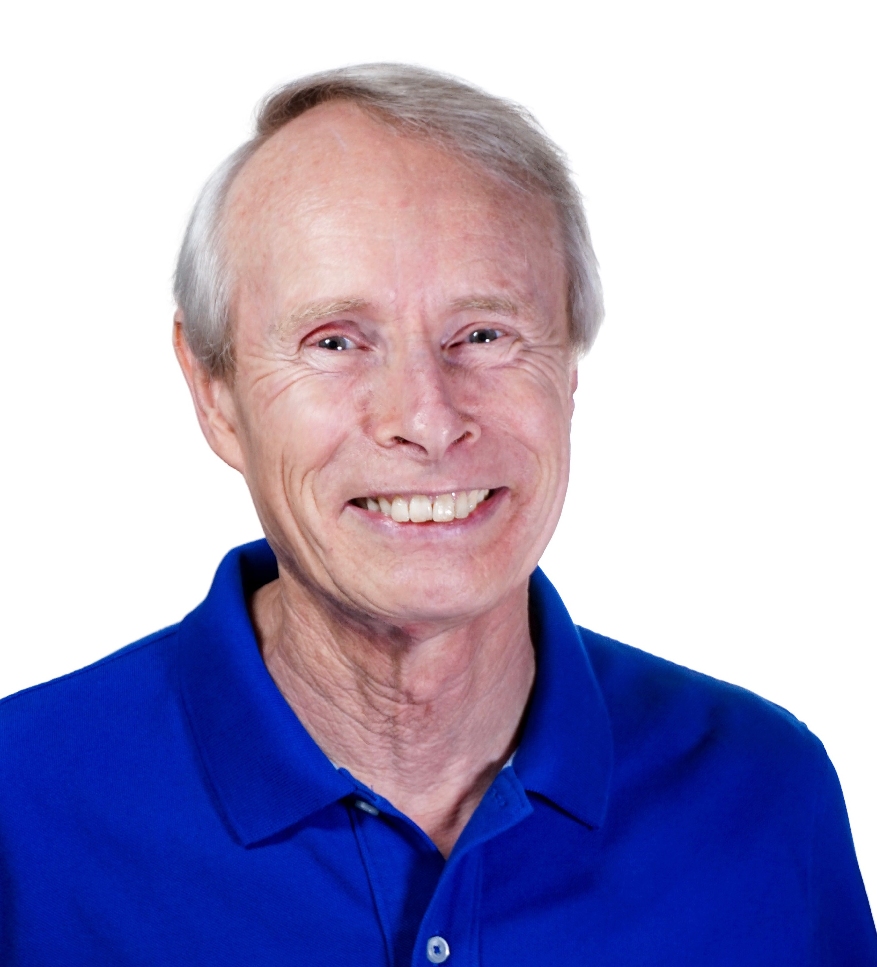
About me
Born and raised in England
PhD University of Cambridge – Radio Astronomy
Postdoc at Caltech – VLBI imaging
at JPL
Deputy Project Scientist – Space Interferometry Mission
Deputy Program Scientist – Navigator Program
Proposal Capture Lead
Proposal Manager, several missions in Earth Science and Astrophysics, including SPHEREx
(Former) Vice President, American Astronomical Society

Slide 2
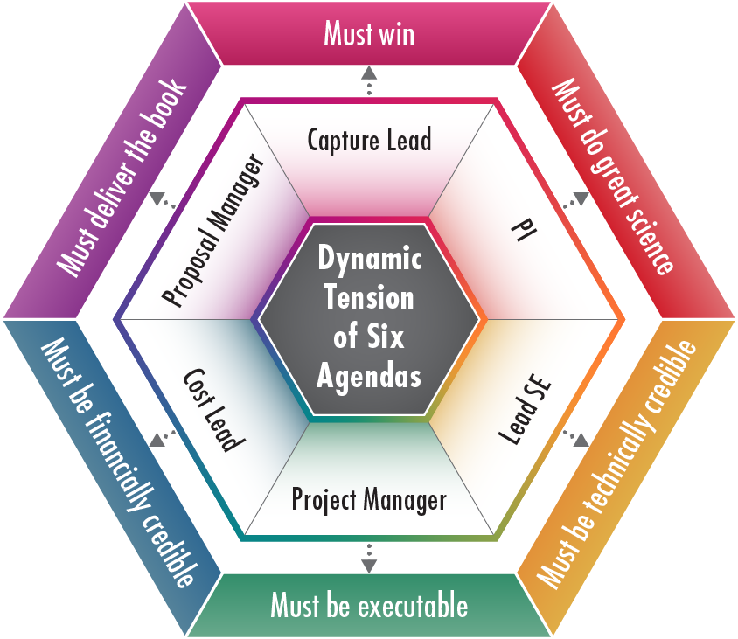
Proposal Writing Team
“It takes a Village”
No one person, perhaps not even the PI, is the ‘most important’ during the proposal phase!
A range of skills is required in the writing team
Helpful to think of 6 roles must be filled – either by individuals or combinations
Tension between roles is healthy as long as the roles remain balanced
If you’re missing expertise, seek to bring in talent as needed

