Slide 1
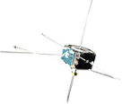
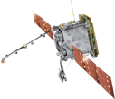
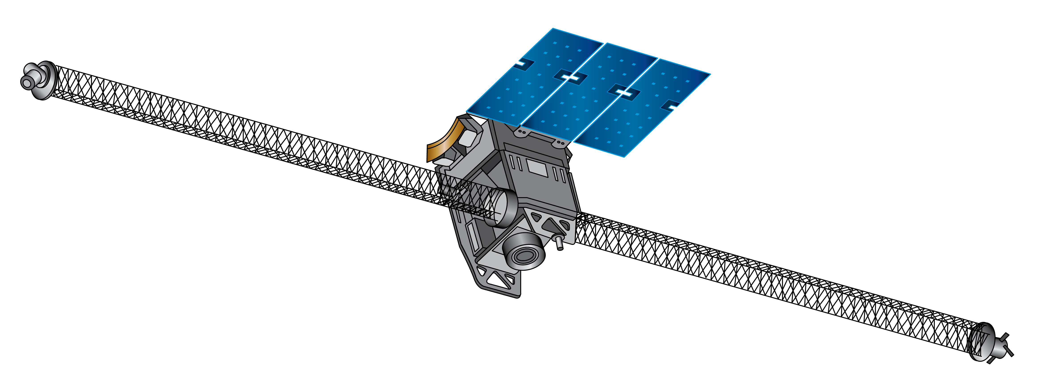
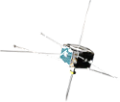
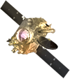
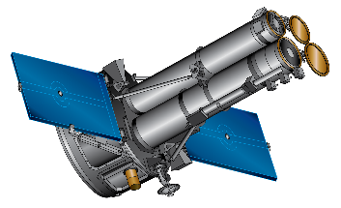
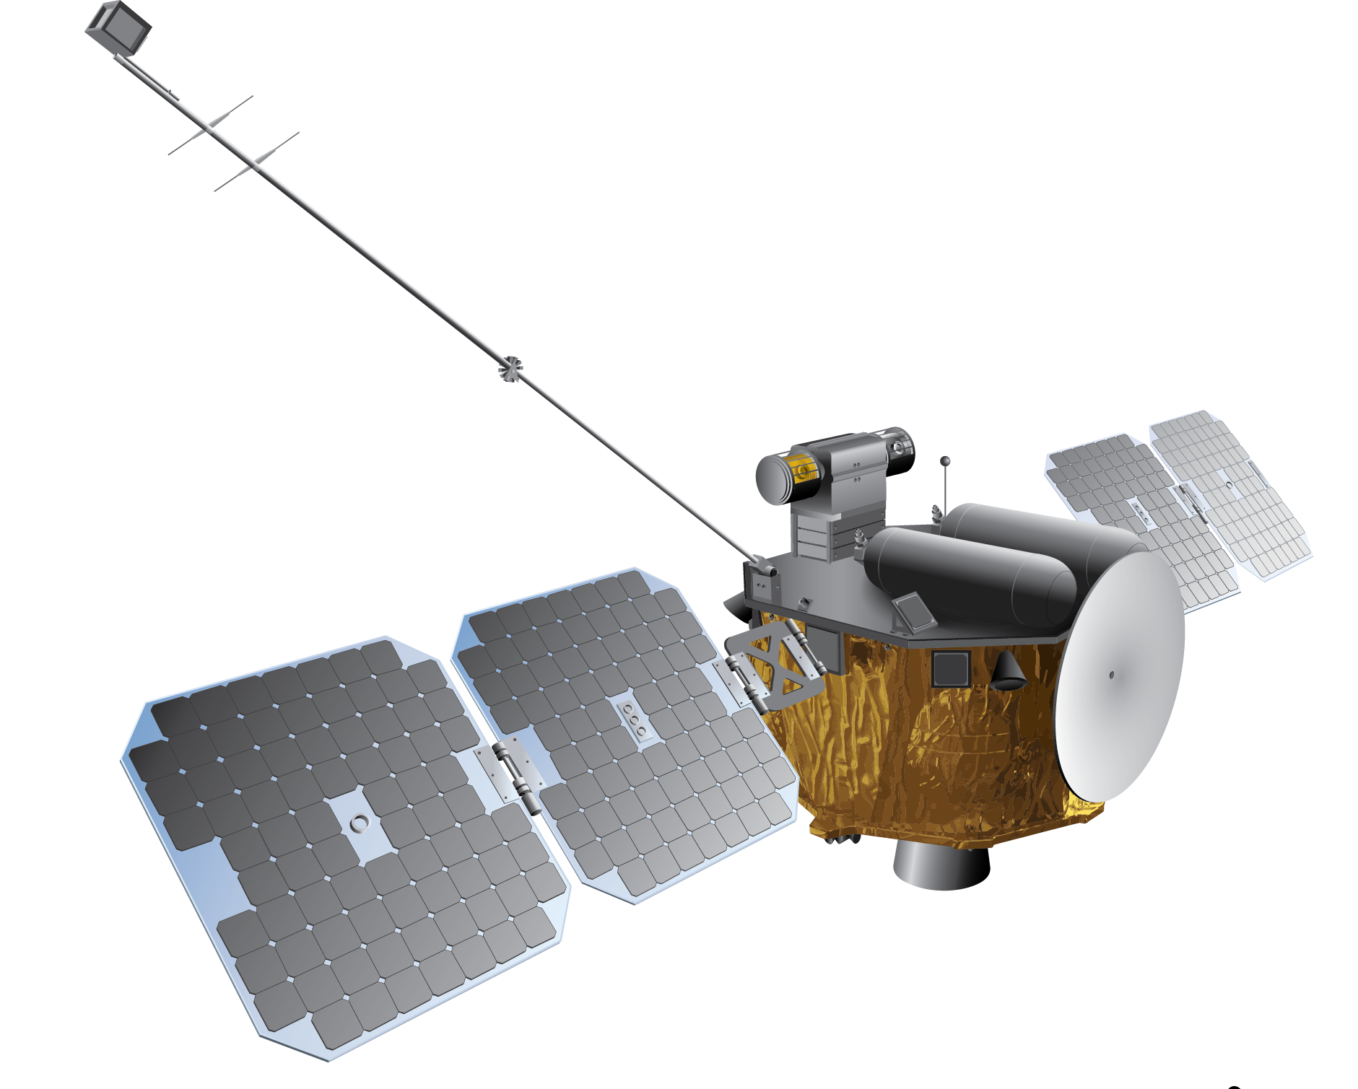
IBEX
EUVST
(JAXA)
HERMES (Gateway)
AIM
SunRISE (6)
Solar Orbiter (ESA)
TRACERS (2)
AWE (ISS)
ACE
SDO
THEMIS-ARTEMIS (2)
ICON
SOHO (ESA)
HelioSwarm (9)
IMAP
Parker Solar Probe
WIND
GOLD (SES)
Carruthers Geocorona Observatory
EZIE (3)
THEMIS (3)
STEREO
TIMED
MMS (4)
MUSE
Hinode (JAXA)
PUNCH (4)
IRIS
RAD
ESCAPADE (2)
Voyager (2)
Notes:
Heliophysics mission fleet
To help us better understand our star, to predict solar events and prevent serious impacts on Earth, NASA uses a fleet of spacecraft strategically placed throughout our heliosphere.
From Parker Solar Probe which is the first human made object and mission to enter the Sun’s atmosphere or “touch” the Sun
To satellites around Earth,
To the farthest human-made object, Voyager, which is sending back observations on interstellar space.
Each mission is positioned at a critical, well-thought-out vantage point to observe and understand the flow of energy and particles throughout the solar system -- all helping us untangle the effects of the star we live with.
Selected 2 MIDEX
Explorers AO
SMEX Step 1 NET October
Vigil AO
Overview:
17 operating missions with 25 spacecraft
13 missions currently in development
Robust sounding rocket and scientific balloon programs and multiple CubeSat missions
New Explorers MIDEX selections MUSE and HelioSwarm in development
NASA AO released for instrument selection (EUV imager) to be hosted on ESA's Vigil mission to L5. Preproposal Conference on 13 July, Notice of Intent (mandatory) due by 9 August, and proposals received 27 September​
GDC and DYNAMIC status​
GDC pause proposed by FY24 President’s Budget Request​
DYNAMIC AO released May 19, proposals due August 22​
Expect to select 1 or more missions to do Phase A studies
Struggling in current budget climate
We did not give blanket permission in DYNAMIC AO – responsibility is on proposer to prove it is low risk
Senior Review conducted in April, report release this summer​
Explorers solicitations in 2022 (SMEX)
SMEX-22 Step Selections expected NET October
Planning MIDEX AO in 2025

