Slide 1


Title (do not change font or font size for any of the chart elements except when stated)
PI: Name/Institution
Target: e.g. Mars subsurface, airless body surfaces, planetary body flyby or orbit, etc.
Replace this box with figure(s) illustrating and clarifying the concept
Figure Caption:
Science:
Bullet list of science that will be enabled by new instrument. What science could we do with this instrument that can not be done with current instruments?
Adjust size of text box as required
Objectives:
Bullet list of major objectives of proposed work
Adjust size of text box as required
Key Milestones (yet to happen):
Short list of key milestones (1-2 per year)
Adjust size of text box as required
Technology Accomplishments:
Include any funding transition from alternative programs, if applicable
Adjust size of text box as required
CoIs: Name-1/Institution; Name-2, Name-3/Group if at same institution; Do not list unpaid Collaborators
Project start date – Anticipated Project stop date
TRL (entry) to (current or exit)
Development and Advancement of Lunar Instrumentation (DALI)

Slide 2
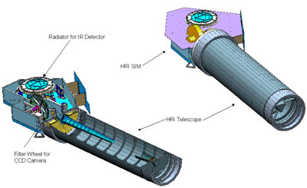
PSD Instrument Technology Development Specification Sheet
Instrument Name:
Instrument Type:
PI, email, and Institution:
Program (year and proposal #): example 22-PICASSO22-0013
TRL: Start= Current= Planned Exit=
Deployment: flyby, orbital, in-situ landed, etc.
Intended target(s):
Current SWaP (specify subsystem OR instrument): (l x w x h), (mass), (watts)
Planned SWaP (Developed to TRL6):
Testing passed (Vib, Vacuum, thermal, radiation, and details):
Detailed specifications: Focus here should be on what distinguishes this development from the SoA? (spectral range, resolution, detection limit, measurement time, S/N, field of view, working distance, data volume, data processing, comm, interface details, CAD drawings of instrument, reference to publication detailing instrument, etc.)
- Service description and its intended use
- Detailed technical specifications, such as measurement range, accuracy, resolution, and precision
- Name and description of instrument that is current SOA also what missions this is being used for
- Operating requirements – voltage, current, environment designed for (temp, pressure, etc.)
Measurement data available: Data on simulants (type of simulant, location of data, comparison to calibrated dataset, etc.)
Example Image of Instrument
Or component here…
Development and Advancement of Lunar Instrumentation (DALI)

