Slide 1
Biological and Physical Sciences Advisory Committee (BPAC) Membership and Biographies
Updated: 4/18/2024

Slide 2
Biological and Physical Sciences Advisory Committee (BPAC) Personnel*
BPAC Leadership
Lisa Carnell
Biological and Physical Sciences Division Director
Mike Robinson
BPAC Executive Secretary
Jamie Foster
BPAC Chair
BPAC Members (Membership is subject to change)
Dan Dumbacher
Ali Rangwala
Mark Weislogel
Simon Gilroy
Aleksandra Radlinska
Nathan Lundblad
Mary Guenther
Kate Rubins
Will Davis
Dan Tagle
Ken Davidian
Maren Mossman
Petia Vlahovska
*As of 4/18/2024

Slide 3
BPAC Member Biographies

Slide 4
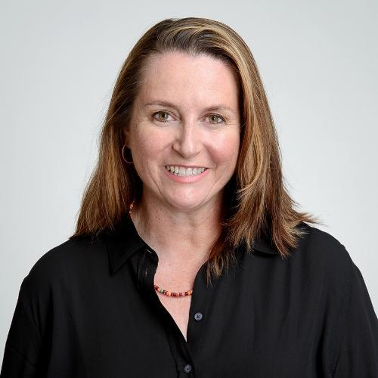
Jamie Foster | Chair
Dr. Foster is a Professor at the University of Florida's Department of Microbiology and Cell Sciences, Space Life Science Lab. She is the former President and 2022 Conference Chair of The American Society for Gravitational and Space Research (ASGSR).
Dr. Foster’s research is “dedicated to examining the interactions between microbial communities and their surrounding environments to improve our understanding of the molecular mechanisms that microbes use to adapt and respond to changes in the environment.” Her academic interests include astrobiology, microbialites, microgravity, and symbiosis.
Dr. Foster earned her BS from the University of Massachusetts, MS from the University of Southern California, and PhD from the University of Hawaii.

Slide 5
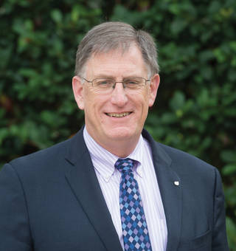
Dan Dumbacher
Dan Dumbacher is the Executive Director of the American Institute of Aeronautics and Astronautics (AIAA).
Before joining AIAA, Mr. Dumbacher was a Professor of Engineering Practice in the School of Aeronautics and Astronautics at Purdue University, where he taught courses in systems thinking, systems engineering, and space policy. Mr. Dumbacher has also served as the Deputy Associate Administrator of the Exploration Systems Development Division within HEO.
Mr. Dumbacher earned his Bachelor's degree in Mechanical Engineering from Purdue University and Master’s degree in Business Administration from the University of Alabama. He has also completed Harvard University’s Senior Managers in Government Program.

Slide 6
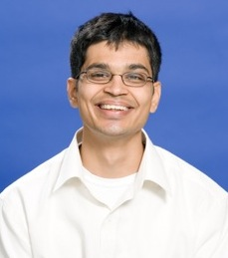
Ali Rangwala
Dr. Ali Rangwala is a professor and researcher at the Worcester Polytechnic Institute (WPI) in Worcester, Massachusetts. His research areas include Industrial Fire and Explosion Safety, Dust and Gas Explosions, Fire Dynamics, Material Flammability, and Hazardous Waste Burning.
Dr. Rangwala currently teaches classes in Industrial Fire Safety, Explosion Protection, Combustion, and Heat Transfer. He is also working on a multitude of projects including the development of measurement and sensing devices designed to identify the presence, velocity, and flow direction of smoke and the development of benchmark tests to better understand the physics of ignition and deflagration in dust-air premixed combustion.
Dr. Rangwala earned his PhD from the University of California, San Diego and his MS from the University of Maryland. He earned his BS from the Government College of Engineering located in Pune, India.

Slide 7
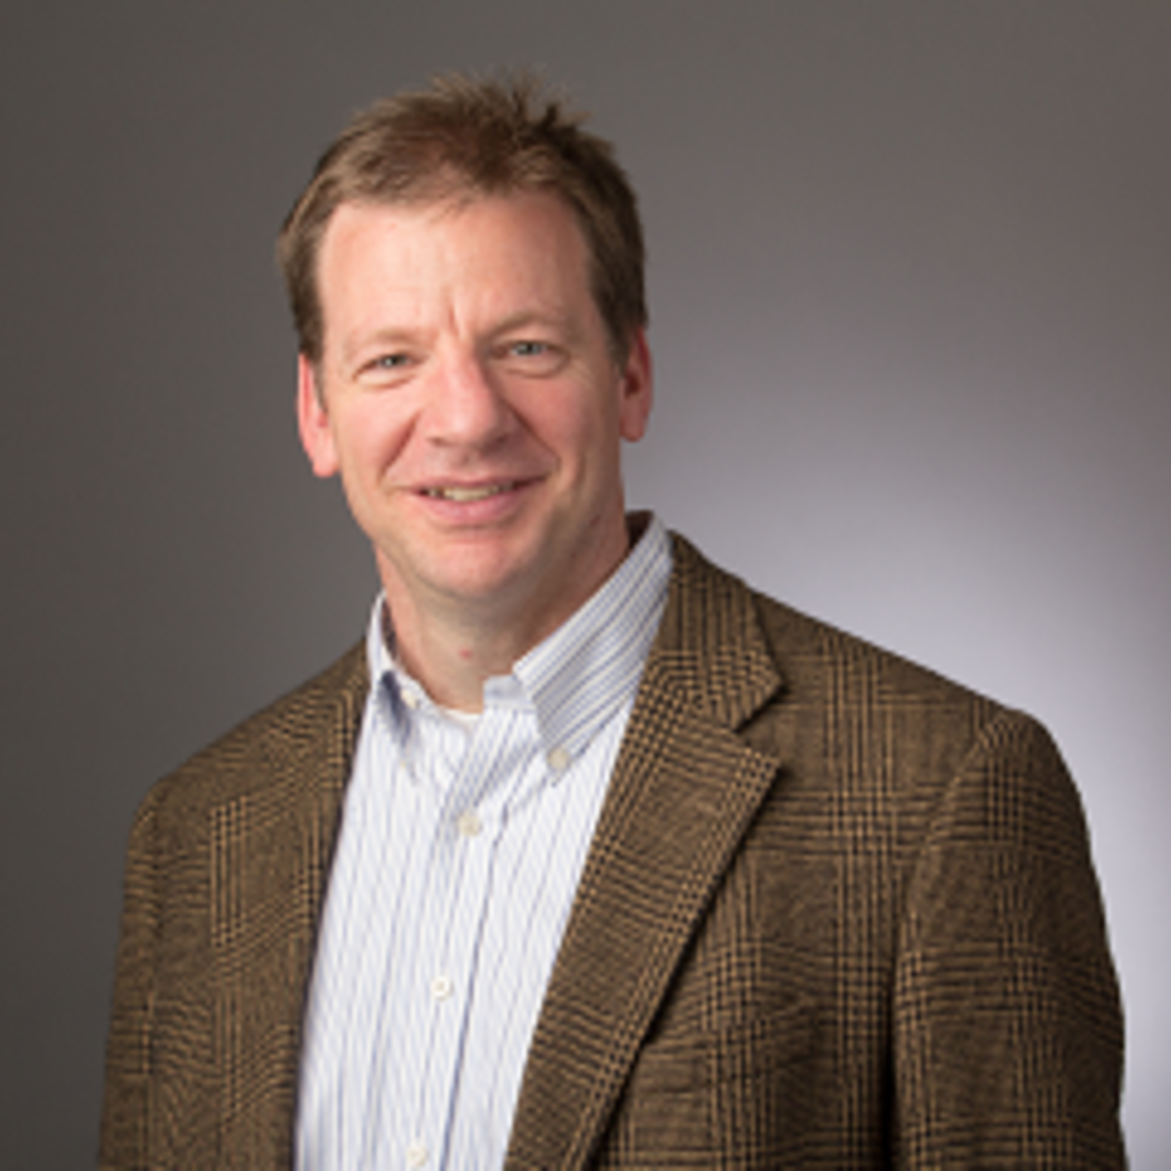
Mark Weislogel
Dr. Mark Weislogel is Co-Founder and a Principal Engineer at IRPI LLC.
Dr. Weislogel’s technical specialties include the thermal/fluid-sciences: capillary fluidics, macroscale and microscale capillary-driven flows in complex geometries, passive cooling systems, microscale thermal devices, microgravity fluid mechanics, and applications to spacecraft fluid systems and terrestrial microfluidic systems. He has made extensive use of drop towers, parabolic aircraft, and space stations to conduct fundamental and applied cross cutting research and development for advanced fluid system designs aboard spacecraft.
Dr. Weislogel earned his PhD in Mechanical Engineering from Northwestern University in 1996 and MSME from Washington State University in 1988.

Slide 8
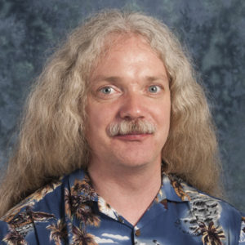
Simon Gilroy
Dr. Simon Gilroy is a Researcher and Professor in the Botany Department of the University of Wisconsin, Madison. He works extensively with NASA on understanding how plants grow on the International Space Station and plans for using plants in life support on planetary bases.
Dr. Gilroy’s research interests include plant cell biology, signal transduction, lipid signaling, tip growth, and tropisms. He runs the Gilroy Life Sciences Lab, dedicated to understanding, at a cellular level, how plants sense and respond to their environment and how these signals regulate plant development.
Dr. Gilroy earned his PhD from Edinburgh University.

Slide 9
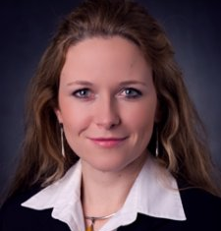
Aleksandra Radlinska
Dr. Aleksandra Radlinska is an Affiliate Researcher and Assistant Professor of Civil and Environmental Engineering at the Pennsylvania State University.
Dr. Radlinska’s research interests include cement and concrete in sustainable design; durability, shrinkage and cracking of concrete; reliability-based analysis of the behavior of construction materials; predicting early-age cracking in concrete materials; and alkali-activat.
Dr. Radlinska earned her PhD from Purdue University﻿ in Concrete Materials. She earned both her MSCE and BS in Civil Engineering from West Pomeranian University of Technology.

Slide 10
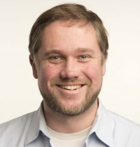
Nathan Lundblad
Dr. Nathan Lundblad is a professor of Physics at Bates College in Lewiston, Maine. He oversees the Lundblad lab, an experimental atomic physics research facility. Dr. Lundblad performs experiments both at Bates and at JPL using ultracold atoms trapped in ultrahigh vacuum with magnetic fields and lasers.
Dr. Lundblad’s work focuses on the physics of matter cooled to just barely above absolute zero, specifically, the phenomena associated with Bose-Einstein condensation in shell-like traps and in optical lattices. He explores the phenomenon of Bose-Einstein condensation terrestrially and in microgravity.
Dr. Lundblad earned his PhD in Physics from the California Institute of Technology. He also earned a BA in Physics and Astrophysics from the University of California, Berkeley.

Slide 11
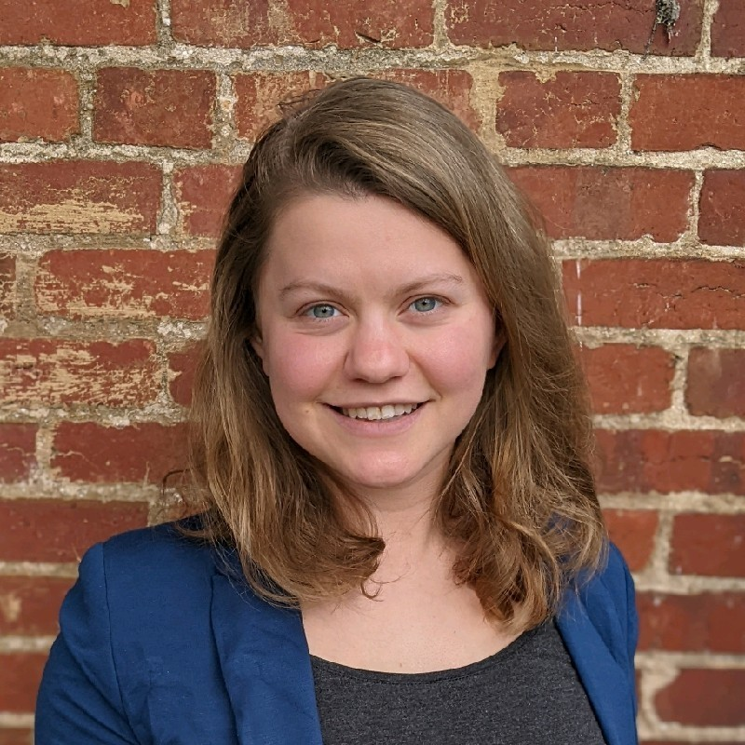
Mary Guenther
Mary Guenther is the Director of Space Policy at the Commercial Spaceflight Federation (CSF). At CSF, Guenther leads the policy development and lobbying efforts, where she is focused on promoting policies that enable fair and open competition, spur innovation, and expand public-private partnerships.
Before joining CSF, Guenther served as a Professional Staff Member at the Senate Commerce Committee. In that position, she was responsible for developing and moving space, manufacturing, and science legislation through the Congress as well as performing oversight on NASA, NSF, NIST, FAA AST, and the DOC Office of Space Commerce. She was integral to the Senate passage of the United States Innovation and Competition Act, which incorporated the NASA Authorization Act of 2019.
Mary Guenther earned her degree from American University, majoring in Public Communication and Economics.

Slide 12
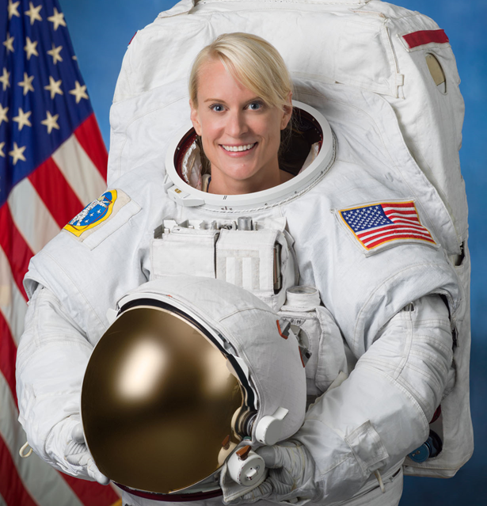
Kate Rubins
Dr. Kathleen (Kate) Rubins is a microbiologist and NASA Astronaut. She was selected in July 2009 for the 20th NASA astronaut class and completed her first spaceflight on Expedition 48/49, where she became the first person to sequence DNA in space. She has spent a total of 300 days in space and completed 4 spacewalks.
Prior to joining NASA, Dr. Rubins was a Principal Investigator at Whitehead Institute/MIT. Her lab focused on viral and human immune system genomics, RNA regulation, and host-pathogen interaction. She has conducted research on poxviruses (Smallpox and Monkeypox), filoviruses (Ebola and Marburg), and arenaviruses (Lassa Fever) as well as collaborative projects with the U.S. Army to develop therapies for Ebola and Lassa viruses.
Dr. Rubins earned her BS in Molecular Biology from the University of California San Diego and her PhD in Cancer Biology from Stanford University.

Slide 13
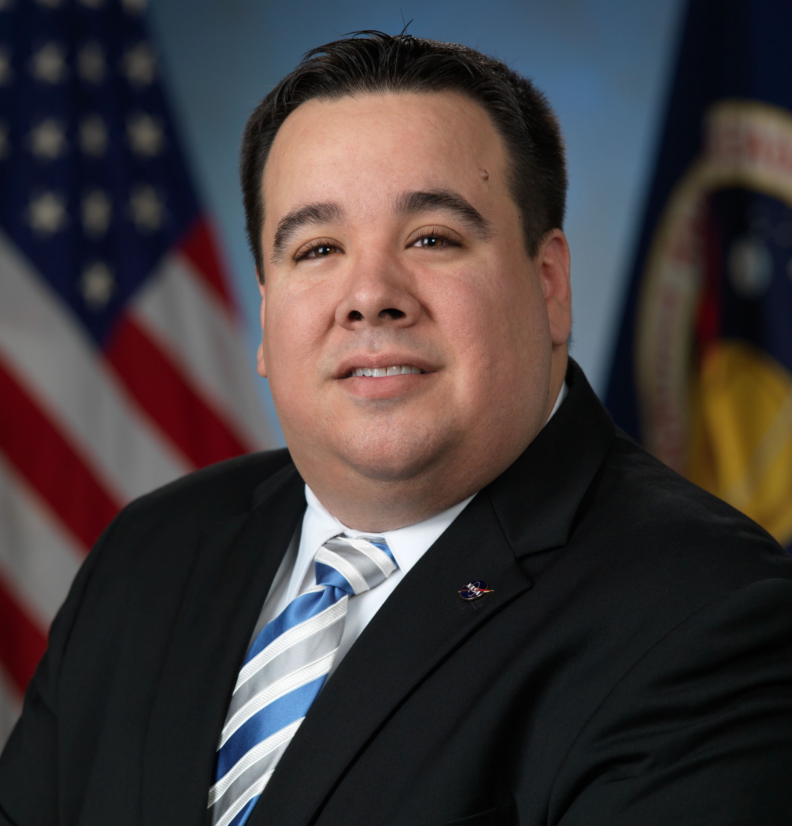
Will Davis
Will Davis serves as the Diversity, Equity, and Inclusion Program Manager and Equal Employment Opportunity Specialist with the Office of Equal Opportunity and Diversity at NASA. He is active in several national non-profit corporations focused on increasing the quality and quantity of underserved individuals, especially those from the Hispanic and LGBTQ communities, in STEM.
Mr. Davis served for 12 years as an engineer with the Safety and Mission Assurance Directorate where he was a subject matter expert in the areas of materials and processes engineering, quality engineering, supplier quality, mechanical parts, and anti-counterfeiting. In this role he supported the Space Shuttle Program, Orion Program, International Space Station Program, and Commercial Crew Program.
Mr. Davis is a 2009 graduate of NASA’s FIRST Program and holds a NASA Green Belt Certification in Lean Six Sigma. He earned his BS and MS in Metallurgical and Materials Engineering from The University of Texas at El Paso.

Slide 14
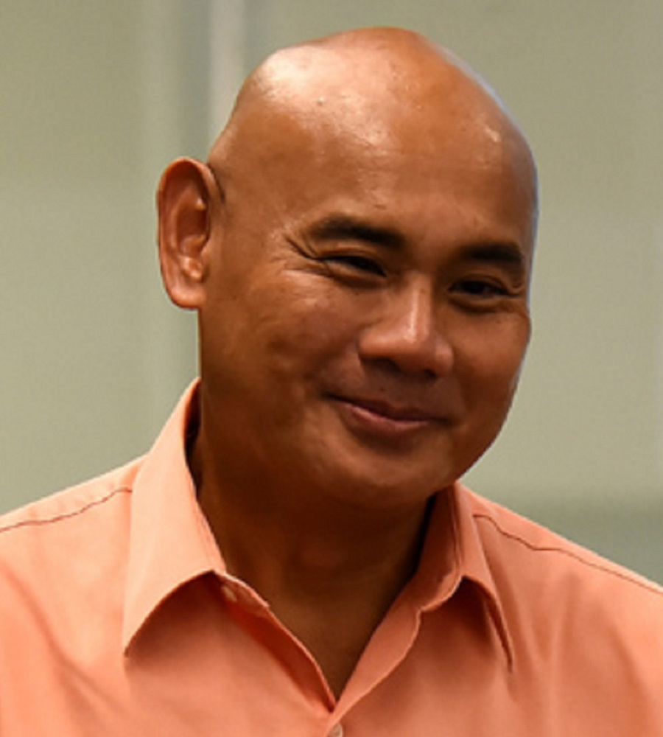
Dan Tagle
Dr. Dan Tagle is the director of NCATS' Office of Special Initiatives.
Prior to joining NCATS, Tagle was a program director for neurogenetics at the National Institute of Neurological Disorders and Stroke (NINDS), where he was involved in developing programs concerning genomics-based approaches for basic and translational research in inherited brain disorders. Before joining NINDS, Dr. Tagle was an investigator and section head of molecular neurogenetics at the National Human Genome Research Institute.
Dr. Tagle obtained his PhD in Molecular Biology and Genetics from Wayne State University School of Medicine in 1990. He was an NIH National Research Service Award postdoctoral fellow in Human Genetics in the Laboratory of Francis S. Collins, MD, PhD, at the University of Michigan.

Slide 15
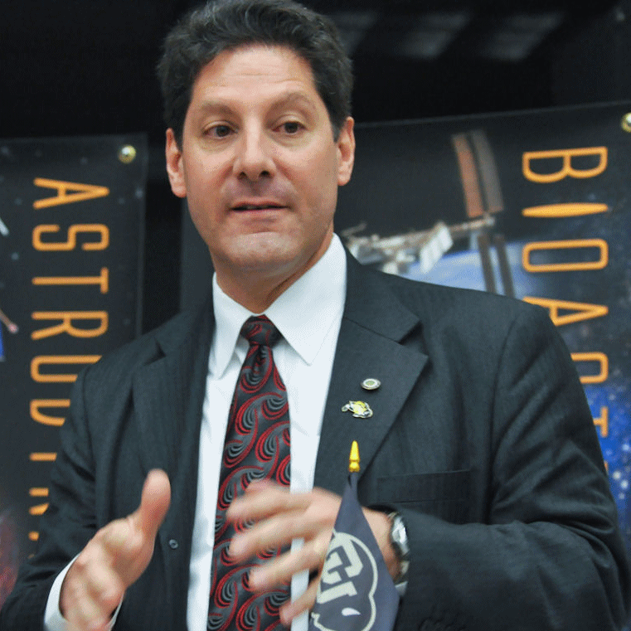
Ken Davidian
Dr. Ken Davidian is the owner of Impossible Research LLC, a process research and research consulting organization.
Dr. Davidian previously spent 14 years working for the FAA’s Office of Commercial Space Transportation, 20 years at NASA (Lewis/Glenn Headquarters) and 5 years in private industry/academia. Davidian is also the Editor-in-Chief of the New Space journal and serves as an Adjunct Professor for Virginia Tech's Pamplin College of Business. Davidian is a member of the AIAA (Associate Fellow), International Academy of Astronautics, and internationally active as an officer or advisor on multiple committees and groups.
Dr. Davidian received a BS degree in Aeronautical and Astronautical Engineering from The Ohio State University and a MS degree in Mechanical Engineering from Case Western Reserve University. In 2018, Davidian received a doctorate in Business Administration from the University of Cape Town.

Slide 16
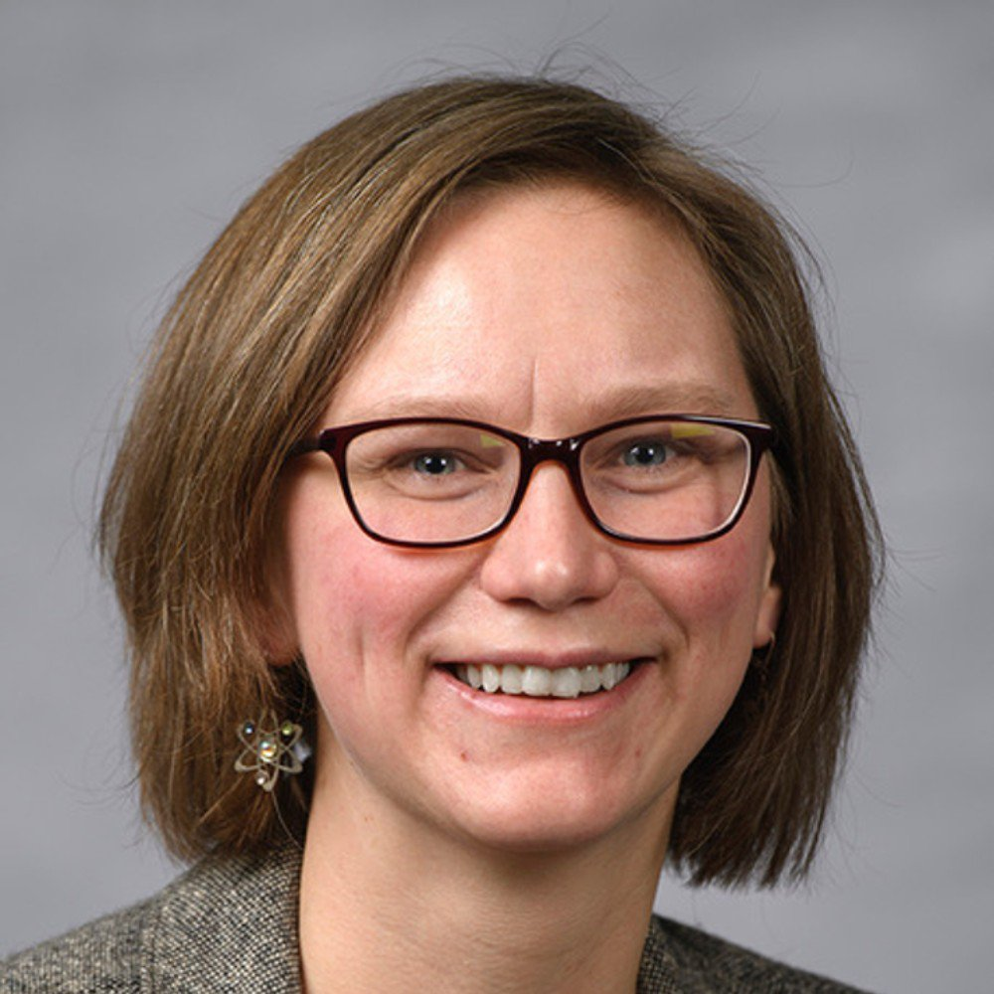
Maren Mossman
Dr. Maren Mossman is the Head of the Quantum Hydrodynamics Lab and an Assistant Professor of Physics at University of San Diego in the Department of Physics and Biophysics. She also serves as an Adjunct Assistant Professor at Washington State University, where she collaborates with the Engels group performing experiments and simulations with NASA’s Cold Atom Laboratory (CAL).
Dr. Mossman studies the behavior of neutral Bose gas mixtures when cooled to temperatures near absolute zero. Her research involves the creation, manipulation, and investigation of dilute ultracold quantum gases, with interests in driven out-of-equilibrium quantum hydrodynamics, quantum simulation, quantum liquids, and few-body physics.
Dr. Mossman received her PhD in Physics from Washington State University in 2019.

Slide 17
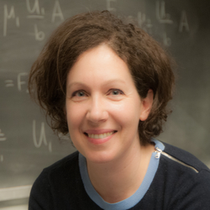
Petia Vlahovska
Dr. Vlahovska is a Professor of Engineering Sciences and Applied Mathematics at Northwestern University.
Dr. Vlahovska’s research interests are in experimental and theoretical modeling of physical and biological systems. Her research spans fluid dynamics, soft matter, and membrane biophysics.
Dr. Vlahovska earned her undergraduate degree and MS in Chemistry from Sofia University in Bulgaria, and her PhD in Chemical Engineering from Yale University.
Dr. Vlahovska is a Fellow of the American Physical Society and a 2024 Guggenheim Fellow.

